Slide 1
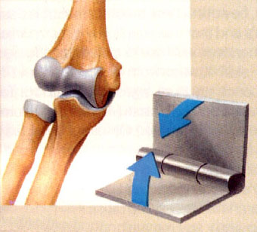
JOINTS & MOVEMENTS
By DR.SANAA ALSHAARAWY

Slide 2
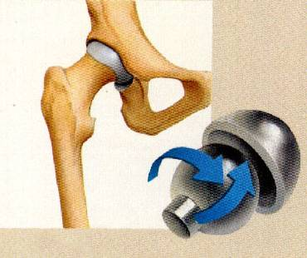
Objectives
By the end of the lecture, the student should be able to:
List the functional & structural classification of the joints.
Name the 3 different types of joints.
Describe the structure of each type.
Name an example of each type.
Describe the movements which occur in each type.

Slide 3
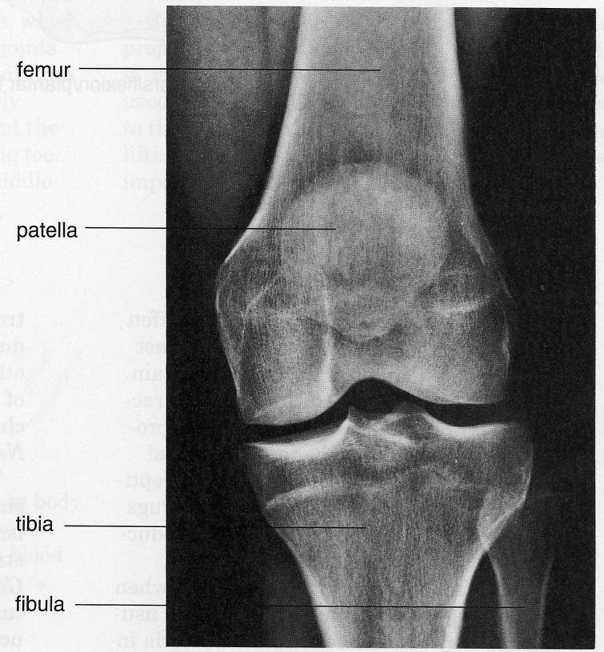
WHAT IS A JOINT ?
It is a meeting of two or more bones.
INTRODUCTION
Every bone in the body forms a joint with at least one or more bone, (except the hyoid bone in the neck).
Joints have two functions:
They hold the bones together securely.
Also it give the rigid skeleton mobility.
Femur
Patella
Tibia
Fibula
X-ray of the knee joint

Slide 4
CLASSIFICATION
Joints could be classified by two ways:
According to function Or
According to structure.

Slide 5
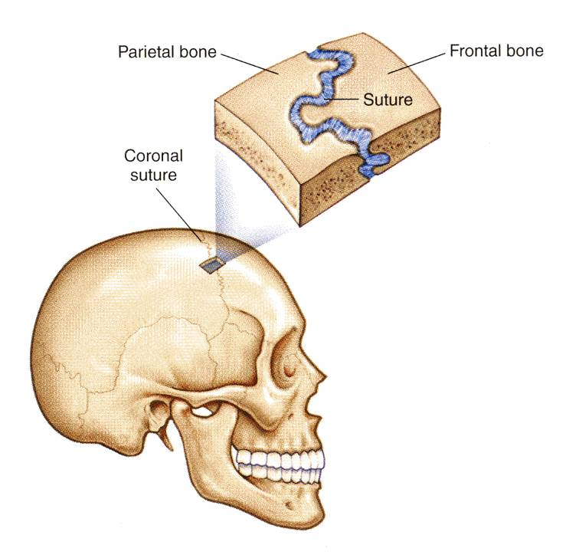
I- FUNCTIONAL CLASSIFICATION
1- Synarthroses or immovable joints,
2- Amphiarthroses or slightly movable joints.
3- Diarthroses or freely movable joints.
The functional classification depends on the amount of movement allowed by the joint.
On this basis, there are:
Synarthroses or immovable joints: Skull sutures.

Slide 6
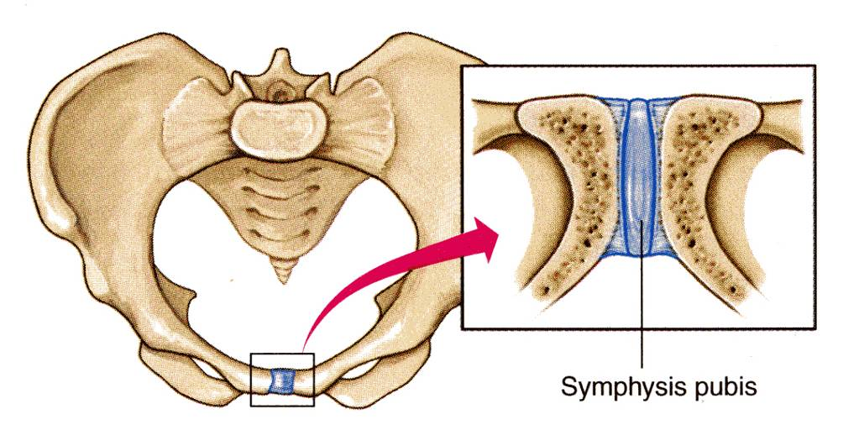
Amphiarthroses or slightly movable joints, e.g. Symphysis pubis.

Slide 7
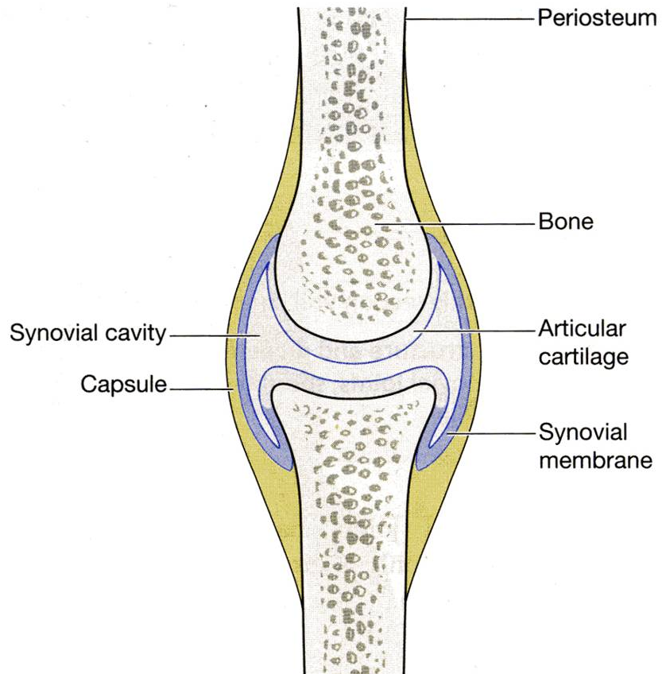
Diarthroses or freely movable joints, (synovial joint)

Slide 8
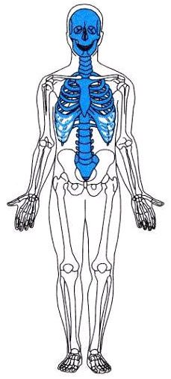
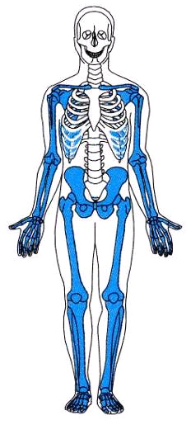
Immovable & slightly movable joints are restricted mainly to the axial skeleton, where firm attachments and protection of internal organs are priorities.
Freely movable joints predominate in the limbs, where mobility is important.

Slide 9
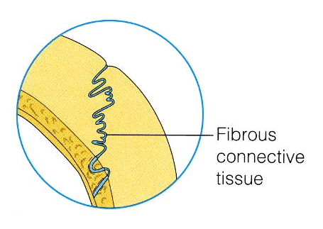
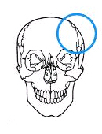
II- STRUCTURAL CLASSIFICATION
This classification depends upon the tissue which connects the bones.
There are three types of joints:
A. Fibrous,
B. Cartilage, or,
C. Synovial joint, where a joint cavity separates the bones.
They are called:
Fibrous joints: Skull sutures

Slide 10
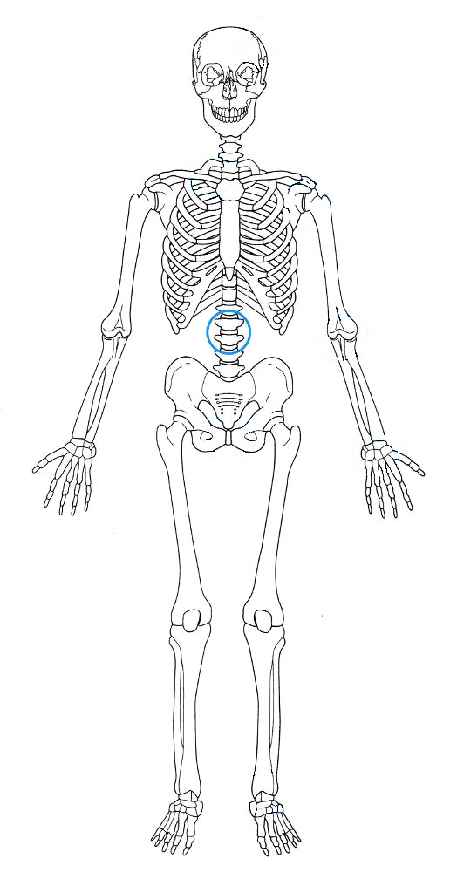
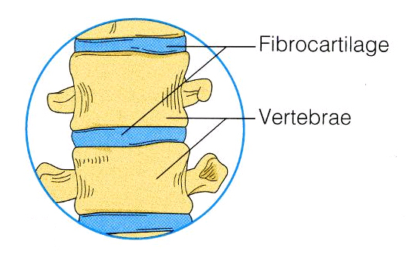
Cartilaginous joints: Intervertebral discs.

Slide 11
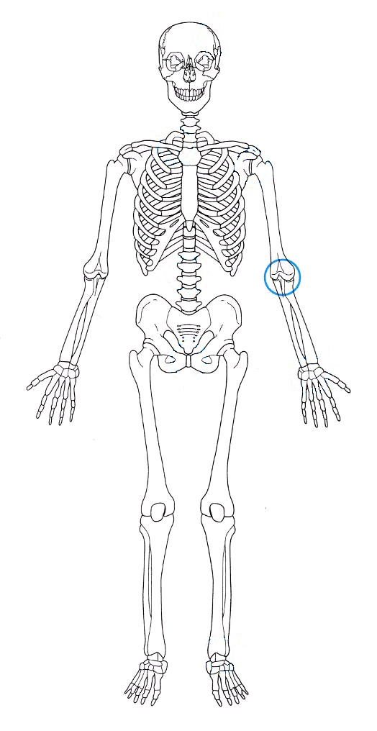
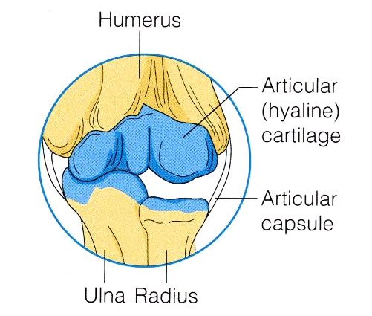
Synovial joints.

Slide 12
AS A GENERAL RULE:
fibrous joints are immovable
synovial joints are freely movable
most cartilaginous joints are slightly movable (amphiarthroses)

Slide 13
FIBROUS JOINTS
In fibrous joints, the bones are united by fibrous tissue.
Examples:
A- Skull sutures
In this joint, the irregular edges of bones interlock and are bound together tightly by fibers tissue, where no movement are allowed.

Slide 14
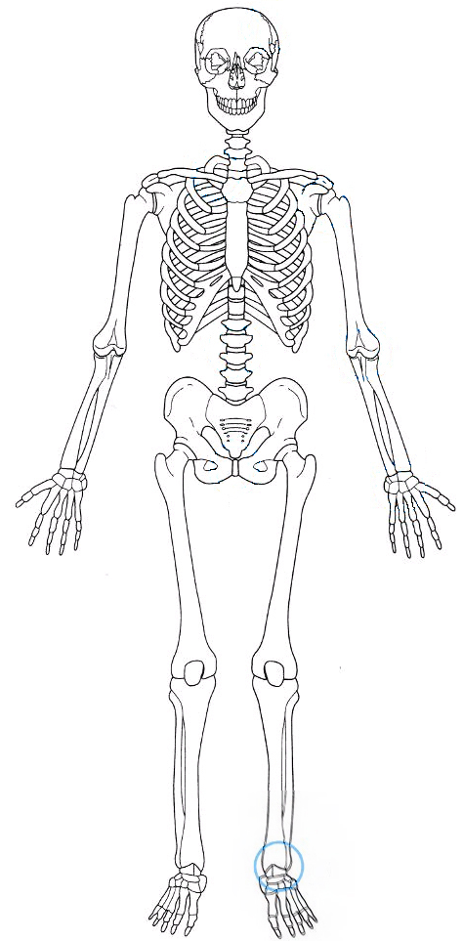
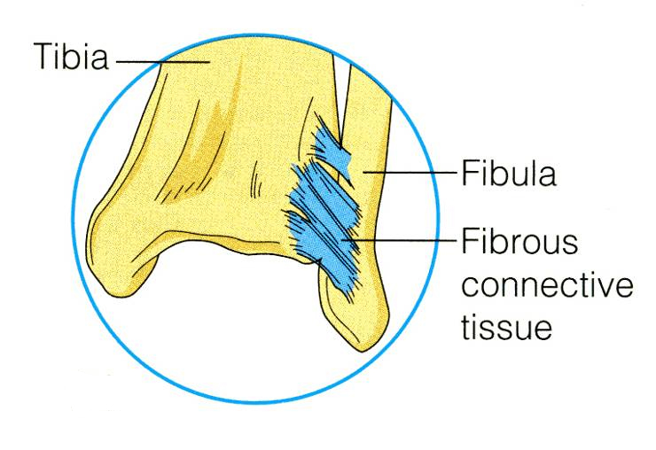
FIBROUS JOINTS
B- Inferior tibiofibular joint, no or very minimal movement is allowed.
It is called syndesmoses.

Slide 15
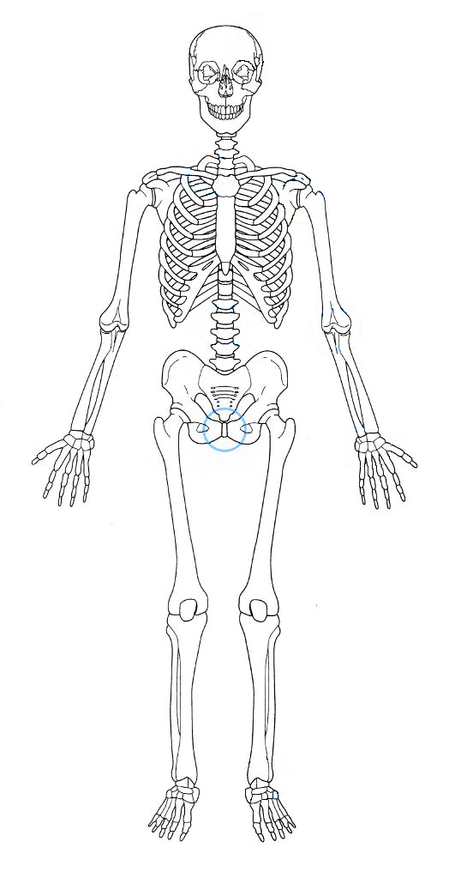
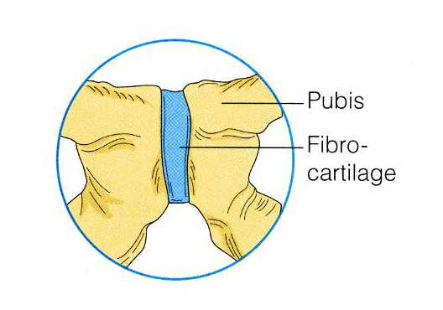
CARTILAGINOUS JOINTS
In cartilaginous joints, the 2 bone ends are connected by cartilage.
Examples:
Pubic symphysis of the pelvis (slightly movable (amphiarthroses)

Slide 16
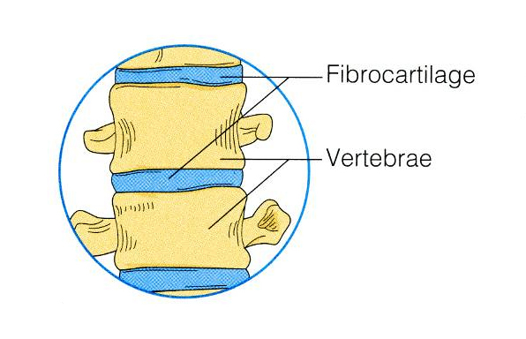
CARTILAGINOUS JOINTS
The intervertebral discs of the vertebral column, where the articulating bone surfaces are connected by pads (discs) of fibrocartilage, are also slightly movable (amphiarthroses) .

Slide 17
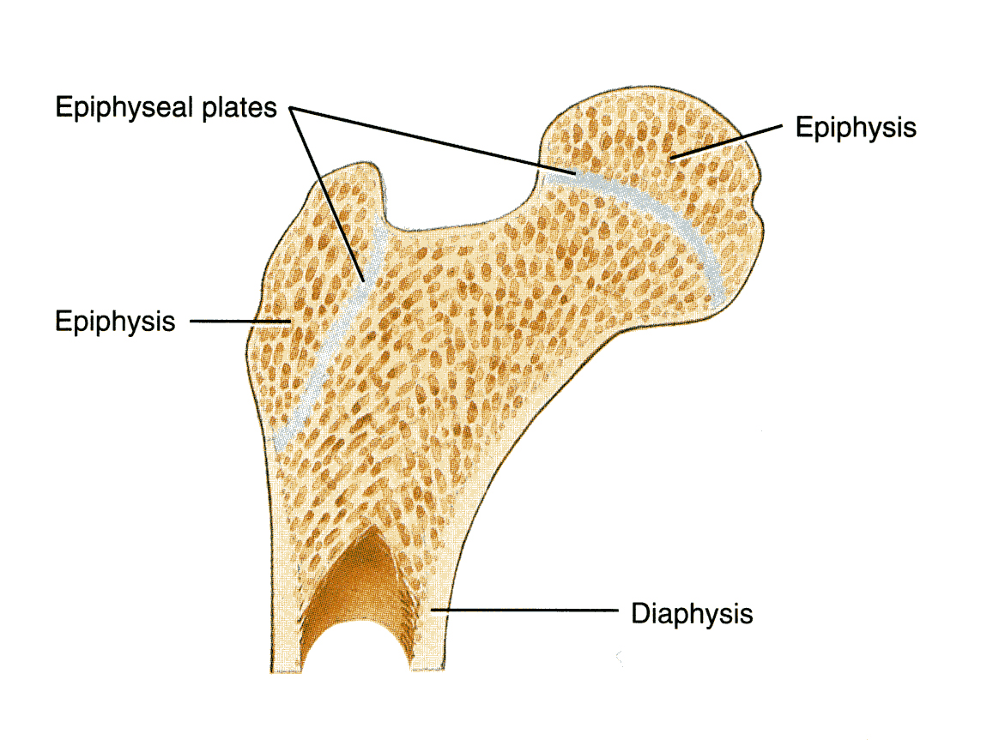
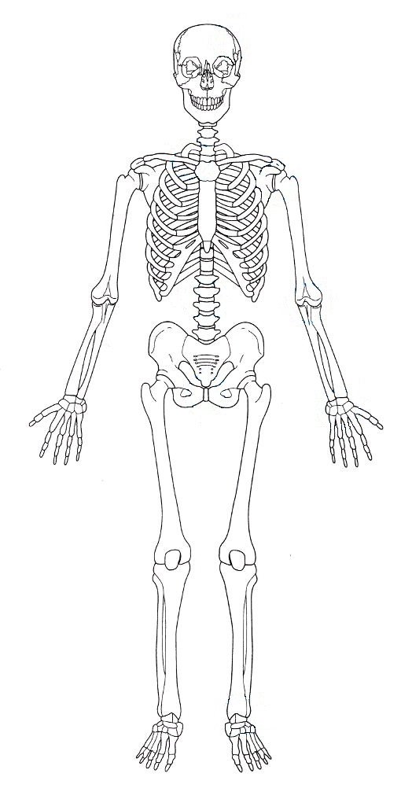
REMEBER !
The hyaline-cartilage Epiphysial plates of growing long bones are immovable (synarthroses) cartilaginous joints.

Slide 18
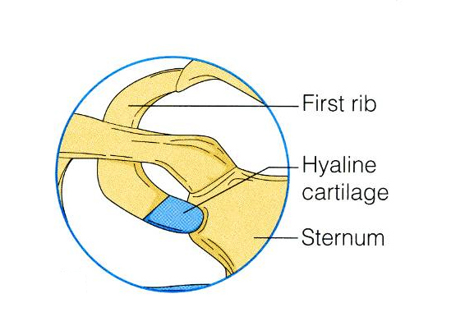
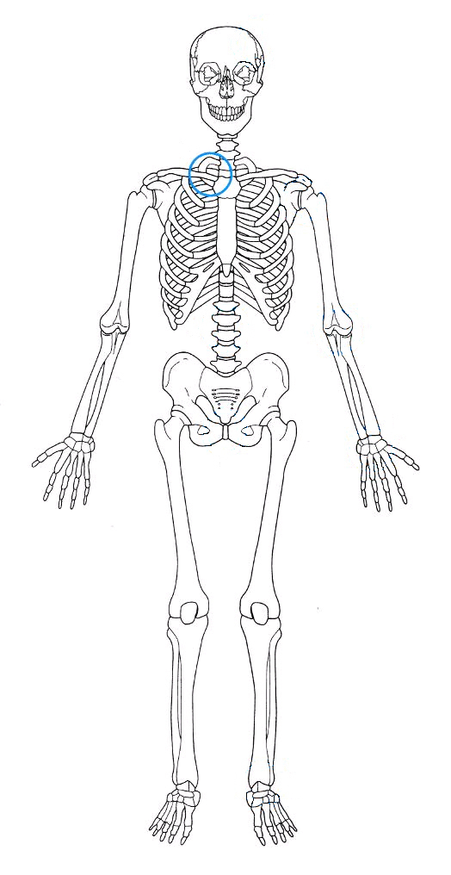
REMEBER !
The cartilaginous joints between the first ribs and the sternum are also immovable (synarthroses) cartilaginous joints.

Slide 19
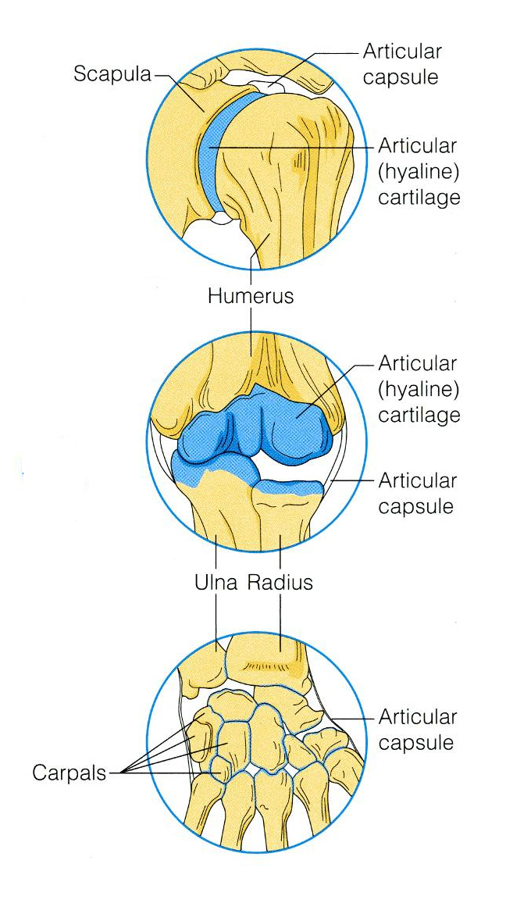
SYNOVIAL JOINTS
Synovial joints are those in which the articulating bone ends are separated by a joint cavity which contains a synovial fluid.
They account for all joints of the limbs.

Slide 20
FEATURES OF SYNOVIAL JOINTS
1- Articular cartilage
2- Fibrous capsule
3- Synovial membrane
4- Joint cavity
5- Extracapsular ligaments
Articular cartilage.
The 2 ends of the bones are covered by articular (hyaline) cartilage.

Slide 21
Fibrous capsule.
The joint surfaces are enclosed by a capsule of fibrous tissue &
3. The capsule is lined with a synovial membrane

Slide 22
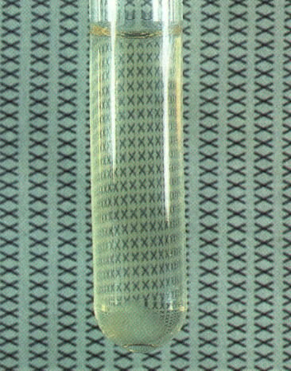
4. Joint cavity
Inside the synovial membrane there is a lubricating (synovial fluid).

Slide 23
5. Reinforcing ligaments.
The fibrous capsule is usually reinforced with ligaments. (extracapsular ligaments).

Slide 24
TYPES OF SYNOVIAL JOINTS BASED ON SHAPE
Based on the shape, the synovial joints can be classified as:
Plane,
Hinge,
Pivot,
Condyloid,
Saddle,
Ball and socket joint.

Slide 25
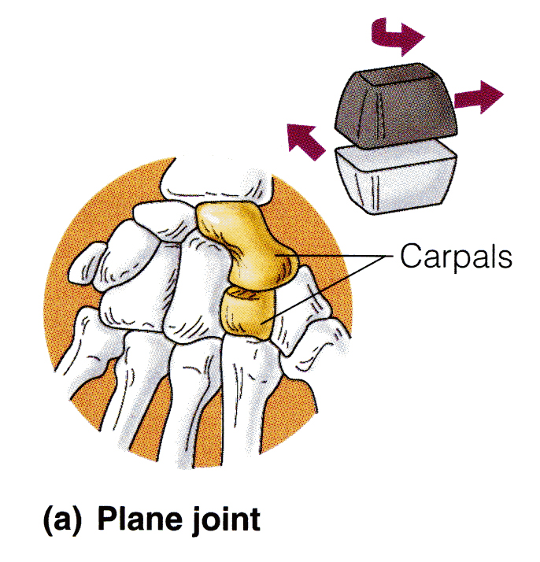
PLANE JOINTS
In a plane joint, the articular surfaces are flat, and only short slipping or gliding movements are allowed.
Example: The intercarpal joints of the wrist.

Slide 26
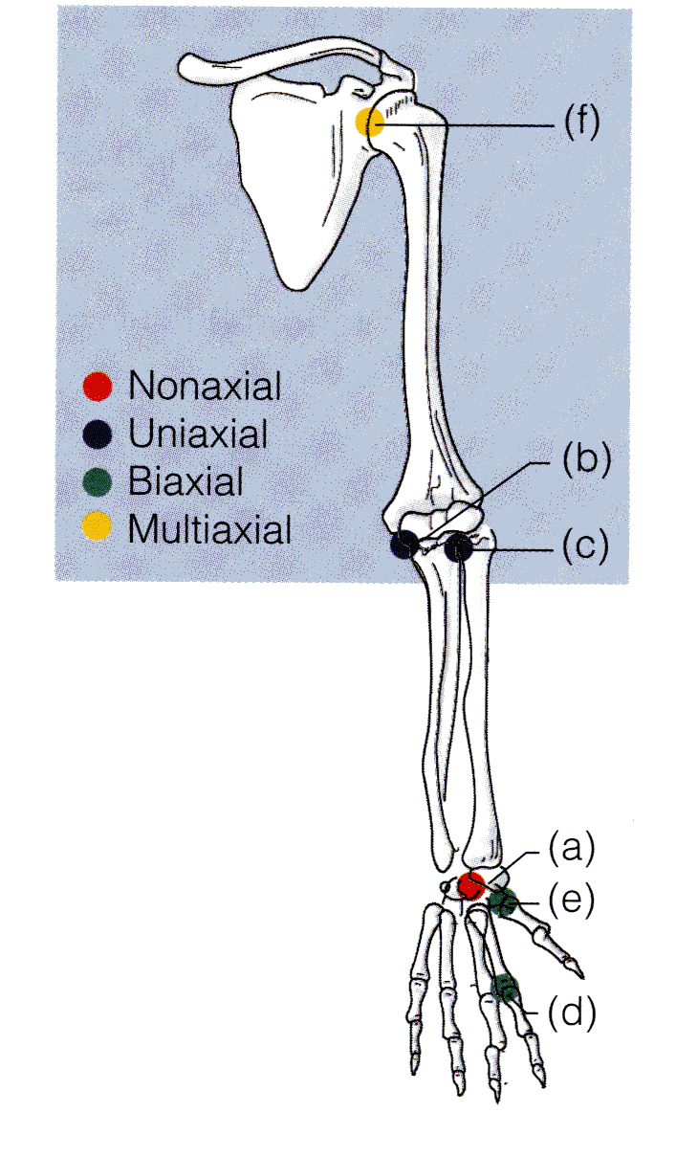
HINGE JOINTS
In a hinge joint, the cylindrical end of one bone fits into a trough-shaped surface on another bone.
Movement is allowed in just one plane, like a hinge.
Hinge joints are Uniaxial ; they allow movement around one axis only.
Examples: elbow & ankle joints, the interphalangeal joints of the fingers.
Axis of movement

Slide 27
PIVOT JOINT
In a pivot joint, the rounded end of one bone fits into a ring of bone (or ligaments).
Because the rotating bone can turn only around its long axis, pivot joints are also Uniaxial joints.
Examples: proximal radioulnar joint
Axis of movement

Slide 28
CONDYLOID JOINTS
In a condyloid joint, the egg-shaped articular surface of one bone fits into an oval concavity in another.
Both of these articular surfaces are oval.
Movement occurs around two axes, hence these joints are biaxial, as in knuckle (metacarpophalangeal) joints.
Condyloid joints allow the moving bone to move:
from side to side and
back and forth,
but the bone cannot rotate around its long axis.
Axes of movement

Slide 29
SADDLE JOINTS
In saddle joints, each articular surface has both convex and concave areas, like a saddle.
These biaxial joints allow essentially the same movements as condyloid joints.
Example: carpometacarpal joint of the thumb.
Axes of movement

Slide 30
BALL-AND-SOCKET JOINTS
In a ball-and-socket joint, the spherical head of one bone fits into a round socket in another.
I t is a multiaxial joints allow movement in all axes, including rotation, and are the most freely movable joints.
Examples: shoulder and hip.

Slide 31
FLEXION, EXTENSION & HYPEREXTENSION
MOVEMENTS
More increasing the angle between 2 bones or parts of body.
Decreasing angle of joint and brings 2 bones closer together.
Increasing angle between 2 bones or parts of the body.

Slide 32
ABDUCTION, ADDUCTION, CIRCUMDUCTION
ROTATION
A movement of a bone around its longitudinal axis as in ball & socket j.and atlas around dense of axis as in shaking head “No”.
Abduction : moving of a limb away from midline,also in fanning of fingers or toes . Adduction : the opposite of abduction, movement of a limb toward body midline.

Slide 33
INVERSION AND EVERSION
DORSIFLEXION AND PLANTAR FLEXION
Dorsiflexion : up movement of the foot at ankle j. as standing on heel.
Plantar flexion : down movement of foot as in pointing the toes.
Inversion : turning sole of foot medially.
Eversion : turning sole of foot laterally.

Slide 34
SUPINATION AND PRONATION
Rotation of forearm laterally so that the palm faces anteriorlly.
Rotation of of forearm medially so that the palm faces posteriorly.

Slide 35
OPPOSITION
A movement of The thumb to touch the tips of other fingers. It occurs in Saddle joint of 1st Carpo-metacarpal joint of the thumb.

Slide 36
THE END

