Slide 2
The Nervous System

Slide 3
Objectives
At the end of the lecture, the students should be able to:
List the subdivisions of the nervous system
Define the terms: grey matter, white matter, nucleus, ganglion, tract and nerve.
List the parts of the brain.
Identify the external and internal features of spinal cord.
Enumerate the cranial nerves
Describe the parts and distribution of the spinal nerve.
Define the term ‘dermatome’
List the structures protecting the central nervous system

Slide 4
The nervous system has three functions:
Collection of sensory input: Identifies changes occurring inside and outside the body by using sensory receptors. These changes are called stimuli
Integration: Processes, analyses and interprets these changes and makes decisions
It then effects a response by activating muscles or glands (effectors) via motor output

Slide 5
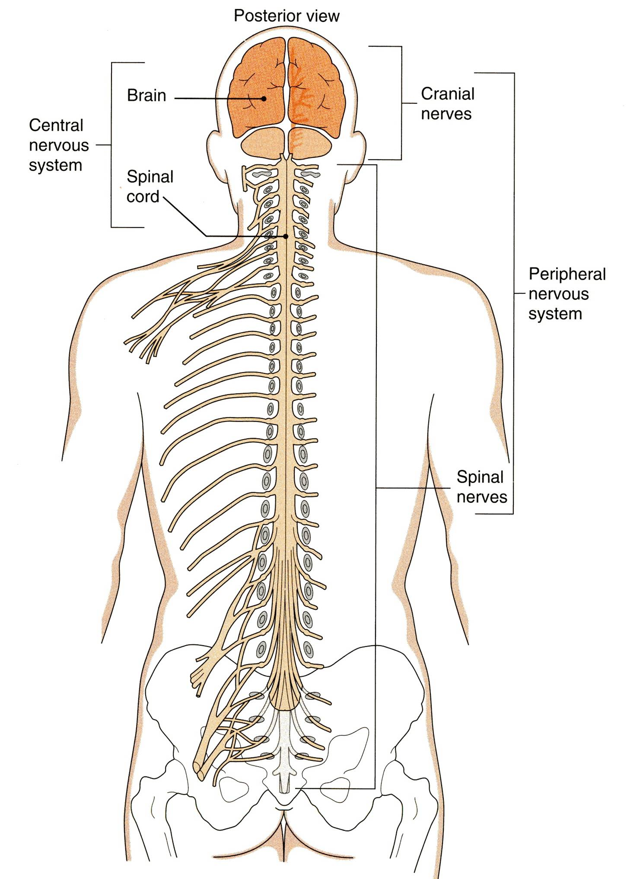
ORGANIZATION
STRUCTURAL
Central Nervous System (CNS): Brain & Spinal cord
Peripheral Nervous System (PNS): Nerves & ganglia

Slide 6
FUNCTIONAL
Sensory division
Motor division
Autonomic
Somatic

Slide 7
Nervous tissue is organized as:
Grey matter: which contains the cell bodies & the processes of the neurons, the neuroglia and the blood vessels.
White matter: which contains the processes of the neurons (no cell bodies), the neuroglia and the blood vessels

Slide 8
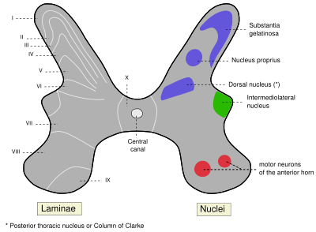
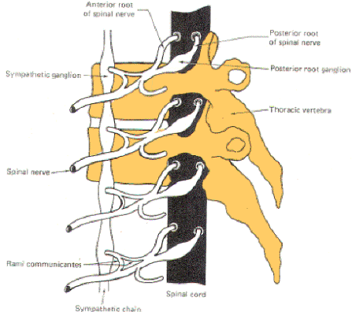
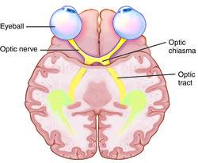
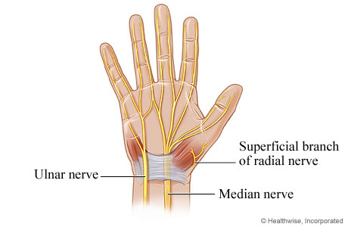
A group of neurons outside the CNS is called a ganglion
A group of neurons within the CNS is called a nucleus
A group of nerve fibers (axons) within the CNS is called a tract
Remember…
A group of nerve fibers (axons) outside the CNS is called a nerve

Slide 9
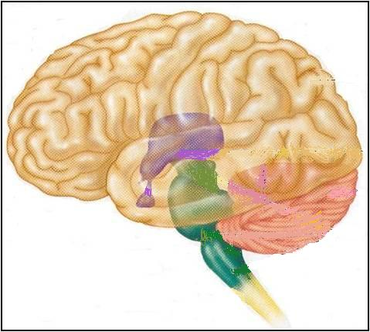
The Brain
Cerebrum (Cerebral hemispheres)
Large mass of nervous tissue located in the cranial cavity
Has four major regions:
Diencephalon: Thalamus, Hypothalamus, Subthalamus & Epithalamus
Cerebellum
Brainstem: Midbrain, Pons & Medulla oblongata

Slide 10
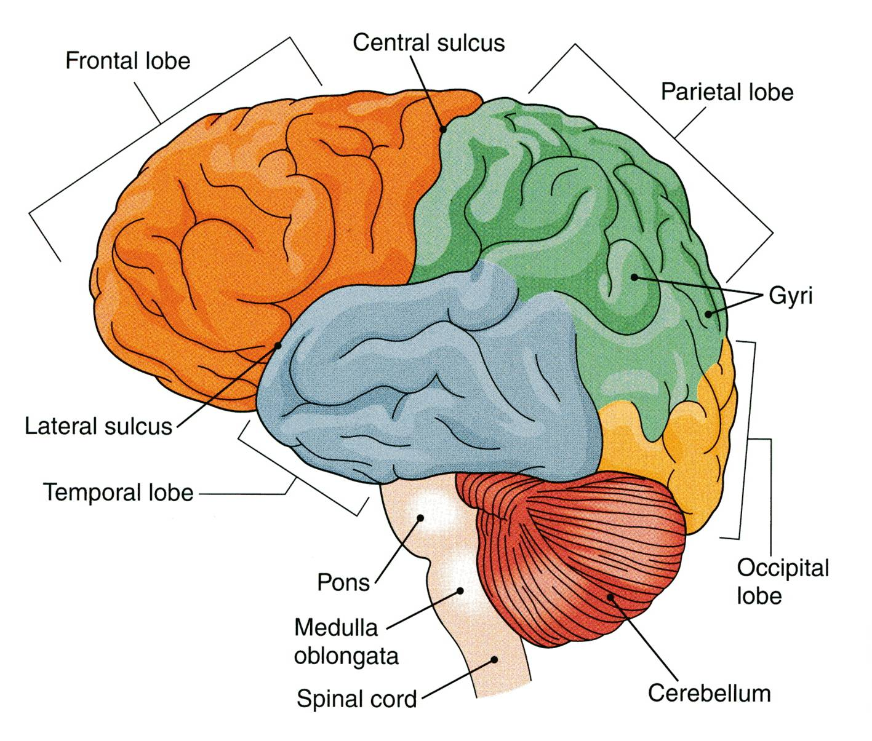
CEREBRUM
The largest part of the brain, has two hemispheres
The cerebral hemispheres are connected by a thick bundle of nerve fibers called corpus callosum
The surface shows ridges of tissue, called gyri, separated by grooves called sulci
Divided into 4 lobes by deeper grooves

Slide 11
TISSUE OF THE CEREBRAL HEMISPHERES
The outermost layer is called gray matter or cortex
Deeper is located the white matter, composed of fiber tracts (bundles of nerve fibers), carrying impulses to and from the cortex
Located deep within the white matter are masses of grey matter called the basal nuclei . They help the motor cortex in the regulation of voluntary motor activities

Slide 12
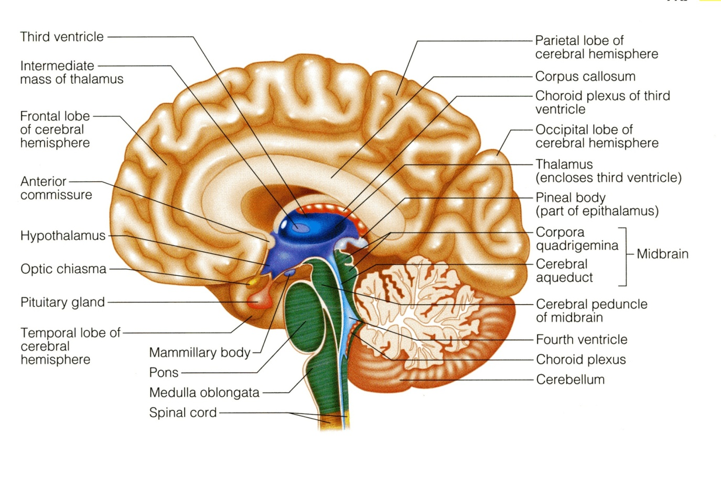
CEREBELLUM
The cerebellum has 2 hemispheres and a convoluted surface. It has an outer cortex made from gray matter and an inner region of white matter. It provides precise coordination for body movements and helps maintain equilibrium.

Slide 13
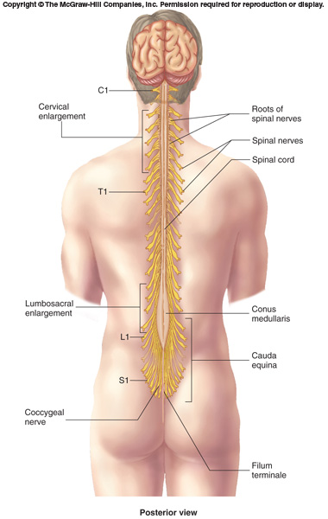
Spinal Cord
It is a two-way conduction pathway to the brain & a major reflex center
42-45 cm long, cylindrical in shape, lies within the vertebral canal.
Extends from foramen magnum to L2 vertebra
Continuous above with medulla oblongata
Caudal tapering end is called conus medullaris
Has 2 enlargements: cervical and lumbosacral
Gives rise to 31 pairs of spinal nerves
Group of spinal nerves at the end of the spinal cord is called cauda equina

Slide 14
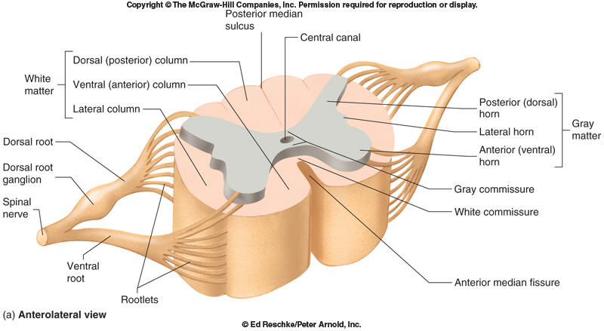
Cross Section of Spinal Cord
The spinal cord is incompletely divided into two equal parts, anteriorly by a short, shallow median fissure and posteriorly by a deep narrow septum, the posterior median septum.
Composed of grey matter in the centre surrounded by white matter
The arrangement of grey matter resembles the shape of the letter H, having two posterior, two anterior and two lateral horns/columns.

Slide 15
Peripheral Nerves
May be sensory, motor or mixed
Two types:
Spinal: 31 pairs, attached to spinal cord named and numbered according to the region of the spinal cord
Cranial: 12 pairs, attached to brain, named, and numbered from1-12

Slide 16
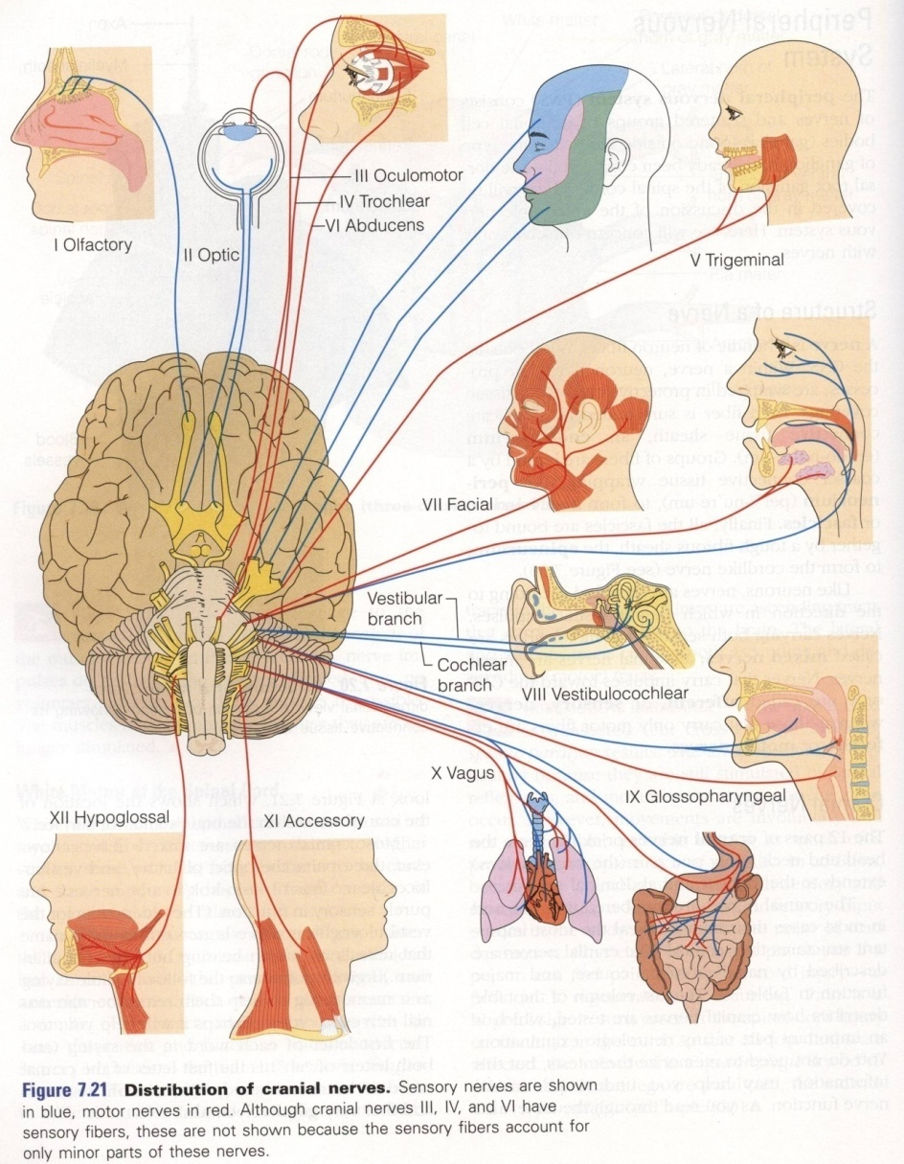
CRANIAL NERVES
12 pairs
4 pairs are mixed
trigeminal n. (5th)
facial n. (7th)
glossopharyngeal n. (9th)
vagus n. (10th)
5 pairs are motor:
occulomotor n. (3rd)
trochlear n. (4th)
abducent n. (6th)
accessory n. (11th)
hypoglossal n. (12th)
3 pairs are sensory:
olfactory n. (1st)
optic n. (2nd)
vestibulocochlear n. (8th)

Slide 17
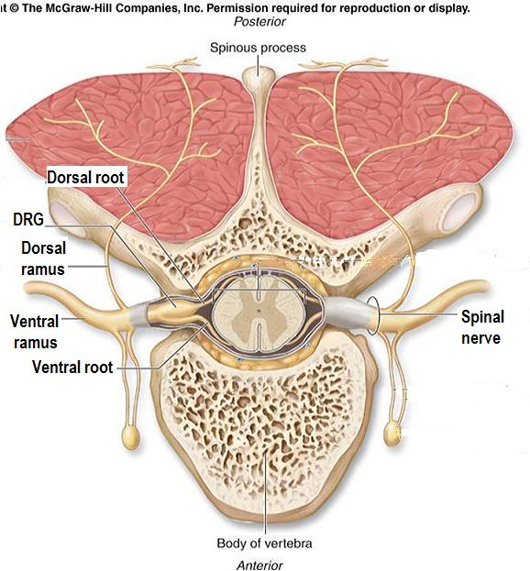
Spinal Nerves and Nerve Plexuses
31 pairs
Each spinal nerve is attached by two roots: dorsal (sensory) & ventral (motor)
Dorsal root bears a sensory ganglion
Each spinal nerve exits from the intervertebral foramen and divides into a dorsal and ventral ramus
The rami contain both sensory and motor fibers
DRG
Dorsal ramus
Ventral ramus

Slide 18
The dorsal rami are distributed individually, supply the skin and muscles of the back
the ventral rami form plexuses (except in thoracic region where they form the intercostal nerves), and supply the anterior part of the body

Slide 19
Dermatomes
The segment of skin supplied by one spinal nerve is called a ‘Dermatome’
Notes:
Al examination

Slide 20
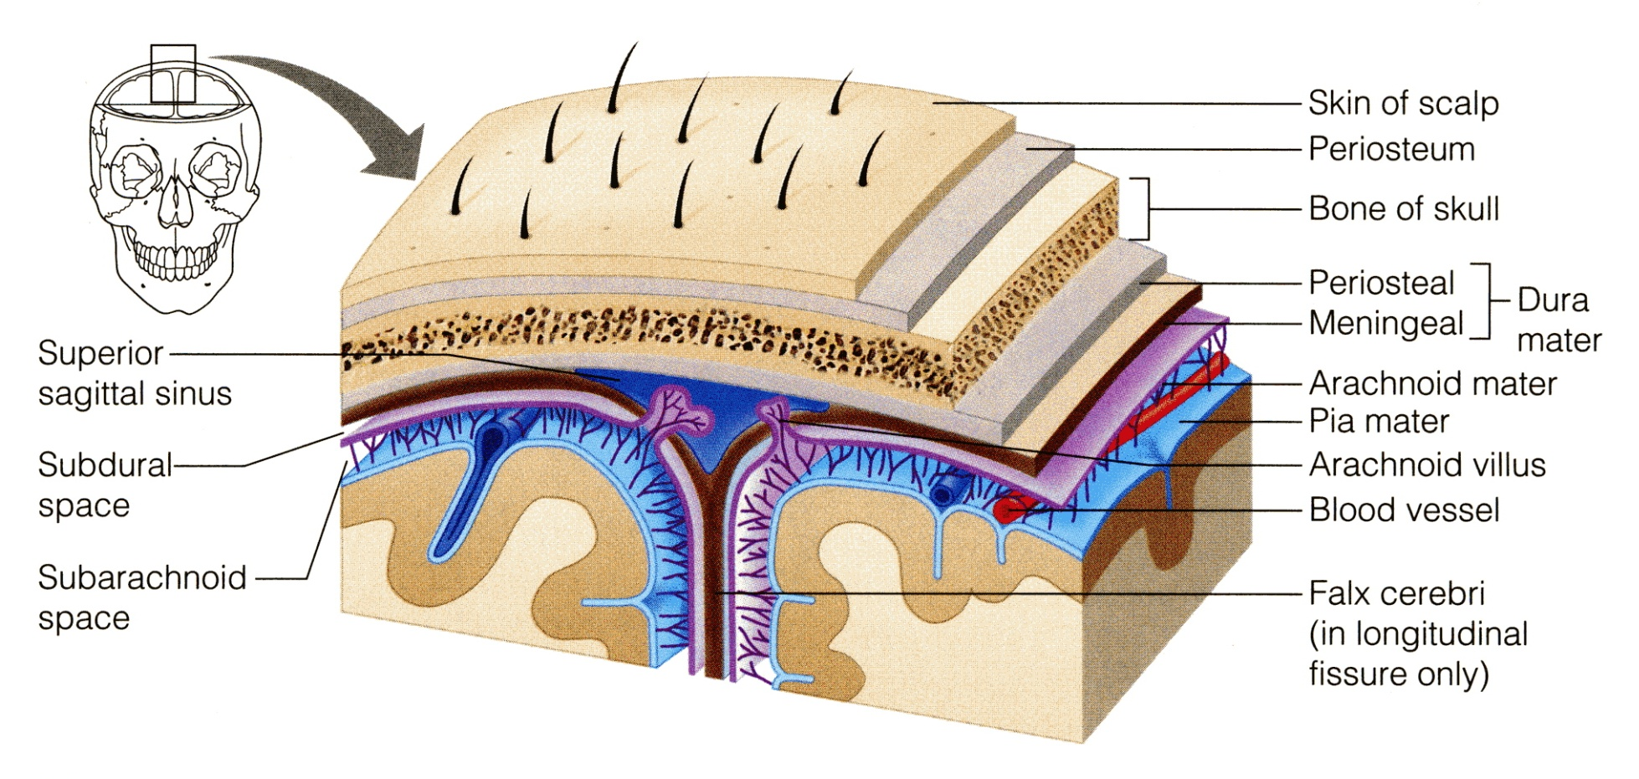
PROTECTION OF THE CNS
THE CNS IS PROTECTED BY:
Skull and the vertebral column (bone)
Meninges (membranes): 3 layers
Cerebrospinal fluid in the subarachnoid space
dura mater (outermost)
arachnoid mater (middle
pia mater (innermost)

Slide 21
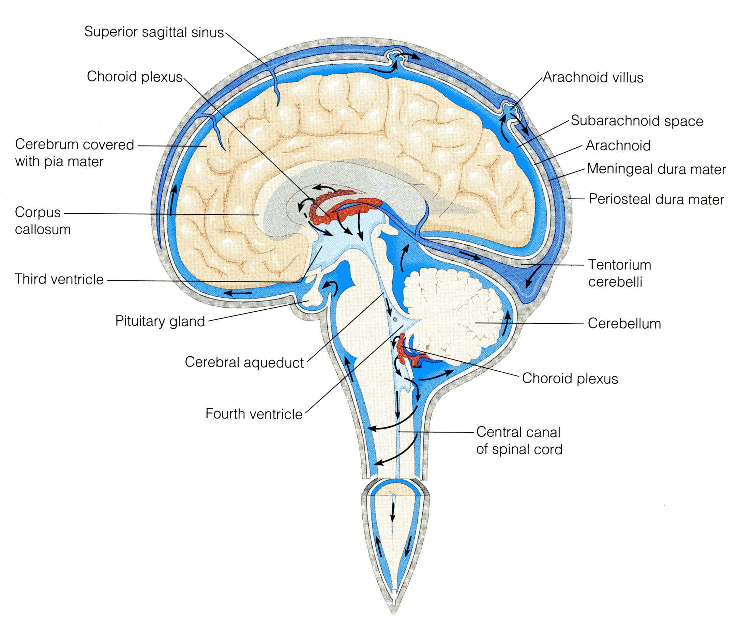
CEREBROSPINAL FLUID
CSF is constantly produced by the choroid plexuses inside the ventricles of brain.
Most of the CSF drains from the ventricles into the subarachoid space around the brain and spinal cord. A little amount flows down in the central canal of the spinal cord.
CSF is constantly drained into the dural sinuses through the arachnoid villi.

Slide 22
Thank U & Good luck

