Slide 1
Autonomic Nervous System

Slide 2
OBJECTIVES
At the end of the lecture, students should be able to:
Define the autonomic nervous system.
Describe the structure of autonomic nervous system
Trace the preganglionic & postganglionic neurons in both sympathetic & parasympathetic nervous system.
Enumerate in brief the main effects of sympathetic & parasympathetic system

Slide 3
Autonomic Nervous System
The division of nervous system concerned with the innervation and control of visceral organs, smooth muscle and glands
Primary function is to maintain homeostasis of the internal environment.
Its activity is regulated by hypothalamus

Slide 4
Organization of the Autonomic Nervous System
Distributed both in the central and peripheral nervous system
Like the somatic nervous system, it has afferent & efferent neurons and interneurons
It is divided into sympathetic and parasympathetic parts
Both divisions operate in conjunction with one another (have antagonistic control over the viscus) to maintain a stable internal environment

Slide 5
Somatic versus Autonomic System
Afferent pathway is similar in both systems
Impulses originate in the receptors and conveyed to interneurons in the spinal cord
the cell bodies of the afferent neurons are located in the sensory ganglia
Somatic
Autonomic

Slide 6
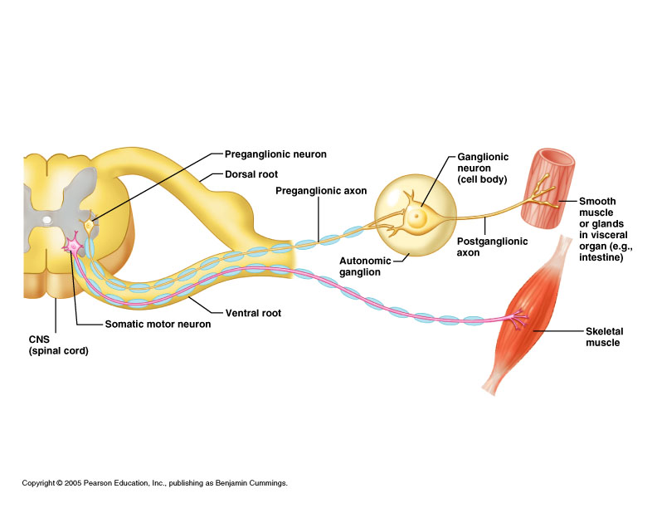
The efferent pathway is made up of preganglionic and postganglionic neurons
The cell bodies of the preganglionic neurons are located in the brain and spinal cord. Their axons synapse with the postganglionic neurons whose cell bodies are located in the autonomic ganglia

Slide 7
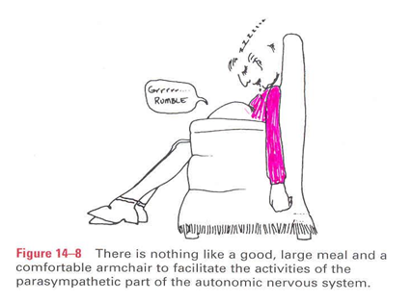
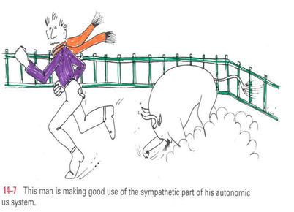
Based on the anatomical, physiological and pharmacological characteristics, the autonomic nervous system is divided into:
Parasympathetic: Concerned with conserving energy. “rest and digest”
Sympathetic Activated during exercise, excitement, and emergencies. “fight, flight, or fright”.

Slide 8
Parasympathetic Divisions
Sympathetic Divisions
Issues from T₁-L₂ segments of spinal cord (thoracolumbar outflow)
Ganglia are located close to the CNS (longer postganglionic fiber)
Issues from brain & S₂-S₄ segments of spinal cord (craniosacral outflow)
Ganglia are located near or within the viscera (longer preganglionic fiber)

Slide 9
Parasympathetic Division
Cranial Outflow
Emerges from brain
Preganglionic neurons located in nuclei of the 3rd,7th, 9th & 10th cranial nerves, in the brain stem
Preganglionic fibers are carried by 3rd,7th, 9th & 10th cranial nerves and supply organs of the head, neck, thorax, and abdomen
Sacral Outflow
Emerges from S₂-S₄
Preganglionic neurons located in lateral horn of spinal gray matter
Preganglionic fibers carried by sacral spinal nerves to supply organs of the pelvis and lower abdomen

Slide 10
Parasympathetic Ganglia
Multiple, small, located nearer the viscera
Ganglia supplying structures in head & neck: (ciliary, otic, pterygopalatine & submandibular).
Ganglia supplying thoracic, abdominal & pelvic viscera.

Slide 11
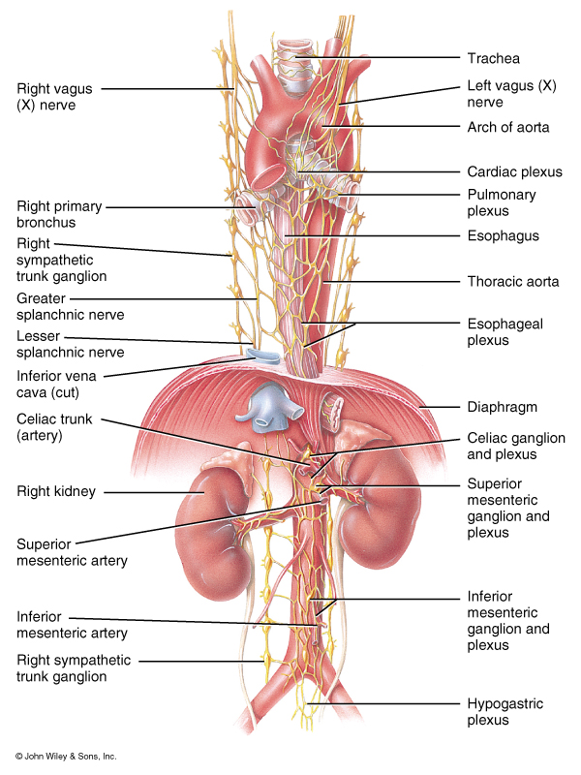
Sympathetic Divisions
Preganglionic neurons located in the lateral gray horn of T1-L2 segments of spinal cord (Thoracolumbar outflow)
Has multiple, large ganglia located nearer the central nervous system as
Prevertebral
Paravertebral

Slide 12
Prevertebral Ganglia
Unpaired, not segmentally arranged
Located in abdomen, anterior to the vertebral column
Main ganglia
Celiac
Superior mesenteric
Inferior mesenteric
Aorticorenal
aorticrenal

Slide 13
Paravertebral Ganglia
Consist of the right and left sympathetic chains or trunks. one on each side of vertebral column.
Number of ganglia:
Three in cervical part of chain
Eleven to twelve in thoracic part
Four in lumbar & sacral parts each
The chains end into a common ‘ganglion impar’ in front of coccyx

Slide 14
Preganglionic fibers leave the spinal cord in the ventral roots of the spinal nerve, travel through the spinal nerve, and then join the sympathetic chain via the white ramus communicantes.

Slide 15
Ascend, descend or remain at the same level and synapse with cells of paravertebral ganglia (postganglionic neurons) whose axons (postganglionic fibers) leave the sympathetic chain & join again the spinal nerve (via grey ramus communicantes) to supply structures in head & neck, thorax + blood vessels & sweat glands
Within the sympathetic chain, the preganglionic fibers may:
Leave the sympathetic chain (without synapse), enter the prevertebral ganglia to synapse. Postganglionic axons supply abdominal & pelvic viscera.

Slide 16
Neurotransmitters of the Autonomic Nervous System
preganglionic axons
Acetylcholine for both divisions (cholinergic)
postganglionic axons
Sympathetic: mostly norepinephrine
Parasympathetic: acetylcholine

Slide 17
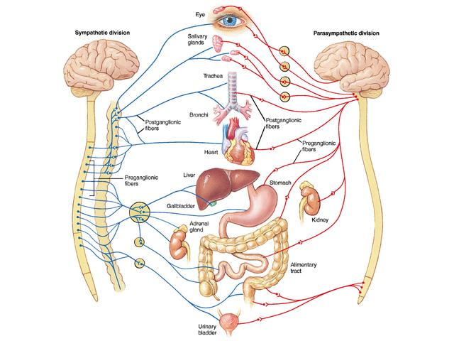

Slide 18
Thank U & Good Luck

