Slide 1
Cardiovascular system

Slide 2
Objectives
At the end of the lecture, students should be able to:
Identify the components of the cardiovascular system.
Describe the Heart as regards (position, chambers and valves).
Describe the Blood vessels (Arteries, Veins and Capillaries).
Describe the Portal System.
Describe the Sinusoids.
Describe the Functional and Anatomical end arteries.
Describe the Arteriovenous Anastomosis.

Slide 3
CONTENTS
Pump : Heart.
Network of Tubes: Blood Vessels.

Slide 4
FUNCTIONS
It is a transportation system which uses the blood as the transport vehicle.
It carries oxygen, nutrients, cell wastes, hormones and many other substances vital for body homeostasis.
The force to move the blood around the body is provided by the beating Heart.

Slide 5
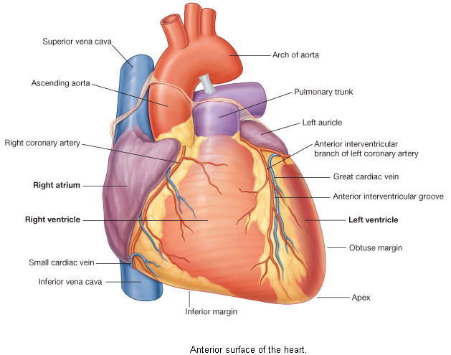
Heart
Is a hollow, cone shaped muscular pump that keeps circulation going on.
It is the size of hand’s fist of the same person.
It has:
Apex,
Base.
Surfaces: Diaphragmatic & Sternocostal.
Borders: Right, Left, Inferior.

Slide 6
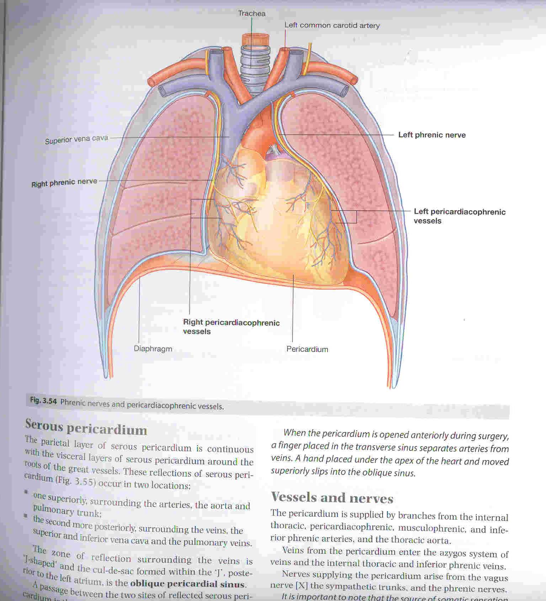
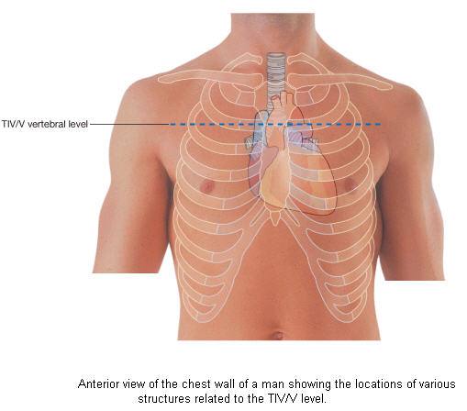
Location of the Heart
It lies in a centrally located partition in the thoracic cavity Known as the Middle Mediastinum between the two pleural sacs.
Enclosed by a double sac of serous membrane (Pericardium).
2/3 of the heart lies to the left of median plane.

Slide 7
Chambers of the Heart
ATRIA :
Two (Right & Left)
Superior in position.
They are the receiving chambers.
They have thin walls.
The upper part of each atrium is the Auricle.
The Right Atrium receives the venous blood coming to the heart.
Left Atrium receives arterial blood coming from the lungs.

Slide 8
Chambers of the Heart
The Ventricles are the inferior chambers.
They have thick walls.
They are the discharging
chambers (actual pumps).
Their contraction propels blood out of the heart into the circulation.

Slide 9
VALVES OF THE HEART
The heart has Four Valves:
Two Atrioventricular
Valves between atria & ventricles.
They allow the blood to flow in one direction from the atria to the ventricles.
Right AVV (Tricuspid)
Left AVV (Mitral)

Slide 10
Two Semilunar (Pulmonary & Aortic)
between the right and left ventricles respectively and the great arteries leaving the heart.
They allow the flow of blood from the ventricles to these arteries.

Slide 11
BLOOD VESSELS
Arteries:
Thick walled, do not have valves.
The smallest arteries are arterioles.
Veins:
Thin walled.
Many of them possess valves.
The smallest veins are venules.
Capillaries.

Slide 12
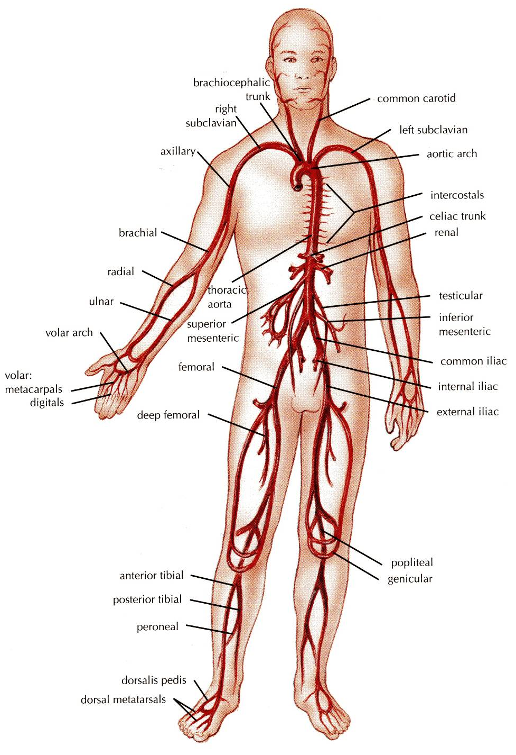
ARTERIES
They transport blood from the heart and distribute it to the various tissues of the body through their branches.

Slide 13
anastomosis
It is the joining of terminal branches of the arteries.

Slide 14
END ARTERIES
Anatomic End arteries:
Vessels whose terminal branches do not anastomose with branches of arteries
supplying adjacent areas.
Functional End arteries:
The terminal branches do anastomose with those of adjacent arteries but the anastomosis is insufficient to keep the tissue alive if one of the arteries is occluded.

Slide 15
VEINS
They transport blood back to the heart.
The smaller veins (Tributries) unite to form larger veins which commonly join with one another to form Venous Plexuses.

Slide 16
DEEP VEINS (VENAE COMITANTES)
Two veins that accompany medium sized deep arteries

Slide 17
capillaries
Microscopic vessels in the form of a network.
They connect the Arterioles to the Venules.

Slide 18
ARTERIOVENOUS ANASTOMOSIS
Direct connections between the arteries and veins without the intervention of capillaries.
Found in:
Tips of the Fingers and Toes.

Slide 19
PORTAL Circulation
It is a system of vessels interposed between two capillary beds.
Veins leaving the gastrointestinal tract do not go direct to the heart.
They pass to the Portal Vein.
This vein enters the liver and breaks up again into veins of diminishing size which ultimately join capillary like vessels (Sinusoids).

Slide 20
sinusoids
Thin walled blood vessels like capillaries.
They are wider with irregular cross diameter.
They are found in:
Liver.
Spleen.
Bone marrow.
Some endocrine glands.

Slide 21
SUMMARY
The cardiovascular system is a transporting system.
It is composed of the heart and blood vessels.
The heart is cone shaped, covered by pericardium and composed of four chambers.
The blood vessels are the arteries, veins and capillaries.
Arteries transport the blood from the heart.
The terminal branches of the arteries can anastomose with each other freely or be anatomic or functional end arteries.
Veins transport blood back to the heart.
Capillaries connect the arteries to the veins.
Sinusoids are special type of capillaries.
The portal system is composed of two sets of capillaries.
The veins from the GIT go first to the liver through the portal vein.

