Slide 1
بسم الله الرحمن الرحيم

Slide 2
Introduction to Histology and Cell Structure

Slide 3
Content & Objectives
In this lecture you are expected to learn:
What is histology and how it is studied.
Composition of the cell and function of each component:
Nucleus.
Cytoplasm:
Organelles: membranous and non-membranous.
Inclusions.

Slide 4
INTRODUCTION
Histology is the microscopic study of normal tissues.
Types of microscopes: LM & EM
Organs are made of tissues and tissues are made of cells.
Thin sections are cut and mounted on glass slides. Sections are stained with Hematoxylin (H) and Eosin (E).
Nucleus is always blue (basophilic).
Cytoplasm may be red (acidophilic), or blue (basophilic).
Notes:
Histology is the science dealing with the microscopic study of normal tissues and organs.
Organs are made of tissues and tissues are made of cells.
Types of Microscopes: 1- Light microscope (LM). 2- Electron Microscope (EM).
To prepare microscopical slides of a given organ, thin sections are cut and mounted on glass slides. Sections are stained, mostly with Hematoxylin (H) and Eosin (E). H is a basic stain while E is an acidic stain. Structures that accept the blue colour of H are called basophilic, while those that accept the red colour of E are acidophilic. Nuclei are always basophilic, while the cytoplasm may be acidophilic or basophilic, according to cell activity.

Slide 5
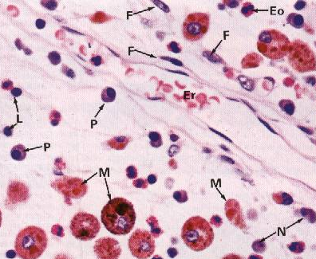
THE CELL
It Is the structural & functional unit of all living tissues.
Cells have different shapes & sizes.
THE CELL is made of:
1- Nucleus
2- Cytoplasm
Notes:
It Is the structural & functional unit of all living tissues (plants & animals).
Cells have different shapes & sizes. Lymphocyte is one of the smallest cells (6 μm), while fat cells and ova are the largest cells (150 μm).
THE CELL is made of:
1- Karyoplasm (nucleus).
2- Cytoplasm

Slide 6
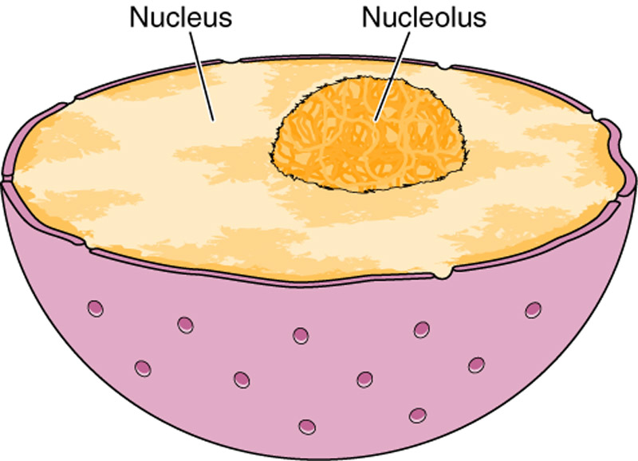
NUCLEUS
Formed of:
Nuclear envelope
Chromatin
Nucleolus
Nucleoplasm
Notes:
Nucleus is formed of:
1. Nuclear envelope. 2. Chromatin.
Nucleolus. 4. Nucleoplasm (nuclear sap).

Slide 7
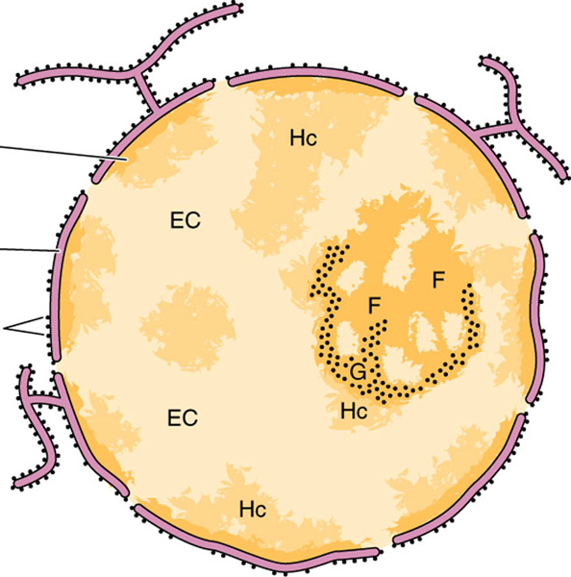
1. Nuclear Envelope
A double membrane with many pores.
a) Outer membrane.
b) Inner membrane.
c) Nuclear pores: provide communication between nucleus and cytoplasm.
Notes:
A double walled membrane with many pores.
a) Outer membrane: continuous with endoplasmic reticulum, even with ribosomes on its surface.
b) Inner membrane: with chromatin granules (peripheral chromatin), attached to its inner surface.
c) Nuclear pores, are circular openings in the nuclear membrane. The inner and outer membranes fuse together at the edge of each pore. Pores provide communication between nucleus and cytoplasm.

Slide 8
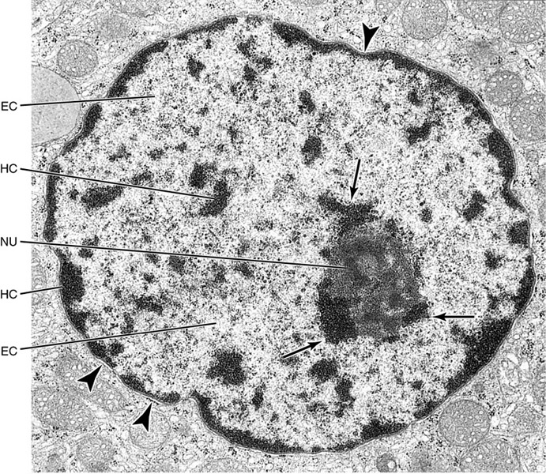
2. Chromatin
Formed of DNA.
2 Forms:
– Euchromatin: extended active chromatin (pale).
– Heterochromatin: condensed inactive chromatin (dark)
Functions:
– Carries genetic information.
– Directs protein synthesis.
Notes:
➢ Chromatin material is formed mainly of DNA, which contains the code of genetic information.
LM: Chromatin appears as basophilic granules.
EM:
– Euchromatin (extended or active). It appears pale.
– Heterochromatin (condensed or inactive). It is dark and distributed as:
a) Peripheral chromatin, attached to the inner wall of the nuclear membrane.
b) Nucleolus-associated chromatin, around nucleolus.
c) Chromatin islands, scattered in the nucleus.
Functions:
– Carries genetic information.
– Directs protein synthesis in the cytoplasm via the formation of the 3 types of RNA (ribosomal rRNA, messenger mRNA, and transfer tRNA).

Slide 9
3. Nucleolus
It is a spherical dark basophilic mass not surrounded by a membrane.
Usually one.
Function: formation of ribosomal RNA (rRNA), which is responsible for protein synthesis in the cytoplasm.
Notes:
LM:
– It is an almost spherical darkly stained mass (basophilic).
– There is one or more nucleoli in each nucleus.
EM:
Showing dark material permeated by light spaces.
Function:
It is Involved in formation of ribosomal RNA (rRNA), which is responsible for protein synthesis in cytoplasm.

Slide 10
4. Nucleoplasm
It is a clear fluid medium in which all the contents of the nucleus are embedded.
Function:
Provides a medium for movement of 3 types of RNA (ribosomal, messenger and transfer RNA) from the nucleus to the cytoplasm.

Slide 11
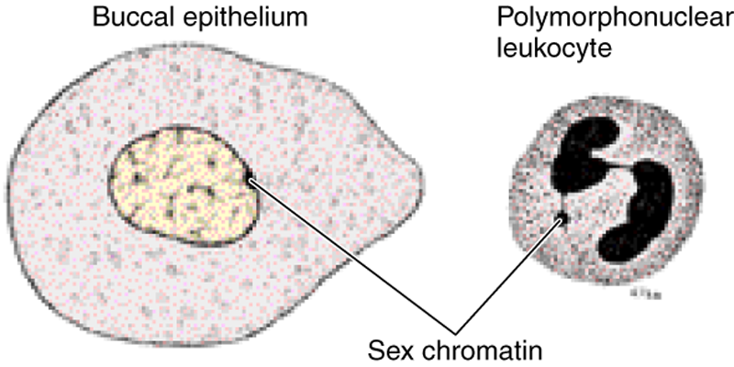
Sex Chromatin (Barr Body)
A dark stained mass of chromatin, usually adherent to the inner aspect of the nuclear envelope of female somatic cells
e.g. Buccal epithelial cells.
A drumstick mass protruding from the nucleus of neutrophils.
Represents one of the two X chromosomes which is inactive (condensed) in normal female .
Seen in normal female cells.
Absent in females with Turner’s syndrome XO.
Seen in males with Klinefelter’s syndrome XXY.
(Neutrophil)

Slide 12
Functions of the Nucleus
1- It is essential for the vitality and division of the cell.
2- It is the site of storage of genetic information.
3- It is the site of formation of the three types of RNA.
Notes:
FUNCTIONS OF THE NUCLEUS
1- It is the maestro of the cell; essential for the vitality and division of the cell.
2- It is the site of storage of genetic information (in DNA of the chromatin, which forms the chromosomes during cell division).
3- It is the site of formation of the three types of RNA, which are essential for the process of protein synthesis on which the vitality and functions of the cell depend.

Slide 13
CYTOPLASM
is formed of:
1- ORGANELLES: They are specialized structures, ESSENTIAL for vital processes of the cell.
2- INCLUSIONS: They are not essential for vitality of cells. may be present or absent. Examples are lipids, glycogen and pigments like melanin & lipofuscin.
Notes:
CYTOPLASM is formed of:
2- Organelles: They are specialized structures, essential for vital processes of the cell (respiration, digestion, secretion, excretion…etc).
3- Inclusions: They are not essential for vitality of cells. They may be present or absent.

Slide 14
CYTOPLASMIC ORGANELLES
A. Membranous:
1. Cell membrane.
2. Mitochondria.
3. Endoplasmic reticulum (rough & smooth).
4. Golgi apparatus.
5. Lysosomes.
6. Secretory vesicles.
B. Non-membranous:
1. Ribosomes.
2. Centrioles.
3. Cilia & Flagella.
4. Filaments:
Actin, Myosin & Intermediate filaments.
5. Cytoskeleton (actin, intermediate filaments & microtubules).
Notes:
They are either membranous or non-membranous.
A) Membranous organelles:
1. Cell membrane (plasma membrane).
2. Mitochondria.
3. Endoplasmic reticulum (rough & smooth).
4. Golgi apparatus (Golgi body or Golgi complex).
5. Lysosomes.
B) Non-membranous organelles:
1. Ribosomes.
2. Centrioles.
3. Cytoskeleton (microfilaments & microtubules).

Slide 15
Cell Membrane
A very thin membrane that surrounds the cell.
LM: Not visible.
EM: appears as 2 dark lines, separated by a light one (trilaminar appearance).
Function: selective barrier.
Notes:
Cell membrane mediates the continuous transport between the internal and external environments of the cell in different ways:
a) Phagocytosis: It is the power of the cell membrane to pass a foreign particle (foreign bodies, viruses, bacteria), forming a phagosome.
b) Pinocytosis: It is the power of the cell membrane to enclose and pass a droplet of fluid, forming a pinocytic vesicle.
c) Exocytosis: It is the power of the cell membrane to extrude waste products, outside the cell.

Slide 16
Cell Membrane
Chemical Structure:
1- Phospholipid molecules:
arranged in 2 layers.
2- Protein molecules:
a) Peripheral protein
b) Integral protein
3- Carbohydrate molecules:
attached to either proteins
or lipids (glycoproteins and
glycolipids), forming the
surface or cell coat (Glycocalyx):
a) Protection of the cell.
b) Cell recognition and adhesion.
Notes:
Molecular Biology: The cell membrane is made of:
1- Phospholipid Component: It consists of Phospholipid molecules arranged into 2 layers (bilipid layer). Each molecule has a head and a tail.
2- Protein Component: It consists of:
a) Peripheral protein: It is formed of loosely attached protein molecules, found on both surfaces of the cell membrane.
b) Integral protein: It protein molecules, that span the entire lipid bilayer (transmembrane protein).
3- Carbohydrate Component: It consists of short chains of polysaccharides conjugated with either proteins or lipids of the external surface of the cell membrane (glycoproteins and glycolipids), forming the surface coat (Glycocalyx).
Surface Coat and Cell Receptors:
➢ Exists on the external surface of the cell membrane.
➢ Formed by molecules of glycoproteins and glycolipids.
➢ Has certain molecules which act as specific receptors that are involved in selective permeability and cell immunity (cell recognition).

Slide 17
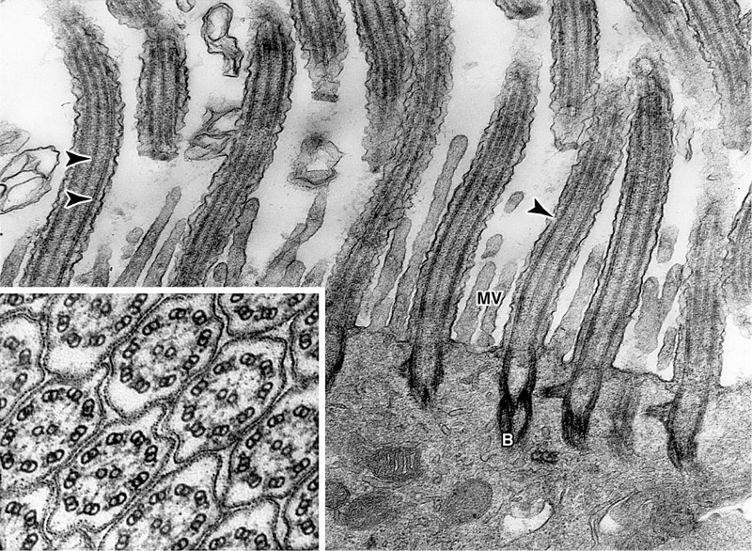
Cell Membrane
Specializations:
Cilia:
Long motile hair like structures surrounded by cell membrane.
Their core is formed of microtubules.
Microvilli (Brush border):
Cylindrical cytoplasmic projections of apical surface to increase surface area.
Their core contains actin filaments.

Slide 18
Cell Membrane
Specializations:
Intercellular Junctions:
Occluding (Tight) Junction: seals the intercellular space.
Adherening Junction: fixes adjacent cells together:
Zonula Adhering Junction.
Desmosome (Macula Adherening Junction).
Gap junction: Allow free communication between the cells.
1
2a
2b
3
When a combination of 1 , 2a and 2b is present, this is called a junctional complex.

Slide 19
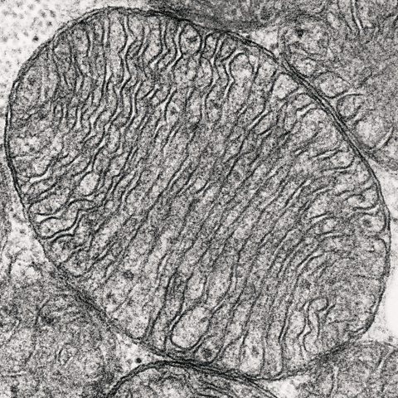
Mitochondria
Each mitochondrion is rod-shaped .
The wall is composed of 2 membranes.
The outer is smooth, the inner is folded to form cristae.
The cavity is filled with mitochondrial matrix, which contains enzymes. Also contains its own DNA.
Functions:
1- Generation of ATP which is the source of energy for the cell. They are called the power-house of the cell.
2- They can form their own proteins and undergo self replication.
Notes:
– Each mitochondrion is surrounded by 2 membranes. The outer membrane is smooth, while the inner one forms incomplete and alternating shelves (cristae).
– Cristae increase the surface area for deposition of enzymes that function in oxidative phosphorylation.
– The cavity is filled with mitochondrial matrix, which contains:
• Enzymes of Krebs cycle and fatty acids oxidation.
• Contains its own genetic apparatus (DNA and RNA).
Functions:
1- Cell respiration and production of adenosine triphosphate (ATP), the primary source of energy for the cell. That is why they are called the power-house of the cell.
2- They can form proteins for themselves and undergo self replication.

Slide 20
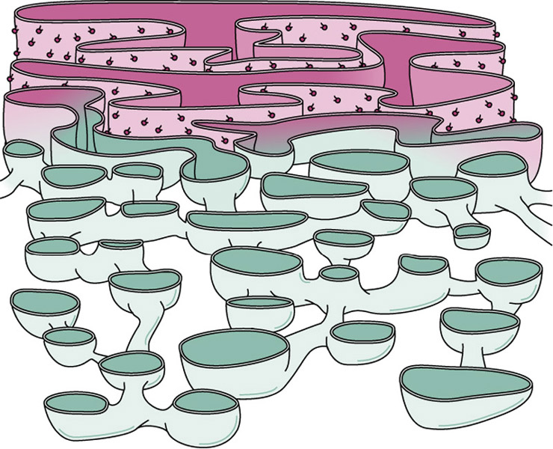
Endoplasmic Reticulum (ER)
It is a system of communicating membranous tubules, vesicles, and flattened vesicles (cisternae).
There are 2 types:
Rough (rER).
Smooth (sER).

Slide 21
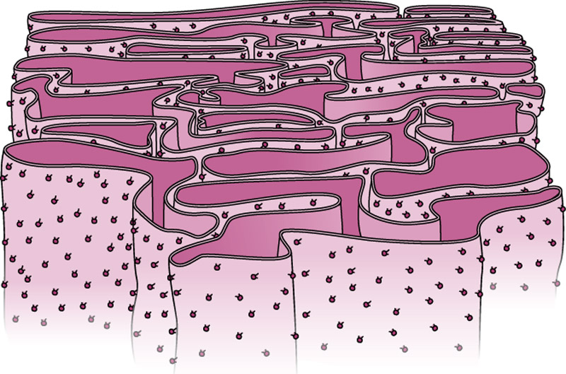
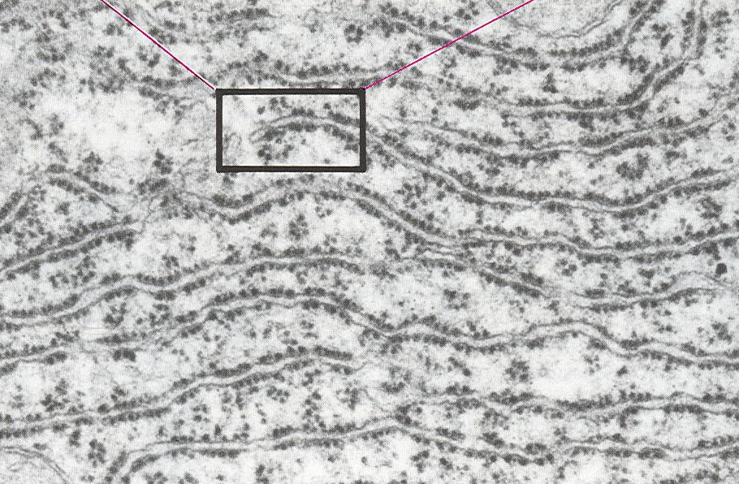
Rough Endoplasmic Reticulum
Membranous sheets of flattened tubules & vesicles with ribosomes on the surface.
Functions:
Synthesis of proteins by ribosomes on its outer surface.
Transfer vesicles transfer the formed protein to Golgi.
Notes:
It is well developed in protein forming cells, e.g. plasma cells.
LM: Its sites appear as basophilic areas, due to the ribosomes on the surface.
EM: It appears as membrane-bound sheets of flattened cisternae with ribosomes attached to its outer surface.
Functions:
1. Synthesis of protein by the ribosomes on their surfaces.
2. Accumulation of the formed proteins, within their cavities.
3. Transfer vesicles (containing protein) bud off from the endoplasmic reticulum, to transfer this protein to the Golgi apparatus.

Slide 22
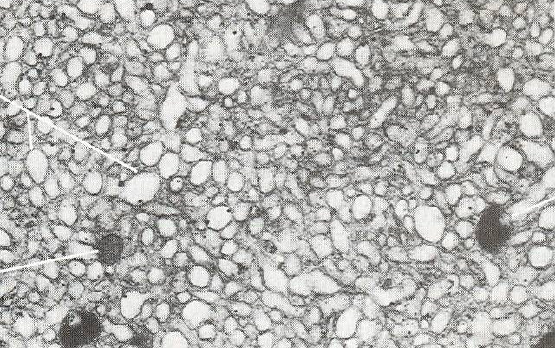
Smooth Endoplasmic Reticulum
Membranous tubules and vesicles, with no ribosomes on the surface.
Functions:
Synthesis of lipids & cholesterol.
Synthesis of steroid hormones, e.g. cortisone.
Helps muscle contraction, by acting as a calcium pump.
Detoxification of drugs & toxins.
Notes:
It is well developed in cells forming lipids and steroid hormones, e.g. cells of suprarenal cortex.
LM: It can not be demonstrated.
EM: It appears as membrane-bound tubules and vesicles, with no ribosomes on surface.
Functions:
1- Synthesis and storage of lipids and cholesterol.
2- Synthesis of steroid hormones, e.g. testosterone & cortisone.
3- Helps muscular contraction, by acting as a calcium pump.
4- Detoxification of drugs & hormones.

Slide 23
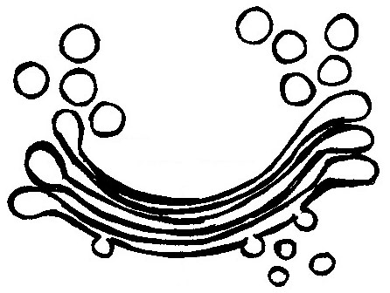
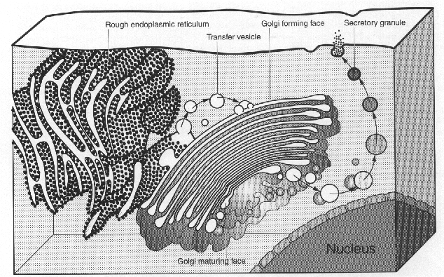
Golgi Apparatus
The secretory apparatus of the cell.
Consists of stacked saucer-shaped flattened vesicles.
Each vesicle has two faces: Convex (forming) face, receives transfer vesicles. Concave (mature) face, forms secretory vesicles.
Functions:
Sorting, modification & packaging of proteins.
Secretory vesicles formation.
Formation of lysosomes.
Secretory vesicles
Mature face
Transfer vesicles
Forming face
Notes:
It is a membranous cytoplasmic organelle, considered as the secretory apparatus of the cell. It is well developed in secretory cells.
– Consists of a stacked system of saucer-shaped flattened vesicles.
– Each vesicle possesses two faces:
a) Convex (forming) face, which receives the small vesicles that carry the protein from rER (transfer vesicles).
b) Concave (mature) face, from which larger vesicles (secretory vesicles) are budding at its periphery.
Functions:
1- Concentration of the secretory products, received from the rough endoplasmic reticulum.
2- Modification of the proteins inside, either by coupling to carbohydrates to form glycoproteins, or by the formation of sulphated proteins.
3- Discharge of secretory products (secretion), which may be the hormones or the enzymes secreted by the cells (secretory vesicles).
4- Formation of lysosomes.
5- Production and maintenance of cell membrane and surface coat.

Slide 24
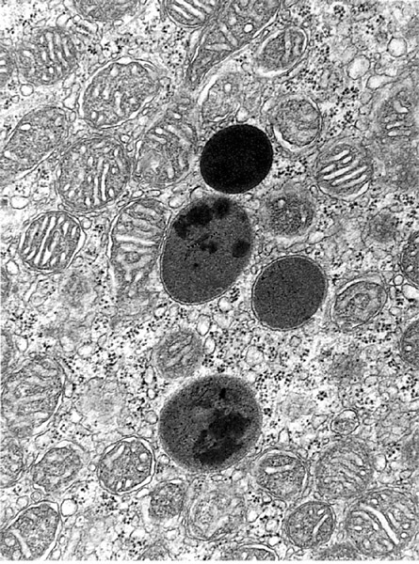
Lysosomes
The digestive apparatus of the cell.
Contain hydrolytic enzymes.
Originate from mature surface of the Golgi apparatus, while their hydrolytic enzymes are formed in the rough endoplasmic reticulum.
Function: intracellular digestion of ingested material or old organelles.
Notes:
They are membranous organelles that are considered as the digestive apparatus of the cell. Lysosomes originate from mature surface of the Golgi apparatus, while their hydrolytic enzymes are synthesized in the rough endoplasmic reticulum.

Slide 25
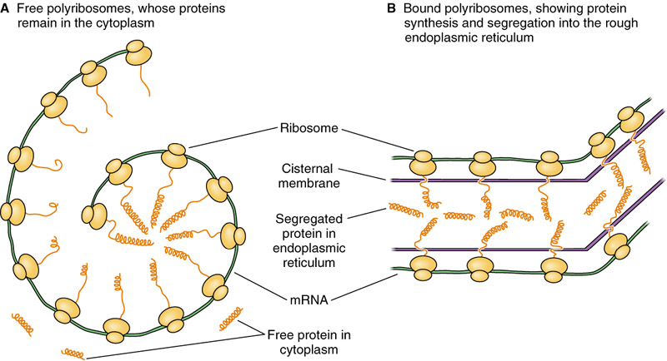
Ribosomes
LM:Basophilic cytoplasm is due to numerous ribosomes .
Consist of ribosomal RNA (rRNA), combined with proteins.
EM:Formed of 2 subunits.
Free in the cytoplasm (may form polyribosomes) or attached to rER.
Formed in the nucleolus.
Function: Protein synthesis
Notes:
➢ Ribosomes are small non-membranous particles.
➢ Consist of a strand of ribosomal RNA (rRNA), with associated proteins.
➢ Ribosomes are formed in the nucleolus and pass to the cytoplasm through the pores of the nuclear membrane.
EM: Appear as electron dense granules, formed of 2 subunits, a large one and a small one.
They may be
– Free, either singly or in groups, connected together by a messenger RNA (mRNA), to form clusters or spiral chains (polyribosomes or polysomes).
– Attached, arranged on the membrane surface of the rough endoplasmic reticulum.
Function: Protein synthesis, either for the cell growth and regeneration of organelles or to form secretory granules and lysosomes.

Slide 26
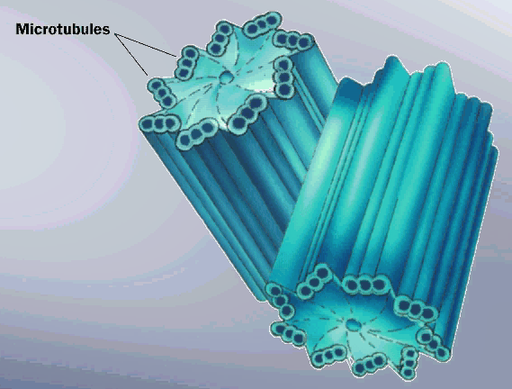
Centrioles
2 cylinders, perpendicular to each other.
Wall is made of 9 triplets of microtubules, i.e. 27 microtubules.
Functions:
1- Essential for cell division.
2- Formation of cilia and flagella.
Notes:
EM: They appear as 2 cylinders, perpendicular to each other. In cross section the wall of each centriole is made of 9 peripheral bundles of microtubules. Each bundle is made of 3 microtubules, i.e. the wall is formed of 9 triplets, or 27 microtubules.
Functions:
1- Initiation of cell division and spindle formation.
2- Formation of cilia and flagella.

Slide 27
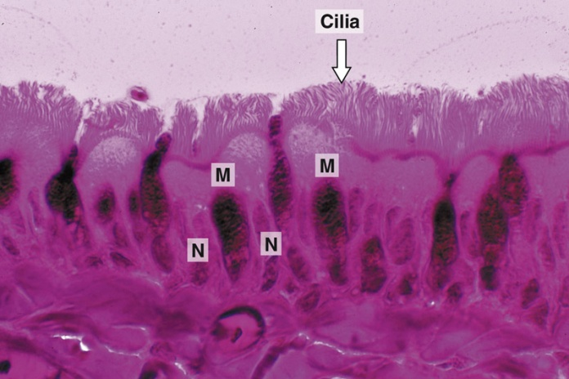
Microtubules-Containing Organelles
1. Centrioles: see before.
2. Cilia:
Hair-like striations on the free surface of some cells.
Basal body is similar to centriole.
Shaft is formed of 9 doublets and 2 central singlets of microtubules, i.e. 20 microtubules..
Function: movement of particles or fluids on the free surface of the cell in one direction.
3. Flagella:
Longer and larger than cilia.
Form the tails of sperms.
Function: important for movement of the sperms.

Slide 28
Clinical application
Immotile cilia syndrome:
Disorder that causes infertility in male and chronic respiratory tract infection in both sexes.
is caused by immobility of cilia and flagella induced by deficiency of dynein.
Dynein protein is responsible for movements of cilia and flagella.

Slide 29
Cytoskeleton
It is the structural skeleton of the cell.
Functions:
Maintains shape of the cell.
Helps transport of material within the cell.
Consists of:
Microfilaments (actin).
Intermediate filaments, e.g. Keratin.
Microtubules.
Notes:
Functions of the cytoskeleton:
– It maintains the shape of the cell.
– It underlies different processes [endocytosis, exocytosis, amoeboid movements & cell division].
– It plays a role in cell motility.
Cytoskeleton consists of: microtubules and microfilaments.

Slide 30
SUMMARY/KEY WORDS
Components of the cell in correlation with their functions:
- Nucleus.
- Cytoplasm:
Membranous cytoplasmic organelles.
Non membranous cytoplasmic organelles.
Specializations of the cell membrane:
Cilia, Microvilli, Intercellular junctions.
Microtubules-containing organelles.
Cytoskeleton.
Cytoplasmic inclusions.
Clinical applications:
- Sex chromatin (Barr body).
- Immotile cilia syndrome (Kartagener’s syndrome).

Slide 31
Suggested Histology References
For Theoretical:
Color Textbook of Histology, L.P. Gartner and J.L. Hiatt, Latest Edition.
For Practical:
Di Fiore’s Atlas of Histology, V.P. Eroschenko, Latest Edition.

Slide 32
THANKS

