Slide 1
Epithelial Tissue
Objectives:
By the end of this lecture, you should be able to:
Describe general characteristics of epithelial tissue.
Discuss microscopic structure and distribution of different types of epithelial membranes.
Classify glandular epithelium according to different parameters.
Enumerate the functions of epithelial tissue.
Understand the following clinical applications:
Immotile cilia syndrome (Kartagener’s syndrome).
Metaplasia.

Slide 2
EPITHELIAL TISSUE
General characteristics:
Cells are tightly joined with little intercellular space.
Rest on a basement membrane.
Avascular.
High power of regeneration.
Classification:
Epithelial membranes:
Simple epithelium: one layer.
Stratified epithelium: more than one layer.
Glands (Glandular Epithelium).
Notes:
GENERAL CHARACTERISTICS:
1- It is formed of crowded cells with very little intercellular substance in-between.
2- It is separated from the underlying connective tissue, by a basement membrane, which may be clear or non-clear.
3- It is not penetrated by blood or lymph vessels (avascular), however, nerve fibres can penetrate between epithelial cells.
4- It has a high power of regeneration.
5- It covers & lines surfaces, some form glands or it may be modified to act as a receptor.
6- It may be ectodermal (as skin), mesodermal (as serous membranes) or endodermal (as GIT) in origin.
TYPES OF EPITHELIUM: simple (formed of one layer), stratified (many layers), glandular (secretory), neuroepithelium (act as receptor) & myoepithelium (contractile).

Slide 3
I. Simple Epithelium
1- Simple Squamous Epithelium:
One layer of flat cells with flat nuclei. Provides smooth thin surface.
Examples of sites:
Endothelium (lining the CVS).
Alveoli of lung.
Notes:
1- SIMPLE SQUAMOUS EPITHELIUM:
It is formed of one layer of flat cells with flattened nuclei.
Sites:
➢ Endothelium, lining heart & blood vessels (CVS).
➢ Mesothelium of serous membranes (as pleura).
➢ Alveoli of lungs.
➢ Bowman’s capsule of kidney.
2- SIMPLE CUBICAL EPITHELIUM:
It is formed of one layer of cubical cells with central rounded nuclei. It lines thyroid follicles, convoluted tubules of kidney and medium-sized ducts of glands.

Slide 4
I. Simple Epithelium
2- Simple Cuboidal Epithelium:
One layer of cuboidal cells with central rounded nuclei.
Example of sites:
Thyroid follicles.
Notes:
1- SIMPLE SQUAMOUS EPITHELIUM:
It is formed of one layer of flat cells with flattened nuclei.
Sites:
➢ Endothelium, lining heart & blood vessels (CVS).
➢ Mesothelium of serous membranes (as pleura).
➢ Alveoli of lungs.
➢ Bowman’s capsule of kidney.
2- SIMPLE CUBICAL EPITHELIUM:
It is formed of one layer of cubical cells with central rounded nuclei. It lines thyroid follicles, convoluted tubules of kidney and medium-sized ducts of glands.

Slide 5
I. Simple Epithelium
3- Simple Columnar Epithelium:
One layer of columnar cells with basal oval nuclei.
Types:
Non-ciliated: Example of sites: Lining of stomach, intestine (with goblet cells) & gall bladder.
Ciliated: with cilia on free surface. Example of sites: Fallopian tubes.
Notes:
3- SIMPLE COLUMNAR EPITHELIUM:
It is formed of one layer of columnar cells with basal oval nuclei. It is found mainly in the digestive system, lining the stomach, small and large intestines, gall bladder & large bile ducts.
4- SIMPLE COLUMNAR CILIATED EPITHELIUM:
The free surfaces of the columnar cells are supplied with cilia. It lines uterus, Fallopian tubes and bronchioles of lung.

Slide 6
I. Simple Epithelium
4- Pseudo-Stratified Columnar:
One layer of columnar cells.
Some cells are tall.
Others are short and don’t reach the surface.
Both rest on the basement membrane.
Nuclei appear at different levels.
Types:
Non-ciliated: Example of sites: vas deferens.
Ciliated with Goblet Cells: Example of sites: trachea.
Notes:
5- PSEUDO-STRATIFIED COLUMNAR EPITHELIUM:
It is formed of columnar cells, which are so crowded that some of them don’t reach the free surface. The presence of nuclei at different levels, gives a false impression of stratification (pseudo : false). However, it is simple epithelium because all the cells are attached to the basement membrane. It is present mainly in the male genital tract lining vas deferens & membranous male urethra.
6- PSEUDO-STRATIFIED CILIATED COLUMNAR
EPITHELIUM:
Lining the upper respiratory tract (trachea & bronchi). (motile cilia).
Epididymis (non-motile cilia = long microvilli).

Slide 7
II. Stratified Epithelium
1- Stratified Squamous Epithelium:
Multiple layers of cells.
Basal cells are columnar with basal oval nuclei.
Intermediate cells are polygonal with central rounded nuclei.
Surface cells are flat with flattened nuclei.
Types:
Keratinized: with a layer of keratin on the surface. Example of sites: epidermis of skin.
Non-keratinized: without a layer of keratin on the surface. Example of sites: esophagus.
Notes:
2- STRATIFIED SQUAMOUS EPITHEIUM:
➢ It is formed of 5-30 layers, resting on a clear wavy basement membrane.
➢ The basal cells are columnar with basal oval nuclei.
➢ The superficial cells are flat with flattened nuclei.
➢ The intermediate cells are polyhedral with central round nuclei. They are connected together by desmosomes and they become smaller near the surface.
➢ It covers skin & lines skin openings.
➢ It may be keratinized (covered by a horny layer) or non-keratinized.
➢ The keratinized type is found in epidermis of skin, external ear & vestibule of nose.
➢ The non-keratinized type is found in: cornea, oral cavity, oesophagus, anal canal, vagina and tip of urethra.

Slide 8
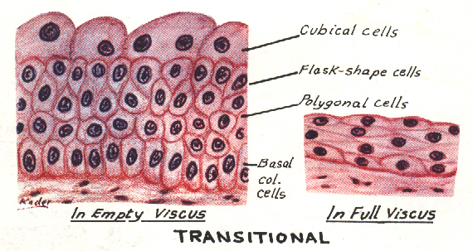
II. Stratified Epithelium
2- Transitional Epithelium:
Multiple layers of cells.
Basal cells are columnar.
Intermediate cells are polygonal.
Surface cells large cuboidal with convex free surface.
Example of sites: Urinary bladder.
Notes:
1- TRANSITIONAL EPITHELIUM:
➢ It consists of 4-8 layers of cells.
➢ The basement membrane is indistinct (not clear).
➢ The basal cells are short columnar with basal oval nuclei.
➢ The superficial cells are large with convex free surfaces and may be binucleated.
➢ The intermediate cells are polygonal with central rounded nuclei.
➢ The intercellular spaces contain a mucoid-like substance, which allows gliding of cells, so during distension of the organ, the epithelium is made of 2-3 layers.
➢ Sites: lining the urinary tract: pelvis of ureters, ureter, urinary bladder & prostatic male urethra.

Slide 9
II. Stratified Epithelium
3- Stratified Columnar Epithelium:
Multiple layers of cells.
Basal cells are columnar.
Intermediate cells are polygonal.
Surface cells are columnar.
Example of sites: large ducts of glands.
Notes:
3- STRATIFIED COLUMNAR EPITHELIUM:
It is similar to stratified squamous epithelium, but the surface cells are columnar. It may be:
➢ Non-ciliated: in cavernous (penile) male urethra & recto-anal junction.
➢ Ciliated: in foetal oesophagus & soft palate.
4- STRATIFIED CUBICAL EPITHELIUM: Its superficial cells are cuboidal. It lines the ducts of sweat glands.

Slide 10
GLANDS (Glandular Epithelium)
Classification:
1- According to presence or absence of ducts:
a. Exocrine: e.g. salivary glands.
b. Endocrine: e.g. thyroid gland.
c. Mixed: e.g. pancreas.
2- According to number of cells:
a. Unicellular: e.g. goblet cells.
b. Multicellular: e.g. salivary glands.

Slide 11
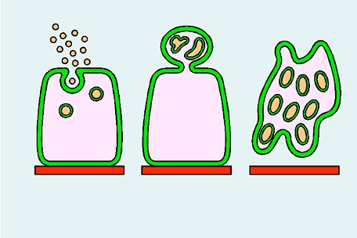
GLANDS (Glandular Epithelium)
Classification:
3- According to mode of secretion:
a. Merocrine: No part of the cell is lost with the secretion, e.g. salivary glands.
b. Apocrine: The top of the cell is lost with the secretion, e.g. mammary gland.
c. Holocrine: The whole cell detaches with the secretion, e.g. sebaceous glands.
Mero-crine
Apo-crine
Holo-crine

Slide 12
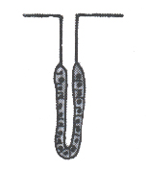
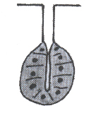
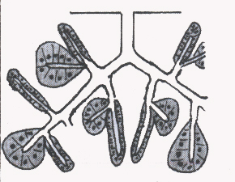
GLANDS (Glandular Epithelium)
Classification:
4- According to shape of secretory part:
1. Tubular: e.g. intestinal gland.
2. Alveolar (acinar): e.g. mammary gland.
3. Tubulo-alveolar: e.g. pancreas.

Slide 13
GLANDS (Glandular Epithelium)
Classification:
5- According to nature of secretion:
a. Serous: e.g. parotid gland.
b. Mucous: e.g. goblet cells.
c. Muco-serous: e.g. sublingual gland.
d. Watery: e.g. sweat gland.

Slide 14
FUNCTIONS OF EPITHELIUM
1- Protection as in epidermis of skin.
2- Secretion as in glands.
3- Absorption as in small intestine.
4- Excretion as in kidney.
5- Reproduction as in gonads.
6- Smooth lining as in blood vessels.

Slide 15
Clinical Applications
Immotile cilia syndrome (Kartegener’s syndrome):
Disorder that causes infertility in male and chronic respiratory tract infection in both sexes.
It is caused by immobility of cilia and flagella induced by deficiency of dynein.
Dynein protein is responsible for movements of cilia and flagella.

Slide 16
Clinical Applications
Metaplasia:
It is the transformation of one type of tissue to another in response to injury. This condition is usually reversible if the injury is removed.
Example: pseudostratified ciliated columnar epithelium of the respiratory passages, e.g. trachea, of heavy smokers may undergo squamous metaplasia, transforming into stratified squamous epithelium.

Slide 17
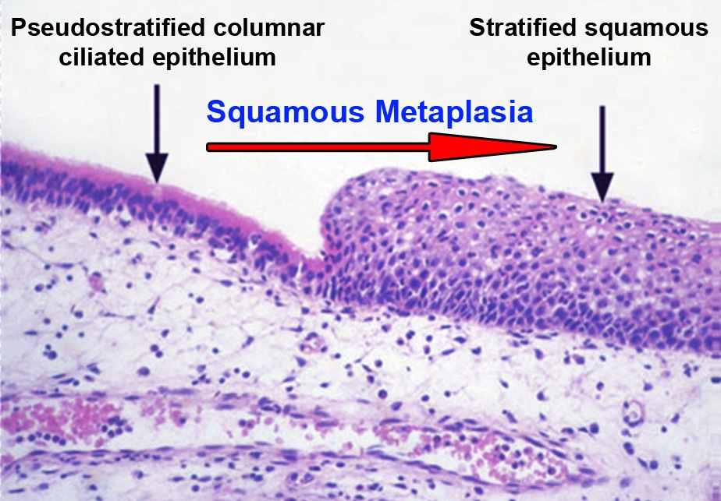
Squamous Metaplasia

Slide 18
Thank You

