Slide 1
LYMPHOID TISSUE
Objectives:
By the end of the lecture, the student should describe the microscopic structure of the following organs in correlation with their functions:
1- Lymph nodes.
2- Spleen.
3- Tonsils.
4- Thymus.

Slide 2
LYMPHOID TISSUE
Lymphocyte

Slide 3
LYMPHOID TISSUE
A) Diffuse lymphoid tissue
B) Encapsulated lymphoid organs:
1- Lymph nodes.
2- Spleen.
3- Tonsils (are incompletely encapsulated)
4- Thymus.
N.B. Both red bone marrow & Thymus are
considered 1ry. Lymphoid organs.

Slide 4
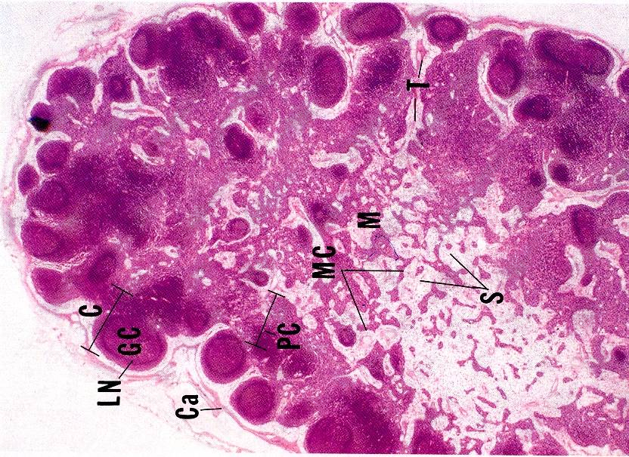
LYMPH NODES (L.N.)
Stroma:
1- Capsule
2- Trabeculae (septa)
3- Reticular C.T.
Parenchyma: (lymphoid tissue + lymph sinuses)
1- Cortex
2- Paracortex
3- Medulla

Slide 5
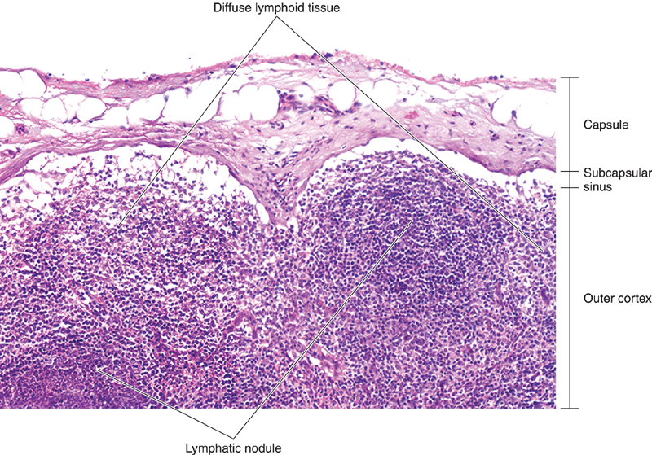
1. CORTEX OF L.N.
1- Lymphatic nodules (follicles):
a- 1ry: without germinal center
b- 2ry: with germinal center: Lighter
2- Cortical lymph sinuses.

Slide 6
2. PARACORTEX Of L.N.
It is the thymus-dependent zone of L.N.
It is composed mostly of T-lymphocytes.
3. MEDULLA OF L.N.
(1) Medullary cords:
are formed mainly of lymphoid cells
( B & T lymphocytes, plasma cells,
macrophages).
(2) Medullary lymph sinuses.
FUNCTIONS OF L.N.
1- Production of immunocompetent cells.
2- Filtration of lymph.

Slide 7
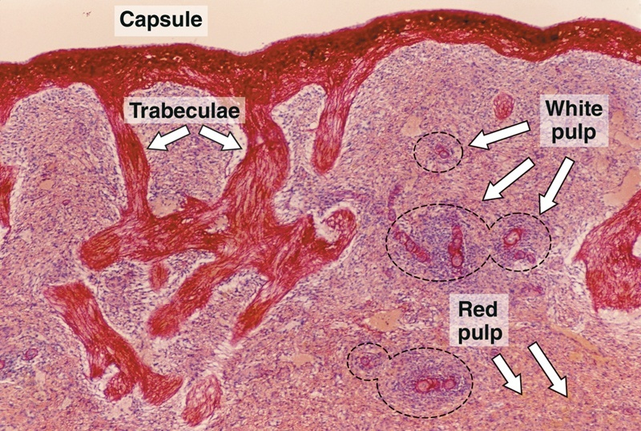
SPLEEN
A. Stroma:
1- Capsule.
2- Trabeculae.
3- Reticular C.T.
B. PARENCHYMA:
(A) White pulp.
(B) RED PULP.
N.B. No cortex, no medulla.

Slide 8
FUNCTIONS OF SPLEEN
1- Filtration of blood.
2- Phagocytosis of old RBCs &
old blood platelets & invading microorganisms.
3- Production & proliferation of immunocompetent B & T lymphocytes.
4- Production of antibodies.

Slide 9
Tonsils
Palatine Tonsils.
Pharyngeal Tonsil.
Lingual Tonsils.

Slide 10
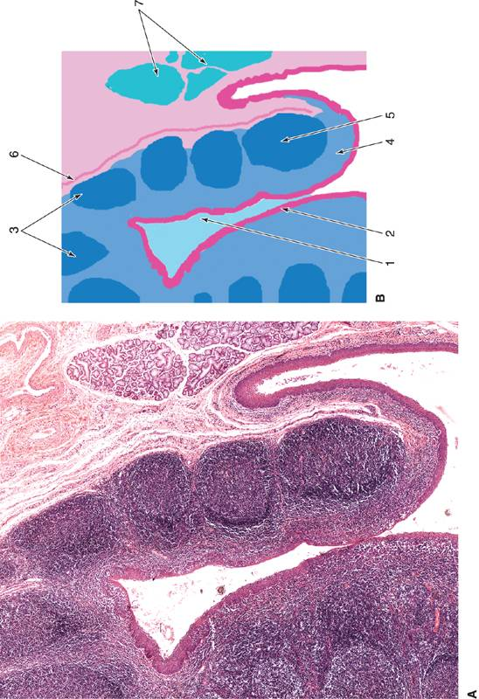
PALATINE TONSILS
Structure:
1- Epithelium:
non-keratinized stratified squamous.
2- Tonsilar crypts.
3- Lymphatic nodules.
4- Capsule: partial.
FUNCTION OF TONSILS
Production of antibodies.

Slide 11
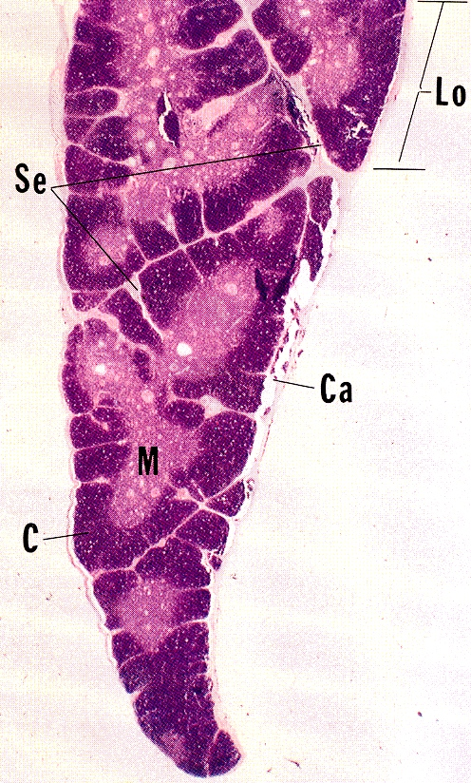
THYMUS
Stroma:
1-Capsule
2-Interlobular trabeculae: incomplete
B) Thymic lobule:
1-Cortex
2-Medulla

Slide 12
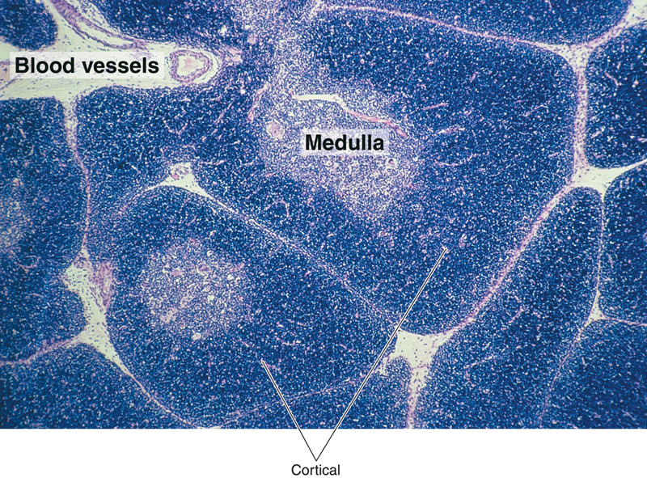
CORTEX OF THYMIC LOBULE
A) It contains developing (immature) T- lymphocytes (thymocytes).
98% of thymocytes die?
B) Epithelial reticular cells
C) Macrophages.
N.B. No lymphatic nodules
No plasma cells
No B-lymphocytes

Slide 13
MEDULLA OF THYMIC LOBULE
1-Hassall’s (thymic) corpuscles:
-Concentrically arranged epithelial reticular cells in the medulla.
2- Mature small T lymphocytes
3- Macrophages.
4- Epithelial reticular cells.
N.B. Medulla of adjacent thymic lobules are interconnected- Why? Incomplete trabeculae

Slide 14
FUNCTION OF THYMUS
Maturation of T lymphocytes.
(Immunoincompetent T cells →Immunocompetent T cells).

Slide 15
General notes about thymus
No lymphoid nodules
No reticular fibers
No sinuses or sinusoids

Slide 16
Clinical Applications Autoimmune disease
Def: mal-function of the immune system that results in the loss of immunological tolerance.
Example:
Grave’s Disease: in which the receptors for thyroid stimulating hormone (TSH) on follicular cells of thyroid gland are perceived to be antigens leading to the formation of antibodies against these TSH receptors.
These antibodies will bind to TSH receptors, so the cells will be stimulated to release excess amount of thyroid hormones leading to Hyperthyroidism

Slide 17
Clinical Application Acquired Immunodeficiency Syndrome (AIDS)
Causative organism: Human immunodeficiency virus (HIV)
Pathogenesis: HIV binds to CD4 molecules of TH resulting in incapacitating TH cells, leading to Spread of the virus, so other TH cells will be infected leading to incapability of immune response against bacterial or viral infections.

Slide 18
Clinical Applications DiGeorge’s syndrome
Def: Congenital failure of the thymus to develop.
Result: Failure to produce T cells leading to non-functional cell-mediated immune response which leads to early death due to infection.

Slide 19
Clinical Applications Palpable lymph node
The presence of antigen or bacteria leads to rapid proliferation of lymphocytes of the lymph nodes (L.N), leading to increase of L.N. to several times of its normal size, so the L.N. becomes hard and palpable to the touch.

Slide 20
Clinical Applications Rupture of Spleen
Spleen is a fragile or friable organ so major trauma to the upper left abdominal quadrant usually leads to rupture spleen, leading to surgical removal of that ruptured spleen.

Slide 21
Thank You

