Slide 1
CONNECTIVE TISSUE ( C.T. )
Objectives:
By the end of this lecture, the student should be able to:
1- Enumerate the general characteristics of C.T.
2- Classify C.T.
3- Classify C.T. proper (C.T.P.)
4- Describe the structure (components) and distribution of different types of C.T.P.
5- Discuss clinical applications related to C.T.P.

Slide 2
DEFINITION OF C.T.
It is a basic type of tissue, of mesodermal origin,
Which provides structural and metabolic support for tissues and organs.
GENERAL CHARACTERISTICS 1- are formed of widely separated, few cells with abundant extracellular matrix.
2- most C.T. are a vascular.

Slide 3
TYPES OF C.T.
1- C.T. Proper.
2- Cartilage.
3- Bone.
4- Blood.

Slide 4
COMPNENTS OF C.T.P.
Components:
1- Cells.
2- Fibers.
3- Ground substance.
2+3= Extracellular matrix
( The major constituents of C.T.)

Slide 5
TYPES OF C.T. PROPER
Loose (Areolar) C.T.
Dense Collagenous C.T.
Elastic C.T.
Reticular C.T.
Adipose Tissue.

Slide 6
I-LOOSE (AREOLAR) C.T. (A) CELLS OF LOOSE C.T.
1- Fibroblasts.
2- Macrophages.
3- Mast cells.
4- Plasma cells.
5- Adipose cells (Adipocytes; Fat cells).
6- Leucocytes.

Slide 7
1- FIBROBLASTS
L/M: Types:
1- Fibroblasts (active form): with basophilic cytoplasm-Why? ( It is rich in RER).
They can divide.
2- Fibrocytes (inactive or old form): with scanty acidophilic cytoplasm.
Function:
1- Synthesis of proteins of extracellular matrix.
2- Healing of wounds.

Slide 8
2- MACROPHAGES
L/M:
Basophilic cytoplasm, rich in lysosomes.
They can divide.
They originate From monocytes.
Function:
1- Phagocytosis.

Slide 9
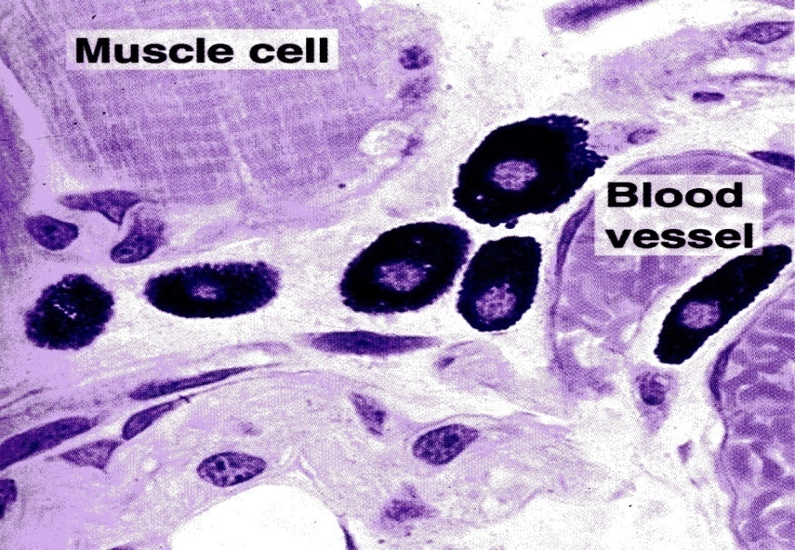
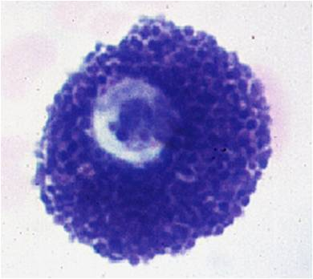
3- MAST CELLS
L/M:
Cytoplasm contains:
Numerous membrane-bound cytoplasmic granules.
Function: secrete Heparin & Histamine.

Slide 10
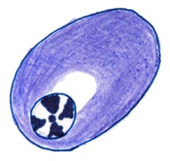
4- PLASMA CELLS
L/M:
Intensely Basophilic cytoplasm-why? Abundant RER
Nucleus: Spherical, eccentric with clock-face appearance of chromatin.
Origin: are derived from B-lymphocytes.
Function: Secretion of antibodies

Slide 11
5- ADIPOCYTES (ADIPOSE CELLS) (FAT CELLS)
L/M of Unilocular adipose cells:
Polyhedral, large with
Large dissolved single fat droplet.
Thin rim of cytoplasm at the periphery.
Nucleus: flattened, peripheral.

Slide 12
(B) FIBERS OF LOOSE C.T.
1- Collagen Fibers (Collagen type I):
non-branched fibers, arranged in bundles.
are acidophilic.
2- Reticular Fibers (collagen type III):
Form network.
are stained black with silver.
3- Elastic Fibers:
Are branched.

Slide 13
Bundles of Collagen Fibers
Reticular Fibers

Slide 14
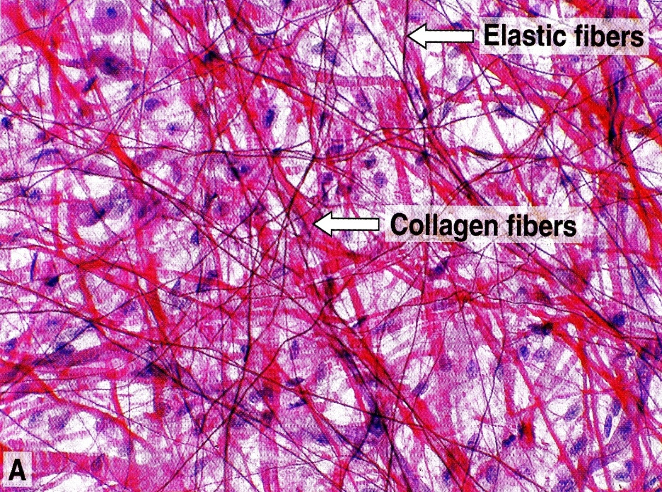
I-LOOSE(AREOLAR) C.T.
L/M:
Contains the all main components of C.T.P.
(no predominant element in loose C.T.)
Sites: Subcutaneous tissue.
N.B. Mechanism of
Development of
Edema.

Slide 15
II-DENSE COLLAGENOUS C.T.
L/M:
Fibroblasts+Predominance of collagen fibers.
Subtypes & Sites of dense collagenous C.T.:
1- Dense irregular: e.g. dermis of the skin, capsule.
2- Dense regular: e.g. Tendons, ligaments.
1
2

Slide 16
III-ELASTIC TISSUE
L/M:
Branching Elastic fibers (or membranes) + Fibroblasts (or smooth muscle cells).
Sites:
e.g. Aorta

Slide 17
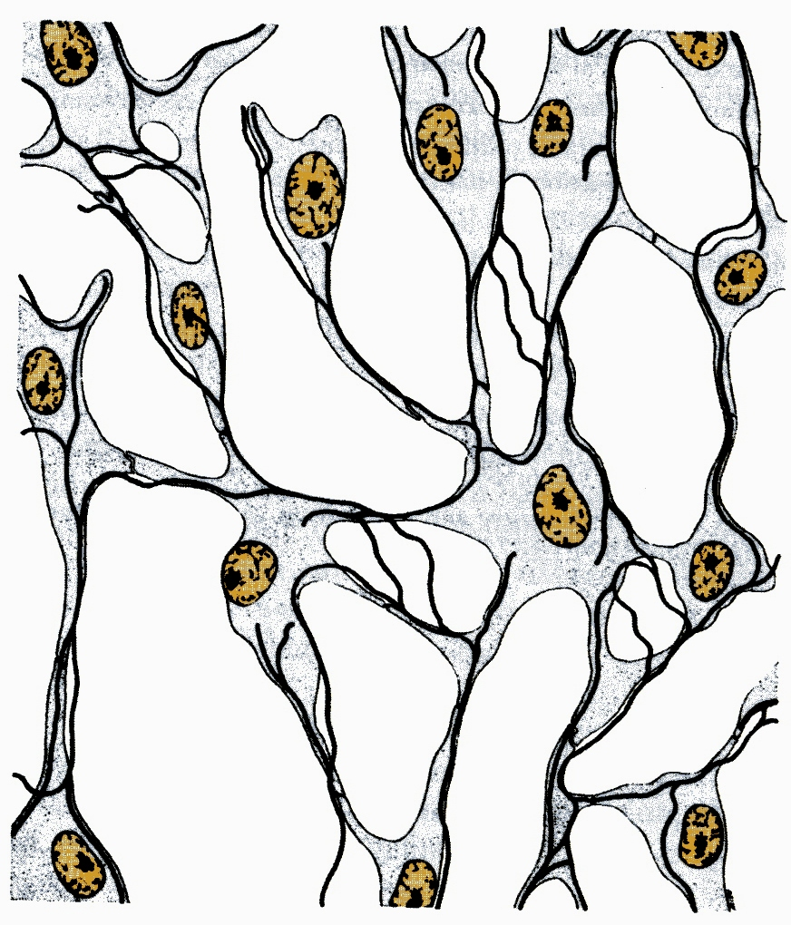
IV-RETICULAR TISSUE
L/M:
Reticular fibers + Reticular cells (specialized fibroblasts)
Sites:
Stroma of organs: e.g. Liver, Lymph Node, spleen.

Slide 18
V-Unilocular adipose tissue ( White adipose tissue )
L/M:
Is formed of lobules of unilocular adipose cells.
Function:
1- Synthesis, Storage & release of fat.
Sites:
Subcutaneous layers especially in buttock & hips.
Abdominal wall.
Female breast.
Around the kidney.

Slide 19
Clinical Applications Allergic Reactions
Hay fever:
Exposure to allergen (Pollens of trees, grasses, weeds or flowers) stimulate mast cells to release Histamine (typical mild and site-specific inflammatory response)
Histamine will increase permeability of the small blood vessels leading to edema, swelling of nasal mucosa that leads to nasal obstruction.

Slide 20
Clinical Applications
Bronchial asthma:
Exposure to allergen will stimulate mast cells in the lungs, which leads to release of Histamine and other chemicals that lead to contraction of the smooth muscle fibers in the wall of the bronchioles (bronchospasm) leading to dyspnea (difficulty in breathing).

Slide 21
Clinical Applications
Anaphylactic Shock:
Secondary exposure to allergen (insect stings, antibiotics---etc) in hyper-allergic persons leads to systemic and severe immediate hypersensitivity reaction (systemic anaphylaxis).
Anaphylactic shock can result in death (within few hours) due to sudden decrease in blood pressure

Slide 22
Clinical Applications Obesity
Types:
1- Hypertrophic obesity:
It results from the accumulation and storage of fat in the unilocular fat cells (white adipocytes). These cells my increase in size as much as four times.
2- Hypercellular obesity:
It results from an increase of number of adipocytes, which may be attributed to increase of the number of adipocyte precursor in infant period

Slide 23
Risks of obesity:
Obesity increase the risk of many health problems such as:
non-insulin dependent diabetes mellitus.
Problems in cardiovascular system.

Slide 24
Thank you

