Slide 1
Medical Genetics
LECTURE 2
CHROMOSOME ANOMALIES
Faiyaz-Ul-Haque, M.Phil, PhD

Slide 2
Lecture Objectives:
By the end of this lecture, the students should be able to:
Describe and explain the events in mitosis & meiosis.
Define non-disjunction and describe its consequences for meiosis and mitosis.
Classify and sub-classify chromosomal abnormalities
Understand the common numerical autosomal disorders: trisomies 21, 13, 18.
Understand the common numerical sex chromosome disorders: Turner`s & Klinefelter`s syndromes
Recognize the main structural anomalies in chromosomes

Slide 3
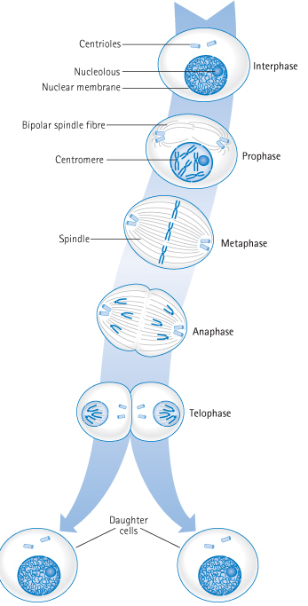
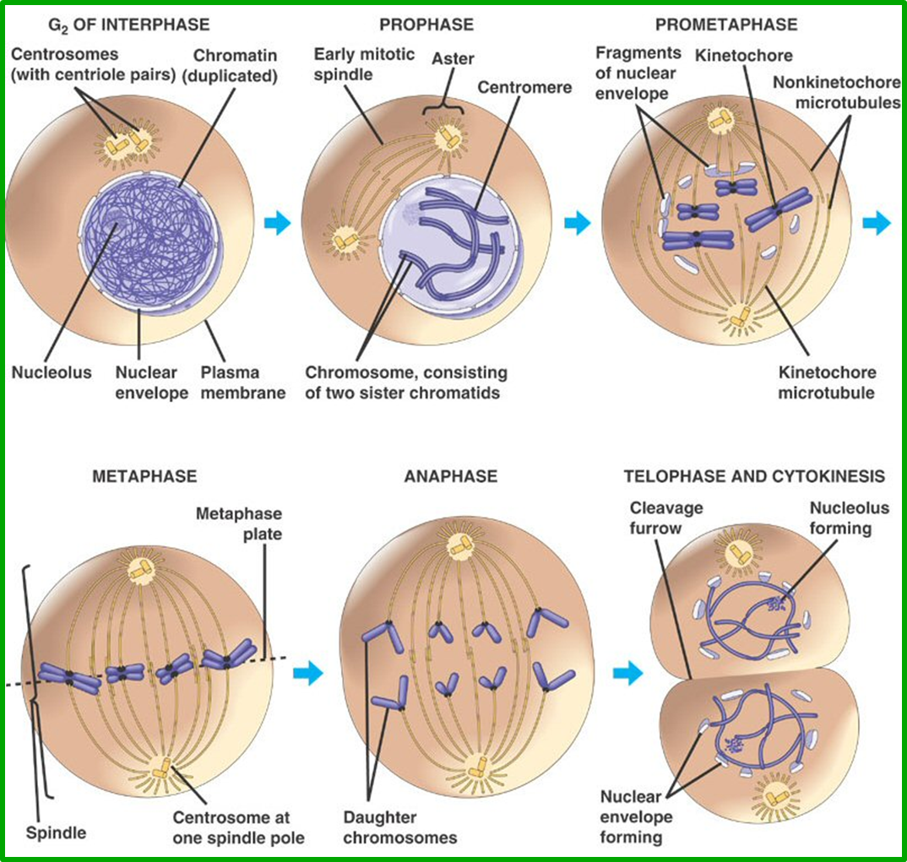
Stages of Mitosis

Slide 4
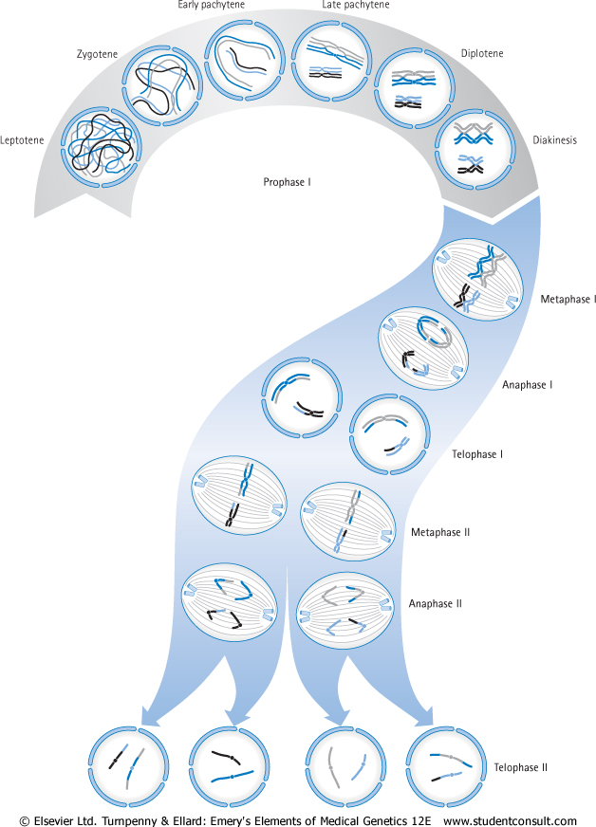
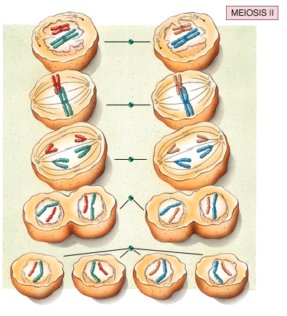
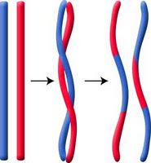
Stages of MEIOSIS

Slide 6
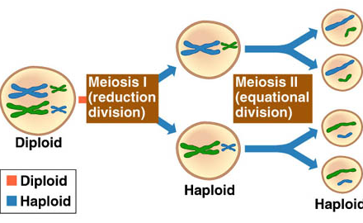
The phases of meiosis I & II

Slide 7
CHROMOSOME ANOMALIES
TYPES:
Numerical
Structural
MECHANISMS
NOMENCLATURE
Etiology

Slide 8
NUMERICAL ANOMALIES

Slide 9
Aneuploidy

Slide 10
Non-disjunction in Meiosis
Nondisjunction ("not coming apart") is the failure of chromosome pairs to separate properly during meiosis stage 1 or stage 2.
As a result, one daughter cell has two chromosomes or two chromatids, and the other has none.
The result of this error is a cell with an imbalance of chromosomes (Aneuploidy)

Slide 11
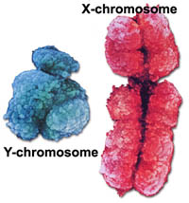
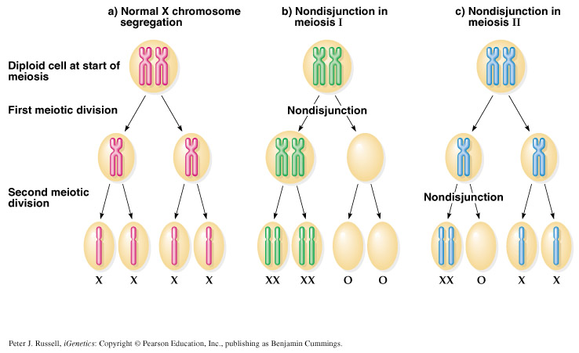

Slide 12
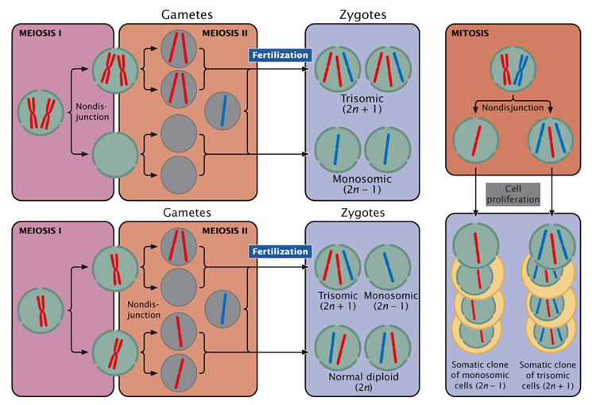

Slide 13
Meiotic non-disjunction
■ can affect each pair of chromosomes
■ is not a rare event
■ non disjunction in first meiotic division produces 4 unbalanced gametes.
■ non disjunction in second division produces 2 normal gametes & 2 unbalanced gametes:
Gamete with an extra autosome
Nullosomic gamete (missing one chromosome)

Slide 14
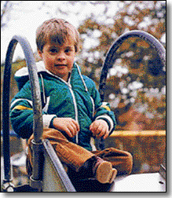
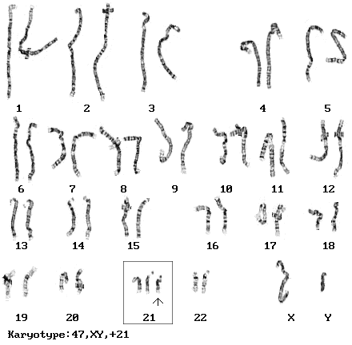
Down syndrome, trisomy 21
The incidence of trisomy 21 rises sharply with increasing maternal age
Most cases arise from non disjunction in the first meiotic division
The father contributing the extra chromosome in 15% of cases (i.e. Down syndrome can also be the result of nondisjunction of the father's chromosome 21)
A small proportion of cases are mosaic and these probably arise from a non disjunction event in an early zygotic division.
The symptoms include characteristic facial dysmorphologies, and an IQ of less than 50.

Slide 15
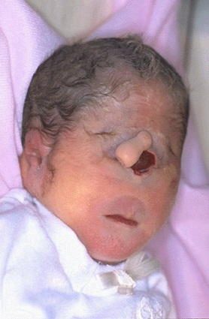
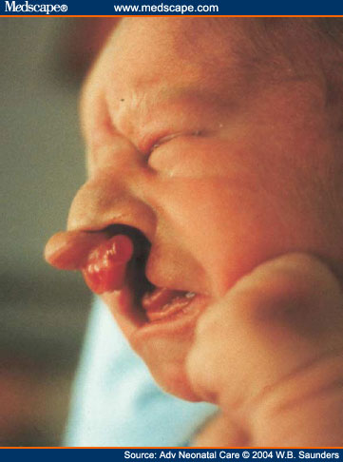
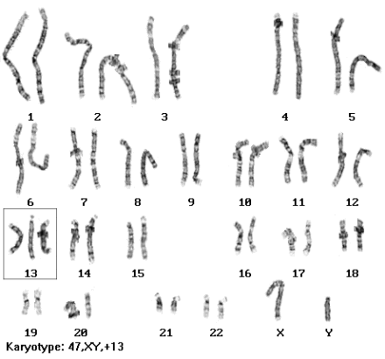
Patau Syndrome, Trisomy 13
Fifty % of these babies die within the first month and very few survive beyond the first year.
There are multiple dysmorphic features.
Most cases, as in Down's syndrome, involve maternal non-disjunction.

Slide 16
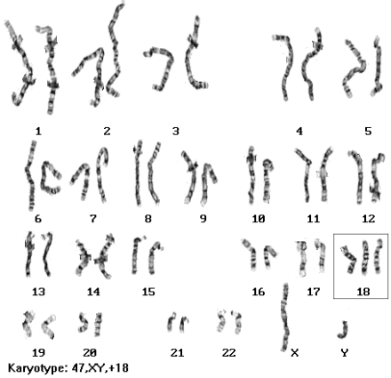
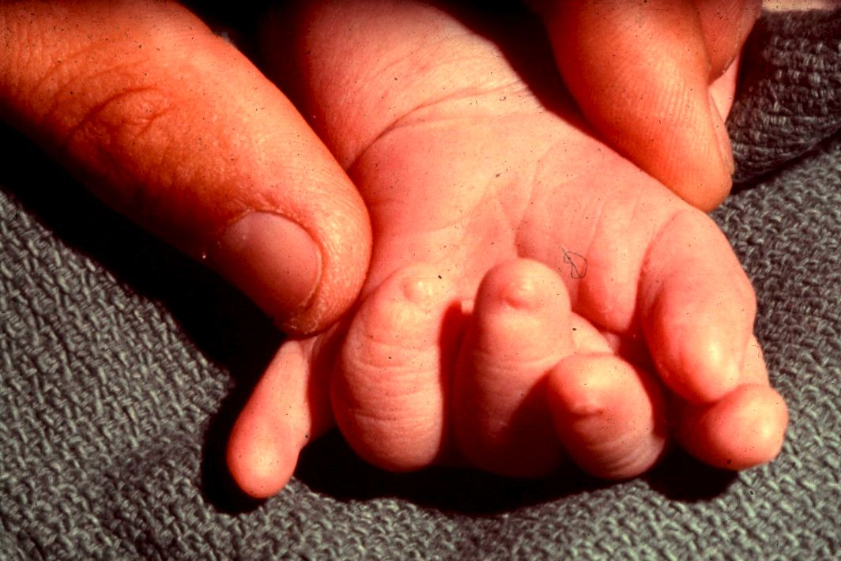
Edward's syndrome, Trisomy 18
Most babies die in the first year and many within the first month.

Slide 17
Numerical anomalies in Sex chromosomes

Slide 18
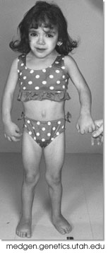
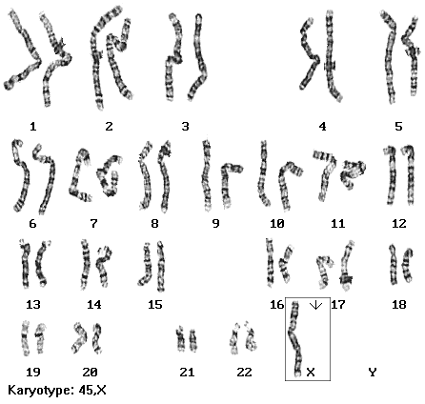
Monosomy X (Turner’s syndrome, 45, XO)
The only viable monosomy in humans
Characteristics:
Webbed neck
Individuals are genetically female
They do not mature sexually during puberty
Sterile
Short stature
Broad chest with widely spaced nipples
Low hairline
Streak ovaries
Normal intelligence
Normal life span

Slide 19
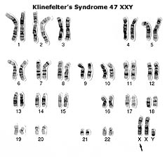
Klinefelter Syndrome: 47,XXY males
Male sex organs; unusually small testes which fail to produce normal levels of testosterone→ breast enlargement (gynaecomastia) and other feminine body characteristic
Patients are taller and thinner than average and may have a slight reduction in IQ but generally they have normal intelligence
No spermatogenesis → sterile
Very rarely more extreme forms of Klinefelter syndrome occur where the patient has 48, XXXY or even 49, XXXXY karyotype. These individuals are generally severely retarded.

Slide 20
Sex chromosome unbalance is much less deleterious
47, XYY
May be without any symptoms. Males are tall but normally proportioned. 10 - 15 points reduction in IQ compared to sibs.
XXX females
It seems to do little harm, individuals are fertile and do not transmit the extra chromosome. They do have a reduction in IQ comparable to that of Kleinfelter's males

Slide 21
Polyploidy

Slide 22
Polyploidy
Triploidies are the most frequent,
- 3N = 69 chromosomes: e.g. 69, XXX, or 69, XXY, or 69, XYY.
- Are found in 20 % of spontaneous miscarriages.
Tetraploidy,
4N = 92 chromosomes.

Slide 23
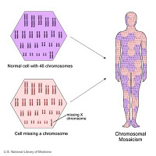
Different Cell Lines e.g. Mosaicism

Slide 24
MOSAICISM
A mosaic individual is made of 2 (or more) cell populations, coming from only 1 zygote
Is denoted by a slash between the various clones observed e.g.46, XY / 47, XY, +21).
Numerical mosaic anomaly is usually due to a mitotic non-disjunction
A mosaic must not be confused with a chimeras.
Chimerism is the presence in an individual of two or more genetically distinct cell lines derive from more than one zygote (e.g. 2 sperms fertilize 2 ova → 2 zygotes that fuse to form 1 embryo

Slide 25
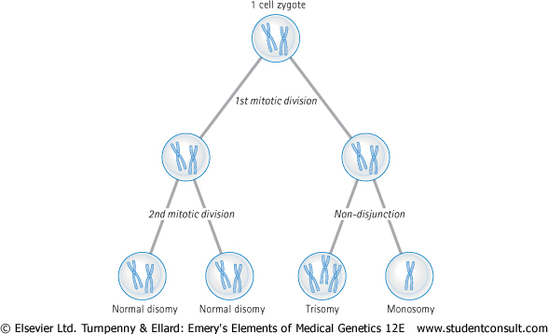
Mitotic non-disjunction as a cause of mosaicism

Slide 26
STRUCTURAL ANOMALIES

Slide 27
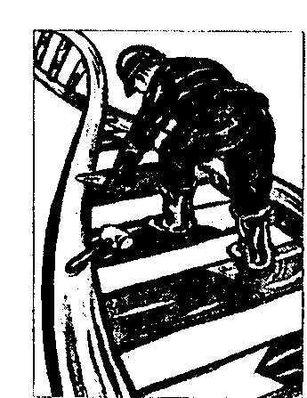
STRUCTURAL CHROMOSOMAL ANOMALIES
The most frequent Structural anomalies are:
Translocations
Inversions
Deletions
Isochromosome ( i )
Ring formation ( Ring chromosome)

Slide 28
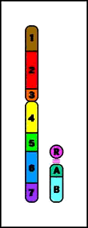
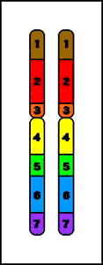
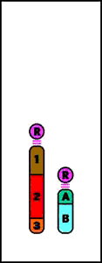
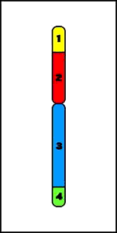
STRUCTURAL CHROMOSOMAL ANOMALIES
Deletion
Duplication
Reciprocal
translocation
Ring
Chromosome
Terminal
Deletion
Insertion
Inversion
Robertsonian
Translocation
Isochromosomes

Slide 29
1 - Reciprocal translocation:
A mutual exchange between terminal segments from the arms of 2 chromosomes.
Provided that there is no loss or alteration at the points of exchange, the new rearrangement is genetically balanced, and called a Balanced rearrangement.
- Recorded as t or rcp (e.g. t(9;22)(q34;q11)).
- The carrier has a normal phenotype.
-They can occur de novo, or be transmitted through several generations.

Slide 30
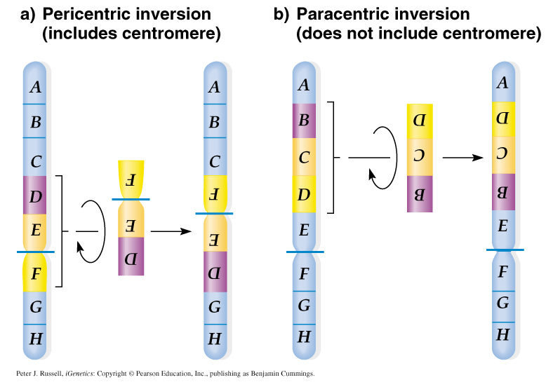
Chromosomal structural mutations - inversion:
Chromosome segment excises and reintegrates in opposite orientation.
Two types of inversions:
Pericentric = include the centromere
Paracentric = do not include the centromere
Generally do not result in lost DNA.

Slide 31
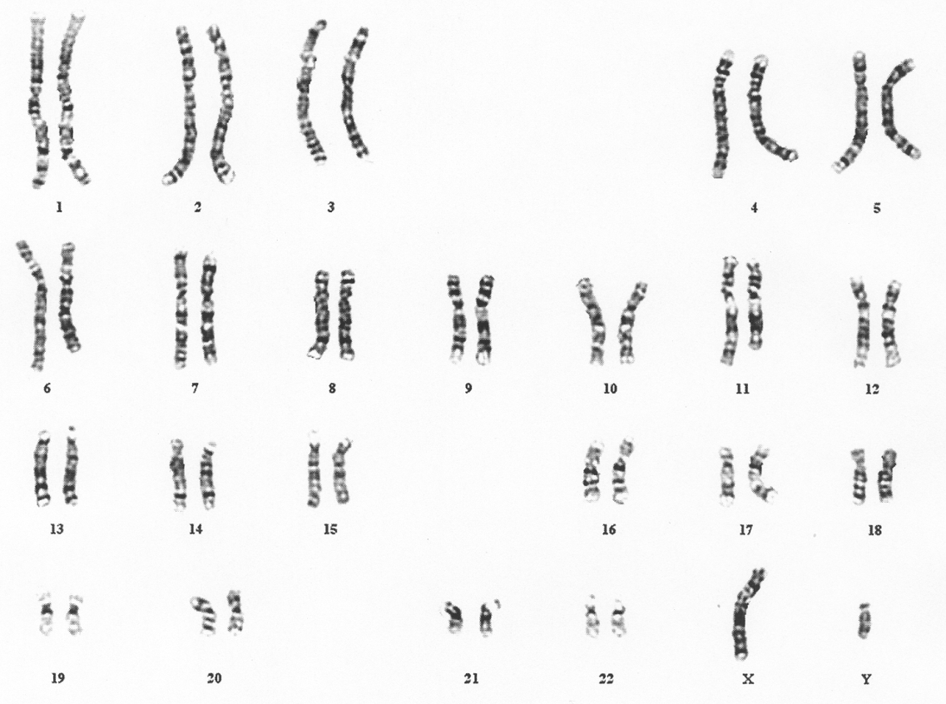
Translocation (11;21)

Slide 32
Deletion
Loss of a segment from a chromosome, either terminal or interstitial
Invariably, but not always, results in the loss of important genetic material
Deletion is therefore an unbalanced rearrangement.
Recorded as del

Slide 33
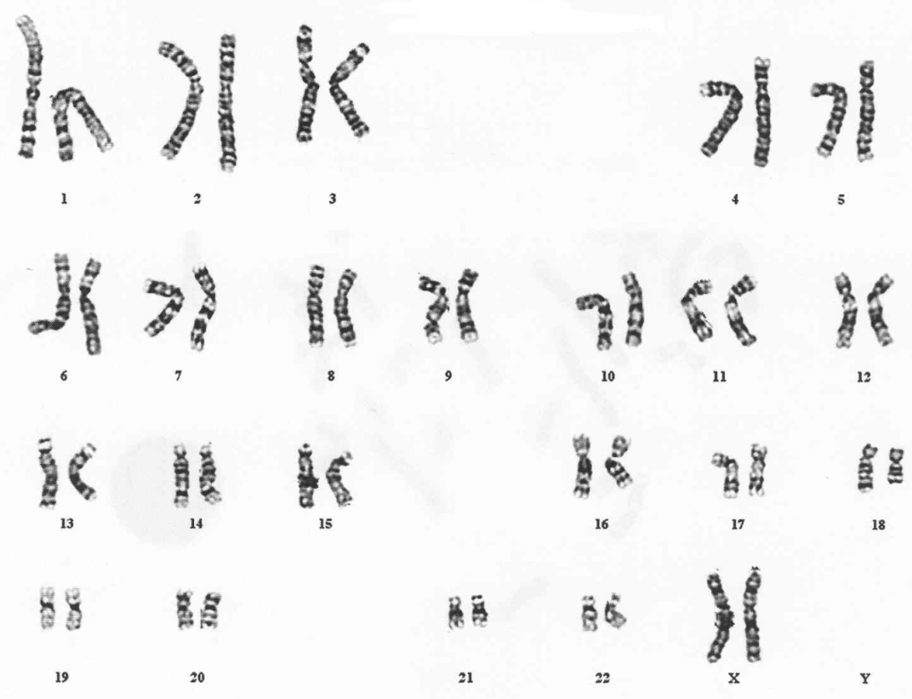
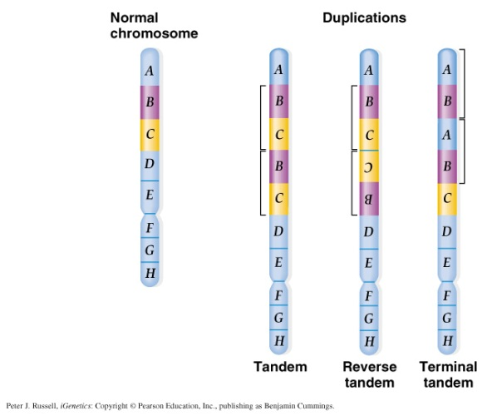
Terminal Deletion
46,XX,del(18)(q21.3).

Slide 34
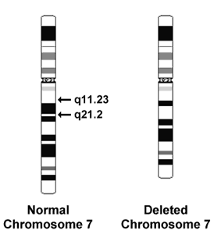
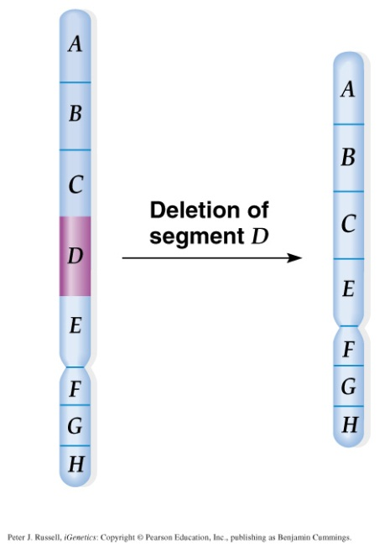
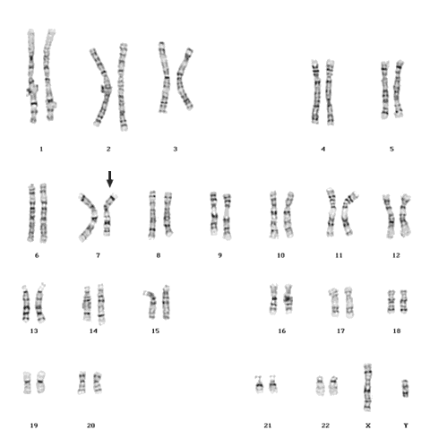
Interstitial deletion (7 Karyotype)
The key to the karyotype description is as follows:
- 46: the total number of chromosomes.
- XY: the sex chromosomes (male).
- del(7): deletion in chromosome 7.
- (q11.23q21.2): breakpoints of the deleted segment.
46,XY,del(7)(q11.23q21.2).

Slide 35
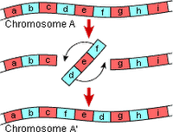
Inversion
Inversion occurs when a segment of chromosome breaks, and rejoining within the chromosome effectively inverts it.
Recorded as inv.
Only large inversions are normally detected.
They are balance rearrangements that rarely cause problems in carriers

Slide 36
Pericentric inversion
An inversion is termed pericentric when the two break-points involved are sited on opposite sides of the centromere
A pericentric inversion can provoke miscarriages, sterility (more often in the male)

Slide 37
Paracentric inversion
An inversion is termed paracentric when the segment involved lies wholly within one chromosome arm.
Are rare (or more likely rarely detected since the majority probably involve very small segments).
The most frequent paracentric inversions chromosomes 3, 7, and 14.

Slide 38
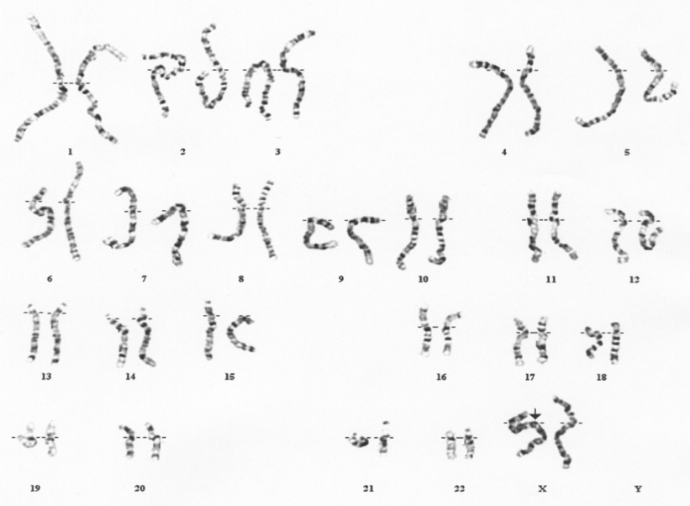
Isochromosome
An isochromosome shows loss of one arm with duplication of the other
The most commonly encountered isochromosome consists of two long arms of the X chromosome. 46,X,i(Xq)

Slide 39
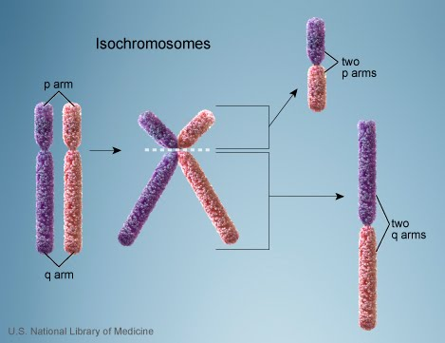
Isochromosome, CONTN.
The most probable explanation for isochromosome is that the centromere has divided transversely rather than longitudinally

Slide 40
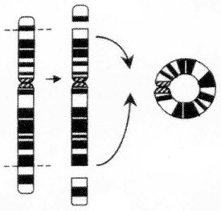
Ring formation (Ring chromosome)
A break on each arm of a chromosome → two sticky ends on the central portion → Reunion of the ends as a ring → loss of the 2 distal chromosomal fragments
Ring chromosomes are often unstable in mitosis

Slide 41
Take home message
During mitosis in somatic cell division, the two sister chromatids of each chromosome separate, with one chromatid passing to each daughter cell.
During meiosis, which occurs during the final stage of gametogenesis, homologous chromosomes pair, exchange segments, and then segregate independently to the mature daughter gametes.

Slide 42
Take home message
Chromosome abnormalities can be numerical or structural.
Numerical abnormalities include aneuploidy and polyploidy.
In trisomy, a single extra chromosome is present, usually as a result of non-disjunction in the 1st or 2nd meiotic division.
In polyploidy, ≥3 complete haploid sets are present instead of the usual diploid complement.
Structural abnormalities include translocations (balanced or unbalanced), inversions, deletions, isochromosome & rings.

Slide 43
THANK YOU ☺

