Slide 1

Medical Genetics
LECTURE 3
MODE OF INHERITANCE
M. Faiyaz-Ul-Haque, PhD, FRCPath

Slide 2
Lecture Objectives
By the end of this lecture, students should be able to:
Asses Mendel’s laws of inheritance
Understand the bases of Mendelian inheritance
Define various patterns of single gene inheritance using family pedigree and Punnett’s squares

Slide 3
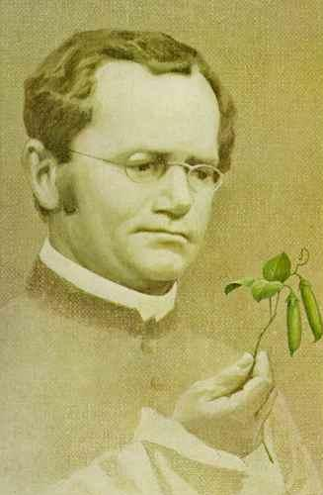
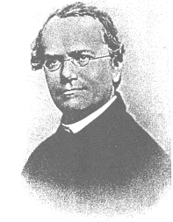
Father of Genetics
Monk and teacher
Discovered some of the basic laws of heredity
Presentation to the Science Society in1866 went unnoticed
He died in 1884 with his work still unnoticed
His work rediscovered in 1900.
Gregor Mendel
Monk and Scientist

Slide 4
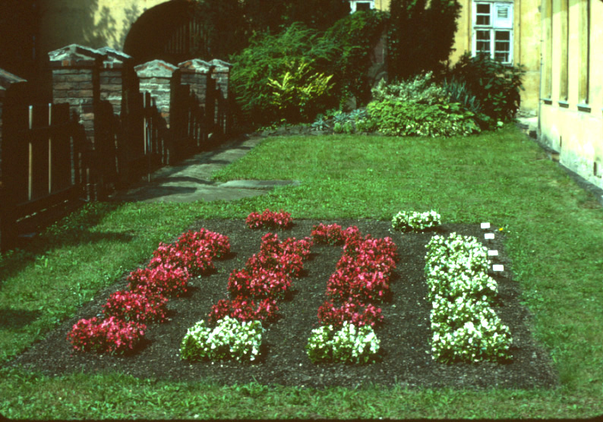
Mendel’s Experimental Garden
10/19/11
4

Slide 5
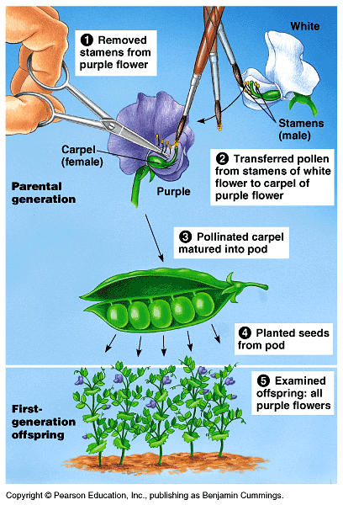
Mendel was fortunate he chose the Garden Pea
Mendel probably chose to work with peas because they are available in many varieties.
The use of peas also gave Mendel strict control over which plants mated.
Fortunately, the pea traits are distinct and were clearly contrasting.

Slide 6
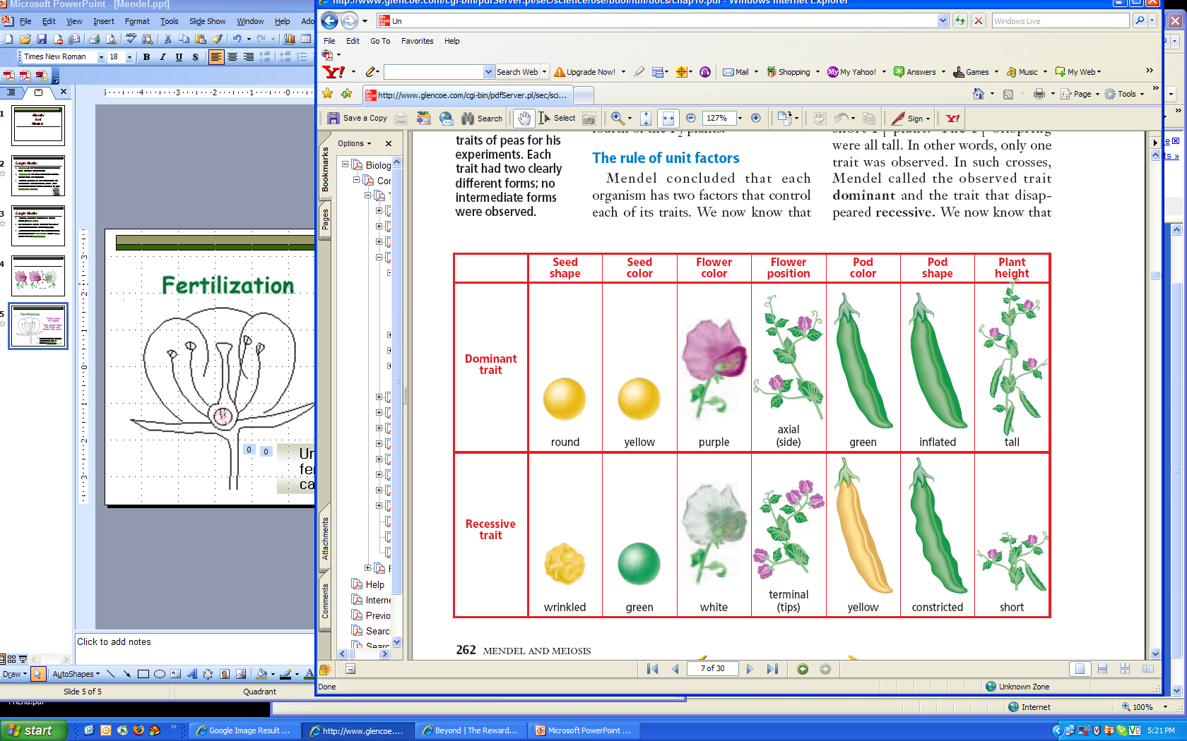
Mendel cross-pollinated pea plants in order to study the various traits:
Dominant: the trait that was observed
Recessive: the trait that disappeared.

Slide 7
Mendel’s breeding experiments: Interpretation of his results
  The plant characteristics being studied were each controlled by a pair of factors, one of which was inherited from each parent.
  The pure-bred plants, with two identical genes, used in the initial cross would now be referred to as homozygous.
  The hybrid F1 plants, each of which has one gene for tallness and one for shortness, would be referred to as heterozygous.
  The genes responsible for these contrasting characteristics are referred to as allelomorphs, or alleles for short.

Slide 8

Genotypes and Phenotypes
T
Homozygous dominant:
Homo (same)
Homozygous recessive:
Heterozyous:
Hetero (different)
T
t
Alleles
T
t
t

Slide 9
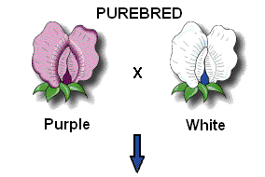
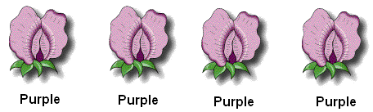
First Experiment
P1 generation
(parental generation)
F1 generation
(filial generation)
Describe the results.
100% Purple
Notes:
Mendel’s First Experiment
He used purebred pea plants becausee they were easy to grow, had many characteristics to study, and they produced a lot of offspring.
P1 generation - parent generation --> pure Tall X pure short
F1 generation - filial genratiooon --> all Tall = 100% tall
It looked like the short trait disappeared! Where did it go? Was it hidden or eliminated?

Slide 10
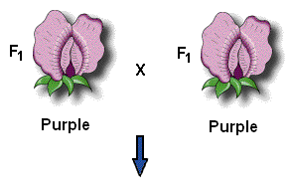
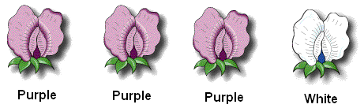
Second Experiment
F1 generation
(filial generation)
F2 generation
(filial generation)
Describe the results.
75% Purple and 25% White

Slide 11
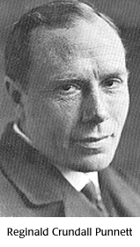
Reginald Punnett
(1875-1967)
In 1902, created the Punnett Square - a chart which helped to determine the probable results of a genetic cross

Slide 12
Punnett Square
Each parent can only contribute one allele per gene
These genes are found on the chromosomes carried in the sex cells.
Offspring will inherit 2 alleles to express that gene
Male gametes
T
t
T
T T
T t
t
T t
t t
Female gametes

Slide 13


Punnett Squares
COMPLETE DOMINANCE - one allele is dominant to another allele
RECALL MENDEL’S 1st EXPERIMENTS
CROSS: Purebred purple female x White male
P1 generation = PP x pp Female gametes
Male gametes
Genotypic ratio = _______________
F1 generation
Phenotypic ratio = ______________
P
P
p
Pp
Pp
p
Pp
Pp
1Pp
1 purple

Slide 14
Punnett Squares
RECALL MENDEL’S 2nd EXPERIMENT
CROSS: Two F1 generation offspring with each other.
F1 generation = Pp x pp Female gametes
Male gametes
Genotypic ratio = ____________________
F2 generation
Phenotypic ratio = ____________________
P
p
P
PP
Pp
p
Pp
pp
1PP:2Pp:1pp
3 purple:1 white

Slide 15
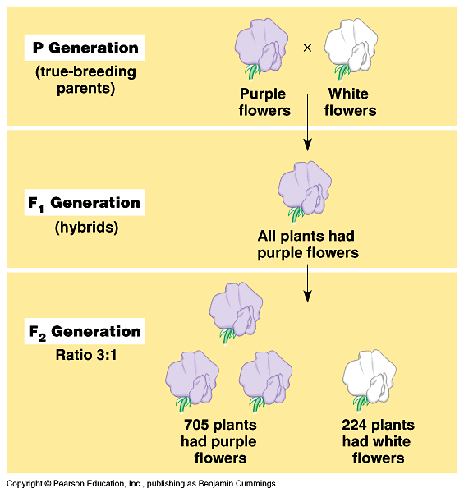
Law of Dominance
In the monohybrid cross (mating of two organisms that differ in only one character), one version disappeared.
What happens when the F1’s are crossed?

Slide 16
The F1 crossed produced the F2 generation and the lost trait appeared with predictable ratios.
This led to the formulation of the current model of inheritance.

Slide 17
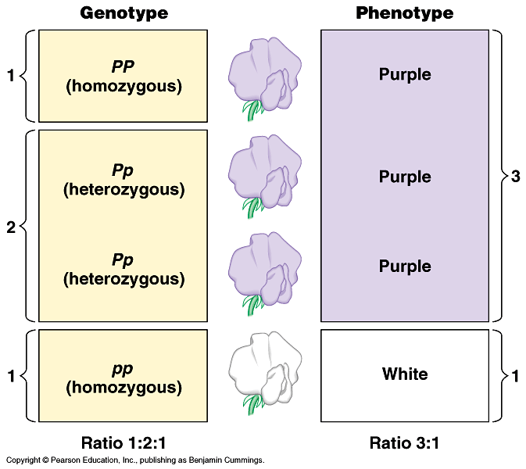
Genotype versus phenotype.
How does a genotype ratio differ from the phenotype ratio?

Slide 18
Mendel’s 3rd Law of Inheritance
Principle of Independent Assortment: the alleles for different genes usually separate and inherited independently of one another. So, in dihybrid crosses you will see more combinations of the two genes.
BT
sperm
BbTt
Bt
haploid (n)
bT
diploid (2n)
bt
meiosis II

Slide 19
STEP 
RG
Rg
rG
rg
RG
RRGG
RRGg
RrGG
RrGg
Rg
RRGg
RRgg
RrGg
Rrgg
rG
RrGG
RrGg
rrGG
rrGg
rg
RrGg
Rrgg
rrGg
rrgg
STEP 
Phenotypic ratio: 9 round, green: 3 round, yellow: 3 wrinkled, green: 1 wrinkled, yellow → (9:3:3:1)
Genotypic ratio: 1 RRGG: 2 RRGg: 2 RrGG: 4 RrGg: 1 RRgg: 2 Rrgg: 2 rrGg: 1 rrGG: 1 rrgg

Slide 20
THE LAW OF UNIFORMITY
It refers to the fact that when two homozygotes with different alleles are crossed, all the offspring in the F1 generation are identical and heterozygous.
“The characteristics do not blend, as had been believed previously, and can reappear in later generations.”

Slide 21
THE LAW OF SEGREGATION
THE LAW OF SEGREGATION
THE LAW OF SEGREGATION
It refers to the observation that each individual possesses two genes for a particular characteristic, only one of which can be transmitted at any one time.
Rare exceptions to this rule can occur when two allelic genes fail to separate because of chromosome non-disjunction at the first meiotic division.

Slide 22
THE LAW OF INDEPENDENT ASSORTMENT
It refers to the fact that members of different gene pairs segregate to offspring independently of one another.
In reality, this is not always true, as genes that are close together on the same chromosome tend to be inherited together, i.e. they are 'linked‘.

Slide 23
MENDELIAN INHERITANCE
(simple pattern of inheritance)
Over 11,000 traits/disorders in humans exhibit single gene unifactorial or Mendelian inheritance.
A trait or disorder that is determined by a gene on an autosome is said to show autosomal inheritance.
A trait or disorder determined by a gene on one of the sex chromosomes is said to show sex-linked inheritance.

Slide 24
MODES OF INHERITANCE OF SINGLE GENE DISORDERS
Autosomal
Sex Linked
Recessive
Dominant
Y Linked
X Linked
Recessive
Dominant

Slide 25
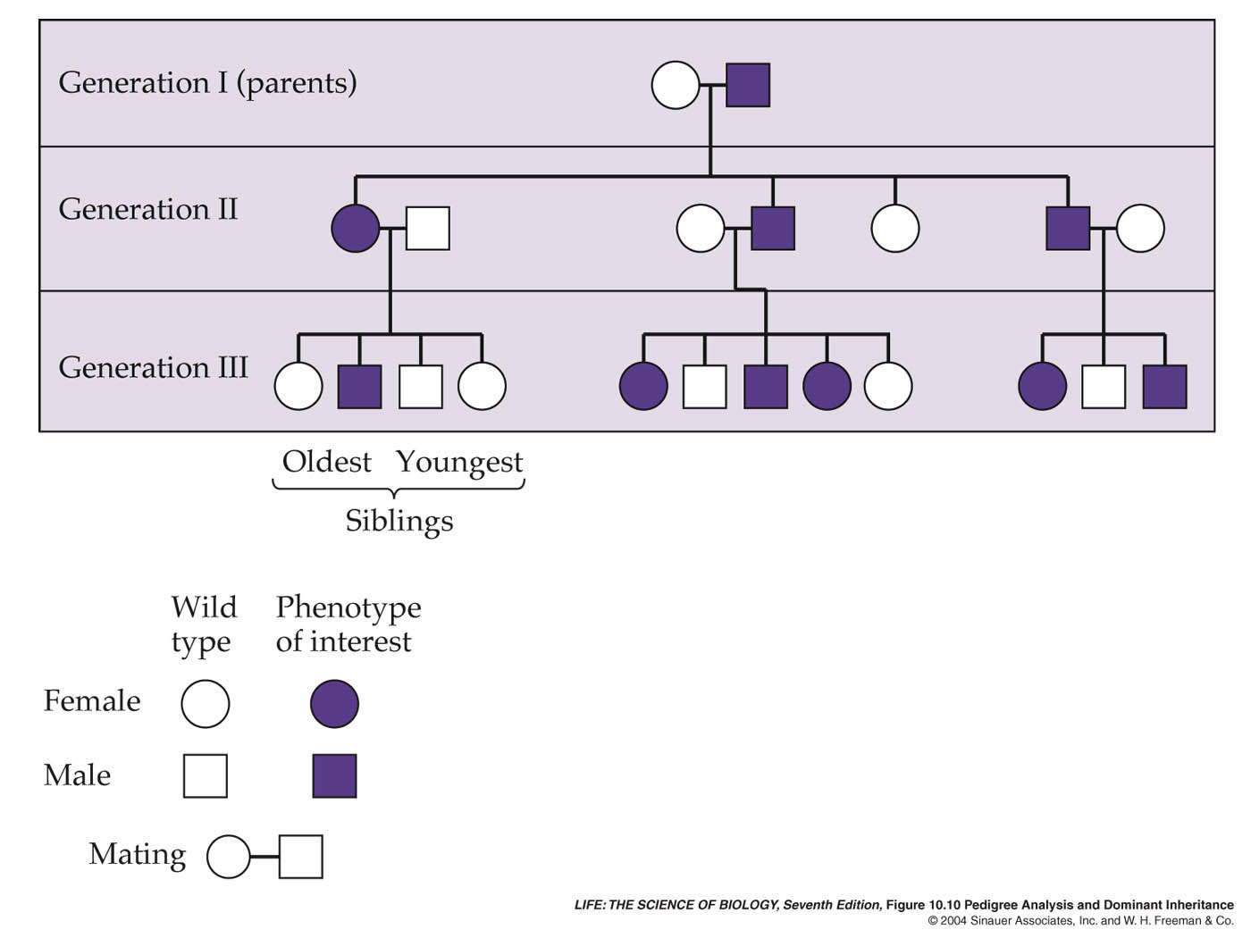
A Pedigree Analysis for Huntington’s Disease
A Pedigree Analysis for Huntington’s Disease

Slide 26
Autosomal Dominant Inheritance
The trait (character, disease) appears in every generation.
Unaffected persons do not transmit the trait to their children.

Slide 27
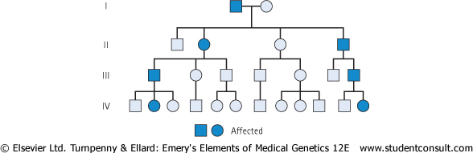
Family tree of an autosomal dominant trait
Note the presence of male-to-male
(i.e. father to son) transmission

Slide 28
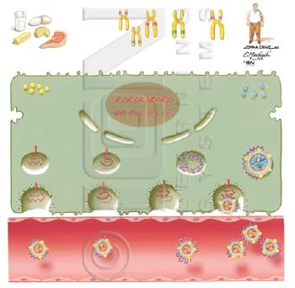
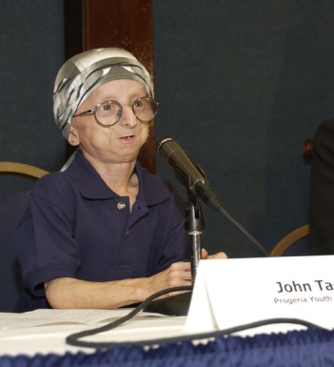
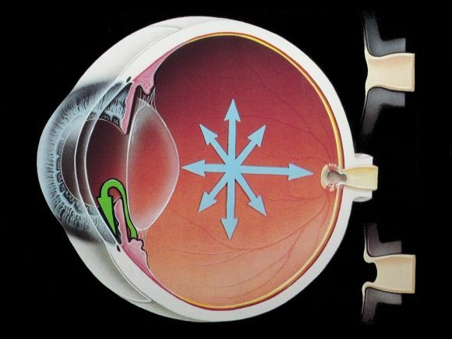
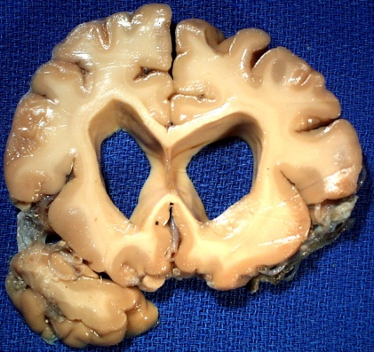
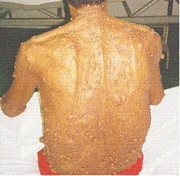
Examples of Autosomal dominant disorders
Familial hypercholesterolemia (LDLR deficiency)
Adult polycystic kidney disease
Huntington disease
Myotonic dystrophy
Neurofibromatosis type 1
Marfan syndrome

Slide 29
Autosomal Recessive Inheritance
The trait (character, disease) is recessive
The trait expresses itself only in homozygous state
Unaffected persons (heterozygotes) may have affected children (if the other parent is heterozygote)
The parents of the affected child maybe related (consanguineous)
Males and female are equally affected

Slide 30
Punnett square showing autosomal recessive inheritance:
(1) Both Parents Heterozygous:
25% offspring affected Homozygous”
50% Trait “Heterozygous normal but carrier”
25% Normal
 | A | a
A | AA | Aa
a | Aa | aa
Mother
Father

Slide 31
(2) One Parent Heterozygous:
Female 50% normal but carrier “Heterozygous”
50% Normal
_________________________________________________________________________
(3) One Parent Homozygous:
Female 100% offsprings carriers.
 | A | a
A | AA | Aa
A | AA | Aa
 | A | A
a | Aa | Aa
a | Aa | Aa

Slide 32
Family tree of an Autosomal recessive disorder
Sickle cell disease (SS)
A family with sickle cell disease -Phenotype
Hb Electrophoresis
AA AS SS

Slide 33
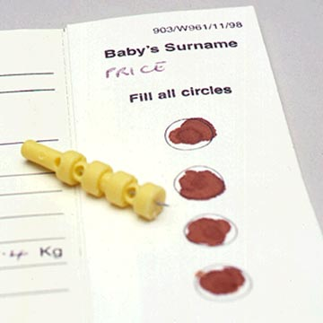
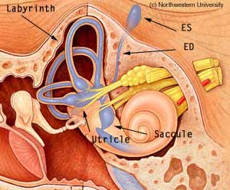
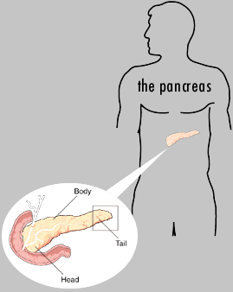
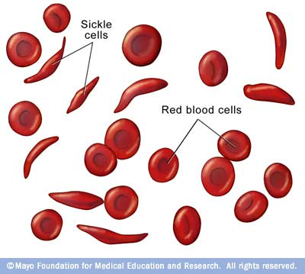
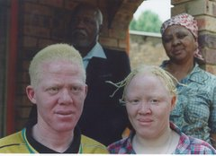
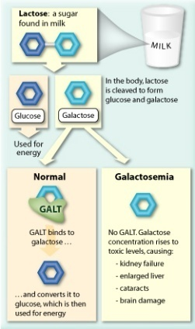
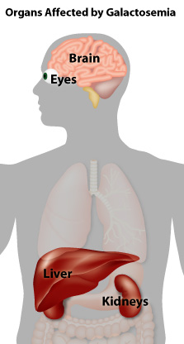
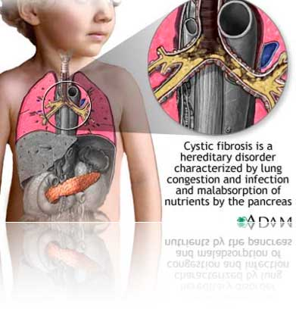
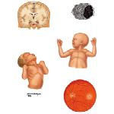
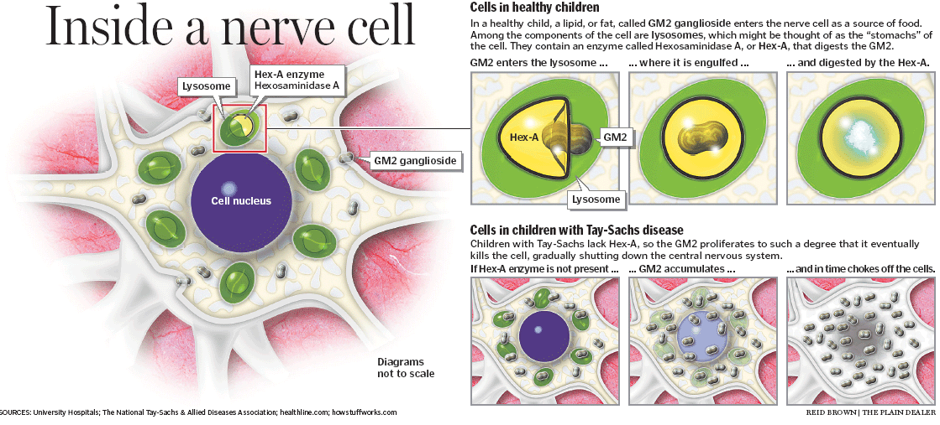
Examples of Autosomal Recessive Disorders
Cystic fibrosis
Phenyketonuria
Sickle cell anaemia
β-Thalassaemia
Recessive blindness
Mucopolysaccharidosis

Slide 34
Sex-Linked Inheritance
X-Linked
Recessive
Sex – linked
inheritance
Dominant
Y- Linked

Slide 35
Sex – Linked Inheritance
This is the inheritance of a gene present on the sex chromosomes.
The Inheritance Pattern is different from the autosomal inheritance.
Inheritance is different in the males and females.

Slide 36
Y – Linked Inheritance
The gene is on the Y chromosomes
The gene is passed from fathers to sons only
Daughters are not affected
Hairy ears in India
Male are Hemizygous, the condition exhibits itself whether dominant or recessive
Father
 | X | Y*
X | XX | XY*
X | XX | XY*
Mother

Slide 37
X – Linked Inheritance
>1400 genes are located on X chromosome (~40% of them are thought to be associated with disease phenotypes)

Slide 38
X-linked inheritance in male & female
 | Genotype | Phenotype
Males | X_{H} | Unaffected
 | X_{h} | Affected
Females | X_{H}/X_{H} | Homozygous unaffected
 | X_{H}/X_{h} | Heterozygous
 | X_{h}/X_{h} | Homozygous affected
X_{H} is the normal allele, X_{h} is the mutant allele

Slide 39
X – Linked Inheritance
The gene is present on the X chromosome
The inheritance follows specific pattern
Males have one X chromosome, and are hemizygous
Females have 2 X chromosomes, they may be homozygous or heterozygous
These disorders may be : recessive or dominant

Slide 40
X – Linked Recessive Inheritance
The incidence of the X-linked disease is higher in male than in female
The trait is passed from an affected man through all his daughters to half their sons
The trait is never transmitted directly from father to sons
An affected women has affected sons and carrier daughters

Slide 41
X – Linked Recessive Inheritance
(1) Normal female, affected male
Mother
 | X | X
X* | X*X | X*X
Y | XY | XY
Father
All sons are normal
All daughters carriers “not affected”

Slide 42
(2) Carrier female, normal male:
Mother
 | X* | X
X | XX* | XX
Y | X * Y | XY
50% sons affected
50% daughters carriers
Father
(3) Homozygous female, normal male:
- All daughters carriers.
- All sons affected.

Slide 43
X - Linked Recessive Disorders
Albinism (Ocular)
Fragile X syndrome
Hemophilia A and B
Lesch–Nyhan syndrome
Mucopoly Saccharidosis 11 (Hunter’s syndrome)
Muscular dystrophy (Duchenne and Beeker’s)
G-6-PD deficiency
Retinitis pigmentosa

Slide 44
X-Linked Dominant Disorders
The gene is on X Chromosome and is dominant
The trait occurs at the same frequency in both males and females
Hemizygous male and heterozygous females express the disease.

Slide 45
Punnett square showing X – linked dominant type of Inheritance
(1) Affected male and normal female:
Mother
 | X | X
X* | X*X | X*X
Y | XY | XY
All daughters affected, all sons normal
Father
(2) Affected female (heterozygous) and normal male:
Mother
 | X* | X
X | XX* | XX
Y | X*Y | XY
Father
50% sons & 50% daughters are affected

Slide 46
(3) Affected female (homozygous) and normal male:
Mother
 | X* | X*
X | X*X | XX*
Y | X*Y | X*Y
Father
All children affected

Slide 47
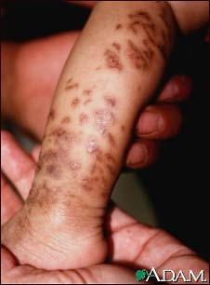
X-linked dominant disorder e.g. Incontinentia pigmenti (IP)
Normal male
Normal female
Disease male
Disease female
Lethal in males during the prenatal period
  Lethal in hemizygous males before birth:
  Exclusive in females
  Affected female produces
  affected daughters
  normal daughters
  normal sons
  in equal proportions (1:1:1)
National Institute of Neurological Disorders and Stroke:
http://www.ninds.nih.gov/disorders/incontinentia_pigmenti/incontinentia_pigmenti.htm

Slide 48
TAKE HOME MESSAGE:
An accurate determination of the family pedigree is an important part of the workup of every patient
Pedigrees for single-gene disorders may demonstrate a straightforward, typical mendelian inheritance pattern
These patterns depend on the chromosomal location of the gene locus, which may be autosomal or sex chromosome-linked, and whether the phenotype is dominant or recessive
Other atypical mode of inheritance will be discussed next lecture.

Slide 49
THANK YOU ☺

