Slide 1
Atypical Patterns of Inheritance
Medical Genetics
LECTURE 4
M. Faiyaz-Ul-Haque, PhD, FRCPath

Slide 2
Lecture Objectives
By the end of this lecture, students should be able to appreciate the possibility of atypical patterns of inheritance with special emphasis on:
Codominant traits
Pseudodominant inheritance
The mitochondrial inheritance
Anticipation
Pleiotropy
Variable expressivity
Heterogeneity
New mutation
Complex trait: multifactorial/Polygenic

Slide 3
Inheritance of Codominant Alleles

Slide 4
Codominance
Codominance: two allelic traits that are both expressed in the heterozygous state.
Example: Blood group AB: the A and B blood groups are codominant.

Slide 5
Possible genotypes, phenotypes & gametes formed from the four alleles: A₁, A₂, B, & O at the ABO locus
Gamete | Phenotype | Genotype
A₁ | A₁ | A₁A₁
A₂ | A₂ | A₂A₂
B | B | BB
O | O | OO
A₁ or A₂ | A₁ | A₁A₂
A₁ or B | A₁B | A₁B
A₁ or O | A₁ | A₁O
A₂ or B | A₂B | A₂B
A₂ or O | A₂ | A₂O
B or O | B | BO

Slide 6
PSEUDODOMINANT INHERITANCE

Slide 7
Pedigree: Pseudodominant inheritance
A woman homozygous for an autosomal recessive disorder whose husband is heterozygous for the same disorder.
Their children have a 1 in 2 (50%) chance of being affected i.e. homozygous ) i.e. pseudodominant

Slide 8
Atypical inheritance of single-gene disorders

Slide 9
What are the situations in which the inheritance of single-gene disorders diverges from typical mendelian patterns?
Maternal inheritance of mitochondrial mutations
Anticipation
Atypical presentation for Autosomal Dominant defects:
Pleotropy
Variable expressivity
Heterogeneity
New mutation
Unusual inheritance patterns due to Genomic Imprinting
Mosaicism:
Somatic mosaicism
Germline mosaicism
√
√
√

Slide 10
MITOCHONDRIAL INHERITANCE

Slide 11
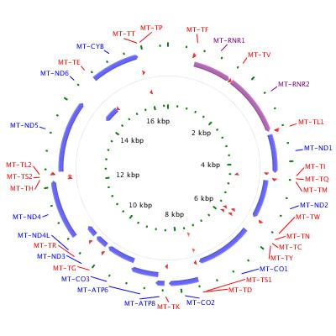
Mitochondrial DNA (mtDNA)
Each cell contains thousands of copies of mitochondrial DNA with more being found in cells having high energy requirement (e.g. brain & muscle)
Mitochondria (& their DNA) are inherited from the mother (through ova)
mtDNA is a small circular double-stranded molecule containing 37 genes (coding for rRNA, tRNA, and some of the proteins of the mitochondrial electron transport chain)
http://ghr.nlm.nih.gov/chromosome=MT

Slide 12
Mitochondrial Disorders
The defective gene is present on the mitochondrial chromosomes
Effect generally energy metabolism
Effect more those tissues which require constant supply of energy e.g muscles
Show maternal inheritance:
Affected mother transmits the disorder equally to all her children
Affected father does not transmit the disease to his children

Slide 13
Mitochondrial Inheritance
Males cannot transmit the disease as the cytoplasm
is inherited only from the mother, and mitochondria
are present in the cytoplasm.

Slide 14
Homoplasmy vs. Heteroplasmy
Homoplasmy = in most persons, the mtDNA from different mitochondria is identical.
Heteroplasmy = the presence of two populations of mtDNA in a cell; the normal mtDNA & the mutant mtDNA.
The proportion of mutant mtDNA varies between cells & tissues → a range of phenotypic severity in mitochondrial inheritance.

Slide 15
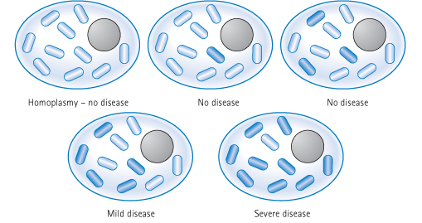
The progressive effect of Heteroplasmy on the clinical severity of mitochondrial genetic disorders
Low proportions of mutant mitochondria are not associated with disease
As the proportion increases, the disease will be manifested

Slide 16
Example of Mitochondrial Disorders
Lebers hereditary optic neuropathy
(LHON)
Rapid Optic nerve death → blindness in young adult life
http://ghr.nlm.nih.gov/condition=leberhereditaryopticneuropathy

Slide 17
ANTICIPATION

Slide 18
Anticipation
A pattern of inheritance in which individuals in the most recent generations of a pedigree develop a disease at an earlier age or with greater severity than do those in earlier generation.
The reason might be the gradual expansion of trinucleotide repeat polymorphisms within or near a coding gene
Examples of diseases showing anticipation:
Huntington disease
Myotonic dystrophy

Slide 19
Myotonic Dystrophy
Autosomal dominant disease
Relatively common
The affected gene is on chromosome 19
The mutation is triplet repeat (CTG) expansion in the 3’ untranslated region of the myotonic dystrophy gene
Clinical manifestations:
Myotonia (Muscular loss & weakness)
Cataracts
Testicular atrophy
Heart disease: arrhythmia
Dementia
Baldness

Slide 20
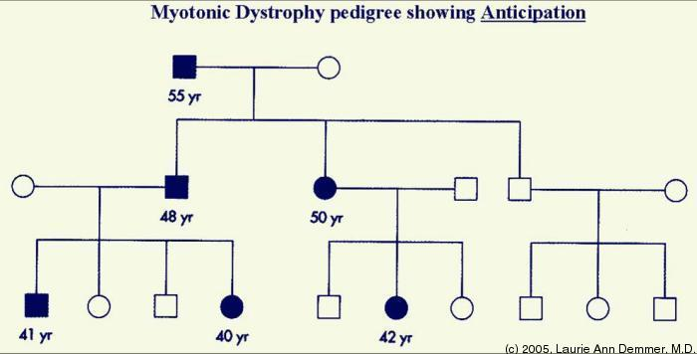
Myotonic Dystrophy, CONTD.

Slide 21
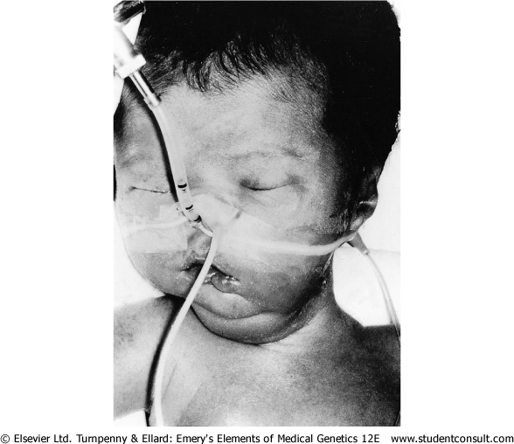
Myotonic Dystrophy, CONTD.
Newborn baby with severe hypotonia requiring ventilation as a result of having inherited myotonic dystrophy from his mother

Slide 22
Atypical presentation for Autosomal Dominant defects

Slide 23
Pleiotropy, reduced penetrance and variable expressivity of a mutant allele need to be taken into account when providing genetic counseling to individuals at risk for autosomal dominantly inherited disorders.

Slide 24
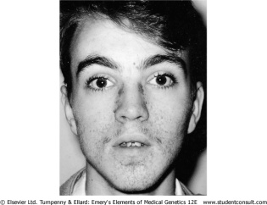
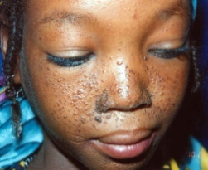
Pleiotropy
It is common for autosomal dominant disorders to manifest in different systems of the body in a variety of ways.
Pleiotropy:- a single gene that may give rise to two or more apparently unrelated effects.
Example: In tuberous sclerosis: affected individuals can present with either
learning difficulties,
epilepsy,
a facial rash,
or, all features

Slide 25
Variable expressivity
The clinical features in autosomal dominant disorders can show striking variation from person to person, even in the same family.
Example: In autosomal dominant polycystic kidney disease:
some affected individuals develop renal failure in early adulthood
others have just a few renal cysts that do not significantly affect renal function

Slide 26
Reduced penetrance
In some individuals heterozygous for gene mutations giving rise to certain autosomal dominant disorders there may be no abnormal clinical features, representing so-called reduced penetrance or 'skipping a generation‘
Reduced penetrance might be due to:
modifying effects of other genes
interaction of the gene with environmental factors

Slide 27
New mutations
In autosomal dominant disorders an affected person will usually have an affected parent.
However, this is not always the case and it is not unusual for a trait to appear in an individual when there is no family history of the disorder.
The sudden unexpected appearance of a condition arising as a result of a mistake occurring in the transmission of a gene is called a new mutation.

Slide 28
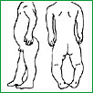
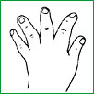
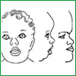
Achondroplasia
A form of short-limbed dwarfism, in which the parents usually have normal stature
Diagnosis/testing:
Characteristic clinical and radiographic finding
Molecular genetic tests: mutation in the FGFR3 gene on chromosome 4p16.3 (coding for fibroblast growth factor receptor 3)
The offspring of persons with achondroplasia had a 50% chance of having achondroplasia
What other possible explanations for the 'sudden' appearance of this disorder?
non-penetrance: One of the parents might be heterozygous for the mutant allele but so mildly affected that it has not previously been detected
Variable expressivity
the family relationships not being as stated, e.g. non-paternity

Slide 29
MULTIFACTORIAL/ POLYGENIC DISORDERS

Slide 30
Complex Traits
Complex traits are conditions which are likely to be due to the interaction of more than one gene.
The effects may be additive, one may be rate-limiting over the action of another, or one may enhance or multiply the effect of another.
e.g. Digenic inheritance: where a disorder has been shown to be due to the additive effects of heterozygous mutations at two different gene loci
In man one form of retinitis pigmentosa, a disorder of progressive visual impairment, is caused by double heterozygosity for mutations in two unlinked genes, which both encode proteins present in photoreceptors. Individuals with only one of these mutations are not affected.

Slide 31
Multifactorial/Polygenic Disorders
Human characteristics such as height, skin color and intelligence could be determined by the interaction of many genes, each exerting a small additive effect.
This model of quantitative inheritance can explain the pattern of inheritance for many relatively common conditions including
congenital malformations such as cleft lip and palate
late-onset conditions such as
Hypertension
diabetes mellitus
Alzheimer disease
The prevailing view is that genes at several loci interact to generate a susceptibility to the effects of adverse environmental trigger factors.

Slide 32
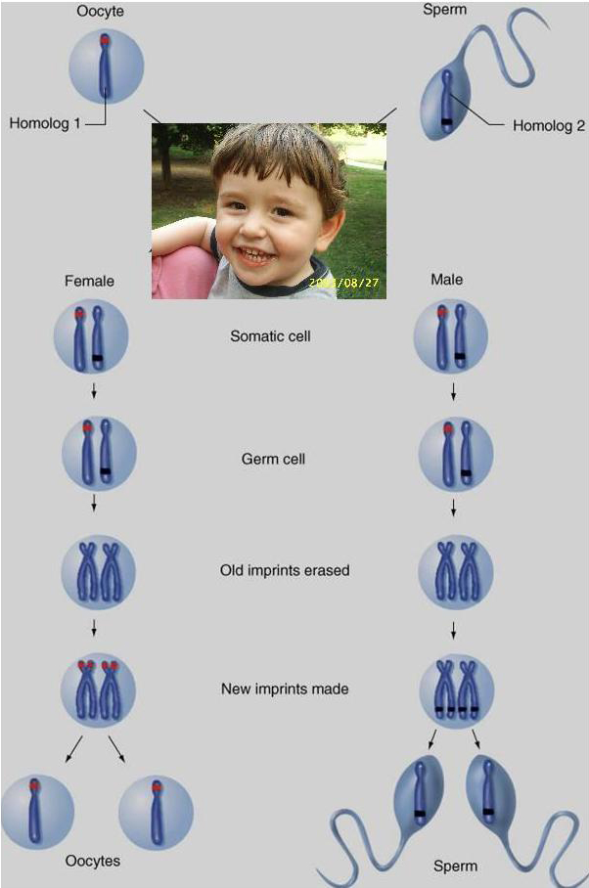
Genomic Imprinting
Certain chromosomes retain a memory or “imprint” of parental origin that influences whether genes are expressed or not during gametogenesis

Slide 33
Take home Message:
An accurate determination of the family pedigree is an important part of the workup of every patient
Exceptions to mendelian inheritance do occur in single-gene disorders.
The inheritance pattern of an individual pedigree may be obscured by a number of other factors that may make the mode of inheritance difficult to interpret
Some characteristics and many common familial disorders, do not usually follow a simple pattern of Mendelian inheritance.

Slide 34
Thank you ☺

