Slide 1
Para & Autocrine Mediators (Autocoids)
Prof. Alhaider
Definition: Auto = self Coids = Remedy or some times called Local Hormones

Slide 2
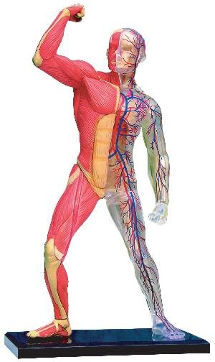
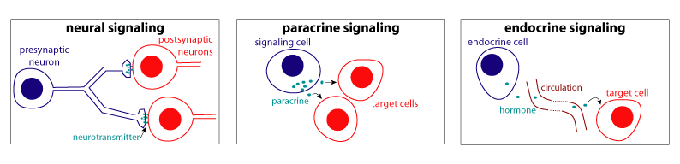
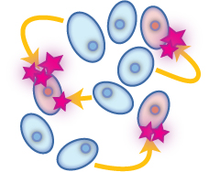
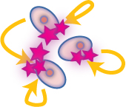
Cell-toCell COMMUNICATION
Distance
Via general routes  Blood
Local
Via  ECF, Gap junctions, ECM...
Along specified path Nerves

Slide 3
LOCAL COMMUNICATION
PARACRINE MEDIATORS
Secreted by one cell & acts upon adjacent cells or surrounding extracellular matrix [ECM]
AUTOCRINE MEDIATORS
Secreted from a cell and acts on the same cell

Slide 4
Paracrine Autocrine Mediators
Chemically they are classified into


EICOSANOIDS
Prostaglandins
Prostacyclines
Thromboxane A₂
Leukotrienes …etc
OTHERS
Cytokines
Chemokine
Growth Factors
….etc.
NO
PEPTIDES
Contractants Angiotensin Endothelin
NPY
Vasopressin
Relaxants Kinines
ANP
Tachykinins [SP]
VIP ….etc

PURINES
ATP / ADP
Adenosine

MONOAMINES
Histamine
Serotonin …etc


Slide 5
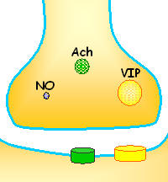
Paracrine Autocrine Mediators
General Features
Act mostly on:
smooth muscles (SMC) [vascular (VSMC) or non vascular (NVSMC)]
nerve endings [> nonadrenergic non-cholinergic (NANC) co-transmission]
+ heart + exocrine glands + CNS …etc
Exist either:
  Preformed & stored in tissues & released by a stimulus
  [Monamines (histamine), most peptides ]
Formed de novo in response to a stimulus
[NO, Eicosanoids, some peptides, cytokines] ]
Their presence is either:
  Constitutive: present all times, to share in normal basic functional regulation within the cells (eNOS / COXI )
  Inducible: only present upon demand i.e. gets expressed [gene transcription, mRNA formation and ribosomal translation into protein]
  (iNOS / COXII)

Slide 6
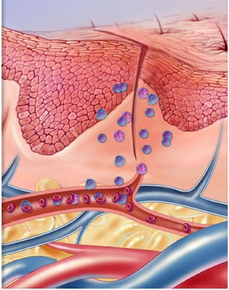
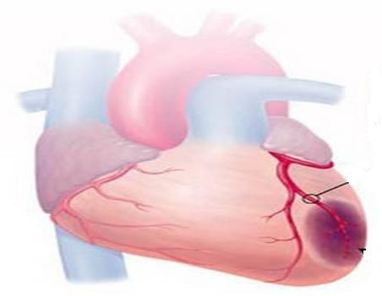
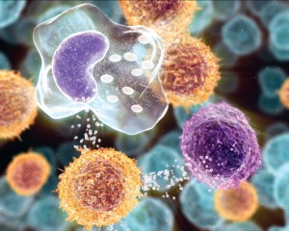
DRUGS Acting On
Paracrine Autocrine Mediators
Nitric Oxide
Angiotensin & Bradykinin
Eicosanoids
Histamines
I
II

Slide 7
DRUGS Acting OnParacrine Autocrine Mediators
Part I
ILOs
By the end of this lecture you will be able to:
Recognize the role of NO in cellular communication.
Classify the different NOS available
Expand on its formation, actions termination and pharmacological
modulation.
Identify role of angiotensin in body homeostasis and local regulation.
Explain its formation, target receptors, feedback regulatory actions,
breakdown, intersection with the kinin system and pharmacological
modulation.

Slide 8
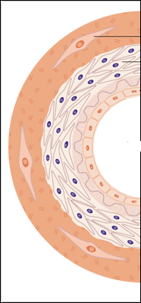
Nitric Oxide

Slide 9
Nitric Oxide
Is a highly diffusible stable gas
L-arginine + O₂ NO + Citrulline + H₂O
Synthesis
NADPH, FAD, CaCAM
Nitric oxide synthase (NOS)
NOS Isoforms
Type I [n-NOS] Neuronal NOS | Type III [E-NOS] Endothelial NOS | Type II [I-NOS] Inducible NOS
Cytosol of Neuronal cells | Bound to membrane of endothelial cell [EC], platelets …etc. | Cytosol of macrophage, neutrophil, kupffer cells … etc
Constitutive | Constitutive | Inducible
Neuronal messenger Cytoprotective | Relaxation of VSMC Cytoprotective | Immunocytotoxicity
Shear Stress or Agonists as; Ach, histamine, bradykinin, …..when bind to receptors  intracellular Ca activate eNOS NO formation

Slide 10
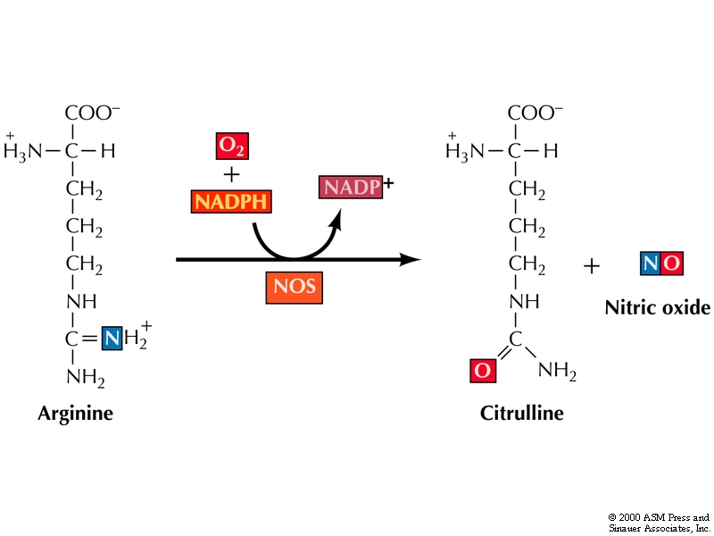
Synthesis of Nitric Oxide
Nitric oxide synthase

Slide 11
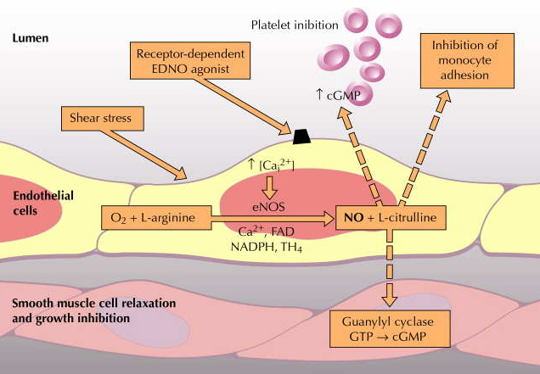
Nitric Oxide
PARACRINE
PARACRINE
AUTOCRINE
PARACRINE
Role of NO in blood vessels
Relaxation of VSMC (Vasodilatation)
Cytoprotection on ECs platelet aggregation,  inflammatory cell recruitment,  Cholesterol deposition…etc.

Slide 12
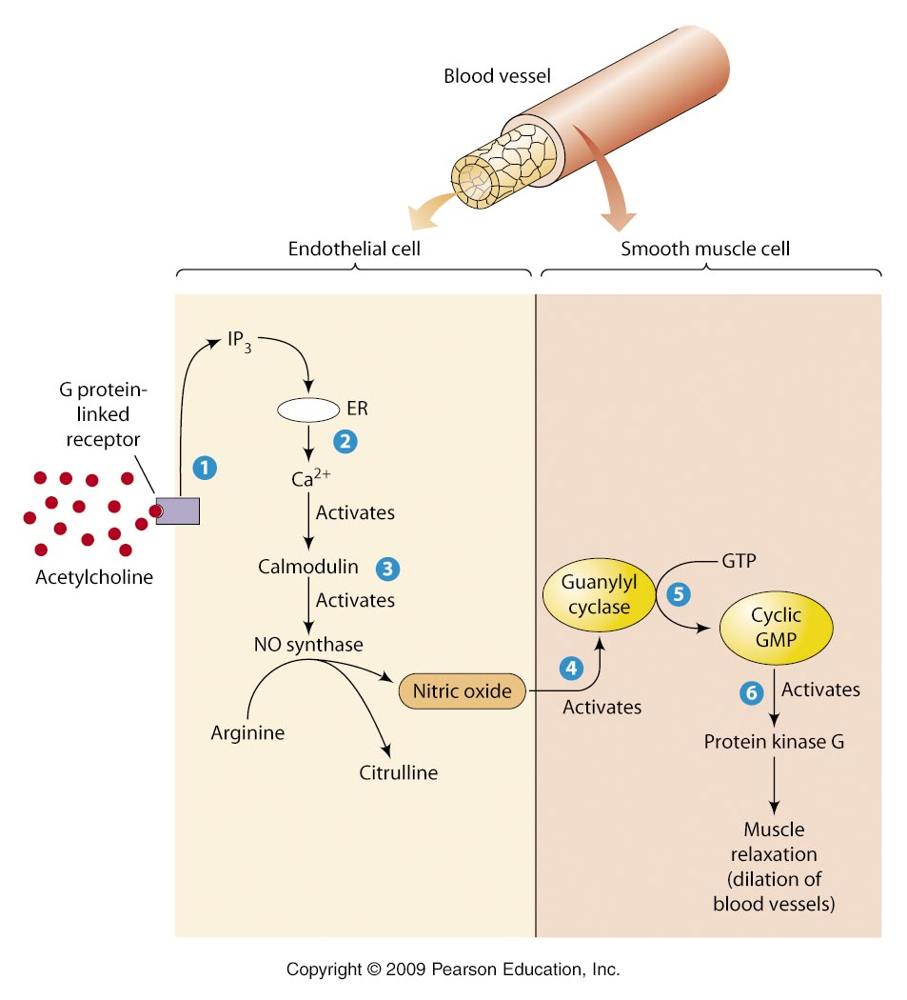
Nitric Oxide
Action
Diffuse to VSMC
Binds soluble GC
Change GTP to cGMP
Endothelial Cell [EC]
Vascular Smooth Muscle [ VSMC]
Diffusion
O₂
Activate PKG &
Ca
Inactivate MLCK
So suppress activation of MLC & actin binding
No contraction
RELAXATION
PKG
H₂O
Phosphorylate
Ca
MLCK
P
Active form
MLCK
Inactive form
P
MLC
MLC
Contraction
Actin
Relaxation

Slide 13
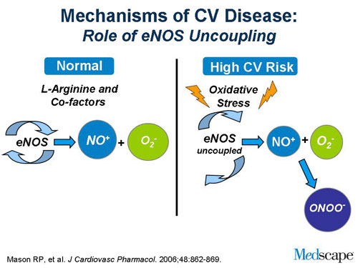
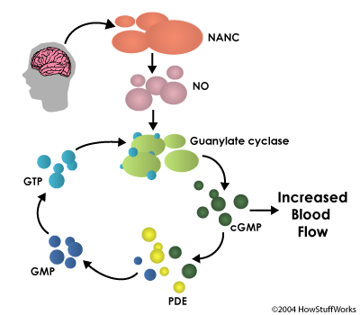
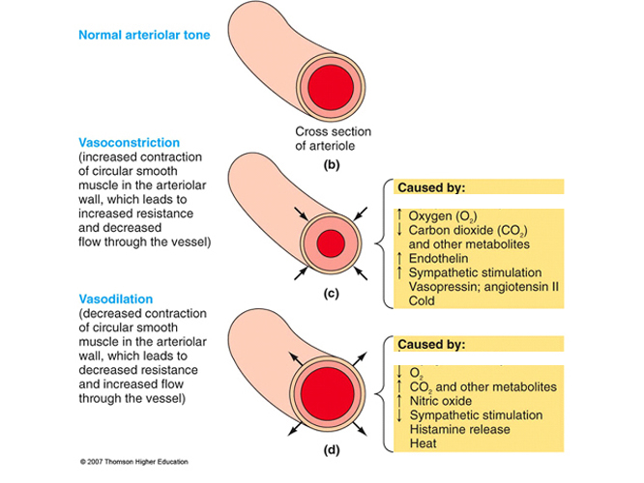
Nitric Oxide
Termination of action
  By formation of
  1. Stable analogues  with
  proteins containing SH ….
  2. Free radical Peroxynitrite  in oxidative stress
  By break down of its downstream signal cGMP by PDE to form GMP
BV

Slide 14
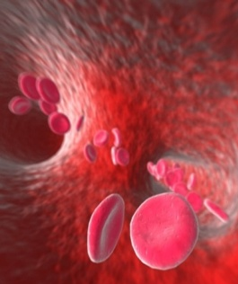
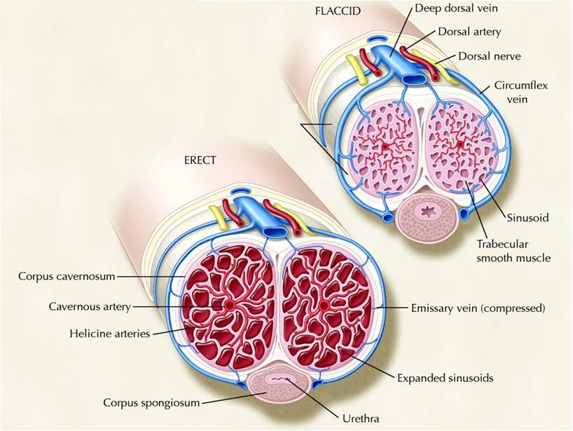
Nitric Oxide
Drugs modulating
  1.Express or Activate eNOS:
  Statins, Estrogen CVS Cytoprotection
  2. Act as NO donners:
  a. Nitrates  >Venulodilators in angina (الذبحة الصدرية)
  b. Na Nitroprusside  Arteriolar dilator in hypertension
  3. Prevent breakdown of PDE (Increase NO):
  Selective PDE₅ Inhibitors; Sildenafil  Erectile dysfunction

Slide 15
Angiotensin

Slide 16
Vasoactive Peptides
A. Vasoconstrictors (angiotensin II ;
vasopressin ; endothelins and neuropeptide Y
B. Vasodilators (Bradykinin and related
Kinins : natriuretic pepties ; vasoactive intestinal peptide ; substance P ; neurotensin)

Slide 17
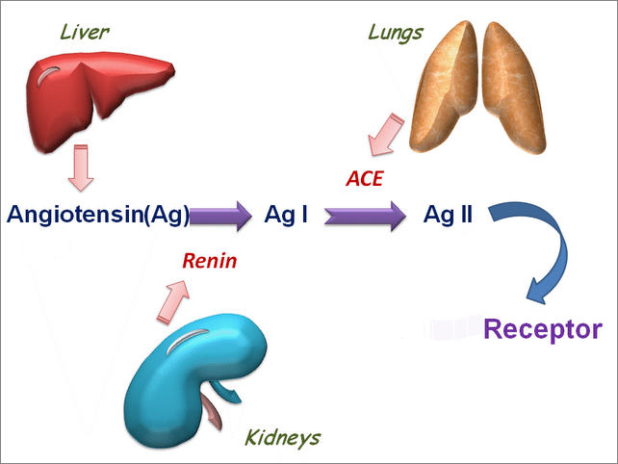
Angiotensin
A the most vasoconstrictor peptide
Synthesis
Precursor is Angiotensinogen;( a plasma α-globulin synthesized in the liver).
Endothelium, brain &
Other Proteolytic Enzymes
Chymase
Endoperoxidase
AT₂
AT₁
IIIIII
IIIIII
IIIIII
Secreted by renal juxtaglomerular apparatus
 Renal SN activation
Renal Blood flow by
β₂ agonists & PGI₂
Blood Pressure

Slide 18
Renin-Angiotensin System
angiotensinogen
renin
angiotensin I (Decapeptide)
Converting enzyme
angiotensin II (octapeptide)
efferent constriction;
PT reabsorption
vasoconstriction
aldosterone; CD Na reabsorption

Slide 19
Summary of Angiotensin II
  You should remember its synthesis?
  Actions:
1. the most potent vasoactive agent in the body (direct and vai NE)
2. Stim release of aldosterone and renin as well.
3. Centrally, stim. Drinking and increase the secretion of vasopressin and ACTH.

Slide 20
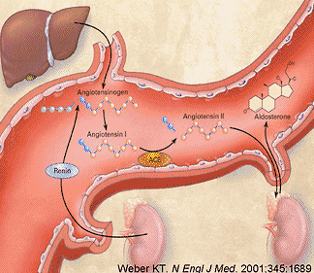
ENDOCRINE
RAAS
PARACRINE
ALDOSTERONE
PARACRINE
Suprarenal Gland

Slide 21
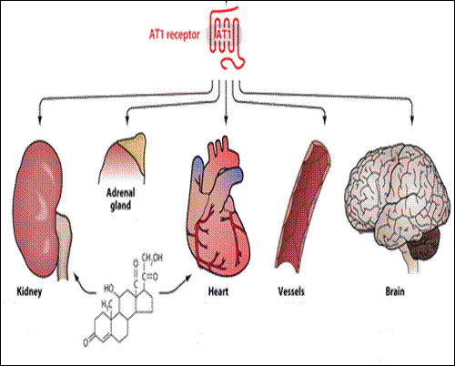
Angiotensin
Ag II
Ag II
Ag II
Ag II
Action
Thirst
SNS activation
Ag II
ALDOSTERONE
ADH
Fibrosis
Hypertrophy
Fibrosis
Remodeling
=Hypertrophy
Na retention
Inotropy
Chronotropy
Vasoconstriction
Blood Pressure

Slide 22
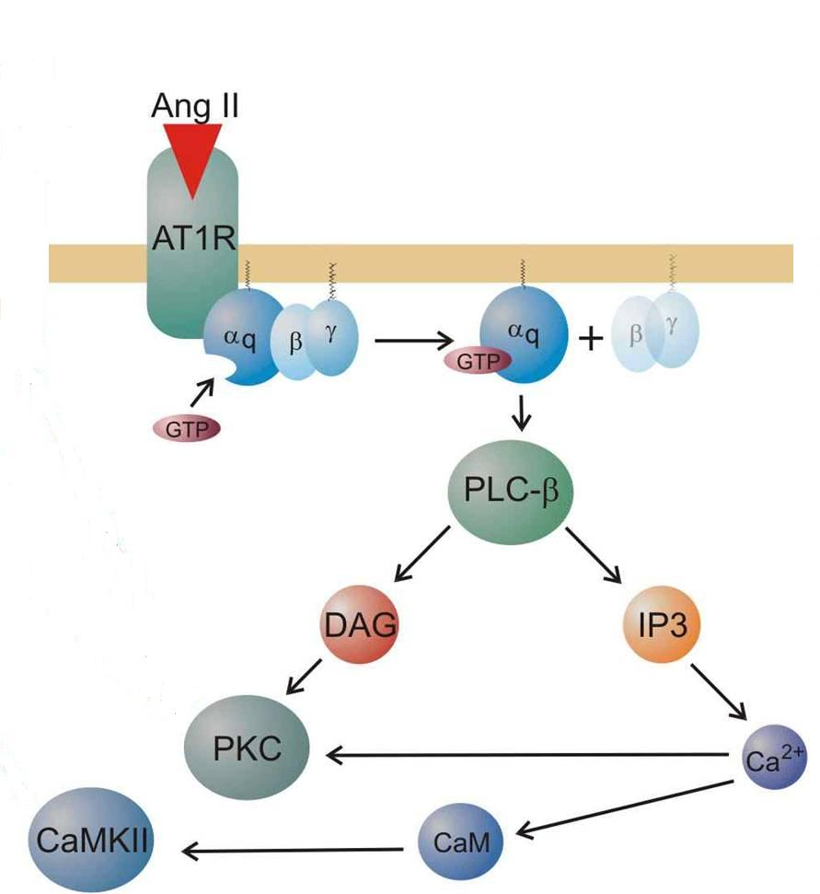
Angiotensin
Ag II
Termination of action
AgII acted upon by peptidases
aminopeptidases (angiotensinase)
to Ag III
[a less active] & then to fragmentation products

Slide 23
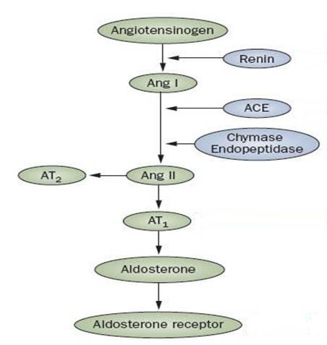
Angiotensin
Clonidine
Propranolol
SN
BF [β₁ ]
Drugs modulating
INHIBITION OF RAAS SYSTEM?
is beneficial in treatment of:
Hypertension
Heart Failure
Diabetics (Protect the kidney)
RENIN Inhibitors
Aliskiren
ACE Inhibitors
Captopril
VASOPEPTIDASE Is
Omapatrilat
ARBs
Candisartan
Lozartan
ADOSTERONE RAs
Eplerenone & Aldactone

Slide 24
Kinins : (e.g. : Bradykinin & kallidin)
Polypeptides present in plasma and several tissues including the kidneys , pancreas , intestine, sweat and salivary glands.
ACTIONS :
CVS : The most vasodilator known in the body ( direct and via increase EDRF ) . Also , increases the body capillary permeability

Slide 25
Bronchioles : Contraction of bronchial smooth muscles.
Inflammation : Kinins can produce all the symptoms of inflammation (pain and edema when injected to tissue).
Pain : Intradermal injection of kinins elicited potent pain (Stimulate nociceptive nerve afferent fibers)
DOES BRADYKININ PLAY ANY ROLE IN THE
MECHANISM OF ACTION OF ACEIs?

Slide 26
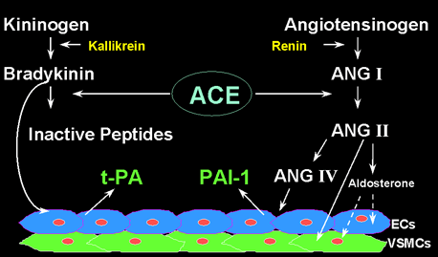
Difference between ACE Is & ARBs
ACE Inhibitors
Captopril



AT₂

AT₁
ARBs
Candisartine

Slide 27
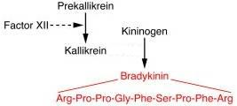
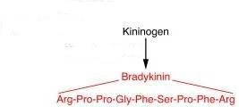
Kinins
Bradykinin is a vasodilator peptides
Synthesis
Kininogen
From liver
Plasma Kallikrin
TissueKallikrin
Aminopeptidase
Bradykinin
Kallidin
Action
Vasodilatation
Inflammation & Exudation (Capillary permeability & edema))
Pain (sensory nerves)
Exocrine gland secretion
ACE & Neutral Endopeptidase (NEP)
Termination of action
Inactive metabolites

Slide 28
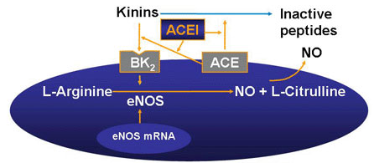
Kinins
◉ Action bradykinin mediated pain → NSAIDs
Drugs modulating .
Breakdowntheir concentration  ACE Inhibitors
VASOPEPTIDASE Is
Antihypertensive drugs

Slide 29
DRUGS Acting OnParacrine Autocrine Mediators
GOOD LUCK

