Slide 1
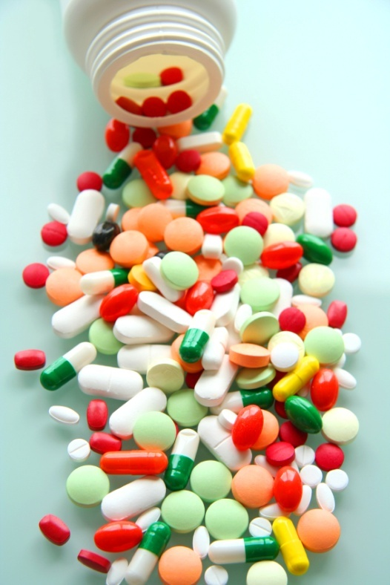
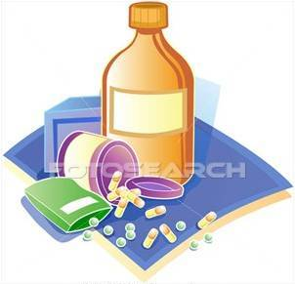
PHARMACOLOGY
PHARMACOLOGY

Slide 2
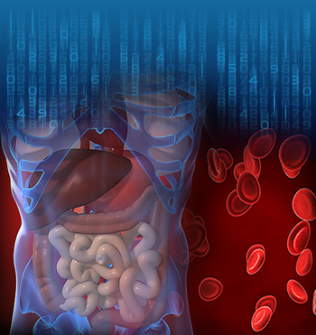
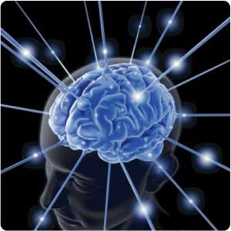
PHARMACOLOGY
Drug ?
Chemical
Chemical

Slide 3
PHARMACOKINETICS
Absorb
Distribute
Metabolize
Excrete
Exceptions
Osmotic Diuretics
Purgatives
Antacids
Interacts with biological molecules
TARGETS
altering their biochemical &/or biophysical activity
Depress
Activate
Replace
Irritate
Destroy
RESPONSE
PHARMACODYNAMICS

Slide 4
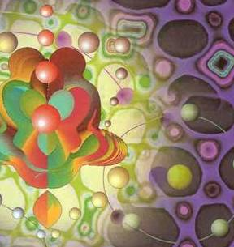
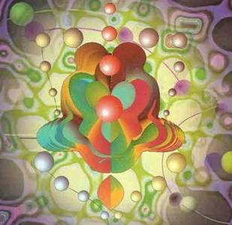
ilos
By the end of this lecture you will be able to :
Identify different targets of drug action
Differentiate between their patterns of action; agonism versus antagonism
Elaborate on drug binding to receptors
MOLECULAR MECHANISMS OF DRUG ACTION
By
Prof. Omnia Nayel
Assoc. Prof. Osama Yousif

Slide 5
TARGETS
> Proteins
STRUCTURAL
REGULATORY
Tubulin is target for:
Vincristine
Colchicine
ENZYME
CARRIER MOLECULE
ION CHANNEL
RECEPTOR
Tubulin
Structure

Slide 6
TARGETS
Proteins
REGULATORY
ENZYME
The drug competes with the natural substrate
for the enzyme
REVERSIBLE
Neostigmine reversibly compete with ACH for cholinestrase at MEP
IRREVERSIBLE
Organophosphates irreversibly competes with ACH for cholinestrase
Neostigmine
Organophosphorsphates

Slide 7
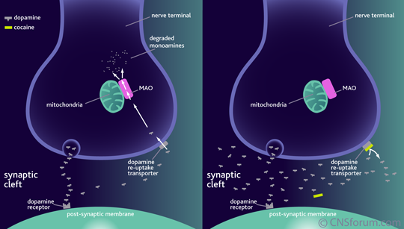
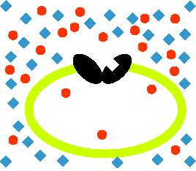
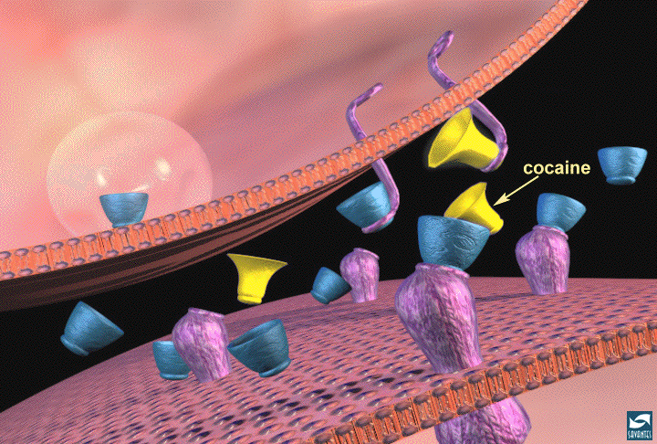
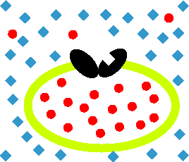
TARGETS
Proteins
REGULATORY
Responsible for transport of ions and small organic molecules between intracellular compartments, through cell membranes or in extracellular fluids.
CARRIER MOLECULE
The drug binds to such molecules altering their transport ability
Cocaine blocks transport of catecholamines at synaptic cleft
Antiporter
Symporter

Slide 8
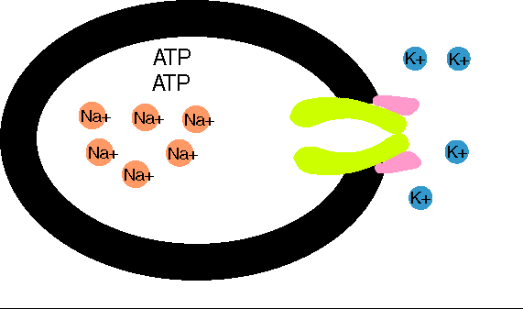
TARGETS
> Proteins
REGULATORY
CARRIER MOLECULE
Digitalis blocks efflux of Na by Na pump
Digitalis
Notes:
8

Slide 9
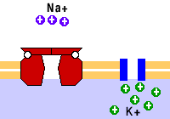
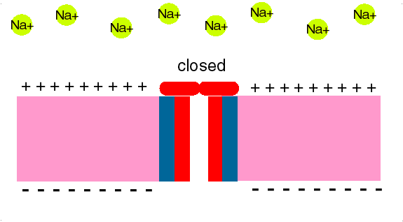
TARGETS
> Proteins
REGULATORY
ION CHANNEL
Responsible for influx or out-flux of ions through cell membranes along their concentration gradients.
They are activated by alteration in action potential and are controlled by gating machinery.
Drugs bind to alter channel function by block or modulation
Local Anesthetics block Na influx through Na channel
in nerve fibers. They are Na channel Blockers.
L.Anaesthesia

Slide 10
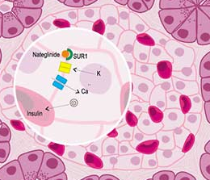
TARGETS
> Proteins
REGULATORY
ION CHANNEL
Sulfonylurea drugs block K⁺ out flux via the K channels in pancreatic cells . They are K Channel Modulator

Slide 11
TARGETS
> Proteins
REGULATORY
Responsible for selectively sensing and binding of a stimulus (ligand) and its coupling to a response via a set of signal transduction machinery
RECEPTOR
Drugs bind and alter R signal transduction machinery.
Bind
Occupy
Initiate
Activate
Physiological
RESPONSE
L
L
R
LR*
AFFINITY
EFFICACY
ENDOGENOUS
LIGAND
Agonist
R
Pharmacological
RESPONSE
A
A drug that possesses both affinity and efficacy
A
R
AR*
ACh
DRUGS
Antagonist
A drug that possesses an affinity but no efficacy
B
B
R
NO RESPONSE
Tubocurarine

Slide 12
The tendency of a drug to bind to the receptors is governed by its affinity.
AFFINITY
The ability for it, once bound, to activate the receptor is denoted by its efficacy.
EFFICACY
Agonist
A drug that possesses both affinity and efficacy
Is that inherent property intrinsic to the agonist that determines how "good" an agonist is.
high intrinsic efficacy
↓
a full agonist
low intrinsic efficacy ↓
a partial agonist.
Antagonist
A drug that possesses an affinity but no efficacy
Notes:
12

Slide 13
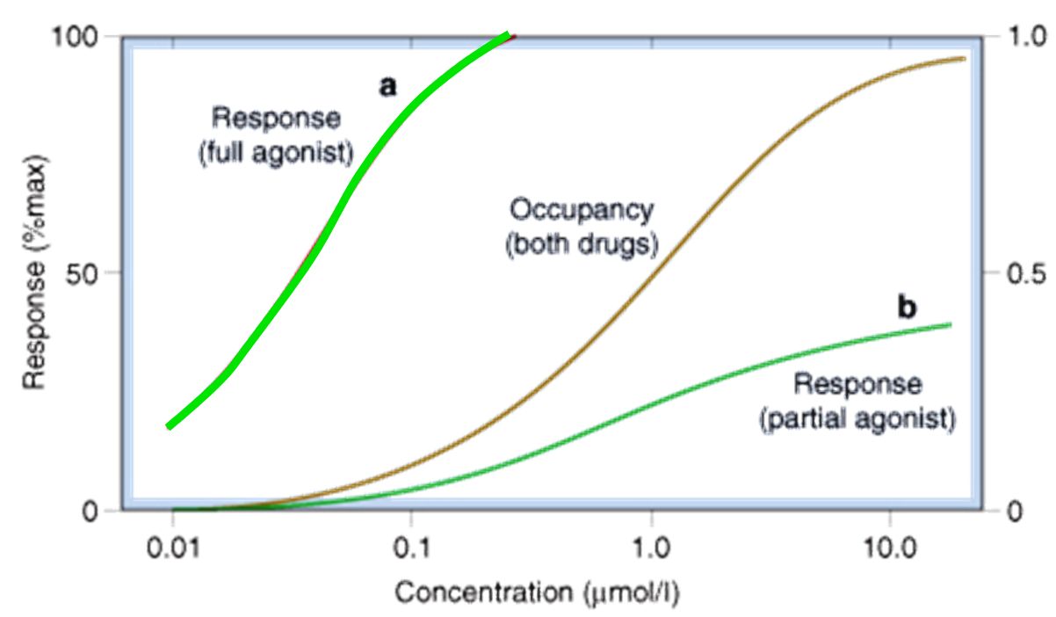
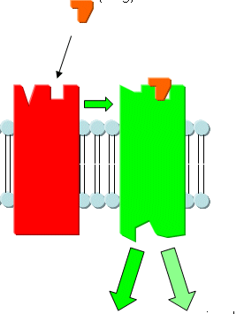
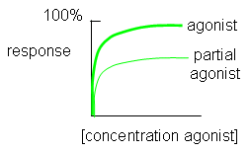
Ligand
Agonist
Ligand
High intrinsic efficacy
↓
Max response
low intrinsic efficacy
↓
Submax response agonist.
A Full Agonist
A Partial
Agonist
Agonistic-Antagonistic
Potentials
Pindolol, a beta blocker which is a partial agonist, produces less decrease in heart rate than pure antagonists such as propranolol.
Notes:
13

Slide 14
The tendency of a drug to bind to the receptors is governed by its affinity.
AFFINITY
The ability for it, once bound, to activate the receptor is denoted by its efficacy.
EFFICACY
QUANTIFY ASPECTS OF DRUG ACTION
Bind
Occupy
Initiate
Activate
D
+
R
D
R
DR*
RESPONSE[R]
Relate concentration [C] of D used (x- axis) to the binding capacity at receptors (y-axis)
Relate concentration [C] of D used (x- axis) to the R produced (y-axis)
Concentration-Binding Curve
Dose Response Curve
AFFINITY
EFFICACY
POTENCY

Slide 15
Concentration-Binding Curve
Bind
Occupy
Initiate
Activate
association rate constant
k₁
D
+
R
D
R
DR*
RESPONSE[R]
k₂
dissociation rate constant
At equilibrium the equilibrium dissociation constant (K_{D}) is presented by ratio (k₂/k₁)
The relationship between drug binding & drug concentration is expressed mathematically by the following equation
B_{max} xC
B = -----------
C+ KD₅₀

Slide 16
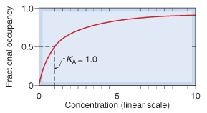
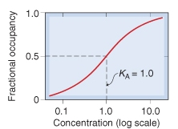
Concentration-Binding Curve
(B_{max}): Total density of receptors in the tissue
K_{D}
K_{D}
(k_{D} ) = [C] of D required to occupy 50% of receptors at equilibrium
?
Concentration-Binding curves are used to determine:
The binding capacity (B_{max}) → total density of receptors in the tissues.
The affinity of D for receptor
The higher the affinity of D for receptor the lower is the K_{D} i.e. inverse relation
?
?

Slide 17
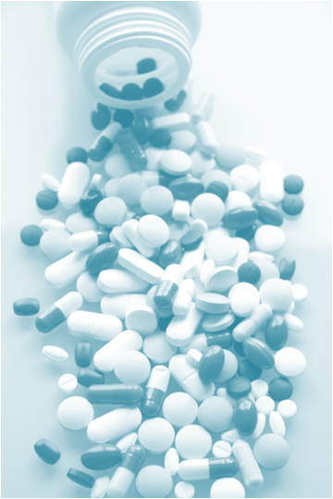
DOSE RESPONSE CURVE
How does response vary with C?
A continuous response
BP, HR, FBG, Cholesterol,…
GRADED DOSE RESPONSE CURVE
An all-or-non response prevention of convulsion, arrhythmias or death…..
Relate C to % of patients eliciting the :
* specified therapeutic response
* adverse response
* lethal outcome
QUANTAL DOSE RESPONSE CURVE
How the therapeutic window of a drug is defined ?

Slide 18
L
G
U
O
C
O
K
D
PHARMACOLOGY

