Slide 1
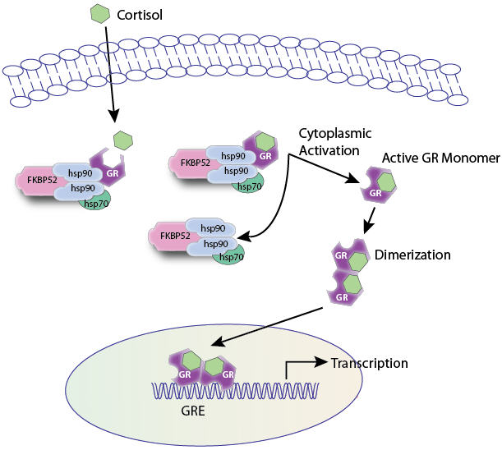
RECEPTOR FAMILIES
RECEPTOR FAMILIES
RECEPTOR FAMILIES
By
Prof. Omnia Nayel
Assoc. Prof. Osama Yousif

Slide 2
ilos
By the end of this lecture you will be able to :
Classify receptors into their main superfamilies
Recognize their different transduction mechanism
Identify the nature & time frame of their response

Slide 3
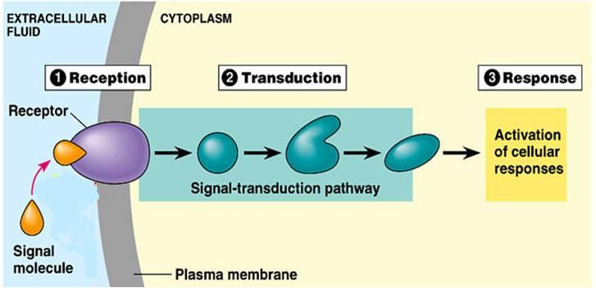
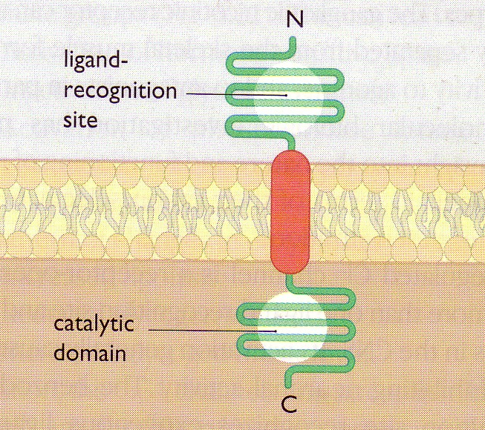
A RECEPTOR
◉
Its Structure:
2
3
4
2. Reception
3. Transduction
4. Response
1
1. Recognition
Direct
◉
Coupler Transduction

Slide 4
RECEPTOR FAMILIES
Classified according to their
Location
Structure
Transduction Mechanism
Nature of Response
Time scale of Response
 4 Main SUPERFAMILIES
Channel-Linked Receptor
G-Protein Coupled Receptors
Enzyme-Linked Receptors
Nuclear Receptors

Slide 5
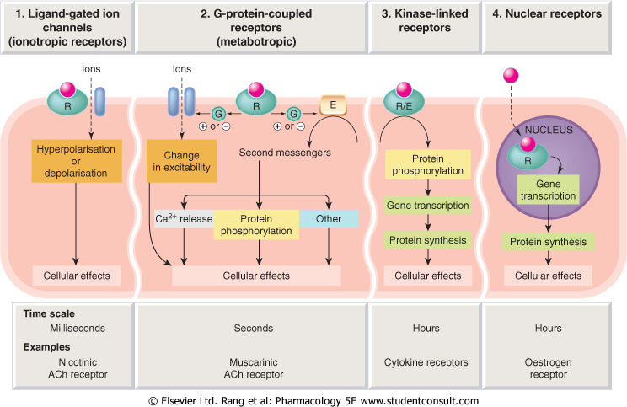
1
2
3
4
Conductance
Cell Signal  
Cell Signal 
Transcription
& Translation
Minutes / Hours
Hours / Days

Slide 6
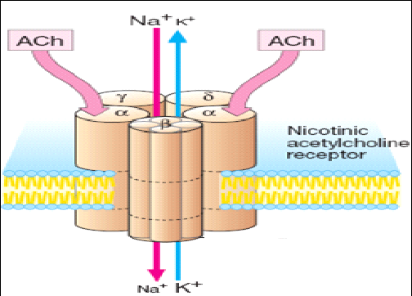
Channel-Linked Receptor
1
Ionotropic Receptor
Ligand-Gated-Ion Channel
Involved in fast synaptic neurotransmittion occuring over milliseconds
It is activated directly when a ligand comes to bind to receptors that are incorporated as part of its structure
Examples;
Nicotinic Ach receptor activated by Ach

Slide 7
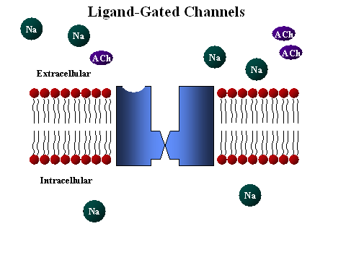
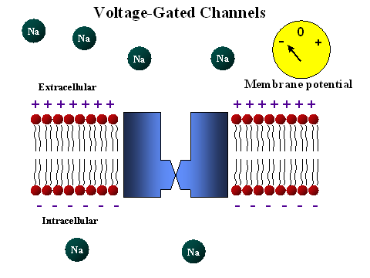
Different from
Voltage-Gated Ion Channel
That is activated by a change in action potential
Not by occupancy of a ligand

Slide 8
G-Protein
Composed of 3 subunits [α β γ] & GDP
◉
G-Protein-Coupled Receptor
2
Agonist
Metabotropic Receptor
Involved in less rapid transmission of
Transmitters: Adrenaline at Adr R, Ach at mAch R …etc
Hormones; Glucagon
Others; Peptides, Purines, …etc
Go-between proteins
Coupler
G-Protein
1. Agonist occupancy dissociates [α], replaces GDP by GTP, activates effector
2. Agonist loss cleaves GTP by GTPase binds [α β γ] again and GDP
An enzyme coupled to a  2nd messenger   
1. Adenyl cyclase (AC) cAMP  PKA
2. Phospholipase C (PLC) IP₃ Ca⁺⁺ intacellular Ca²⁺/CaMCAMPK
DAG  PKC
?
?
RESPONSE
PHOSPHORYLATION OF TARGET PROTEINS

Slide 9
G-Protein-Coupled Receptor
Adenyle cyclase
R
G-Protein
E
α
β
γ
ATP
ATP
ATP
ATP
3 subunits [α β γ]
◉ + GDP
PKA

Slide 10
?
?
R
Channels
E
α
α
α
P
β
γ
ATP
ATP
ATP
ATP
cAMP
Enzymes
P
PKA
Cytoskeletal Proteins
P

Slide 11
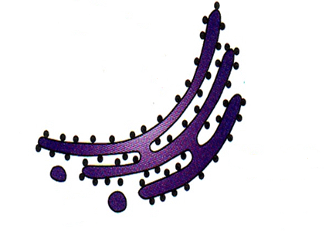
G-Protein-Coupled Receptor
Phospholipase C
E
α
α
PIP₂
DAG
Channels
β
γ

Phosphatidic a
Inositol
↑
P
IP₃
PKC
?
?
Ca⁺⁺
+CaM
CAMPK
P
P
P
Enzymes
P
Cytoskeletal Proteins

Slide 12
G-Protein-Coupled Receptor
Are the Most Abundant Type
Different Classes of Receptors
Ach R  m Adrenergic R  α & β
Dopaminergic R  D₁ & D₂ 5-HT  5-HT₁₋₂ / 5-HT ₄₋₇
Different Receptors Subtypes
mAch; m₁, m₂, m₃, m₄,
Adrenergic receptors; α₁ & α₂ / β₁ & β₂
5-HT_{1;} 5-HT_{1A} – _{1D} receptor
Different in G-Protein Classes
Divided according to their α-subunits into G_{s}, G_{i} and G_{q}
G_{s} and G_{i} produce, respective, stimulation and inhibition of AC
G_{q} is linked to activation of PLC-IP₃ -Ca⁺⁺ CaM & PKC
Receptors are selective to α subunit & effector with which they couple

Slide 13
ADRENOCEPTORS
a₁ Adrenoceptors couple to G_{q} to stimulate PLC.
α₂ Adrenoceptors couple to G_{i} to inhibit AC.
β_{1&2} Adrenoceptors couple to G_{s} to stimulate AC
Adr
Adr
Inhibitory Receptor
Stimulatory Receptor
G_{i}
G_{s}
AC
α₂ Adrenoceptor
β Adrenoceptor
+
cAMP
↑cAMP

Slide 14
CHOLINERGIC RECEPTORS
M₁ & M₃ Ach receptors couple to G_{q} to stimulate PLC
M₂ & M₄ Ach receptors couple to G_{i} to inhibit AC
Ach
Adr
Stimulatory Receptor
Stimulatory Receptor
G_{q}
G_{q}
PLC
PLC
M₃ Ach receptor
α₁ Adrenoceptor
+
+
Bronchi
↑Ca ⁺⁺
↑Ca ⁺⁺
Blood Vessel

Slide 15
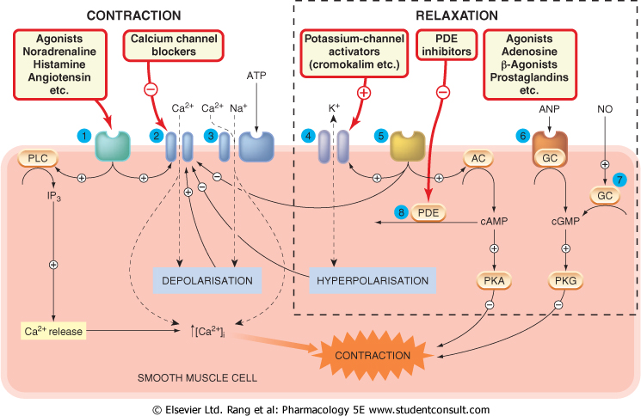
Complexity of a response is governed by many ligands, receptors & effectors

Slide 16
Enzyme-Linked Receptors
3
Involved in slow action of; hormones (insulin), growth factors, cytokines, …..
Their cytosolic domain either:
1. Associate directly with an enzyme GC (guanyl cyclase) as in ANP receptor.
2. Possess intrisic kinase activity (as tyrosine or serine/threonine kinase) that can phosphorylate itself (autophosphorylation) & / or other proteins that they dock as in insulin receptor
They control many cellular functions as motility, growth, different-iation, division & morphogenesis.
This usually require many intracellular signaling steps that take time to process.

Slide 17
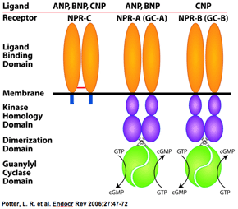
Enzyme-Linked Receptors
3
1.Guanyle cyclase-Linked Receptors
They have a single transmembrane spanning element.
These have integral intrinic guanylate cyclase activity .
Their 2nd messenger is cGMP
→ activates PKG
→ phosphorylate down stream
protein signaling molecules.
Example: Atrial Natriueretic Peptide [ANP] receptors
↑cGMP

Slide 18
3
Enzyme-Linked Receptors
Tyrosine Kinase-Linked Receptors
Ligands dimerize receptors
Activated Receptor autophosphorylates
Phosphorylate other proteins that it docks
Phosphorylated docked proteins
RESPONSE
Example
Insulin receptor

Slide 19
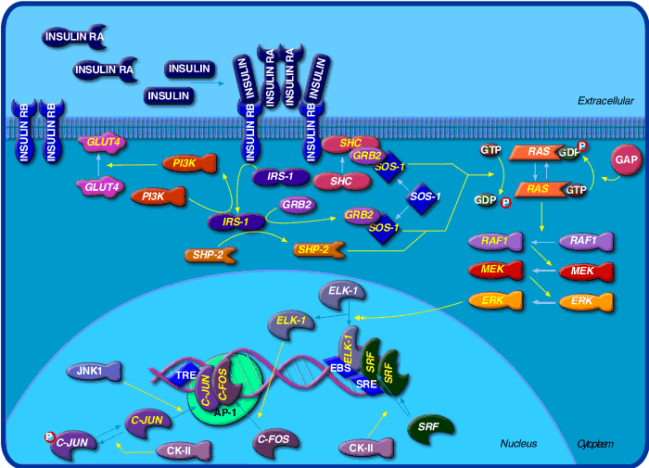
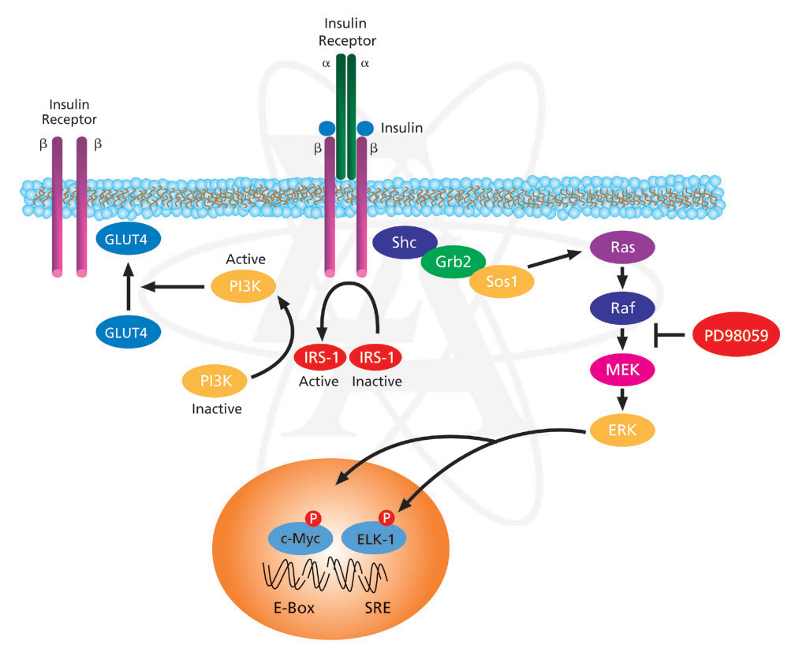
3
Enzyme-Linked Receptors
Non activated Insulin Receptor
Activated
Insulin Receptor
Tyrosine Kinase-Linked Receptors
INSULIN RECEPTOR
Insulin

Slide 20
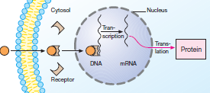
Are intra-cellularly located whether in cytosol or the nucleus.
Nuclear Receptors
4
Their ligands are usually :
Extracellular lipophylic hormones; steroids, thyroids, …etc
Extracellular lipids; linolinic a., retinoic a.
Phosphorylated protein end product of 2nd messenger signaling
◆ Involved in regulation of PROTEIN SYNTHESIS →most slowest in action.
They possess a conserved area that recognizes specific DNA sequence in the nucleus which is called a Responsive Element
◆ They react as
TRANSCRIPTION FACTORS
expressing or repressing
target genes.
Protein
Translation
Transcription

Slide 21
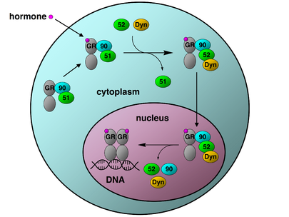
Nuclear Receptors
4
GLUCOCORTICOID RECEPTOR
proteins
The activated GR complex
◆ Up-regulates expression of anti- inflammatory proteins
◆ Represses expression of pro-inflammatory proteins in cytosol ( preventing the translocation of other transcription factors from the cytosol into the nucleus).

Slide 22
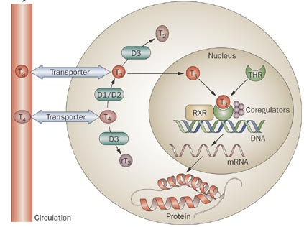
Nuclear Receptors
4
THYROID HORMONE
RECEPTOR

Slide 23
RECEPTOR FAMILIES
L
G
U
O
C
O
K
D

