Slide 1
Pharmacokinetics I
Drug administration and absorption
Prof. Hanan Hagar
Pharmacology Department

Slide 2
Pharmacokinetics
By the end of this lecture, the student should be able to
Discuss the different routes of drug administration
Identify the advantages and disadvantages of various routes of drug administration
Know the various mechanisms of drug absorption
List different factors affecting drug absorption
Define bioavailability

Slide 3
Recommended books
Lippincott’s illustrated reviews (Pharmacology) by Howland and Mycek
Basic and Clinical Pharmacology by Katzung

Slide 4
Pharmacokinetics of drugs
(ADME)
Are studies of ADME of drugs
Absorption
Distribution
Metabolism
Excretion

Slide 5
Drug
Pharmacokinetics
Excretion
Administration
Blood
Metabolism
Absorption
Site of action
Distribution
Different organs &
tissues

Slide 6
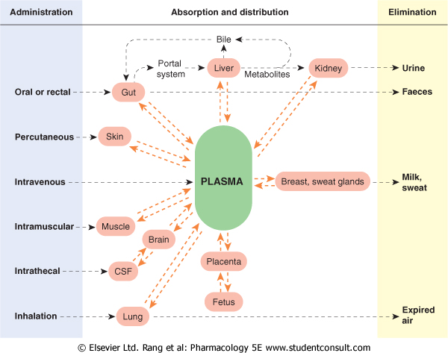
Sites of
Administration
Absorption & distribution
Elimination

Slide 7
Routes of drug administration
Enteral via gastrointestinal tract (GIT).
  Oral
  Sublingual
  Rectal
Parenteral administration = injections.
Topical application
Inhalation

Slide 8
Oral administration
Disadvantages | Advantages
- Slow effect No complete absorption - Destruction by pH and enzymes - GIT irritation - Food - Drug interactions Drug-Drug interactions First pass effect (low bioavailability). Not suitable for vomiting & unconscious patient emergency & bad taste drugs | - Easy Self use Safe convenient - cheap - No need for sterilization

Slide 9
First pass Metabolism
Drugs taken orally are first taken to liver (via portal circulation) where they are metabolized before reaching to rest of body.
so the amount reaching blood circulation is less than the amount absorbed

Slide 11
First pass Metabolism
Where ?
Liver
Gut wall
GIT Lumen
Results ?
Low bioavailability= low serum level of active drug that can produce action
Short duration of action.
Notes:
11

Slide 12
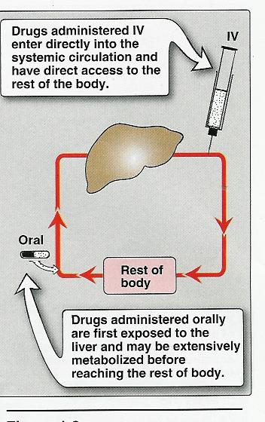
First pass effect

Slide 13
Oral Dosage Forms (oral formulations)
Tablets (enteric coated tablets)
Capsules (hard and soft gelatin capsules)
Syrup
Suspension
Emulsion

Slide 14
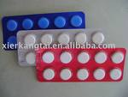

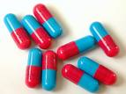
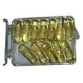
Tablets
Spansule
Hard- gelatin capsule
Soft- gelatin capsule

Slide 15
Sublingual
Disadvantages | Advantages
Not for Irritant drugs Frequent use | Rapid effect can be used in emergency High bioavailability No first pass effect. No GIT irritation No food drug - interaction Dosage form: friable tablet

Slide 16
Rectal administration
Disadvantages | Advantages
Irregular absorption & bioavailability. Irritation of rectal mucosa. | Suitable for children Vomiting or unconscious patients Irritant & Bad taste drugs. less first pass metabolism (50%) Dosage form: suppository or enema

Slide 17
Parenteral administration
Intradermal (I.D.) (into skin)
  Subcutaneous (S.C.) (under skin)
  Intramuscular (I.M.) (into muscles)
  Intravenous (I.V.) (into veins)
  Intra-arterial (I.A.) (into arteries)
  Intrathecal (I.T.) (cerebrospinal fluids )
  Intraperitoneal (I.P.) (peritoneal cavity)
  Intra - articular (Synovial fluids)

Slide 18
Intravenous administration
Disadvantages | Advantages
Only for water soluble drugs Infection Sterilization. Pain Needs skill Anaphylaxis Expensive Not suitable for oily solutions or poorly soluble substance | Rapid action (emergency) High bioavailability No food-drug interaction No first pass metabolism No gastric irritation Suitable for Vomiting &unconscious Irritant & Bad taste drugs. Dosage form: Vial or ampoule

Slide 19
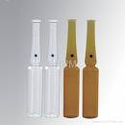
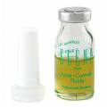
Ampoule Vial
Single use
Repeated use

Slide 20
Injection | Special Utility | Limitations
I.D. | minute volume (0.1 ml) suitable for vaccinations & sensitivity test | not suitable for large volumes
S.C. | 0.1 ml – 1 ml suitable for poorly soluble suspensions and for instillation of slow-release implants e.g. insulin zinc preparation | not suitable for large volumes
I.M. | larger volume 3-5 ml Suitable for moderate volumes, for oily solutions or poorly soluble substances | not suitable for irritant drugs Abscess- necrosis may happen
I.V. | suitable for large volumes and for irritating substances | not suitable for oily solutions or poorly soluble substances Must inject solutions slowly as a rule

Slide 21
Drugs are applied to skin, ear, eye, nose, vagina,
respiratory tract
Usually used to provide local action.
No first pass metabolism.
Used for lipid soluble drugs
Topical application

Slide 22
Inhalation
Disadvantages | Advantages
Not suitable for irritant drugs Only for some drugs as inhalation anesthetics & bronchodilators | mucous membrane of respiratory system rapid absorption (due to large surface area) provide local action in limited systemic effect less side effects. no first pass effect Dosage form: aerosol, nebulizer

Slide 23
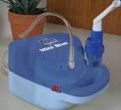
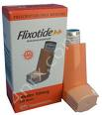

Nebulizer Atomizer

Slide 24
Drug absorption
Is the passage of drug from its site of administration to its site of action through cell membranes.
Cell membrane
Sites of
Administration
Sites of
action

Slide 25
Mechanisms of drug absorption
  Simple diffusion = passive diffusion.
  Active transport.
  Facilitated diffusion.
  Pinocytosis (Endocytosis).

Slide 26
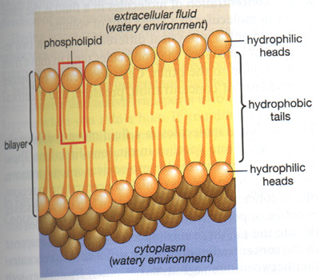
Cell membrane

Slide 27
Simple or passive diffusion
    water soluble drug (ionized or polar) is readily absorbed via diffusion through aqueous channels or pores in cell membrane.
    Lipid soluble drug (nonionized or non polar) is readily absorbed via diffusion through lipid cell membrane itself.

Slide 28
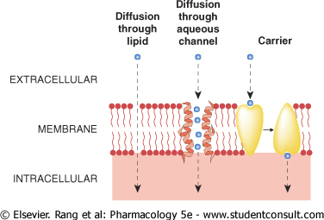
Simple diffusion

Slide 29
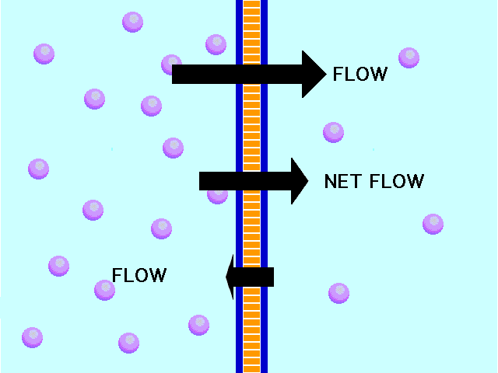
Simple diffusion
High conc
Low conc

Slide 30
Simple diffusion
Characters
  common.
  Occurs along concentration gradient.
  Non selective
  Not saturable
  Requires no energy
  No carrier is needed
  Depends on lipid solubility.
  Depends on pka of drug - pH of medium.

Slide 31
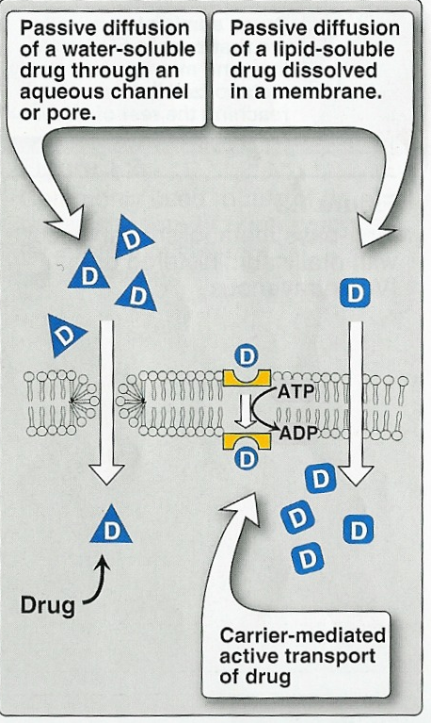

Slide 32
Simple diffusion
Drugs exist in two forms ionized (water soluble) nonionized forms (lipid soluble) in equilibrium.
Drug ionized form + nonionized form
Only nonionized form is absorbable.
Nonionized / ionized ratio is determined
by pH and pKa

Slide 33
PKa of the drug
(Dissociation or ionization constant):
pH at which half of the substance is ionized & half is unionized.
pH of the medium
Affects ionization of drugs.
  Weak acids → best absorbed in stomach.
  Weak bases → best absorbed in intestine.

Slide 34
Active Transport
  Relatively unusual.
  Occurs against concentration gradient.
  Requires carrier and energy.
  Specific
  Saturable.
  Iron absorption.
  Uptake of levodopa by brain.

Slide 35
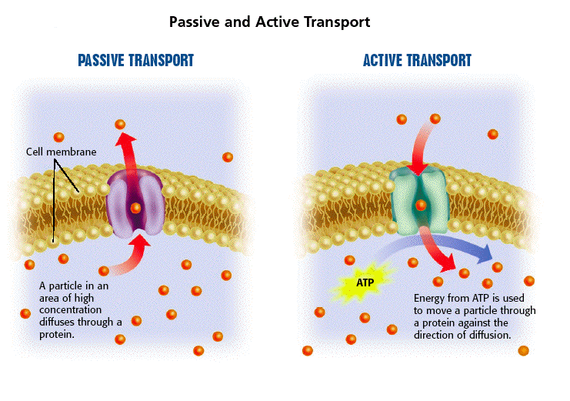

Slide 36
Carrier-mediated Facilitated Diffusion
  Occurs along concentration gradient.
  Requires carriers
  Selective.
  Saturable.
  No energy is required.

Slide 37
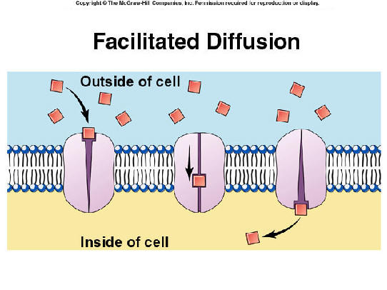

Slide 38
Active transport | Passive transport
against concentration gradient (From low to high) | along concentration gradient (From high to low)
Needs carriers | No carriers
saturable | Not saturable
Selective | Not selective
energy is required | No energy

Slide 39
Carrier-mediated facilitated diffusion | Active transport
along concentration gradient (From high to low) | Against concentration gradient (From low to high)
Needs carriers | Needs carriers
saturable | saturable
Selective | Selective
No energy is required | Energy is required

Slide 40
Phagocytosis (Endocytosis & Exocytosis)
Endocytosis: uptake of membrane-bound particles.
Exocytosis: expulsion of membrane-bound particles.
Phagocytosis occurs for high molecular weight
Drugs or highly lipid insoluble drugs.

Slide 41
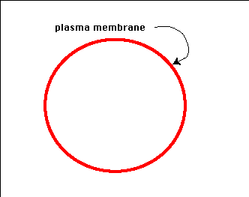
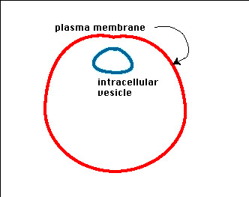
(Endocytosis)
(Exocytosis)
OUT
IN
IN
OUT

Slide 42
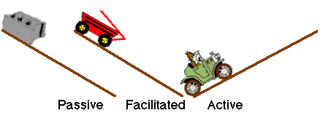
Mechanisms of drug absorption

Slide 43
Bioavailability
Is the fraction of unchanged drug that enters systemic circulation after administration and becomes available to produce an action
I.V. provides 100% bioavailability.
Oral usually has less than I.V.

Slide 44
Summary
Different routes of administration are available
Parenteral administration is the suitable route to provide rapid effect
IV is used in emergency and provide high availability
Oral administration is best avoided during emergency or when severe first pass metabolism may occur
Drugs may cross any cell membrane by simple diffusion, active transport, facilitated diffusion, and pinocytosis

Slide 45

Questions?

