Slide 1
Pharmacokinetics II:
Bioavailability and Distribution
Prof. Hanan Hagar
Pharmacology Department

Slide 2
Distribution
What student should know
Major body fluid compartments
Concept of compartments.
Apparent volume of distribution (vd).
Plasma protein binding.
Tissue binding.
Redistribution

Slide 3
Distribution
Is the process by which drugs leave blood circulation and enters the interstitium and/or the cells of the tissues.

Slide 5
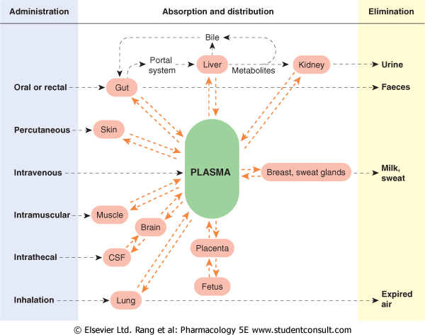
Sites of
Administration
Absorption & distribution
Elimination

Slide 6
The major body fluid compartments are
Extracellular fluid (22%)
- Plasma ( 5 % of body weight = 4 liters ).
- Interstitial fluid ( 16 % = 10 liters).
- Lymph ( 1 % ).
Intracellular fluid ( 35 % )
fluid present inside all cells in the body (28 L).
Transcellular fluid ( 2%)
cerebrospinal, intraocular, synovial, peritoneal, pleural & digestive secretions.

Slide 7
Total body fluids
(60% of body weight in 70-kg individual)
Plasma (4 L)
Interstitial fluids (10 L)
Intracellular volume ( 28 L)
Total body
Fluids
(42 Liters)

Slide 8
Apparent Volume of Distribution (Vd)
is the ratio of drug amount in the body to the concentration of drug in blood
Vd (L)= total amount of drug in body (mg)
concentration in blood (mg/L)
Large Vd = means long duration of action

Slide 9
FACTORS AFFECTING DISTRIBUTION
1.Cardiac output and blood flow.
2. Physiochemical properties of the drug.
Molecular weight
Pka.
Lipid solubility.
3. Capillary Permeability
4. Plasma protein binding
5. Tissue binding.

Slide 10
Blood flow to organs
The greater the blood flow to tissues, the more distribution that occurs from plasma to interstitial fluids.
Drugs distribute more rapidly to brain, liver and kidney > more than skeletal muscles & fat.

Slide 11
Physiochemical properties
Most lipid soluble drugs cross biological membranes
Hydrophilic drugs do not readily cross membranes but go through slit junctions

Slide 12
Volume of Distribution (Vd)
Drugs with high Vd
Have higher concentrations in tissues than in plasma.
Relatively lipid soluble.
Distributed intracellularly
Not efficiently removed by haemodialysis.
e.g. phenytion, morphine, digoxin

Slide 13
Volume of Distribution (Vd)
Drugs with low Vd
confined to plasma & interstitial fluid.
distributed in extracellular compartments.
Polar comp or lipid insoluble drugs. e.g. Carbenicillin, vecuronium, gentamycin.
High MW e.g. heparin – insulin.
High plasma protein binding e.g. warfarin.
Do not cross BBB or placental barriers.

Slide 14
Capillary permeability
Endothelial cells of capillaries in tissues other than brain have wide slit junctions allowing easy movement & distribution.
Brain has tight junction Blood Brain Barrier (BBB).

Slide 15
Blood brain barrier (BBB):
Only lipid soluble drugs or carrier mediated transport can cross BBB.
Hydrophilic drugs (ionized or polar drugs) can not cross BBB.
Inflammation as in meningitis increase permeability to hydrophilic drugs
e.g. penicillin & gentamycin
Placental barrier
Lipid soluble drugs can cross placental barrier and enter the fetal blood.

Slide 18
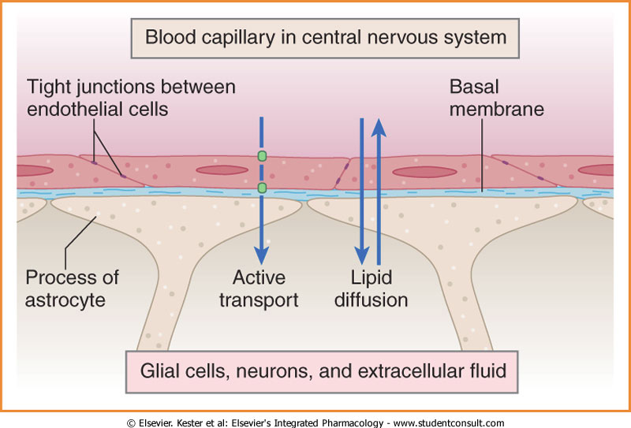

Slide 20
Binding of Drugs
Plasma proteins binding.
Tissue proteins binding.

Slide 21
Plasma protein binding
Drugs can bind to plasma proteins (acidic drug bind to albumin while basic drugs bind to glycoprotein)
Drugs exist in two forms bound and unbound forms in equilibrium
Unbound drug (free) bound drug

Slide 22
Tissues Binding
Drugs can bind to specific tissue
Tetracycline bind to bone
Iodides accumulate in salivary & thyroid glands

Slide 23
bound form of drug
non diffusible form
can not combine with
receptors
not available for
elimination
has long duration of
action (t ½).
Unbound form of drug
diffusible form
combine with receptors
available for elimination
has short duration of
action (t ½).

Slide 24
Characters & consequences of Binding
Usually reversible.
determines volume of distribution (vd)
Slows drug metabolism & excretion.
Prolongs duration of drug action (t1/2).
Result in clinically important drug interactions.

Slide 25
Redistribution
Redistribution of the drug away from its site of action to other tissues where it can not produce an action e.g. thiopental
Termination
Biotransformation.
Excretion.
Redistribution.

