Slide 1

Pharmacokinetics III
Concepts of drug disposition
Metabolism
Prof. Hanan Hagar
Pharmacology Department

Slide 2
METABOLISM
By the end of this lecture, students should:
Recognize the importance of biotransformation
Know the different sites for drug metabolism
Define the major phase I and phase II metabolic reactions.
Describe the modulation of liver microsomal enzymes by inducers and inhibitors
Mention two drugs that are known as enzyme inducers and inhibitors.
Know the impact of first pass metabolism on drug bioavailability.

Slide 3
Drug Metabolism (Biotransformation)
Definition
Chemical reactions which lead to modification of drugs.
Importance of metabolism
Termination of drug action
Enhance excretion by transforming the drug to a less lipid soluble, less readily reabsorbed form.

Slide 4
Organ sites of drug metabolism
Liver (the major site).
Intestinal Mucosa and Lumen
Kidney
Skin
Lung
Plasma

Slide 5
Cellular sites of drug metabolism
  Cytosol
  Mitochondria
  Lysosomes
  Smooth endoplasmic reticulum (microsomes)
  Microsomal enzyme system = mixed function oxidase = mono-oxygenase =
  Cytochrome P-450.

Slide 6
TYPES OF METABOLIC REACTIONS
  Phase I Reactions
  Phase II Reactions

Slide 7
Phase I reactions
Oxidation.
Reduction.
Hydrolysis.
Phase II reactions
Conjugation reactions

Slide 8
Oxidation Reactions
Microsomal oxidation (CYT-P450).
Oxidation by cytochrome P450 enzymes
Non-microsomal oxidation.
Oxidation by soluble enzymes in cytosol or
mitochondria of cells (as oxidases and
dehydrogenases) e.g. monoamine oxidase (MAO) and alcohol dehydrogenase.

Slide 9
Reduction reactions
Microsomal reduction
Non microsomal reduction
Hydrolysis
All are non microsomal
Drugs affected are either esters or amides
Hydrolysis occurs by enzymes (esterases or amidases) e.g. acetylcholine and lidocaine

Slide 10
Phase I reactions can result in
Inactivation of drug (termination of action)
Conversion of active drug to another active metabolite.
Conversion of drugs to toxic metabolites.
Paracetamol → acetaminophen hepatotoxicity
Activation of pro-drug
Product might undergo phase II.

Slide 11
Phase II Conjugation Reactions
Conjugation of metabolite (phase I) with endogenous substance as methyl group, acetyl group, sulphate, amino acid or glucouronic acid to produce conjugate that is water soluble and easily excreted.

Slide 12
Types of conjugation reactions
Conjugation reaction | Enzyme required
glucouronide conjugation | glucouronyl transferase
Acetylation | N-acetyl transferase
Sulphation | Sulfotransferase
Methylation | methyl transferase
Amino acids conjugation

Slide 13
Phase II reactions:
All are non microsomal except glucouronidation
Deficieny of glucouronyl transferase enzyme in neonates may result into toxicity with chloramphenicol (Gray baby syndrome).

Slide 14
Characteristics of Phase II Products
Usually Pharmacologically inactive.
Polar
more water soluble.
more readily excreted in urine.

Slide 16
Factors affecting metabolism
Age
Nutrition
Genetic Variation
Diseases
Gender
Degree of Protein Binding
Enzyme Induction & inhibition
Route of Drug Administration

Slide 17
Pharmacokinetics III
Concepts of drug disposition
Excretion of Drugs

Slide 18
Excretion of Drugs
By the end of this lecture, students should be able to
Identify main and minor routes of Excretion including renal elimination and biliary excretion
Describe enterohepatic circulation and its consequences on duration of drugs.
Describe some pharmacokinetics terms including clearance of drugs.
Biological half-life (t ½), multiple dosing, steady state levels, maintenance dose and Loading dose.

Slide 19
Routes of Excretion
Main Routes of Excretion
Renal Excretion
Biliary Excretion
Minor Routes of Excretion.
Exhaled air (Exhalation)
Salivary
Sweat
Milk
Tears

Slide 20
Renal Excretion
Structure of kidney
  The structure unit of kidney is nephron
  That consists of :
  Glomerulus
  Proximal convoluted tubules
  Loop of Henle
  Distal convoluted tubules
  Collecting ducts

Slide 21
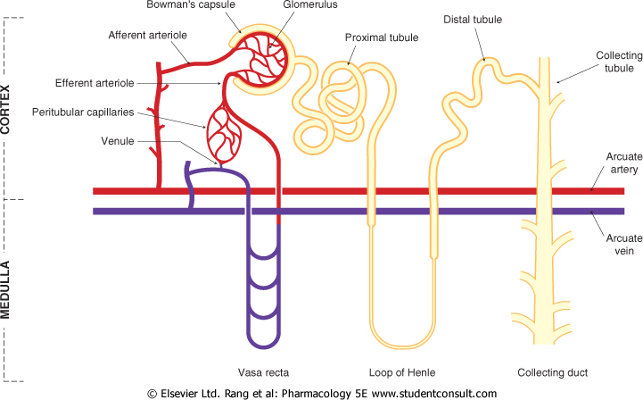
Kidney

Slide 22
Renal Excretion includes
  Glomerular filtration.
  Passive tubular reabsorption.
  Active tubular secretion.

Slide 23
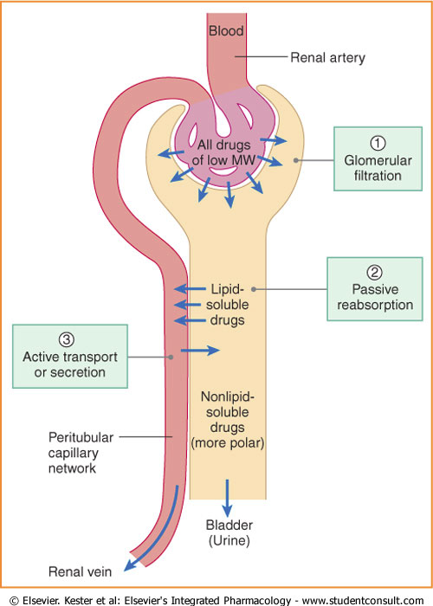

Slide 24
Polar drug= water soluble
Non polar drug = lipid soluble

Slide 25
Glomerular filtration (GFR):
Depends upon renal blood flow (600 ml/min)
GFR 20% of RPF = 125 ml/min.
Glomerular filtration occurs to
  Low MW drugs
  Only free drugs (unbound to plasma proteins) are filtered.

Slide 26
Tubular secretion:
occurs mainly in proximal tubules; increases drug conc. in lumen
organic anionic and cationic tranporters mediate active secretion of anioinc and cationic drugs.
can transport drugs against conc. gradients.
  Penicillin is an example of actively secreted drug.
  Passive diffusion occurs for uncharged drugs

Slide 27
Passive tubular reabsorption
In distal convoluted tubules & collecting ducts.
Passive diffusion of unionized, lipophilic drugs
Lipophilic drugs can be reabsorbed back into blood circulation and urinary excretion will be Low.
Ionized drugs are poorly reabsorbed & so urinary excretion will be High.

Slide 28
Urinary pH trapping (Ion trapping)
Changing pH of urine via chemicals can inhibit or enhance the tubular drug re-absorption. used to enhance renal clearance of drugs during toxicity.
Urine is normally slightly acidic and favors excretion of basic drugs.

Slide 29
Acidification of urine using ammonium chloride (NH4Cl) increases excretion of basic drugs (amphetamine).
Alkalization of urine using sodium bicarbonate NaHCO3 increases excretion of acidic drugs (aspirin).

Slide 30
Renal Excretion
Drugs excreted mainly by the kidney include:
Aminoglycosides antibiotics (Gentamycin)
Penicillin.
Lithium
These drugs are contraindicated in
  Renal disease.
  Elderly people

Slide 31
Biliary Excretion
Occurs to few drugs that are excreted into feces.
Such drugs are secreted from the liver into bile by active transporters, then into duodenum.
Some drugs undergo re-absorption back into systemic blood circulation (enterohepatic circulation).

Slide 32
Enterohepatic circulation
Drugs excreted in the bile in the form of glucouronides will be hydrolyzed in intestine by bacterial flora liberating free drugs that can be reabsorbed back if lipid soluble.
This prolongs the action of the drug. e.g. Digoxin, morphine, thyroxine.

Slide 33
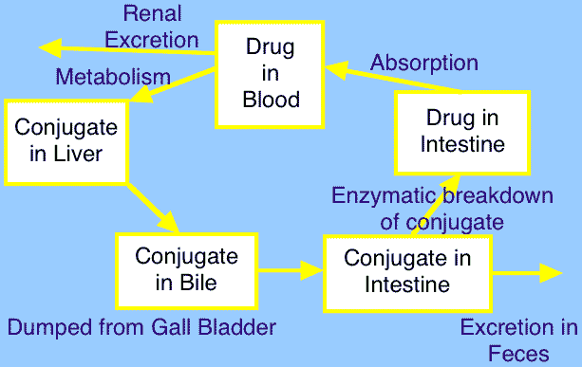

Slide 34
Plasma half-life (t ½)
is the time required for the plasma concentration of a drug to fall to half.
Is a measure of duration of action.
Determine the dosing interval
Drugs of short plasma half life
Penicillin, tubocurarine.
Drugs of long plasma half life
Digoxin, thyroxine, arsenic.

Slide 35
Factors that may increase half-life (t ½ )
Decreased metabolism
  Liver disease.
  Microsomal inhibitors.
Decreased clearance
  Renal disease.
  Congestive heart failure.
High binding of drugs
  Plasma proteins.
  Tissue binding.
Enterohepatic recycling

Slide 36
Steady state levels.
A state at which the plasma concentration of the drug remains constant.
Rate of drug administration = Rate of drug elimination.

Slide 37
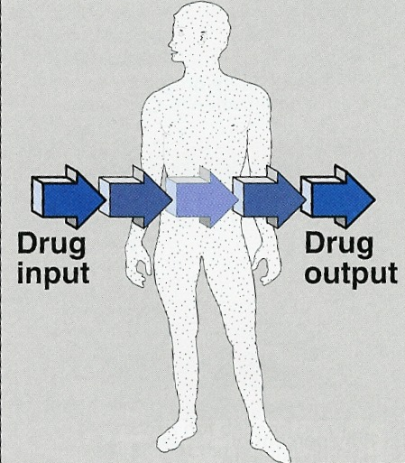
Steady state of a drug

Slide 38
Summary
Polar drugs are readily excreted and poorly reabsorbed.
Lipid soluble drugs are reabsorbed back and excretion will be low
Acidic drugs are best excreted in alkaline urine (sodium bicarbonate).
Basic drugs are best excreted in acidic urine (ammonium chloride).
Enterohepatic circulation prolongs half life of the drug.

Slide 39

Questions?
E-mail: hananhhagar@yahoo.com

