Slide 1
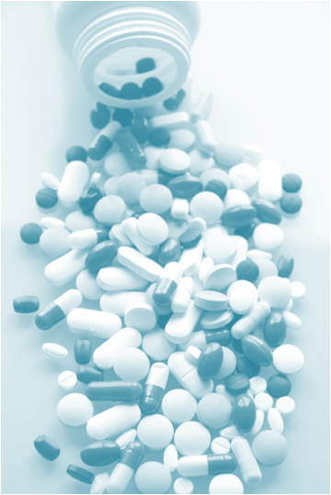
VARIATION IN DRUG RESONSIVNESS
Decrease in drug effects.
Development of side effects
Between different individuals
Within the same individual

Slide 2
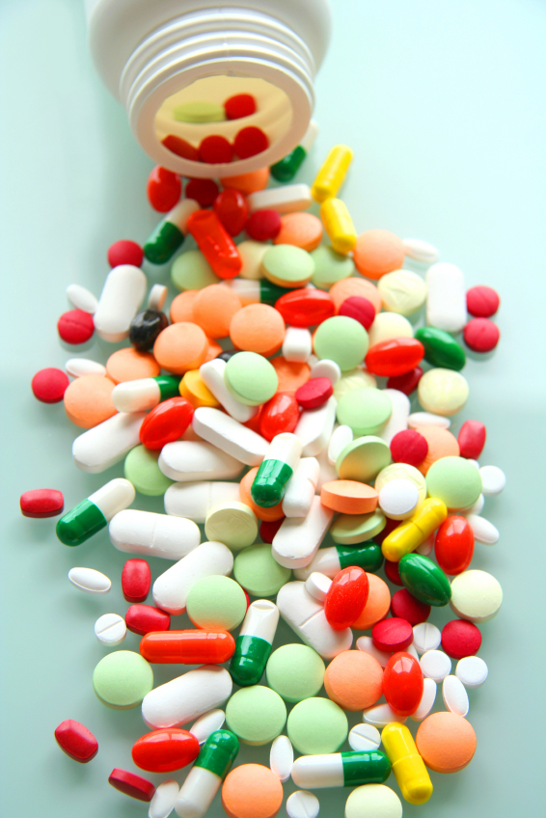
ilos
By the end of this lecture you will be able to :
Distinguish difference between tolerance and desensitization ( tachyphylaxis ) and reasons for their development
Recognize patterns of adverse drug reactions (ADR)
TOLERANCE / DESENSITIZATION &
ADVERSE DRUG REACTIONS
By
Prof. Omnia Nayel
Assoc. Prof. Osama Yousif

Slide 3
Phenomenon of variation in drug response, where by there is a gradual diminution of the response to the drug when given continuously or repeatedly
TOLERANCE and DESENSITIZATION

Slide 4
DIMINUTION OF A RESPONSE
Rapid, in the course of few minutes
Gradual in the course of few days to weeks
TACHYPHYLAXIS / DESENSITIZATION
TOLERANCE
These SHOULD BE DISTINGUISHED FROM
Loss of effectiveness of antimicrobial agent
Resistance

Slide 5
REASONS FOR DEVELOPMENT OF TOLERANCE
PRE RECEPTOR EVENTS
EVENTS AT RECEPTORS
POST RECEPTOR EVENTS
↓ drug availability at the relevant receptors due to pharmaco- kinetic variables
Nullification of drug response by a physiological adaptative homeostatic response
Drug becomes:
> metabolized or excreted
< absorbed
altered distribution to tissues
Antihypertensive effects of ACE Is become nullified by activation of renin angiotensin system by NSAIDs
eg. Barbiturates  metabolism of Contraceptive pills =  it availability
LOSS OF THERAPEUTIC EFFICACY
Refractoriness

Slide 6
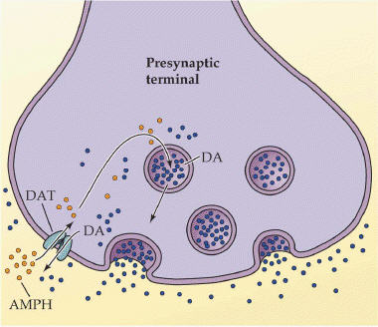
REASONS FOR DEVELOPMENT OF TOLERANCE
PRE RECEPTOR EVENTS
EVENTS AT RECEPTORS
POST RECEPTOR EVENTS
BINDING ALTERATION
DOWN REGULATION
EXHUSTION
OF MEDIATORS
Depletion of mediator stores by amphetamine
Phosphorylation of R by ß-adrenoceptors → ↓ activation of AC to related ionic channel [functional defect]
↓ number of receptors.
Isoprenaline activation to β receptors →↑ R recycling by endocytosis [structural defect]
DOWN REGULATION
BINDING ALTERATION

Slide 7
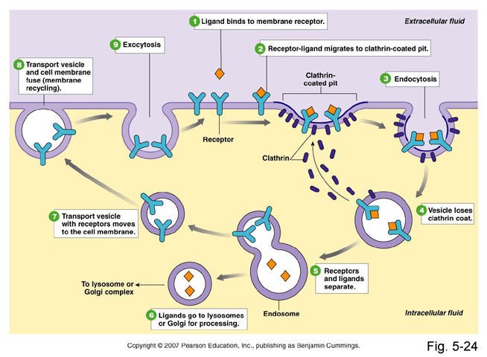
DOWN REGULATION

Slide 8
ADVERSE DRUG REACTIONS [ADR]
Harmful or seriously unpleasant effects occurring at doses intended for therapeutic effects.

Slide 9
TYPES OF ADR
Type A
Type C
Type E
Augmented
Continuous
End-of-Use
PREDICTABLE
Occurs during chronic drug administration
Occurs upon sudden stoppage of chronic drug use due to existing adaptive changes present
Occurs consequent but in excess of drug primary pharmacological effect.
Of quantitative nature
Type B
Type D
Bizzar
Delayed
UNPREDICTABLE
Occurs after long period of time even after drug stoppage
Occurs different [heterogenous / idiosyncrotic ] to known drug pharmacological effect usually due to patient’s genetic defect or immunological response.
Of qualitative nature

Slide 10
TYPES OF ADR
Type C
Continuous
End-of-Use
Type E
e.g. Patients can develop
1. Osteoporosis secondary to chronic corticosteroid intake
2. DEPENDENCE:
a. Psychological [Craving] as by cannabis
b. Psychological [Craving] + Physical withdrawal manifestations (syndrome) = ADDICTION as by morphine
e.g. Patients on stoppage of - Clonidine develop rebound hypertension
Morphine develop withdrawal syndrome
Type D
Delayed
Long after patients can show:
TERATOGENICITY after retinoids
CARCINOGENICITY after tobacoo smoking

Slide 11
Comparison between typeA & B ADRs
 | Type A Augmentation | Type B Idiosyncrotic
Pharmacological predictability | Yes | No
Nature | Quantitative [ extension of pharmacology effect ] | Qualitative [ immune or genetic base]
Dose dependent | Yes (dose response relationship present) | No (dose response relationship absent)
Onset of symptoms | Usually Rapid | Usually delayed
Incidence and morbidity | High | Low
Mortality | Low | High
Treatment | Dose adjustment or Substitute by > selective + Antagonize unwanted effect of 1st drug | Stop drug + Symptomatic treatment
Example | Bradycardia β- ADR Blockers Hemorrhage Warfarin | Apnea succinylcholine Thrombocytopenia Quinine

Slide 12
Examples of TYPE A & B ADR
Drug Type A Type B
Chlorpromazine Sedation Cholestatic jaundice
Naproxen GIT haemorrhage Agranulocytosis
Phenytoin Ataxia Hepatitis, lymphadenopathy
Thiazides Hypokalaemia Thrombocytopenia
Quinine Tinnitus Thrombocytopenia
Warfarin Bleeding Breast necrosis
Genetics Variation / defect
Immunological Predisposition

Slide 13
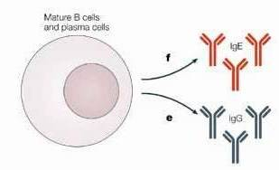
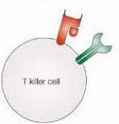
TYPE B
Immunological Predisposition
The drug or its bi-product [protein macromolecules or haptens] react as antigens and provoke immune response that results in damage to the tissue Hypersensitivity Reaction
IgE
1st exposure to a drug
IgG
Sensitization
T killer cells
Repeated exposures
HYPERSENSITIVITY REACTION

Slide 14
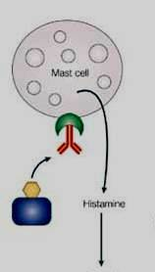
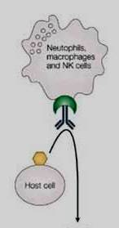
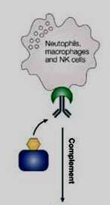
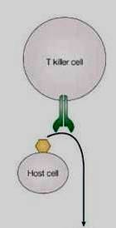
TYPE B
HYPERSENSITIVITY REACTION
TYPE I
Anaphylaxsis
TYPE II
Cytotoxic
TYPE III
Immune complex
TYPE IV
Cell mediated
release of histamine, serotonin leukotrienes from tissue mast cells or blood basophils
IgE
IgG
IgG
Interaction of cells release cytokines that attracts inflammatory cell infiltrate
deposition of soluble antigen–antibody- complement complexes in small blood vessels
antibody-directed cell-mediated lysis

Slide 15
TYPE B
TYPE I
TYPE II
TYPE III
TYPE IV
Release of histamine, serotonin leukotrienes from tissue mast cells or blood basophils
Antibody-directed cell-mediated lysis
Deposition of soluble antigen–antibody- complement complexes in small blood vessels
Interaction release cytokines that attracts inflammatory cell infiltrate
Contact dermatitis by local anaesthetics creams , anti histamine creams, topical antibiotics
Urticaria rhinitis, bronchial asthma
by Penicillin, Streptomycin
Haemolytic anaemia thrombocytopenia by Penicillin, Quinidine
Serum sickness (fever arthritis enlarged lymph nodes, urticaria)
by Sulphonamides, Penicillin, Streptomycin

Slide 16
G
O
O
D
L
U
C
K
G
O
O
D
L
U
C
K
TOLERANCE / DESENSITIZATION & ADVERSE DRUG REACTIONS

