Slide 1
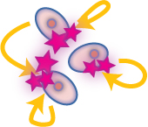
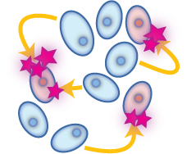
Paracrine Autocrine Mediators
General Features
Act mostly on:
smooth muscles (SMC) [vascular (VSMC) or non vascular (NVSMC)]
nerve endings [> nonadrenergic non-cholinergic (NANC) co-transmission] + heart + exocrine glands + CNS …etc
Exist either:
Preformed & stored in tissues & released by a stimulus
[Monamines (histamine), most peptides ]
Formed de novo in response to a stimulus
[NO, eicosanoids, some peptides, cytokines] ]
Their presence is either:
Constitutive: present all times, to share in normal basic functional regulation within the cells (eNOS / COXI )
Inducible: only present upon demand i.e. gets expressed [gene transcription, mRNA formation and ribosomal translation into protein]
(iNOS / COXII)

Slide 2
DRUGS Acting OnParacrine Autocrine Mediators
Part I
ILOs
By the end of this lecture you will be able to:
Recognize the role of NO in cellular communication.
Classify the different NOS available
Expand on its formation, actions termination and pharmacological modulation.
Identify role of angiotensin in body homeostasis and local regulation.
Explain its formation, target receptors, feedback regulatory actions, breakdown, intersection with the kinin system and pharmacological modulation.

Slide 3
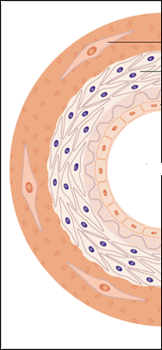
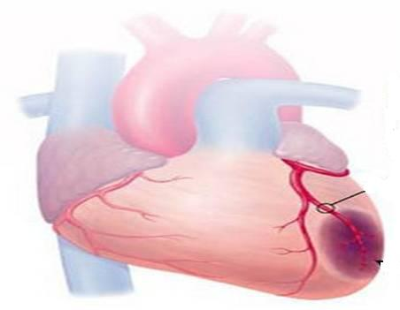
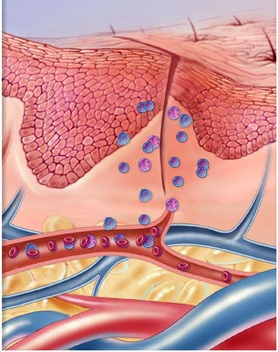
Nitric Oxide

Slide 4
Nitric Oxide
Is a highly diffusible stable gas
L-arginine + O₂ NO + Citrulline + H₂O
Synthesis
NADPH, FAD, CaCAM
Nitric oxide synthase (NOS)
NOS Isoforms
Type I [n-NOS] Neuronal NOS | Type III [E-NOS] Endothelial NOS | Type II [I-NOS] Inducible NOS
Cytosol of Neuronal cells | Bound to membrane of endothelial cell [EC], platelets …etc. | Cytosol of macrophage, neutrophil, kupffer cells … etc
Constitutive | Constitutive | Inducible
Neuronal messenger Cytoprotective | Relaxation of VSMC Cytoprotective | Immunocytotoxicity
Shear Stress or Agonists as; Ach, histamine, bradykinin, …..when bind to receptors  intracellular Ca activate eNOS NO formation

Slide 5
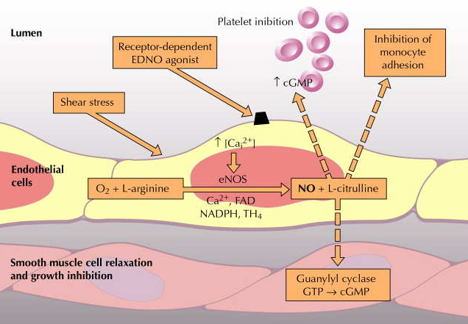
Nitric Oxide
PARACRINE
PARACRINE
AUTOCRINE
PARACRINE
Role of NO in blood vessels
Relaxation of VSMCs (Vasodilatation) + Cytoprotection

Slide 6
Nitric Oxide
Action
PARACRINE
1. Diffuse to VSMC
Binds soluble GC
Change GTP to cGMP
Endothelial Cell [EC]
Vascular Smooth Muscle [ VSMC]
Activate PKG &
Ca
So suppress binding of MLC & actin
No contraction
RELAXATION of VSMCs
Diffusion
O₂
H₂O
PKG
Phosphorylate
Ca
AUTOCRINE
MLCK
P
2. Cytoprotection on ECs
platelet aggregation,
◉ inflammatory cell recruitment
◉ Cholesterol deposition…etc.
Active form
MLCK
Inactive form
PARACRINE
P
MLC
MLC
Contraction
Actin
Relaxation

Slide 7
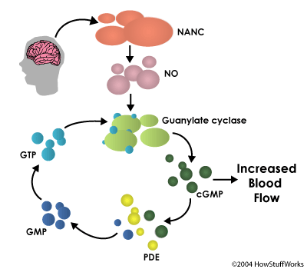
Nitric Oxide
Termination of action
By formation of
1. Stable analogues  with
proteins containing SH ….
2. Free radical Peroxynitrite  in oxidative stress
By break down of its downstream signal cGMP by PDE to form GMP
BV

Slide 8
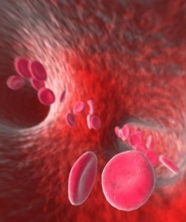
Nitric Oxide
Drugs modulating
1.Express eNOS:
Statins, Estrogen CVS Cytoprotection
2. Act as NO donners:
a. Nitrates  >Venulodilators in angina
b. Na Nitroprusside  Arteriolar dilator in hypertension
3. Prevent breakdown of PDE:
Selective PDE₅ Inhibitors; Sildenafil  Erectile dysfunction

Slide 9
Angiotensin

Slide 10
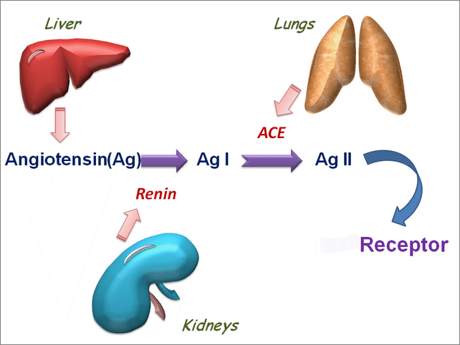
Angiotensin
A vasoconstrictor peptide
Synthesis
Precursor is Angiotensinogen; a plasma α-globulin synthesized in the liver.
Lungs Endothelium & Brain
Angiotensinogen (Ag)
The active form
Other Proteolytic Enzymes
Chymase
Endoperoxidase
Secreted by renal juxtaglomerular apparatus.HOW ?
AT₁
AT₂
When Blood Pressure   Renal SN & Blood flow 
○ Renin is released
Vasoconstriction

Slide 11
ENDOCRINE
PARACRINE
RAAS
PARACRINE
ALDOSTERONE
PARACRINE
Suprarenal Gland

Slide 12
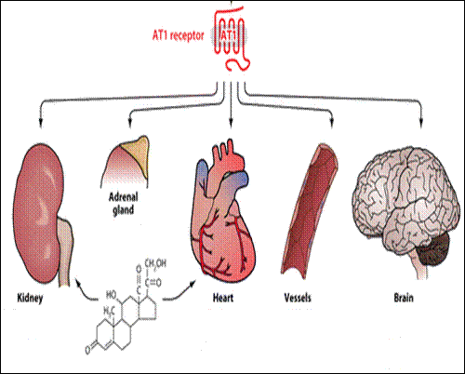
Angiotensin
Ag II
Ag II
Ag II
Ag II
Action
Thirst
RAAS
SNS activation
ENDOCRINE / PARACRINE
Ag II
ALDOSTERONE
ADH
Na retention
Inotropy
Chronotropy
Vasoconstriction
Blood Pressure
Ag II
AUTOCRINE
Hypertrophy
Fibrosis
Remodeling
=Hypertrophy
Fibrosis

Slide 13
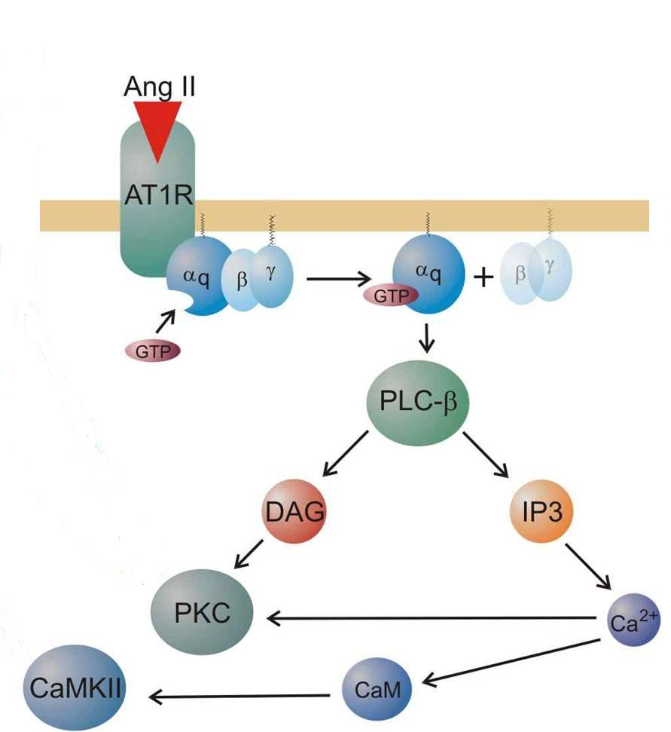
Angiotensin
AT₁
Termination of action
Ag II
AT₁ R; GP receptor coupled to α_{q} PKC + Ca CAMK
AgII acted upon by peptidases
aminopeptidases (angiotensinase)
to Ag III
[a less active] & then to fragmentation products

Slide 14
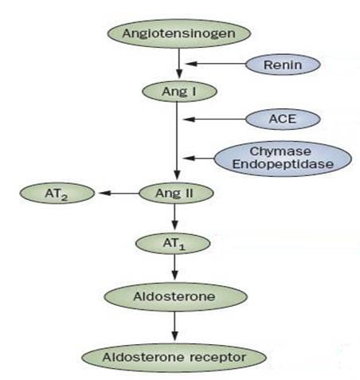
Angiotensin
Clonidine
Propranolol
SN
BF [β₂ ]
Drugs modulating
INHIBITION OF RAAS SYSTEM
is beneficial in treatment of:
Hypertension (hypertrophy)
Heart Failure (hypertrophy & fibrosis)
Diabetics (Protect the kidney)
RENIN Inhibitors
Aliskiren
ACE Inhibitors
Ramipril
VASOPEPTIDASE Is
Omapatrilat
ARBs
Candisartian
ADOSTERONE RAs
Spirinolactone
Eplerenone

Slide 15
Kinins
Synthesis
Bradykinin is a vasodilator peptides
Kininogen
From liver
Plasma Kallikrin
TissueKallikrin
Aminopeptidase
Bradykinin
Kallidin
Action
Vasodilatation
Inflammation & Exudation
Pain (sensory nerves)
Exocrine gland secretion
ACE & Neutral Endopeptidase (NEP)
Termination of action
Inactive metabolites
◉ Action bradykinin mediated pain → NSAIDs
Drugs modulating .
Breakdowntheir concentration  ACE Inhibitors VASOPEPTIDASE Is
Antihypertensive drugs

Slide 16
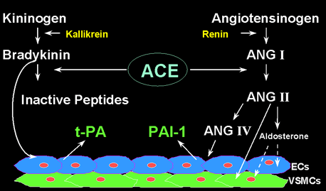
Difference between ACE Is & ARBs action
Inhibit activation of AgI to AGII + decrease degradation of bradykinin
ACE Inhibitors
Ramipril



AT₂

AT₁
ARBs
Candisartan
Block action of AgII on AT1 in VSMCs that is causing vasoconstriction
The AgII act on non-blocked AT2 on endothelial cells causing vasodilatation

Slide 17
Quiz?
NO is an example of mediator that is:
Stored in preformed granules
Synthesized de novo
Only inducible
Vasoconstrictor

Slide 18
Quiz?
Renin is:
Secreted by the liver
Changes angiotensin I to II
Inhibited by alsikiren
Activated by elevated blood pressure

Slide 19
Quiz?
Bradykinin is responsible for:
Vasoconstriction
Pain sensation
Endocrine gland secretion
Skeletal muscle contraction

Slide 20
Quiz?
ACE is:
Responsible for activation of kininogen to bradykinin
Responsible for activation of angiotensinogen to angiotensin I.
Mostly concentrated in the kidney
Inactivated by vasopetidase inhibitors.

Slide 21
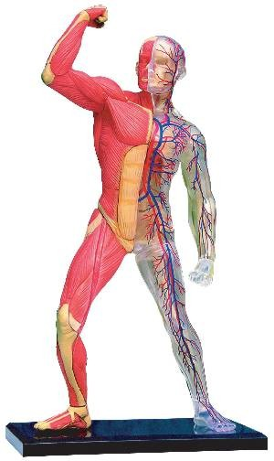
DRUGS Acting OnParacrine Autocrine Mediators
GOOD LUCK

