Slide 1
HISTAMINE

Slide 2
Storage Sites
Highest amounts in mast cells
Basophils
Skin
Lung
Intestinal mucosa
Stomach
Brain

Slide 3
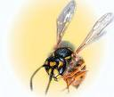
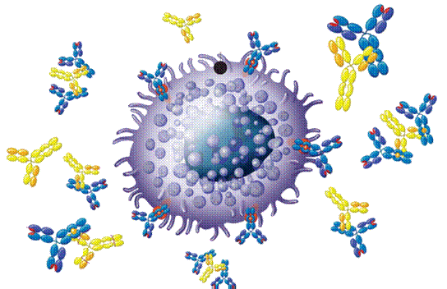
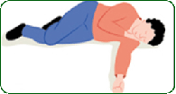
RELEASE

Slide 4
Rlease
Primary mechanism during allergic reactions IgE antibody interacts with antigen on the surface of mast cells
Enzymes as trypsin or drugs as morphine liberate histamine without prior sensitization
Inhibition of release with β₂ agonists

Slide 5
SYNTHESIS & INACTIVATIONTION

Slide 6
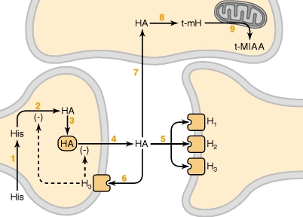
H istamine
Mediator
Neurotransmitter
CNS
ANS
H ₁
+
H ₂
+
H ₁
H ₃
+
H ₃
-ve presynaptic autoregulation

Slide 7
Histamine receptors
Receptor Type | Major Tissue Locations | Major Biologic Effects
H₁ | smooth muscle, endothelial cells | acute allergic responses
H₂ | gastric parietal cells | secretion of gastric acid
H₃ | central nervous system | modulating neurotransmission
H₄ | mast cells, eosinophils, T cells | regulating immune responses

Slide 8
Histamine receptors antagonists

Slide 9
Diphenhydramin ( First generation)
H₁ antagonists
Clinical uses :
Insomnia
Motion sickness

Slide 10
Loratadine (Second generation)
H₁ antagonists
Non-sedating
Clinical uses
Allergic conditions :
allergic rhinitis
Conjunctivitis
Urticaria

Slide 11
Cimetidine
H₂ antagonists
Inhibitor of gastric acid secretion
Used in the treatment of :
peptic ulcers

Slide 12
BETAHISTINE
H₃ antagonists
Used in treatment of :
vertigo in middle ear

Slide 13
Eicosanoids

Slide 14
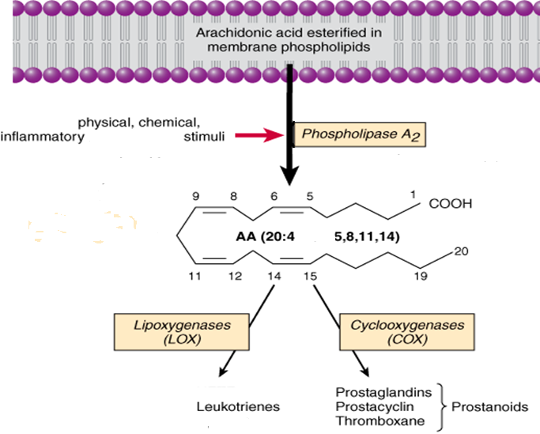

Slide 15
INHIBITORS OF EICOSANOIDS

Slide 16
Drugs
Phospholipids
Corticosteroids
Phospholipase A₂
Arachidonic Acid
Zileuton
NSAIDs
Lipoxygenase
COX1 & COX2
Leukotrienes
LTA4, B4, D4, C4
Prostaglandins
PGE2, PGD2, PGF2α
Prostacyclin (PGI2)
Thromboxane (TXA2)

Slide 17
ACTIONS

Slide 18
Vascular smooth muscles:
PGE₂ and PGI₂
Thromboxane A₂
Potent vasoconstrictor.
Potent vasodilators .

Slide 19
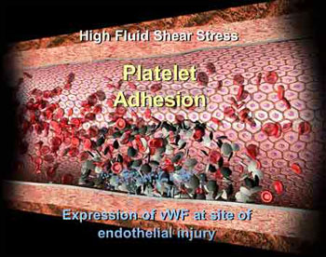
Blood:
TXA2
a potent inducer of platelet aggregation.
PGE₂ and PGI₂
inhibit platelet aggregation

Slide 20
Inflammation:
One of the chemical mediators in inflammatory reactions.

Slide 21
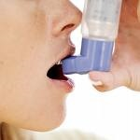
Bronchial smooth muscle:
-PGE₂ cause dilatation.
-PGF_{2α}
-LTs and thromboxane are potent bronchoconstrictors in man → allergic bronchospasm.

Slide 22
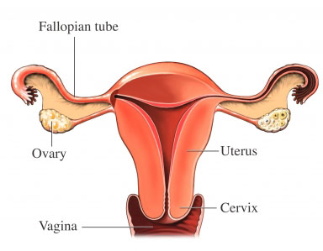
Uterine smooth muscle:
PGE₂ and PGF_{2α} → Menstruation/ Dysmenorrhea/ Labor contractions

Slide 23
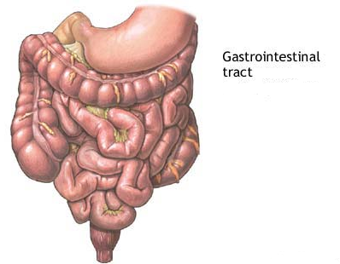
GIT smooth muscle:
- PGE₂ and PGF_{2α} and LTs
GIT
motility

Slide 24
GIT secretions:
PGE₂ , PGE₁ PGI₂
↓acid and pepsinogen secretion .
↑ mucin, water and bicarbonate & Blood flow.

Slide 25
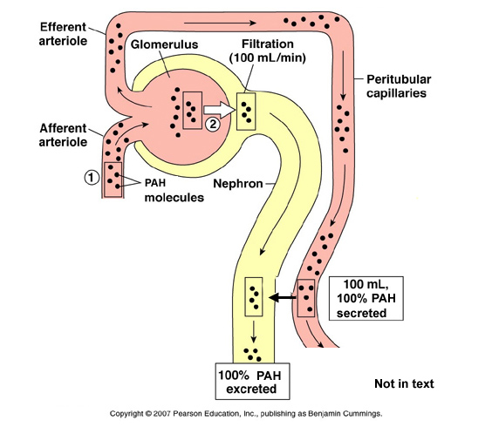
Kideny
PGE2 and PGI2 increase renal blood flow and diuresis.

Slide 26
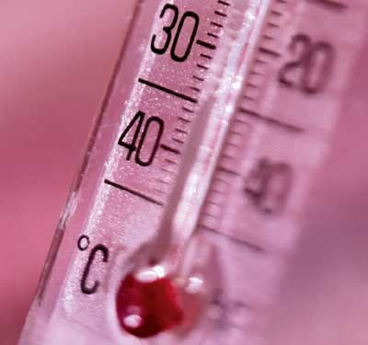
Central and peripheral nervous systems
Fever: PGE₁ and PGE₂ increase body temperature.

Slide 27
CLINICAL USES OF PGs ANALOGS

Slide 28
Carboprost
PGF_{2α} ( analog)
Abortifacient:
Trigger abortion in first trimester.

Slide 29
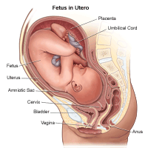
2) For postpartum haemorrhage
vasoconstriction + uterine muscle contraction

Slide 30
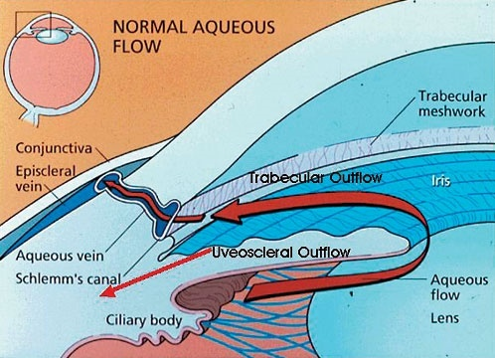
Latanoprost
(PGF_{2α} analog )
eye drops in open angle glaucoma.
↓ IOP by enhancing outflow of the aqueous humar.

Slide 31
Alprostadil
(PGE₁analog)
1- Injected in corpus cavernosum of the penis for some forms of male impotence.

Slide 32
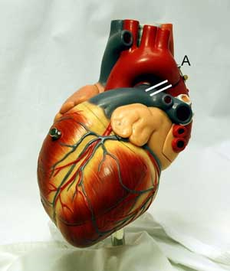
2- In congenital heart anomalies
to keep the patent ductus arteriosus until surgery.

Slide 33
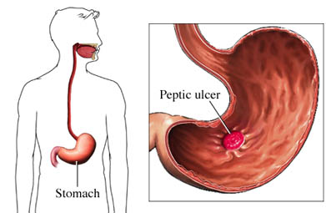
Misoprostol
(PGE₁ analog)
Peptic ulcer

Slide 34
Thank you

