Slide 1
Enzyme inhibition
Inhibition is a process by which the enzyme activity is regulated or controlled or stopped
To inhibit means to stop enzyme activity

Slide 2
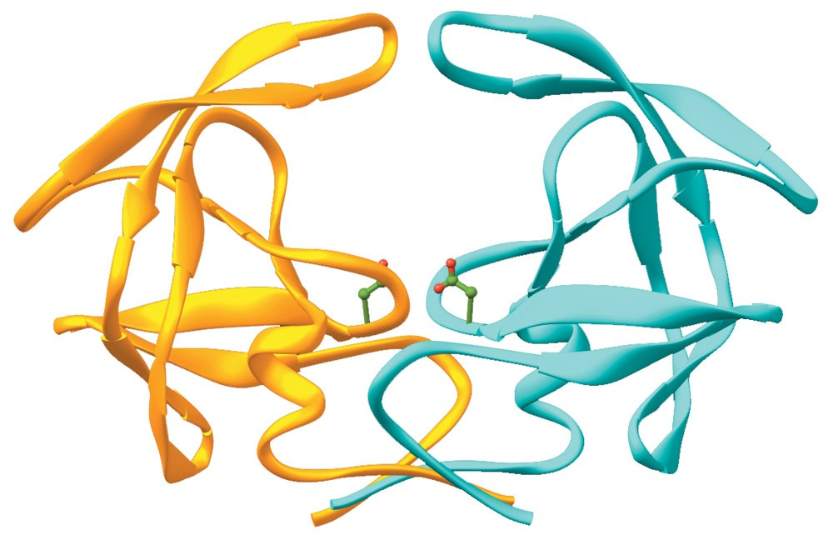
An enzyme without inhibitor
Page 538

Slide 3
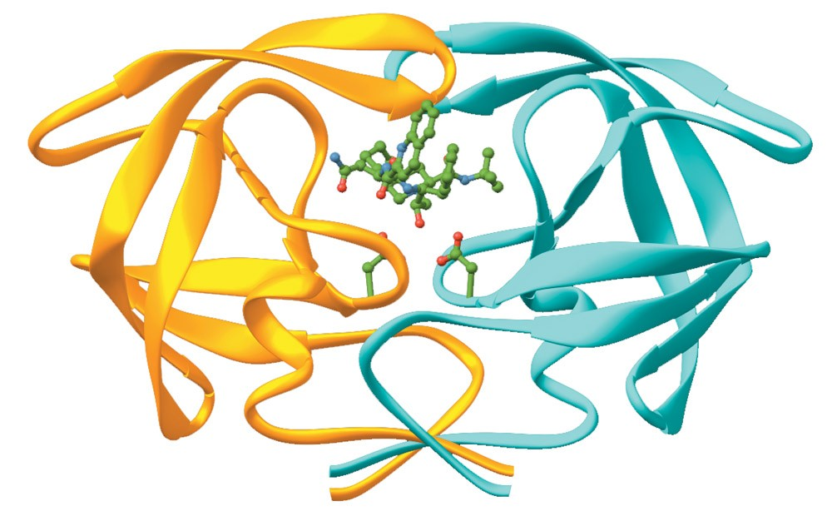
An enzyme with inhibitor
Page 538

Slide 4
K_{i} (Inhibitor constant)
K_{i} is a measure of the affinity of inhibitor for enzyme
Also called dissociation constant

Slide 5
Enzyme inhibition
There are three types of enzyme inhibition:
Competitive
Noncompetitive
Uncompetitive

Slide 6
Competitive inhibition
The inhibitor is a structural analogue (similar) that competes with the substrate for binding to the active site of enzyme
Two reactions are possible:
E + S ↔ ES → E + P
and
E + I ↔ EI

Slide 7
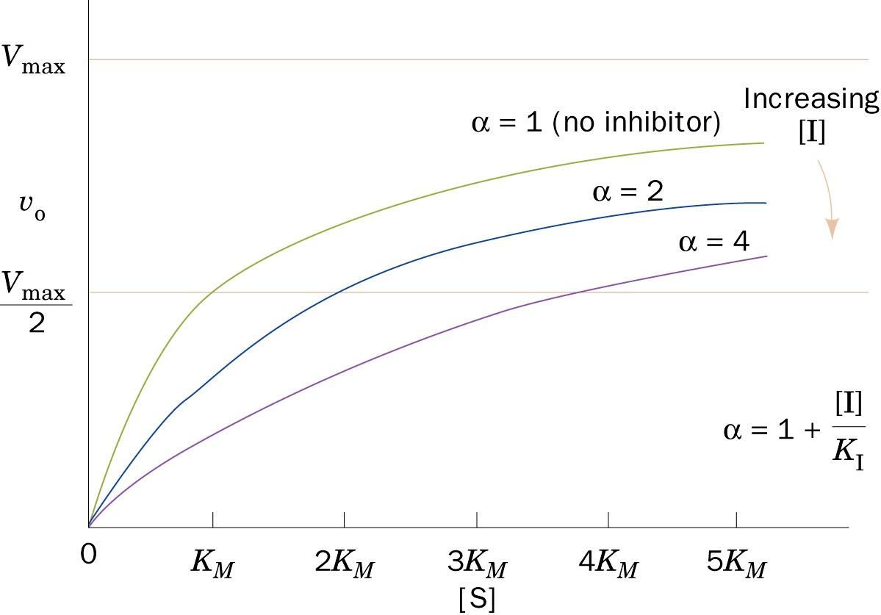
Competitive inhibition
Page 484

Slide 8
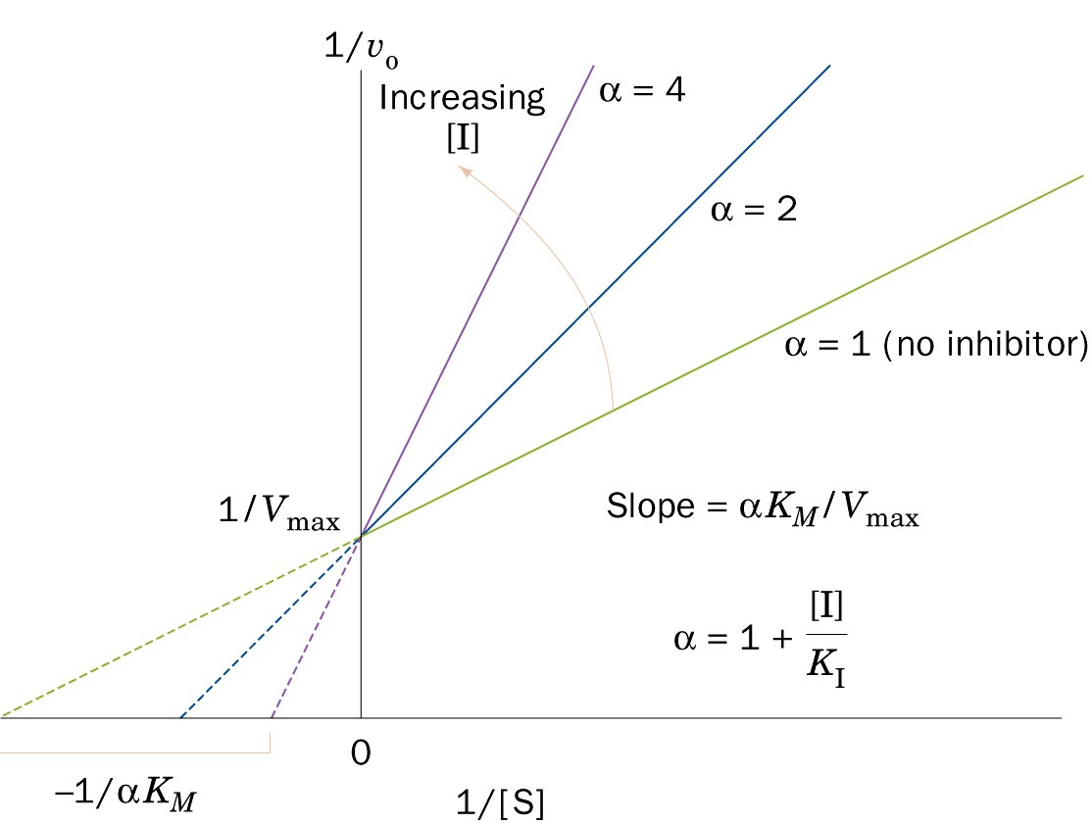
Lineweaver–Burk plot of the competitively inhibited Michaelis–Menten enzyme
Page 484

Slide 9
In competitive inhibition, V_{max} is unchanged in the presence and the absence of inhibitor
The value of K_{m} is increased because S and I compete for binding at the same site
A higher [S] is required to achieve half-maximal velocity

Slide 10
Noncompetitive inhibition
The inhibitor does not have structural similarity to the substrate
The inhibitor binds to the enzyme at a site away from the substrate binding site
No competition exists between the inhibitor and the substrate
The inhibitor can bind to a free enzyme or to an enzyme-substrate complex
In both cases the complex is catalytically inactive

Slide 11
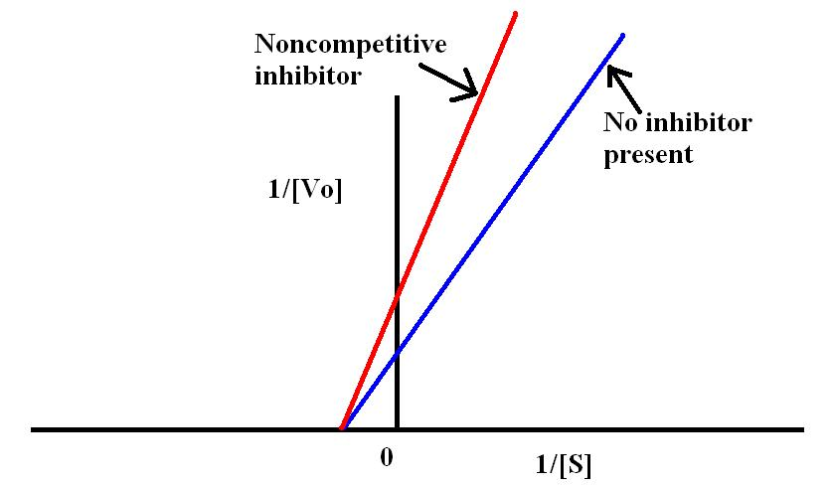
Noncompetitive inhibition
Page 484

Slide 12
ES + I ↔ ESI (inactive)
E + I ↔ EI (inactive)
The value of V_{max} is decreased by the inhibitor
K_{m} is unchanged because the affinity of S for E is unchanged

Slide 13
Uncompetitive inhibition
The inhibitor binds to ES complex to form ESI complex
ES + I ↔ ESI
Both V_{max} and K_{m} are changed in uncompetitive inhibition

Slide 14
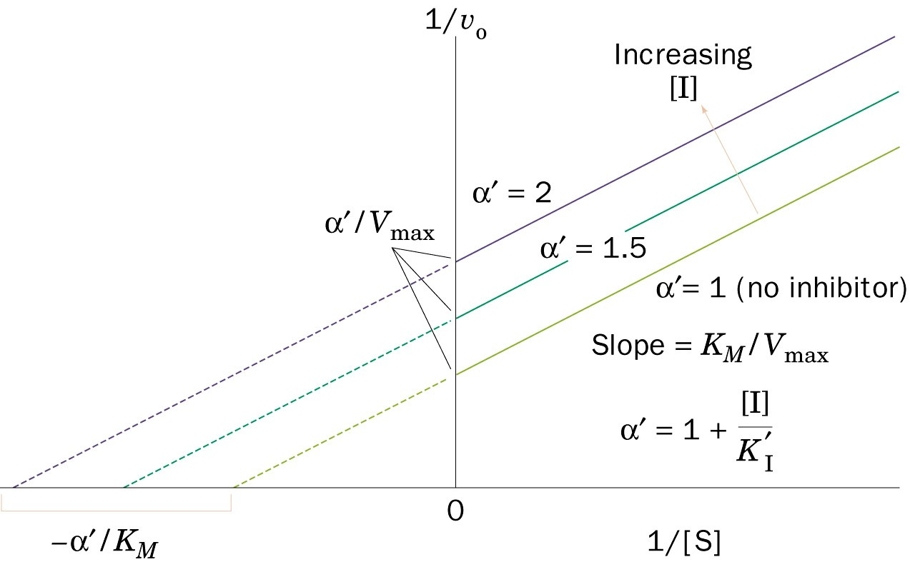
Figure 14-13 Lineweaver–Burk plot of a simple Michaelis–Menten enzyme in the presence of uncompetitive inhibitor.
Page 485

Slide 15
Regulation of enzyme activity
Regulatory enzymes usually catalyze the first or an early reaction in a metabolic pathway
They catalyze a rate limiting reaction that controls the overall pathway
They may also catalyze a reaction unique to that pathway known as committed step

Slide 16
Feedback inhibition:
When the end-product of a metabolic pathway exceeds its conc. limit, it inhibits the regulatory enzyme to normalize the pathway (feedback inhibition)
Feed positive activation:
When the end-product of a metabolic pathway is below its conc. limit, it activates the regulatory enzyme to normalize the pathway

Slide 17
Types of regulation
Allosteric enzyme regulation
Enzymes in metabolic pathways are regulated by certain compounds (ligand)
These ligands do not bind to active site
They bind to other site (regulatory site) on the enzyme (allosteric enzymes)
The term “allosteric” came from Greek word “allos” meaning “other”

Slide 18
Cooperative binding
Binding of a ligand to a regulatory site affects binding of the same or of another ligand to the enzyme
This is called cooperative binding

Slide 19
Binding of a ligand causes a change in the active site of enzyme
This causes a change in the binding affinity of enzyme for the substrate

Slide 20
The effect of a ligand may be positive (activation) or negative (inhibition)
Positive: increased E, S affinity
Negative decreased E, S affinity
Most allosteric enzymes are oligomers (two or more polypeptide chains or subunits)
The subunits are known as protomers

Slide 21
Two types of interactions occur in allosteric enzymes:
Homotropic
Heterotropic
Homotropic: Effect of one ligand on the binding of the same ligand
A regulatory enzyme controlled by its own substrate
Heterotropic: Effect of one ligand on the binding of a different ligand

Slide 22
Enzymatic diagnosis and prognosis of diseases
Enzymes are used clinically in three ways:
As indicators of enzyme activity or conc. in body fluids (serum, urine) in the diagnosis/prognosis of diseases
As analytical reagents in measuring activity of other enzymes or compounds in body fluids
As therapeutic agents

Slide 23
The most commonly used body fluids for measuring enzyme activity are serum and plasma
There are:
Plasma-specific enzymes
Nonplasma-specific enzymes

Slide 24
Serum markers in the diagnosis of diseases
Heart disease
Pancreatic diseases
Liver diseases

