Slide 1
Molecular Biology
(Foundation Block)
2 Lectures Dr. Usman Ghani
The central dogma of molecular biology
Nucleotide chemistry
DNA, RNA and Chromosome Structure
DNA Replication
Gene Expression
Transcription
The genetic code
Translation

Slide 2
The Central Dogma of Molecular Biology
Human genome contains about 35,000 genes

Slide 3
Nucleotides
Nucleotides are composed of a nitrogenous base, sugar, and phosphate group(s)
The nitrogenous bases are of two types:
Purine
Pyrimidine

Slide 4
The most common purines are:
Adenine (A)
Guanine (G)
The most common pyrimidines are:
Cytosine (C)
Uracil (U)
Thymine (T)

Slide 5
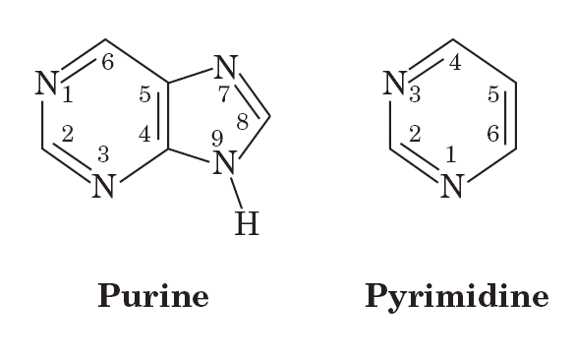

Slide 6
Names and Abbreviations of Nucleic Acid Bases, Nucleosides, and Nucleotides
Page 86

Slide 7
Ribose Sugar
Ribose sugar is a pentose sugar (with 5 carbon ring)
Two types of ribose sugar:
Deoxyribose (no OH at C₂)
Ribose (with OH at C₂)

Slide 8
Chemical structures of (a) ribonucleotides and (b) deoxyribonucleotides
Page 81

Slide 9
In ribonucleotides, the sugar is ribose
In deoxyribonucleotides, the sugar is deoxyribose
The sugar carbon numbers are primed (1’ 2’ 3’ etc.)
The nitrogenous base atoms are unprimed
The nitrogenous base is bonded to C₁’ of sugar
The PO₄ group is bonded to C₃’ or C₅’ of sugar

Slide 10
Chemical structures of (a) ribonucleotides and (b) deoxyribonucleotides
Page 81

Slide 11
Structure of a nucleotide
Page 82

Slide 12
Functions of Nucleotides
Nucleotides in DNA and RNA store and transfer genetic information
Free nucleotides have metabolic functions only
Other nucleotides: ATP, FAD, NAD, CoA

Slide 13
Types of Nucleic acids
DNA (Deoxyribonucleic acid)
RNA (Ribonucleic acid)

Slide 14
Structure of DNA
DNA is a double-stranded, helical polymer of deoxyribonucleotides

Slide 15
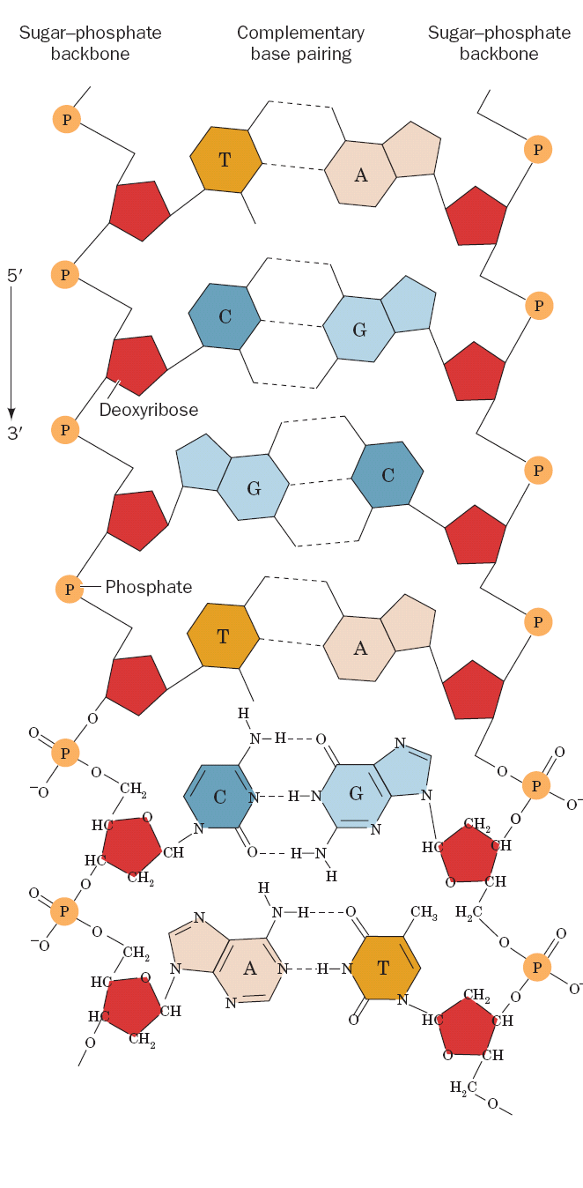

Slide 16
Chemical structure of a nucleic acid
The PO₄ bridges the 3’ and 5’ positions of ribose sugar
The PO₄ and sugar bonding is the backbone of DNA structure
Page 82

Slide 17
Chemical structure of a nucleic acid
The linkage between the nucleotides is called phosphodiester bond
Page 82

Slide 18
Base pairing in DNA
Adenine(A) Thymine (T)
Guanine (G) Cytosine (C)
In RNA there is no Thymine (T)
Adenine (A)
Uracil (U)
Guanine (G)
Cytosine (C)

Slide 19
Watson-Crick base pairs
Page 88

Slide 20
The double helix DNA
The first DNA structure was determined by James Watson and Francis Crick in 1953
Commonly known as Watson-Crick structure

Slide 21
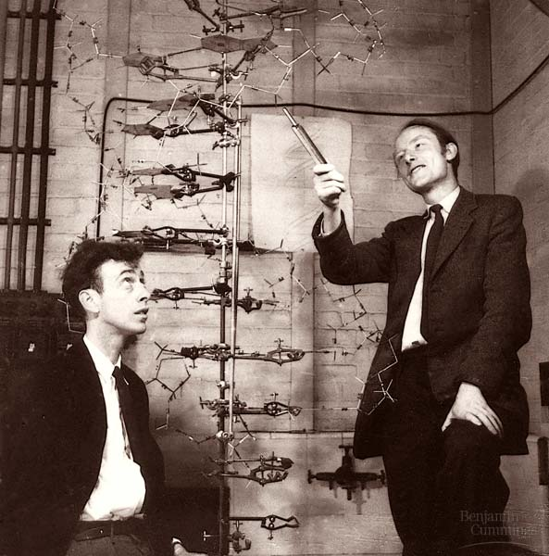
James Watson and Francis Crick

Slide 22
Three-dimensional structure of B-DNA
Page 87

Slide 23
The Features of Watson-Crick DNA structure
Two polynucleotide chains wind around a common axis to form a double helix
The two strands are anti-parallel (run in opposite direction)
Each strand is a right-handed helix
The nitrogenous bases are in the center of the double helix and the sugar-phosphate chains are on the sides

Slide 24
The Features of Watson-Crick DNA structure
The surface of the double helix contains 2 grooves: the major and minor grooves
Each base is hydrogen bonded to a base in the opposite strand to form a planar base pair (A-T and G-C), known as complementary base pairing
The helix has 10 base pairs (bp) per turn

Slide 25
Structure of B-DNA
Page 1108

Slide 26
Types of DNA Structure
A-DNA
B-DNA (Watson-Crick DNA)
Z-DNA

Slide 27
Structure of A-DNA
Page 1110

Slide 28
Structure of Z-DNA
Page 1112

Slide 29
DNA Supercoiling
The chromosomes of many bacteria and viruses contain circular DNA which is supercoiled

Slide 30
DNA Supercoiling in bacteria and viruses
Page 1122

Slide 31
Melting Temperature (Tm)
The temperature at which the double-stranded DNA is separated into two single strands
Melting temp. of DNA depends on nitrogenous base content (A-T and G-C)
G-C has 3 hydrogen bonds (stronger than A-T)

Slide 32
DNA melting due to heat
Page 90

Slide 33
Structure of RNA
RNA is a single-stranded polymer of ribonucleotides

Slide 34
Types of RNA
mRNA (messenger RNA)
Function: Transcription process (from DNA to mRNA)

Slide 35
Types of RNA
tRNA (transfer RNA)
Function: Translation process (from mRNA to protein synthesis)
It transfers amino acids to the growing protein chain

Slide 36
Structure of a tRNA
Page 1292

Slide 37
Types of RNA
rRNA (ribosomal RNA)
Function: Site of protein synthesis (factory)

Slide 38
Structure of ribosome
Page 1310

Slide 39
Chromosome Structure: How DNA is organized in a chromosome?
The human genome contains 3.5 billion base pairs and more than 95% is non-coding or “junk” DNA
The DNA from single 23 human chromosomes have a length of 1 meter
How such large quantities of DNA are packed into a single cell?

Slide 40
Electron micrograph of a human chromosome
Page 1423

Slide 41
The DNA of a human chromosome
Page 1430

Slide 42
Chromatin: Each chromosome is a complex of a single linear DNA molecule and histone proteins called chromatin
Chromatin consists of:
50% DNA
50% histones

Slide 43
Electron micrograph of chromatin filaments
Page 1429

Slide 44
Histones
Five major types of histones:
H1 H2A H2B H3 H4
Histones have positively charged amino acids (arginine and lysine)
These proteins bind to negatively charged PO₄ groups of DNA to stabilize the chromatin structure

Slide 45
Nucleosomes
Nucleosomes are particles consisting of DNA and histones connected by thin strands of naked DNA (like beads on a string; Sibhah in Arabic)
Nucleosomes consist of the histone octamer (eight) and DNA
(H2A)₂(H2B)₂(H3)₂(H4)₂
H1 binds to 2 complete helical turns of DNA

Slide 46
Electron micrograph of chromatin showing nucleosomes
Page 1424

Slide 47
A nucleosome showing interaction of histones with the DNA
Page 1427

Slide 48
Chromatin filament with nucleosomes and naked DNA
Page 1430

