Slide 1
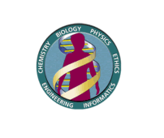
Amino Acids
(Foundation Block)
1 Lecture Dr. Sumbul Fatma
Objectives
What are amino acids?
Structure
Types
Peptide bond: building blocks of proteins
Non-standard amino acids
Derivatives of amino acids

Slide 2
Amino acids
Building blocks of proteins
Amino acids are joined together by peptide bond like a chain in a protein
There are 20 standard amino acids present in mammalian proteins

Slide 3
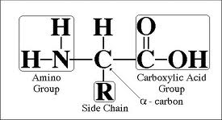
Structure of amino acids
Groups attached to α- carbon
  a carboxyl group
  an amino group
  a side chain (R)
Side chain groups
are variable

Slide 4
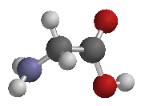
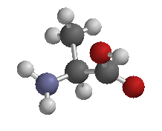
Examples
H
I
H₂N—C —COOH
I
H glycine
CH₃
I
H₂N—C —COOH
I
H alanine

Slide 5
The amino and carboxylic groups of amino acids can readily ionize

Slide 6
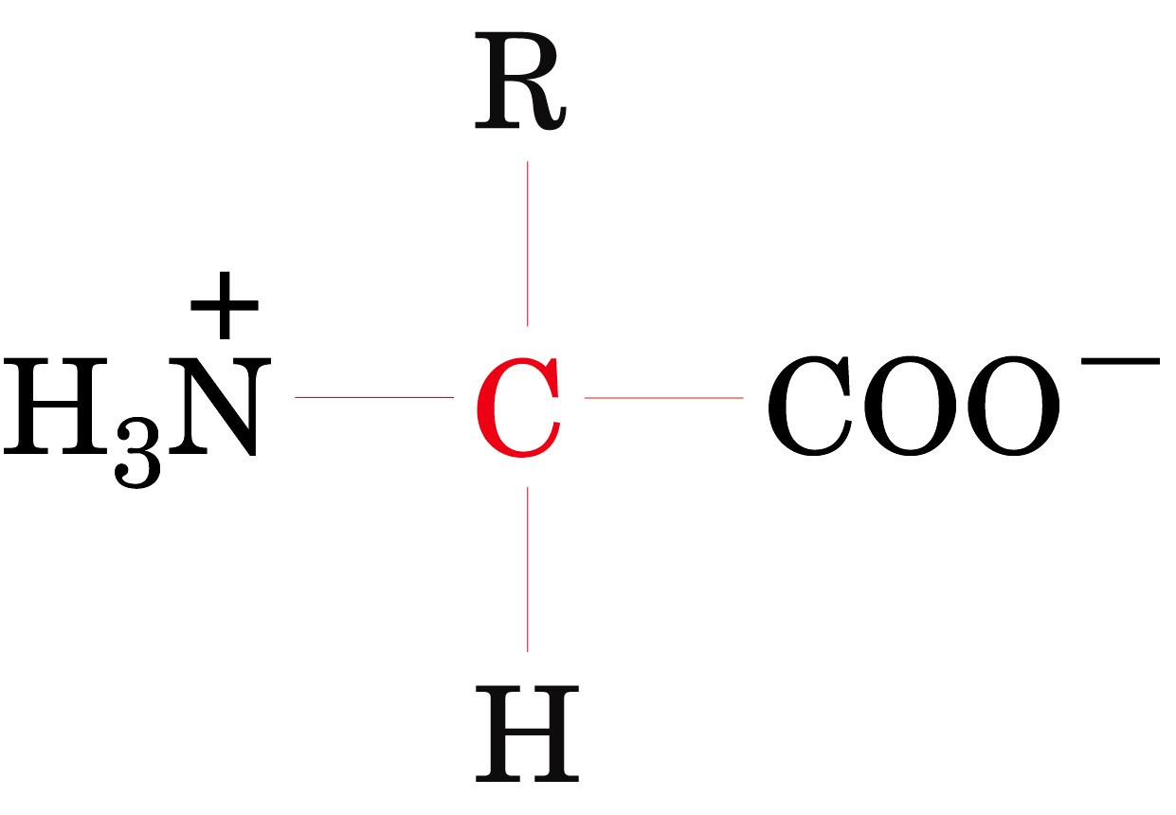
Zwitterions (Dipolar ions)
Net charge is zero on the molecule

Slide 7
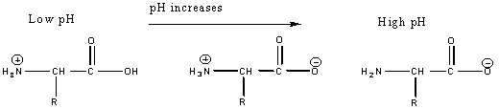
Isoelectric point (pI)
The pH at which the molecule carries no net charge
In acidic solution-cationic
In alkaline solution- anionic

Slide 8
pK Value
It is the ability of an acid to donate a proton (dissociate)
Also known as pKa or acid dissociation constant

Slide 9
The pK values of a-carboxylic group is in the range of 2.2
The pK values of a-amino group is in the range of 9.4

Slide 10
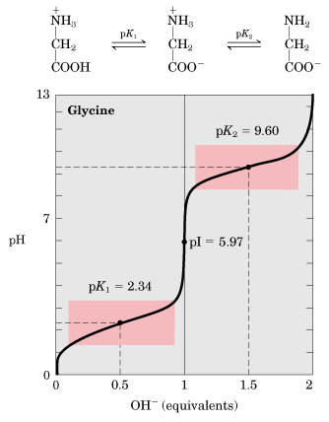
Titration curve of glycine
pK1- pH at which 50% of molecules are in cation form and 50% are in zwitterion form
pK2- pH at which 50% of molecules are in anion form and 50% are in zwitterion form
Buffering action is maximum around pK values and minimum at pI

Slide 11
Classification on the basis of side chain
Three major types of amino acids:
  Nonpolar
  Uncharged polar
  Charged polar

Slide 12
Classification on the basis of side chain
Non-polar
  Side chain does not bind or give off protons
  hydrophobic
  Glycine Alanine
  Valine Leucine
  Isoleucine Methionine
  Proline Phenylalanine
  Tryptophan

Slide 13
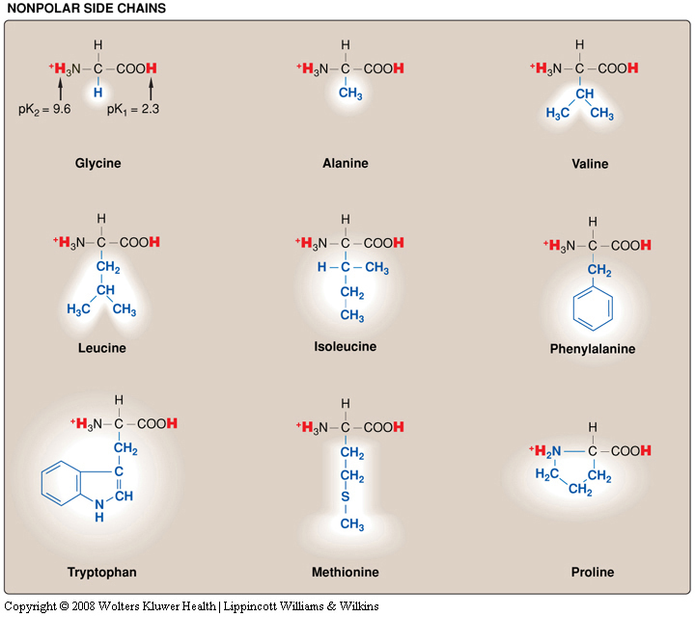

Slide 14
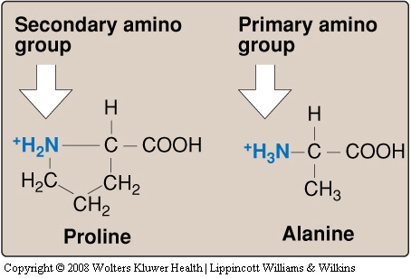
Proline
Imino acid
  Has a secondary amino group

Slide 15
Classification on the basis of side chain
Uncharged Polar
Have zero net charge at neutral pH
Hydrophillic
  Serine Threonine
  Asparagine Glutamine
  Tyrosine Cysteine

Slide 16
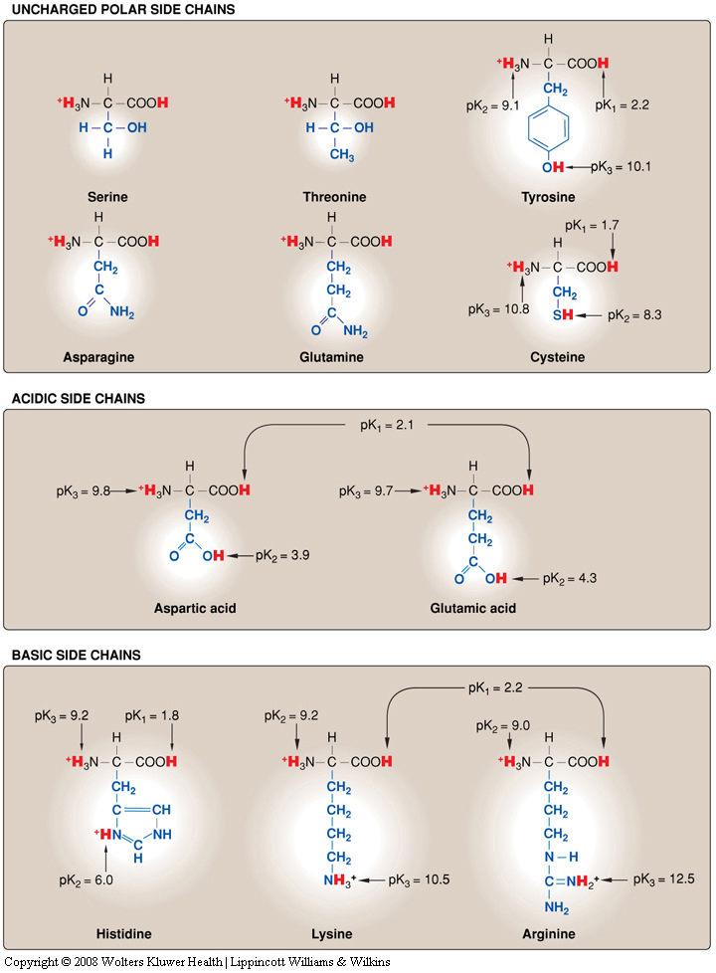

Slide 17
Classification on the basis of side chain
Charged Polar
  Acidic amino acids
  Basic amino acids

Slide 18
Polar acidic amino acids
Have a negative charge on the R-group

Slide 19
Polar basic amino acids
Have a positive charge on the R-group

Slide 20
Peptide bond
Amino acids can be polymerized to form chains
Amino acids are joined together in a chain by peptide bond [CO-NH linkage]
α-carboxyl group of one amino acid reacts with α-amino group of another amino acid

Slide 21
Proteins are made by controlled polymerization of amino acids

Slide 22
Peptides
2 aa- dipeptide
3-?
4- ?
Upto 10- oligo peptide
10-50- polypeptide
More than 50 - proteins

Slide 23
Peptide bond contd..
Each amino acid in a chain makes two peptide bonds
The amino acids at the two ends of a chain make only one peptide bond
The aa with a free amino group is called amino terminus or N-terminus
The aa with a free carboxylic group is called carboxyl terminus or C-terminus

Slide 24
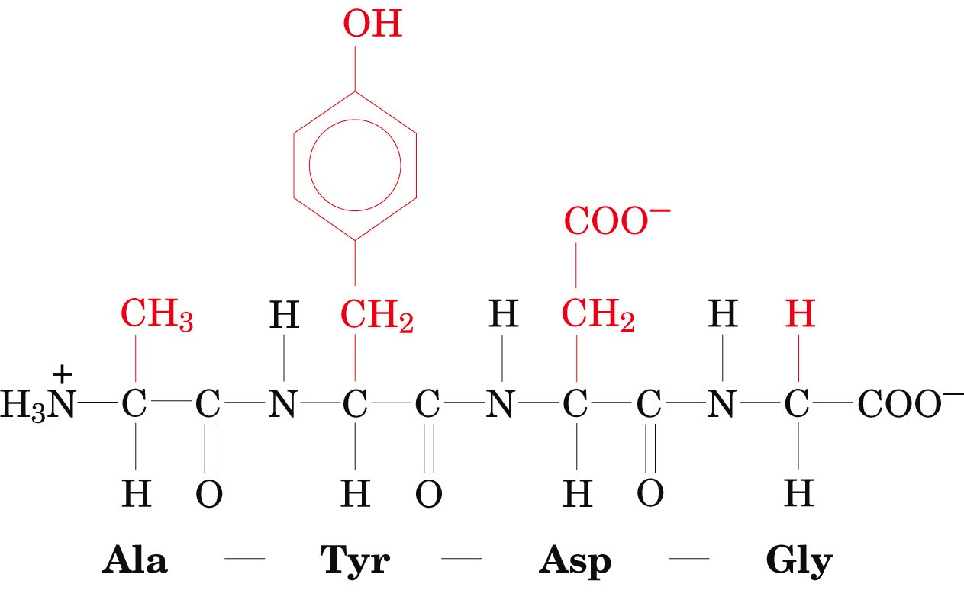
The tetrapeptide Ala-Tyr-Asp-Gly
Page 71
The tetrapeptide Ala-Tyr-Asp-Gly

Slide 25
Optical activity
All aa are optically active except glycine
  They rotate the plane of polarized light in a polarimeter
Optically active molecules are asymmetric:
    They are not superimposable on their mirror image
    Asymmetric means α-C is bonded to four different groups

Slide 26
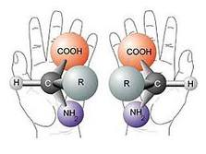

Slide 27
  Glycine contains two hydrogen atoms on α-C
  The α-C of glycine is not asymmetric
  Therefore glycine is optically inactive

Slide 28
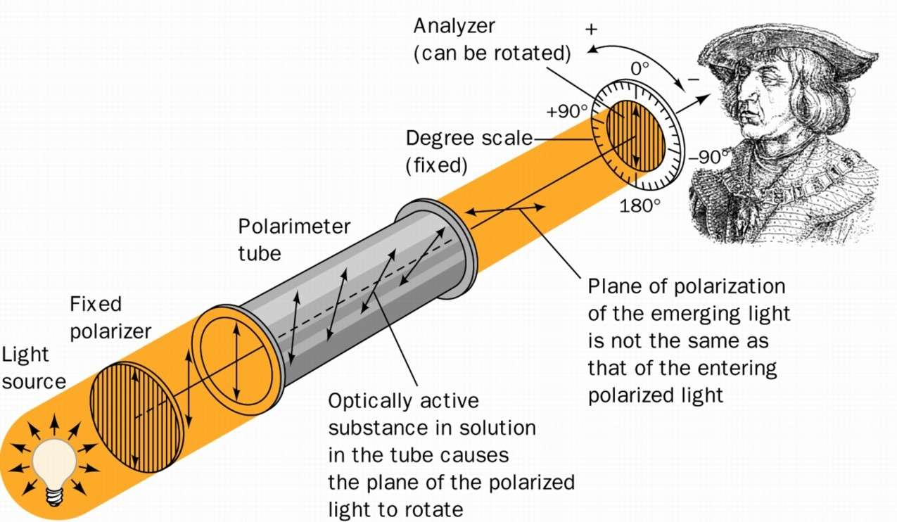
Schematic diagram of a polarimeter
Page 72

Slide 29
D and L- amino acids
L-Amino acids rotate polarized light to the left
D-Amino acids rotate polarized light to the right
Both L and D forms are chemically same
L-amino acids – natural amino acids
D-amino acids are found in antibiotics (like Gramicidin-S, Actinomycin-D and Valinomycin) and in plant and bacterial cell walls

Slide 30
Non-standard amino acids

Slide 31
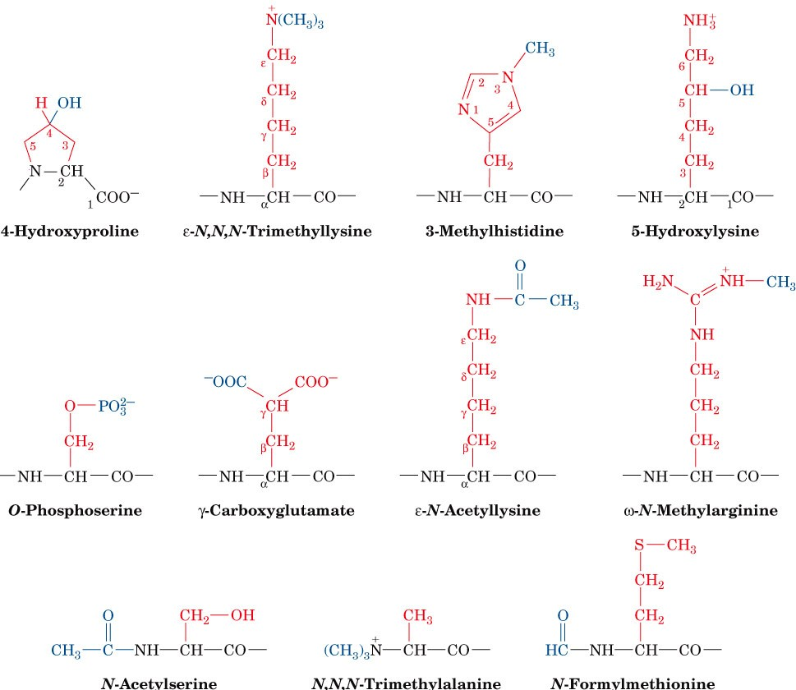
Some uncommon amino acid residues that are components of certain proteins
Page 77

Slide 32
Amino acid derivatives of importance
Gamma amino butyric acid (GABA, a derivative of glutamic acid) and dopamine (from tyrosine) are neurotransmitters
Histamine (Histidine) is the mediator of allergic reactions
Thyroxine (Tyrosine) is an important thyroid hormone

Slide 33
References
Lippincott’s Illustrated reviews: Biochemistry 4th edition – unit 1

