Slide 1
Proteins
Dr. Sumbul Fatma
Clinical Chemistry Unit
Department of Pathology
Tel- 014673314
Email- sfatma@ksu.edu.sa
sumbulfatma@gmail.com

Slide 2
What are proteins?
Proteins are polymers of amino acids joined together by peptide bonds

Slide 3
Peptide Bond (amide bond)

Slide 4
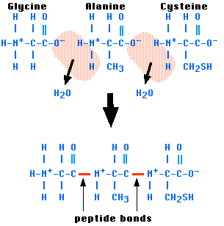
Each amino acid in a chain makes two peptide bonds
The amino acids at the two ends of a chain make only one peptide bond
The aa with a free amino group is called amino terminus or N-terminus
The aa with a free carboxylic group is called carboxyl terminus or C-terminus

Slide 5
Peptides
Amino acids can be polymerized to form chains
2 aa- dipeptide
3-?
4- ?
Few (~ 10)- oligo peptide
more- polypeptide

Slide 6
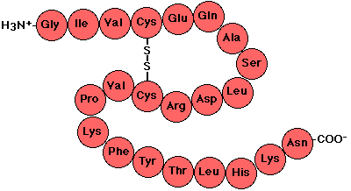
Primary Structure
It is the linear sequence of amino acids
Covalent bonds
  Peptide bond
  Dislphide bond
  (if any)

Slide 7
Secondary Structure
It is the local three-dimensional arrangement of a polypeptide backbone
Excluding the conformations (3D arrangements) of its side chains

Slide 8
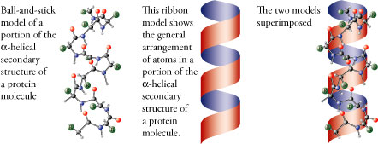
α Helix
α helix is right-handed
It has 3.6 amino acid residues per turn
Stabilized by hydrogen bonding
  Between 1st carboxylic group and 4th amino group
The side chains point outward and downward from the helix
The core of the helix is tightly packed and its atoms are in van der Waals contact

Slide 10
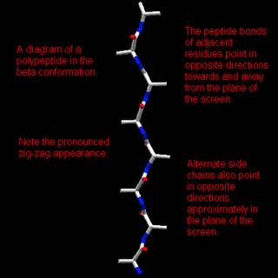
β Sheets
Two or more polypeptide chains make hydrogen bonding with each other
Also called pleated sheets because they appear as folded structures with edges

Slide 11
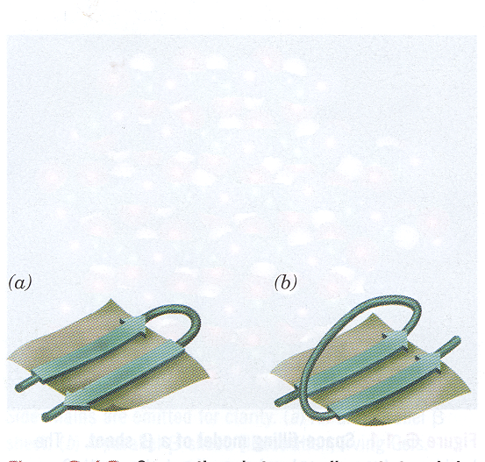
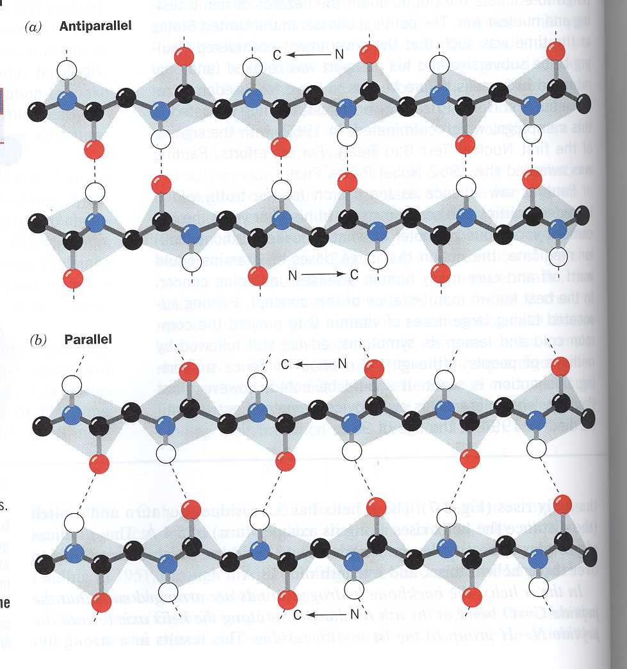
Antiparallel β sheets
Two or more hydrogen-bonded polypeptide chains run in opposite direction
Hydrogen bonding is more stable

Slide 12
Parallel β sheets
Two or more hydrogen-bonded polypeptide chains run in the same direction
Hydrogen bonding is less stable (distorted)

Slide 13
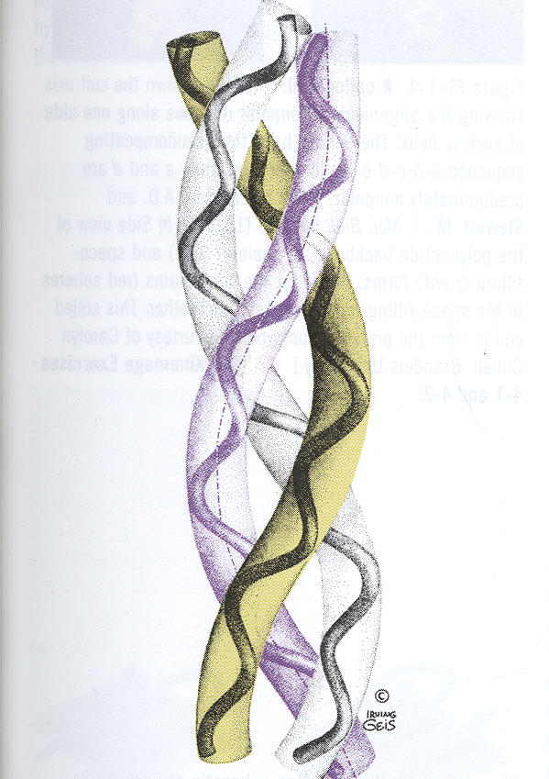
Collagen – a triple helix
A fibrous protein
Part of connective tissues: bone, teeth, cartilage, tendon, skin, blood vessels
Contains three left-handed coiled chains (not α helix)
Three residues per turn

Slide 14
Proline in collagen
Rich in proline amino acid
Proline prevents collagen chains to form α-helix because:
  It does not have back bone amino group (it is cyclic)
  Therefore hydrogen bonding within the helix is not possible

Slide 15
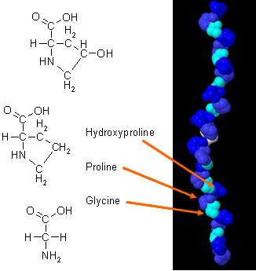
Non-standard amino acids in collagen
Proline is converted to 4-hydroxyprolyl residue by prolyl hydroxylase enzyme
The enzyme requires vitamin C for its function

Slide 16
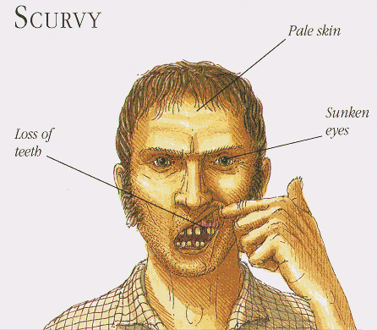
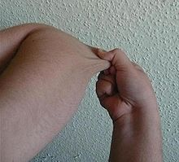
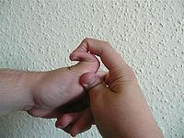
Collagen diseases
Scurvy: due to vitamin C deficiency
Ehlers-Danlos syndromes: hyperextensibility of joints and skin
Mutations in collagen gene

Slide 17
Other Secondary Structures
Turns (reverse turns)
Loops
Β bends
Random coils

Slide 18
Supersecondary structures or motifs
β α β motif: a helix connects two β sheets
β hairpin: reverse turns connect antiparallel β sheets
α α motif: two α helices together
β barrels: rolls of β sheets

Slide 19
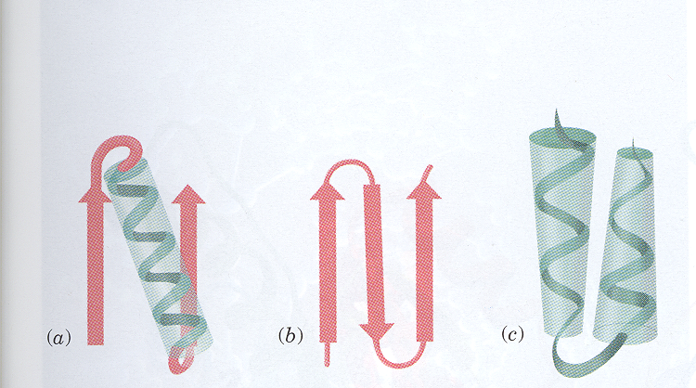
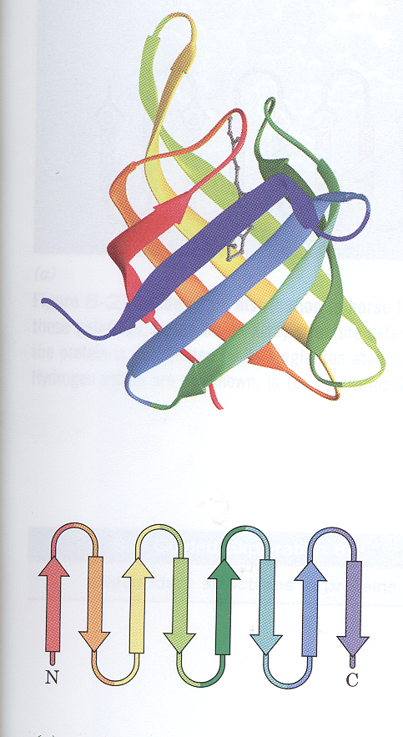
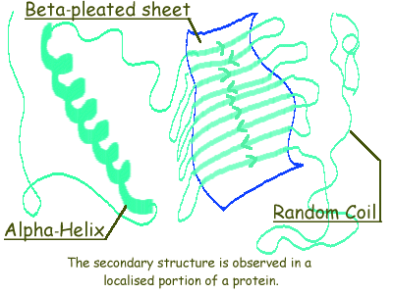
Crosssover
connection
Reverse turn/loop
β α β
β hairpin
α α
loop
β barrels

Slide 20
Tertiary Structure
It is the 3-d structure of an entire polypeptide chain including side chains
It includes the folding of secondary structure (α helix and β sheets) and side chains
Helices and sheets can be combined to form tertiary structure

Slide 21
Domains
Polypeptide chains (>200 amino acids) fold into two or more clusters known as domains
Domains are functional units that look like globular proteins
Domains are parts of protein subunits

Slide 22
Quaternary Structure
Many proteins contain two or more polypeptide chains
Each chain forms a three-dimensional structure called subunit
It is the 3D arrangement of different subunits of a protein

Slide 23
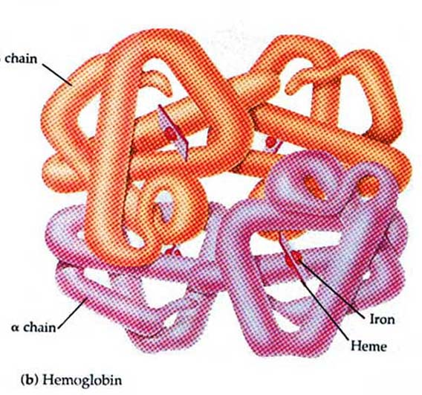
Hemoglobin
Hemoglobin is a globular protein
A multisubunit protein is called oligomer
Composed of α ₂ β ₂ subunits (4 subunits)
Two same subunits are called protomers

Slide 24
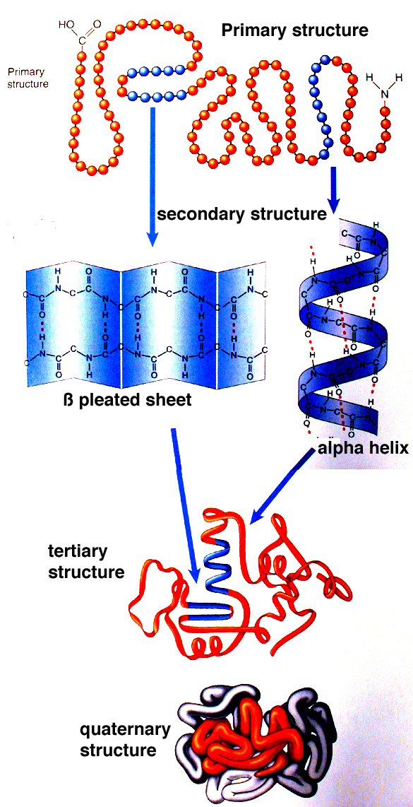

Slide 25
Forces that stabilize protein structure
Hydrophobic effect:
  Nonpolar groups to minimize their contacts with water
  Nonpolar side chains are in the interior of a protein
Hydrogen bonding
  A weak electrostatic bond between one electronegative atom like O or N and a hydrogen atom
Electrostatic interactions (ion pairing):
  Between positive and negative charges
van der Waals forces (weak polar forces):
  Weak electrostatic interactions between neutral molecules

Slide 26
Protein denaturation
Denaturation: A process in which a protein looses its native structure
Factors that cause denaturation:
  Heat: disrupts hydrogen bonding
  Change in pH: alters ionization states of aa
  Detergents: interfere with hydrophobic interactions
  Chaotropic agents: ions or small organic molecules that disrupt hydrophobic interactions

Slide 27
Protein Misfolding
Every protein must fold to achieve its normal conformation and function
Abnormal folding of proteins leads to a number of diseases in humans
Alzheimer’s disease:
  β amyloid protein is a misfolded protein
  It forms fibrous deposits or plaques in the brains of Alzheimer’s patients

Slide 28
Creutzfeldt-Jacob or prion disease:
  Prion protein is present in normal brain tissue
  In diseased brains, the same protein is misfolded
  Therefore it forms insoluble fibrous aggregates that damage brain cells

