Slide 1
Carbohydrates: structure and Function
By
Dr. Sumbul Fatma

Slide 2
Objectives
To understand:
The structure of carbohydrates of physiological significance
The main role of carbohydrates in providing and storing of energy
The structure and function of glycosaminoglycans

Slide 3
OVERVIEW
Carbohydrates:
The most abundant organic molecules in nature
The empiric formula is (CH₂O)n, “hydrates of carbon”
Carbohydrates:
provide important part of energy in diet
Act as the storage form of energy in the body
are structural component of cell membranes

Slide 4
OVERVIEW
CONT’D
Many diseases associated with disorders of carbohydrate metabolism including:
Diabetes mellitus
Galactosemia
Glycogen storage diseases
Lactose intolerance

Slide 5
CLASSIFICATION
Monosaccharides: Simple sugar
Disaccharides: 2 monosaccharide units
Oligosaccharides: 3-10 monosaccharide units
Polysaccharides: more than 10 sugar units
Homopolysaccharides & heteropolysaccharides

Slide 6
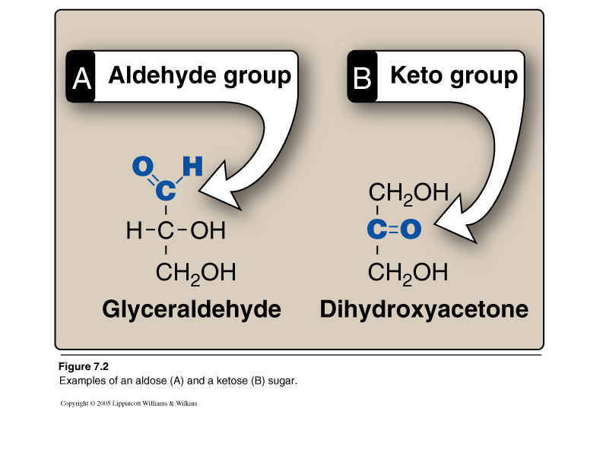
Monosaccharides
Further classified based on:
1. No. of carbon atoms
2. Functional sugar group:
Aldehyde group – aldoses
Keto group – ketoses

Slide 7
Monosaccharides
CONT’D
 | Aldose | Ketose
Triose | Glyceraldehyde | Dihydroxyacetone
Pentose | Ribose | Ribulose
Hexose | Glucose | Fructose

Slide 8
Isomerism
Isomers
Compounds having same chemical formula but different
structural formula

Slide 9
Aldo-Keto Isomers
Example:
Glucose (Aldose)
and
Fructose (Ketose)

Slide 10
Epimers
Epimers
CHO dimers that differ in configuration around only one specific carbon atom
-Glucose and galactose, C4
-Glucose and Mannose, C2
Galactose and mannose are not epimers

Slide 11
Enantiomers (D- and L-Forms)
Structures that are mirror images of each other and are designated as D- and L- sugars based on the position of –OH grp on the asymmetric carbon farthest from the carbonyl carbon
Majority of sugars in humans are D-sugars

Slide 12
α- and β-Forms
Cyclization of Monosaccharides Monosaccharides with 5 or more carbon are predominantly found in the ring form
The aldehyde or ketone grp reacts with the –OH grp on the same sugar
Cyclization creates an anomeric carbon (former carbonyl carbon) generating the α and β configurations

Slide 13
Mutarotation
In solution, the cyclic α and β anomers of a sugar are in equilibrium with each other, and can be interconverted spontaneously
Fischer Projection
Fischer Projection
Haworth Projection

Slide 14
Sugar Isomers
Aldo-keto
Epimers
D- and L-Forms
α- and β-anomers

Slide 15
Disaccharides
Joining of 2 monosaccharides
by O-glycosidic bond:
Maltose (α-1, 4)= glucose + glucose
Sucrose (α-1,2) = glucose + fructose
Lactose (β-1,4) = glucose + galactose

Slide 16
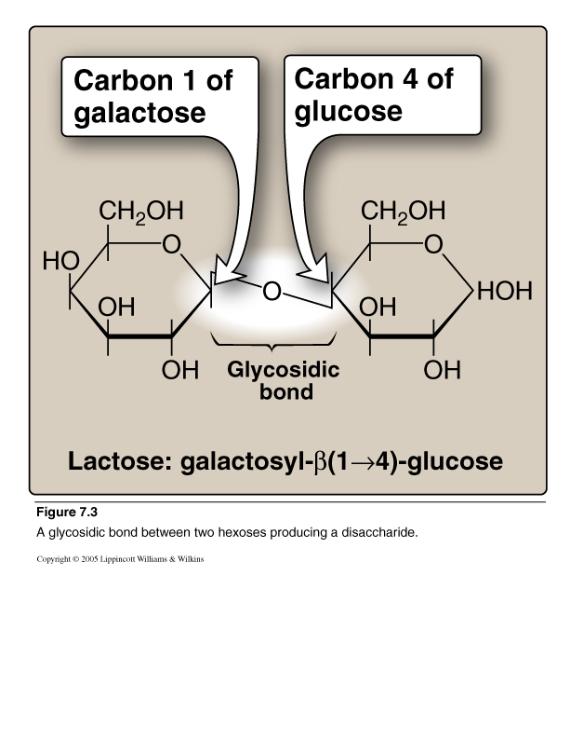
Disaccharides
CONT’D
Lactose

Slide 17
Polysaccharides
Homopolysaccharides:
Branched:
Glycogen and starch (α-glycosidic polymer)
Unbranched:
Cellulose (β-glycosidic polymer)
Heteropolysaccharides:
e.g., glycosaminoglycans (GAGs)

Slide 18
Reducing Sugars
If the O on the anomeric C of a sugar is not attached to any other structure (Free), that sugar can act as a reducing agent
Reducing sugars reduce chromogenic agents like Benedict’s reagent or Fehling’s solution to give a colored precipitate
Urine is tested for the presence of reducing sugars using these colorimetric tests

Slide 19
Reducing Sugars
CONT’D
Examples:
Monosaccharides
Maltose and Lactose
Sucrose is non-reducing, Why?

Slide 20
Complex Carbohydrates
Carbohydrates attached to non-carbohydrate structures by glycosidic bonds (O- or N-type) e.g.,
1. Purine and pyrimidine bases in nucleic acids
2. Bilirubin
3. Proteins in glycoproteins and proteoglycans
4. Lipids found in glycolipids

Slide 21
Glycosidic Bonds
N-Glycosidic
O-Glycosidic

Slide 22
Glycosaminoglycans (GAGs)
Glycosaminoglycans (GAGs) are large complexes of negatively charged heteropolysaccharide chains
are associated with a small amount of protein, forming proteoglycans, which consist of over 95 percent carbohydrate
bind with large amounts of water, producing the gel-like matrix that forms body's ground substance
The viscous, lubricating properties of mucous secretions also result from GAGs, which led to the original naming of these compounds as mucopolysaccharides

Slide 23
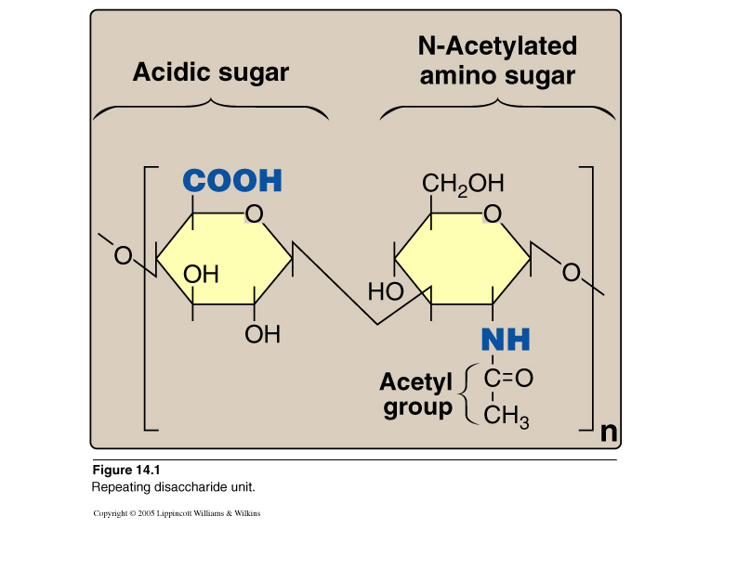
Glycosaminoglycans (GAGs)
GAGs are linear polymers of repeating disaccharide units
[acidic sugar-amino sugar]n
The amino sugar (usually sulfated) is either
D-glucosamine or D-galactosamine
The acidic sugar is either
D-glucuronic acid or L-iduronic acid
GAGs are strongly negatively-charged: carboxyl groups of acidic sugars
Sulfate groups

Slide 24
Resilience of GAGs
Relationship between glycosaminoglycan structure and function
Because of negative charges, the GAG chains tend to be extended in solution and repel each other and when brought together, they "slip" past each other
This produces the "slippery" consistency of mucous secretions and synovial fluid
When a solution of GAGs is compressed, the water is "squeezed out" and the GAGs are forced to occupy a smaller volume. When the compression is released, the GAGs spring back to their original, hydrated volume because of the repulsion of their negative charges
This property contributes to the resilience of synovial fluid and the vitreous humor of the eye

Slide 25
Members of GAGs
Examples of GAGs are:
Chondroitin sulfates: Most abundant GAG
Keratan sulfates: Most heterogeneous GAGs
Hyaluronic acid: Compared to other GAGs, it is unsulfated and not covalently attached to protein
Heparin: Unlike other GAGs, Unlike other GAGs that are extracellular, heparin is intracellular and serves as an anticoagulant

Slide 26
Take home Message
Structure and function of carbohydrates
Mono-, Di-, and Poly-saccharides
Sugar Isomers: Aldo-keto, epimers, D- and L-, α- and β-anomers
Complex carbohydrates:
e.g., Glycosaminoglycans and proteoglycans
Structure and function of GAGs
Examples of GAGs: chondroitin sulfate, keratin sulfate, hyaluronic acid and heparin

Slide 27
Reference
Lippincott’s Illustrated reviews- Biochemistry, 4th Edition

