Slide 1
بسم الله الرحمن الرحيم

Slide 2
Lipid Compounds of Physiological Significance
By
Reem M. Sallam, MD, PhD

Slide 3
Objectives
Functions of lipid compounds
Clinical problems
Lipid compounds of physiological importance
Complex lipids:
Phospholipids, glycolipids and lipoproteins

Slide 4
Functions of lipid compounds
Major energy source for the body
Structural component of cell membranes
Important regulatory molecules:
e.g., Fat-soluble vitamins Steroid hormones Prostaglandins Signaling molecules: Inositol triphosphate (IP3)

Slide 5
Lipids and Related Clinical Problems
Obesity
Atherosclerosis and hypertension
Coronary heart diseases

Slide 6
Lipid Compounds
Heterogeneous group
Relatively water-insoluble (? Exception)
Soluble in non-polar solvents

Slide 7
A. Simple Lipids:
Fatty acids
Ketone bodies
Triacylglycerol
Cholesterol
B. Complex Lipids:
Phospholipids
Lipoproteins
Glycolipids
Lipid Compounds:
Heterogeneous Group

Slide 8
Free Fatty Acids
Amphipathic: Both hydrophobic & hydrophilic parts

Slide 9
Free Fatty Acids (FFA)
1. Chain length:
Short-chain and Medium-Chain
Long-Chain e.g., Palmitic acid 16:0
Very long-chain e.g., Nervonic acid 24:1
2. Degree of saturation:
Saturated: No double bonds
Unsaturated: Mono- or poly-unsaturated
Cis- or trans-form
3. Branched Vs straight-chain
4. Essential fatty acids

Slide 10
Fatty Acids

Slide 11
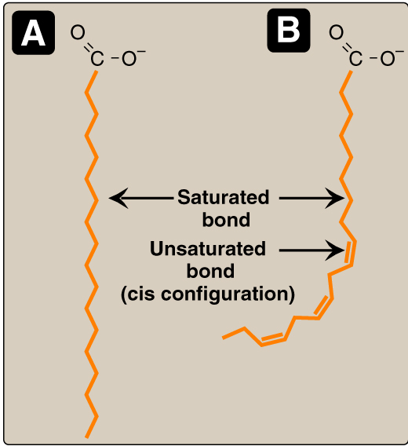
Fatty Acids
Saturated Vs Unsaturated
Melting temperature (T_{m}):
Addition of double bonds:
T_{m}
Increase chain length:
T_{m}
Kink

Slide 12
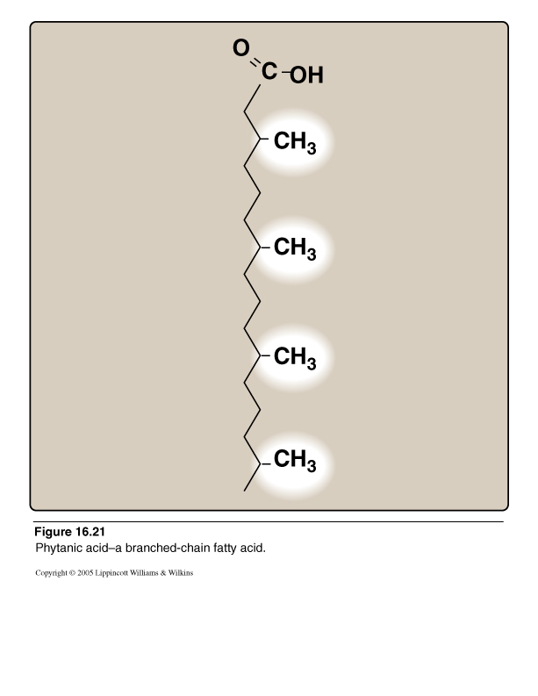
Branched-chain
Fatty acid:
Phytanic acid
Milk & dairy products

Slide 13
Plasma Fatty Acids
Esterified form (~90%):
In triacylglycerol, cholesterol ester, phospholipids
(as part of lipoproteins)
Free-form (unesterified):
Transported in association with albumin

Slide 14
Triacylglycerols
Storage form in adipose tissue
~ 90% of dietary lipids
Glyscerol plus 3 fatty acids
Blood transport: Chylomicrons and VLDL

Slide 15
1. Water-soluble
2. Diabetic Ketoacidosis
Ketone Bodies
Acetone
Acetoacetate
β-Hydroxybutyrate

Slide 16
Phospholipids
A. Glycerophospholipids
Glycerol-containing phospholipids
1. Phosphatidylcholine (Lecithin)
e.g., Surfactant (Dipalmitoylecithin)
2. Cardiolipin (antigenic)
3. Phosphatidyl inositol (signaling molecule)
B. Sphingo-phospholipids:
Sphingosine-containing phospholipids:
e.g., sphingomyelin (Myelin sheath)

Slide 17
Phospholipids:
A. Glycerophospholipids
Members:
1. Phosphatidylcholine
(Lecithin)
e.g., Surfactant
(Dipalmitoyl lecithin)
Parent Compound
Phosphatidic acid

Slide 18
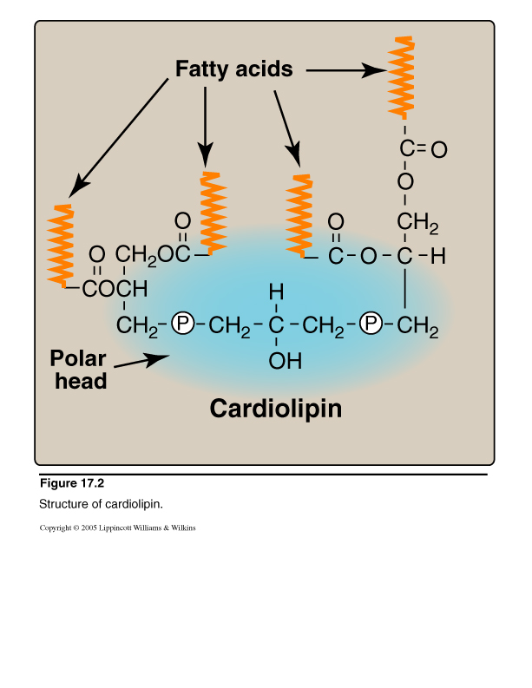
Diphosphatidyl glycerol

Slide 19
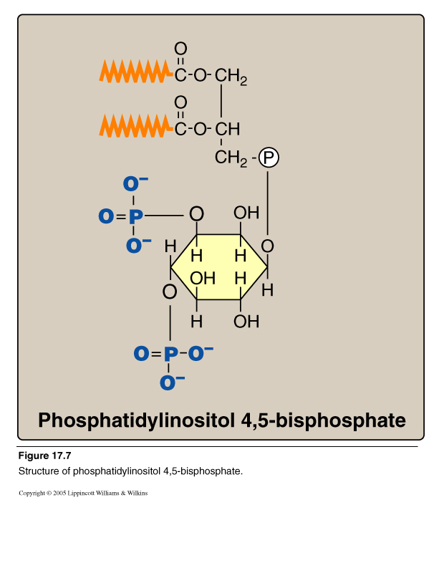

Slide 20
Intracellular Signaling by Inositol triphosphate

Slide 21
Phospholipids: B. Sphingo-phospholipids
Sphingomyelin
CH₃ (CH₂)₁₂ CH CH CH CH CH₂O
Phosphorylcholine
OH
NH
CH₃
(CH₂)_{n}
C
O
Long Chain Fatty acid

Slide 22
Sphingosine
CH₃ (CH₂)₁₂ CH CH CH CH CH₂OH
OH
NH₂
Long chain, unsaturated amino alcohol

Slide 23
Ceramide: Parent Sphingolipid Compound
CH₃ (CH₂)₁₂ CH CH CH CH CH₂OH
OH
NH
CH₃
(CH₂)_{n}
C
O
Long Chain Fatty acid

Slide 24
Sphingomyelin
CH₃ (CH₂)₁₂ CH CH CH CH CH₂O
Phosphorylcholine
OH
NH
CH₃
(CH₂)_{n}
C
O
Long Chain Fatty acid

Slide 25
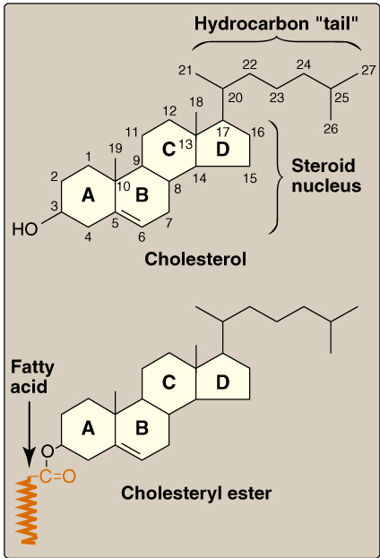
Cholesterol: Structure

Slide 26
Overview and Functions
Major Sterol of animal tissues
Component of cell membranes
Precursor for:
Bile acids & salts
Vitamin D
Steroid hormones:
Mineralocorticoids e.g., Aldosterone
Glucocorticoids, e.g., Cortisol
Sex hormones, e.g., Testosterone
Estrogen & progesterone
Hypercholesterolemia: Atherosclerosis & CAD

Slide 27
Cholesterol: Types
Animal and plant sterols:
Animal sterol: Cholesterol
Plant sterol: β-Sitosterol
• Poor intestinal absorption
• Active transport back to intestinal lumen
• Block cholesterol absorption
• Dietary treatment of hypercholesterolemia
(Trans fatty acid-free margarine)

Slide 28
Cholesterol: Types
CONT’D
 | Free cholesterol | Esterified cholesterol
OH at C3 Hydrophobic Membranes Plasma Transport | Free Less Found Less LDL/HDL | Fatty acid More Absent Most HDL/LDL

Slide 29
Lipoprotein Structure
Protein part: Apoproteins or apolipoproteins
Abbreviations: Apo-A, B, C
Functions:
Structural and transport function
Enzymatic function
Ligands for receptors
Lipid part:
According to the type of lipoproteins
Different lipid components in various combinations

Slide 30
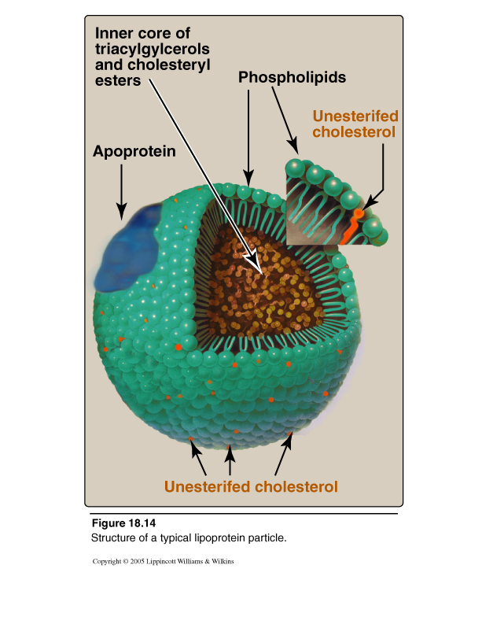
Lipoprotein Structure

Slide 31
Chylomicrons
Very low density
Lipoprotein (VLDL)
Low density
Lipoprotein (LDL)
High density
Lipoprotein (HDL)
Composition
of
Lipoproteins

Slide 32
Ultracentrifugation
of
Lipoproteins

Slide 33
Plasma Lipoproteins
Triacylglycerol transport:
Chylomicrons: TG of dietary origin
VLDL: TG of endogenous synthesis
Cholesterol transport:
LDL: Mainly free cholesterol
HDL: Mainly esterified cholesterol

Slide 34
Take Home Message
Lipids are heterogeneous group of compounds
Lipids are relatively water-insoluble
Simple lipids:
FFA, TG, Ketone bodies, Cholesterol
Complex lipids:
e.g., Phospholipids, Lipoproteins
Lipids have important physiological functions
Lipid disorders are the basis for common human
diseases, namely obesity and atherosclerosis

