Slide 1
Cell Signaling and Regulation of Metabolism
By
Dr. Reem M. Sallam, MD, PhD
Clinical Chemistry Unit
Department of Pathology
College of Medicine, King Saud University

Slide 2
Objectives
Different steps in signaling pathways
The second messenger systems
Function of signaling pathways for
Signal transmission
Amplification
The role signaling pathways in regulation and integration of metabolism

Slide 3
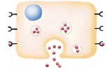
No cell lives in isolation
Cells communicate with each other
Cells send and receive information (signals)
Information is relayed within cell to produce a response

Slide 4
Signaling Process
Recognition of signal
Receptors
Transduction
Change of external signal into intracellular message with amplification and formation of second messenger
Effect
Modification of cell metabolism and function

Slide 5
Signaling Process
Recognition of signal
Receptors
Transduction
Change of external signal into intracellular message with amplification and formation of second messenger
Effect
Modification of cell metabolism and function

Slide 6
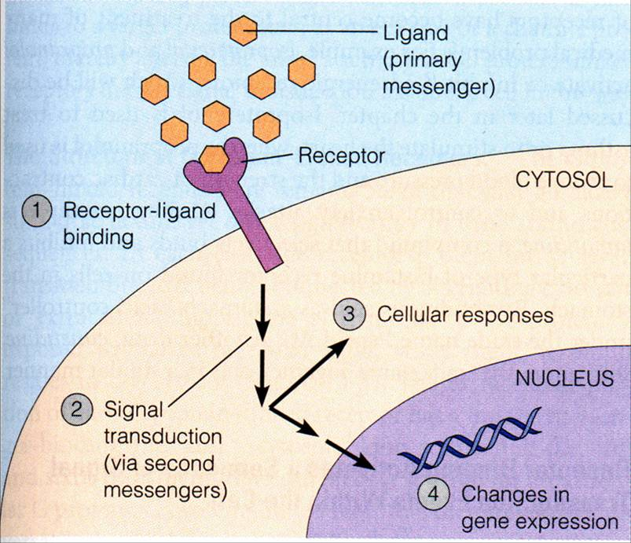
General Signaling Pathway

Slide 7
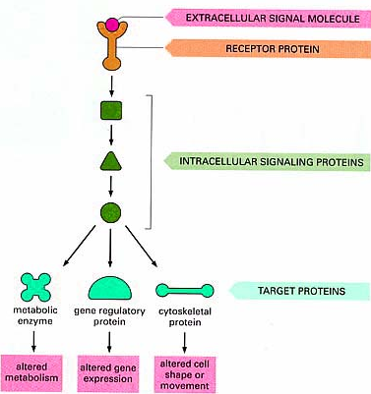
Signaling Cascades

Slide 8
Recognition
Performed by receptors
Ligand will produce response only in cells that have receptors for this particular ligand
Each cell has a specific set of receptors

Slide 9
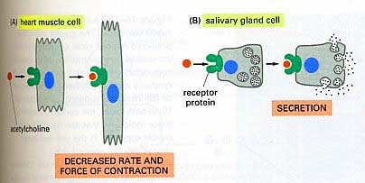
Different Responses to the Same Signaling Molecule
(A) Different Cells

Slide 10
Different Responses to the Same Signaling Molecule
(B) One Cell but, Different Pathways
Hypoglycemia
Glucagon secretion
Hepatocyte: Glucagon/receptor binding
Second messenger: cAMP
Response: Enzyme phosphorylation
P
P
Glycogen synthase
(Inactive form)
Inhibition of glycogenesis
Glycogen phosphorylase
(Active form)
Stimulation of glycogenolysis

Slide 11
GTP-Dependant Regulatory Proteins
(G-Proteins)
G-Proteins: Trimeric membrane proteins (αβγ)
G-stimulatory (G_{s}) and G-inhibitory (G_{i})
Binds to GTP/GDP
Forms of G-Proteins
Inactive form
Trimeric –bound GDP
(αβγ/GDP)
Active form
α-bound GTP
(α/GTP)
The α-subunit has intrinsic GTPase activity, resulting in hydrolysis of GTP into GDP and inactivation of G-proteins

Slide 12
Signaling Pathways for
Regulation of Metabolism
Two important second messenger systems:
Adenylyl cyclase system
Calcium/phosphatidylinositol system

Slide 13
Adenylyl cyclase
Adenylyl cyclase: Membrane-bound enzyme
Converts ATP to cAMP
Activation/Inhibition:
Signal: Hormones or neurotransmitters
(e.g., Glucagon and epinephrine) or toxins
(e.g., Cholera and pertussis toxins)
Receptor: G-protein coupled receptor
Response: Activation/inhibition of protein kinase A
(cAMP-dependent protein kinase)

Slide 14
Signal Transduction: Adenylyl Cyclase System
Resting state: No Signal
Ligand/Receptor Binding
Activation of G_{s}-protein

Slide 15
Signal Transduction: Adenylyl Cyclase System
Activation of adenylyl cyclase

Slide 16
Adenylyl Cyclase System: cAMP-Dependent Protein Kinase (Protein Kinase A)
*
AMP
*Phosphodiesterase

Slide 17
Termination of Signal (A)
*
AMP
*Phosphodiesterase
Protein phosphatase
Phosphodiesterase → ↓cAMP → Inactive protein kinase

Slide 18
Termination of Signal (B)

Slide 19
Termination of Signal (C)
Х

Slide 20
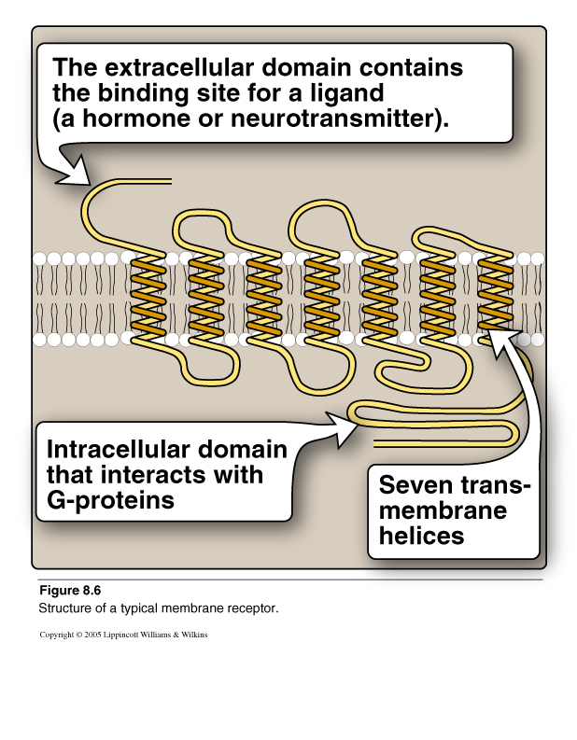
G-Protein Coupled Membrane Receptor

Slide 21
Regulation of Glycogen Metabolism by Glucagon:
Effects on Glycogen Synthase and Phosphorylase
Hypoglycemia
Glucagon secretion
Hepatocyte: Glucagon/receptor binding
Second messenger: cAMP
Response: Enzyme phosphorylation
P
P
Glycogen synthase
(Inactive form)
Inhibition of glycogenesis
Glycogen phosphorylase
(Active form)
Stimulation of glycogenolysis

Slide 22
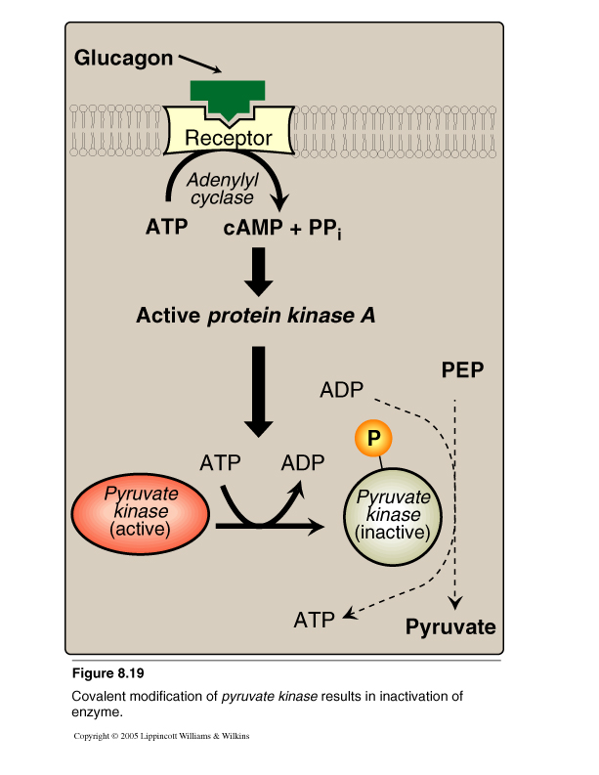
Pyruvate Kinase Regulation: Covalent Modification

Slide 23
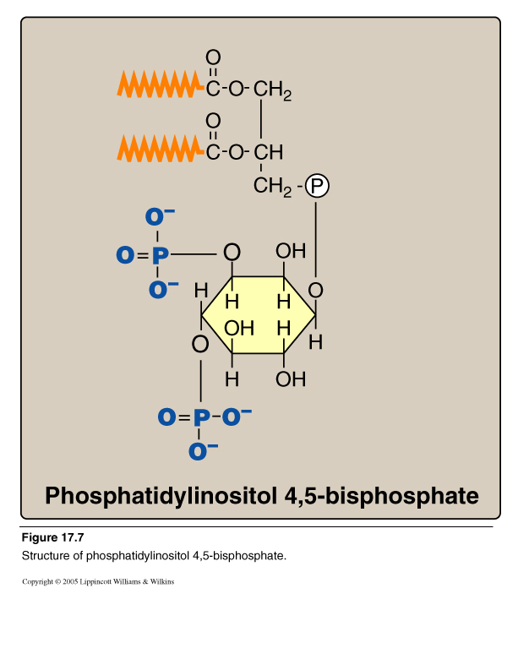
Calcium/Phosphatidylinositol System

Slide 24
Calcium/Phosphatidylinositol System
Diacylglycerol
(DAG)
Inositol Trisphosphate
(IP₃)
Phospholipase C

Slide 25
e.g., Antidiuretic hormone (ADH)
Acetylcholine
Intracellular Signaling by Inositol trisphosphate

Slide 26
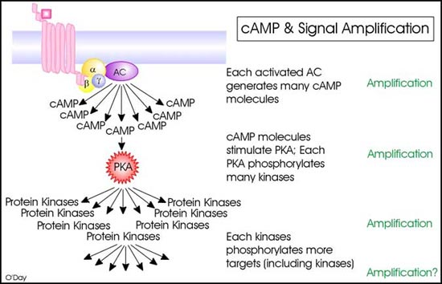
Signal Amplification

Slide 27
Take Home Message
Cell signaling allows
Signal transmission and amplification
Regulation of metabolism
Intercellular communications & coordination of complex biologic functions
Notes:
A signal is amplified in these pathways, such that each step in the pathway results in a larger number of activated components than in the previous step. Amplification can occur at many points in the pathway eg as long as the ligand remains bound to the receptor, the receptor can activate a succession of G proteins. In addition, each adenylyl cyclase can convert numerous ATPs into cAMP molecules.

