Slide 1
بسم الله الرحمن الرحيم

Slide 2
Glucose Metabolism: An Overview Major Metabolic Pathways of Glucose
By
Reem M. Sallam, MD, PhD.
Clinical Chemistry Unit, Pathology Dept.
College of Medicine, KSU

Slide 3
Metabolic Pathway
Definition
Site:
Cellular (tissue) and Subcellular
Reactions
Rate-limiting enzyme(s)
Regulatory mechanism(s):
Rapid, short-term:
Allosteric Covalent modification
Slow, long-term:
Induction/repression

Slide 4
Metabolic Pathways of Glucose: Production and Utilization
Glycogenolysis
Hexose interconversion
Gluconeogenesis
Production
Glucose
Utilization
Glycolysis
HMP/PPP
Glycogenesis
Hexose interconversion
Krebs cycle

Slide 5
Metabolic Pathways of Glucose: Catabolic and Anabolic
Catabolic cycles
Glycolysis (Mainly)
Krebs (Mainly)
Glycogenolysis
HMP
Anabolic cycles
Gluconeogenesis
Glycogenesis

Slide 6
Glycogenesis and Glycogenolysis
Glycogenesis:
Synthesis of glycogen from glucose
Mainly liver and muscle, Cytosol
Glycogenolysis
Degradation of glycogen into glucose
Mainly liver and muscle, Cytosol

Slide 7
Hexose Monophosphate Pathway (HMP) or Pentose Phosphate Pathway (PPP)
Important source for NADPH:
NADPH can be used in reductive syntheses
Source for metabolically active ribose
Ribose is used for production of nucleotides:
For nucleic acids
For co-enzymes

Slide 8
Glucose Transport
Na⁺-Monosaccharide Cotransporter:
Against concentration gradient
Energy dependent
Carrier-mediated
Coupled to Na⁺ transport
Occurs in small intestine, renal tubules & choroid plexus
Na⁺-Independent Facilitated Diffusion:
With concentration gradient
Energy Independent
Through Glucose Transporters (GLUT 1-14)

Slide 9
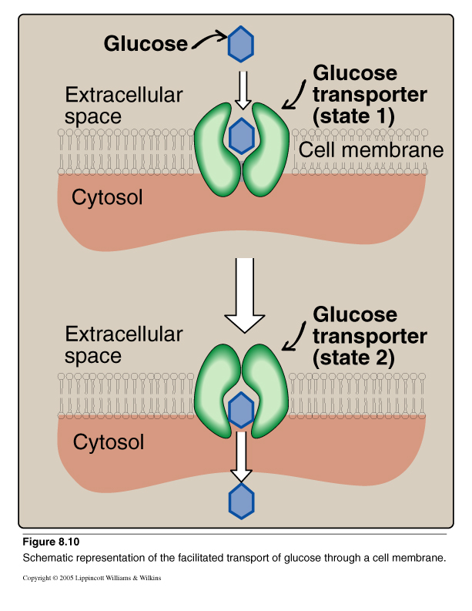
Glucose Transport: Facilitated Diffusion

Slide 10
Glucose Transporters
Tissue-specific expression pattern
GLUT-1 RBCs and brain
GLUT-2 Liver, kidney & pancreas
GLUT-3 Neurons
GLUT-4 Adipose tissue & skeletal muscle
GLUT-5 Small intestine & testes
GLUT-7 Liver (ER-membrane)
Functions:
GLUT-1, 3 & 4 Glucose uptake from blood
GLUT-2 Blood & cells (either direction)
GLUT-5 Fructose transport

Slide 11
Glycolysis: Objectives
Major oxidative pathway of glucose
The main reactions of glycolytic pathway
The rate-limiting enzymes/Regulation
ATP production (aerobic/anaerobic)
Pyruvate kinase deficiency hemolytic anemia

Slide 12
Glycolysis: An Overview
Glycolysis, the major pathway for glucose oxidation, occurs in the cytosol of all cells.
It is unique, in that it can function either aerobically or anaerobically, depending on the availability of:
oxygen &
intact mitochondria.
It allows tissues to survive in presence or absence of oxygen, e.g., skeletal muscle.
RBCs, which lack mitochondria, are completely reliant on glucose as their metabolic fuel, and metabolize it by anaerobic glycolysis.

Slide 13
Glycolysis: An Overview
Glycolysis, the major pathway for glucose oxidation, occurs in the cytosol of all cells.
It is unique, in that it can function either aerobically or anaerobically, depending on the availability of oxygen and intact mitochondria.
It allows tissues to survive in presence or absence of oxygen, e.g., skeletal muscle.
RBCs, which lack mitochondria, are completely reliant on glucose as their metabolic fuel, and metabolizes it by anaerobic glycolysis.

Slide 14
Glycolysis: An Overview
Glycolysis, the major pathway for glucose oxidation, occurs in the cytosol of all cells.
It is unique, in that it can function either aerobically or anaerobically, depending on the availability of oxygen and intact mitochondria.
It allows tissues to survive in presence or absence of oxygen, e.g., skeletal muscle.
RBCs, which lack mitochondria, are completely reliant on glucose as their metabolic fuel, and metabolizes it by anaerobic glycolysis.

Slide 15
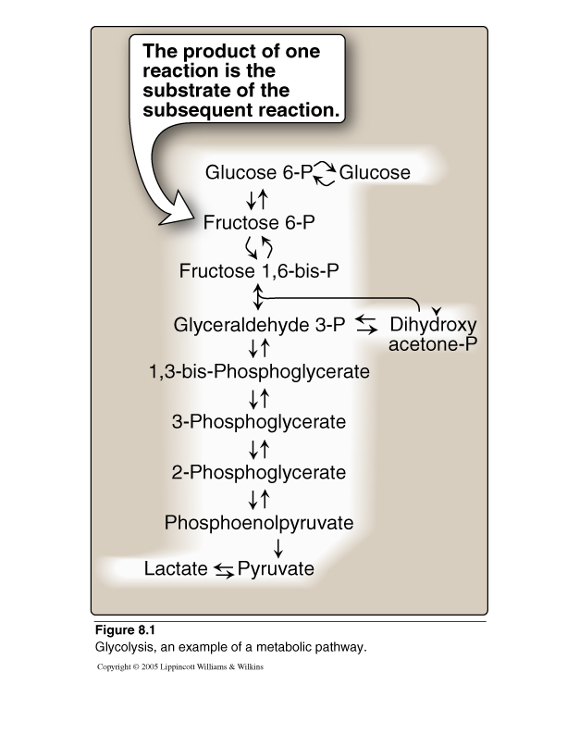
Glycolysis

Slide 16
Aerobic Vs Anaerobic Glycolysis

Slide 17
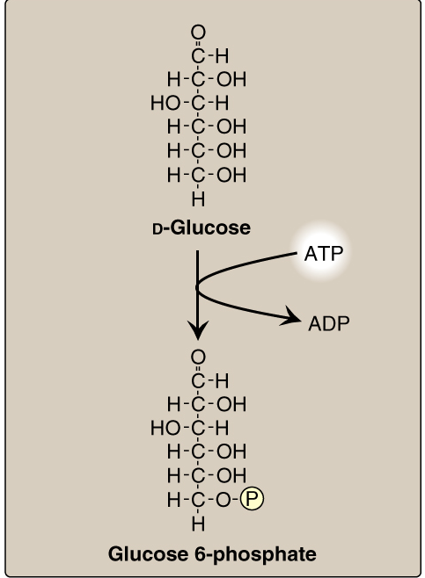
Aerobic Glycolysis-1
Hexokinase
Glucokinase

Slide 18
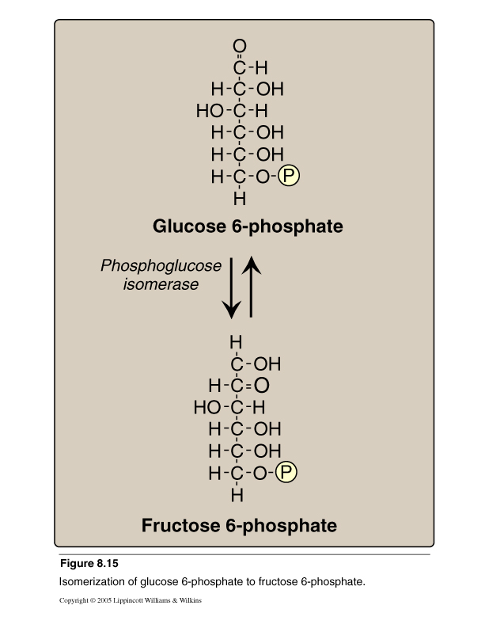
Aerobic Glycolysis-2

Slide 19
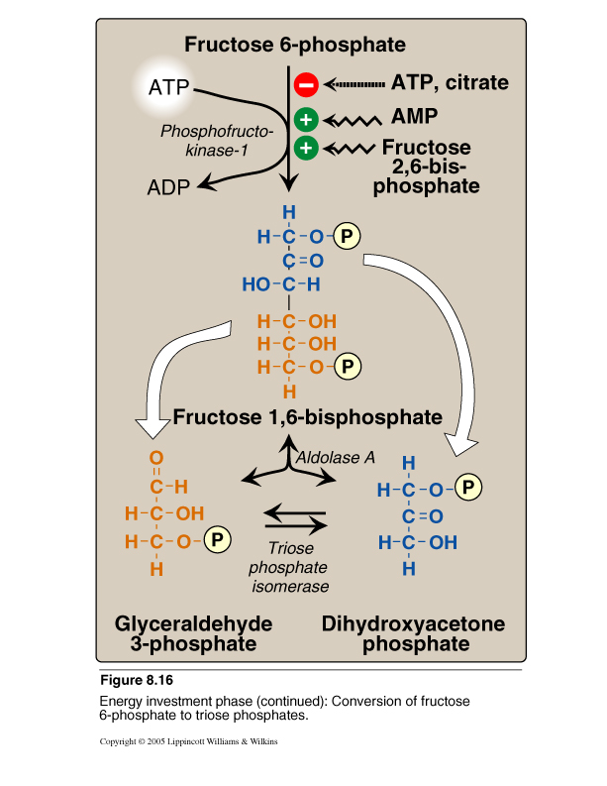
Aerobic Glycolysis: 3-5

Slide 20
Aerobic Glycolysis: 6 -10
2
2
2
2
2
2

Slide 21
Aerobic Glycolysis-1
Hexokinase:
Most tissues
Glucokinase:
Hepatocytes
Hexokinase
Glucokinase

Slide 22
PFK-1 : Regulation

Slide 23
Aldolase and Triose Isomerase

Slide 24
Glyceraldehyde 3-Phosphate Dehydrogenase
2
2
For each NADH, 3 ATP will
be produced by ETC
in the mitochondria
i.e., 6 ATP are produced
2
2
2
2

Slide 25
Phospho- glycerate Kinase
2
2
Substrate-
Level
Phosphorylation
2
2
2
2

Slide 26
Pyruvate Kinase
2
2
2
Substrate-
Level
Phosphorylation
2
2
2

Slide 27
Substrate-level phosphorylation Vs. Oxidative phosphorylation
Phosphorylation is the metabolic reaction of introducing a phosphate group into an organic molecule.
Oxidative phosphorylation: The formation of high-energy phosphate bonds by phosphorylation of ADP to ATP coupled to the transfer of electrons from reduced coenzymes to molecular oxygen via the electron transport chain (ETC); it occurs in the mitochondria.
Substrate-level phosphorylation: The formation of high-energy phosphate bonds by phosphorylation of ADP to ATP (or GDP to GTP) coupled to cleavage of a high-energy metabolic intermediate (substrate). It may occur in cytosol or mitochondria

Slide 28
Substrate-level phosphorylation Vs. Oxidative phosphorylation
Phosphorylation is the metabolic reaction of introducing a phosphate group into an organic molecule.
Oxidative phosphorylation: The formation of high-energy phosphate bonds by phosphorylation of ADP to ATP coupled to the transfer of electrons from reduced coenzymes to molecular oxygen via the electron transport chain (ETC); it occurs in the mitochondria.
Substrate-level phosphorylation: The formation of high-energy phosphate bonds by phosphorylation of ADP to ATP (or GDP to GTP) coupled to cleavage of a high-energy metabolic intermediate (substrate). It may occur in cytosol or mitochondria

Slide 29
Substrate-level phosphorylation Vs. Oxidative phosphorylation
Phosphorylation is the metabolic reaction of introducing a phosphate group into an organic molecule.
Oxidative phosphorylation: The formation of high-energy phosphate bonds by phosphorylation of ADP to ATP coupled to the transfer of electrons from reduced coenzymes to molecular oxygen via the electron transport chain (ETC); it occurs in the mitochondria.
Substrate-level phosphorylation: The formation of high-energy phosphate bonds by phosphorylation of ADP to ATP (or GDP to GTP) coupled to cleavage of a high-energy metabolic intermediate (substrate). It may occur in cytosol or mitochondria

Slide 30
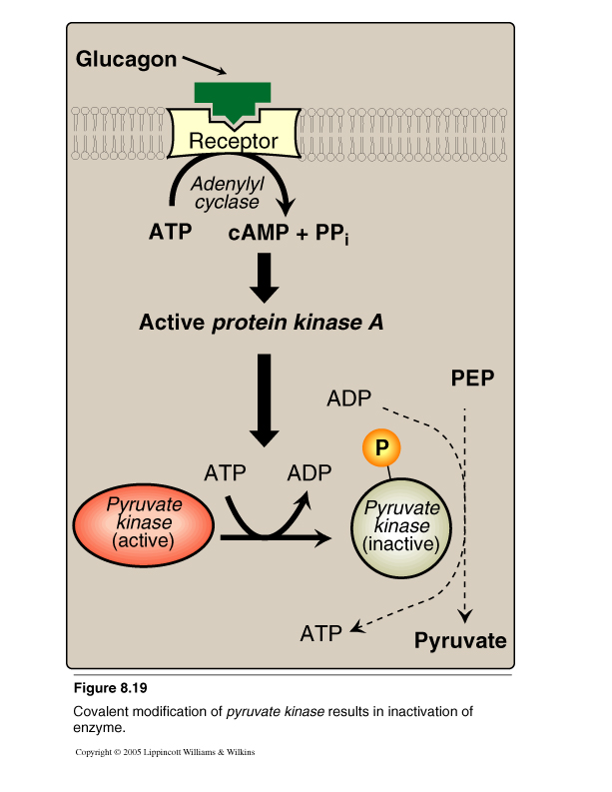
Pyruvate Kinase Covalent Modification

Slide 31
Pyruvate Kinase Deficiency Hemolytic Anemia

Slide 32
Summary: Regulation of Glycolysis
Regulatory Enzymes (Irreversible reactions):
Glucokinase/hexokinase
PFK-1
Pyruvate kinase
Regulatory Mechanisms:
Rapid, short-term:
Allosteric
Covalent modifications
Slow, long-term:
Induction/repression
Apply the above mechanisms for each enzyme where applicable

Slide 33
Aerobic Glycolysis: ATP Production
ATP Consumed:
2 ATP
ATP Produced:
Substrate-level 2 X 2 = 4 ATP
Oxidative-level 2 X 3 = 6 ATP
Total 10 ATP
Net: 10 – 2 = 8 ATP

Slide 34
Take Home Message
Glycolysis is the major oxidative pathway for
glucose
Glycolysis is employed by all tissues
Glycolysis is a tightly-regulated pathway
PFK-1 is the rate-limiting regulatory enzyme

Slide 35
Take Home Message
Glycolysis is mainly a catabolic pathway for
ATP production, But …..
It has some anabolic features (amphibolic)
Pyruvate kinase deficiency in RBCs results in
hemolytic anemia

Slide 36
THANK YOU

