Slide 1
بسم الله الرحمن الرحيم

Slide 2
Glucose Metabolism: Glycolysis
By
Reem M. Sallam, M.D.; Ph.D.
Assistant Prof., Clinical Chemistry Unit, Pathology Dept.
College of Medicine, KSU
sallam@ksu.edu.sa

Slide 3
Glycolysis: Revision
Major oxidative pathway of glucose
The main reactions of glycolytic pathway
The rate-limiting enzymes/Regulation
ATP production (aerobic/anaerobic)
Pyruvate kinase deficiency hemolytic anemia

Slide 4
Substrate-level phosphorylation Vs. Oxidative phosphorylation
Phosphorylation is the metabolic reaction of introducing a phosphate group into an organic molecule.
Oxidative phosphorylation: The formation of high-energy phosphate bonds by phosphorylation of ADP to ATP coupled to the transfer of electrons from reduced coenzymes to molecular oxygen via the electron transport chain (ETC); it occurs in the mitochondria.
Substrate-level phosphorylation: The formation of high-energy phosphate bonds by phosphorylation of ADP to ATP (or GDP to GTP) coupled to cleavage of a high-energy metabolic intermediate (substrate). It may occur in cytosol or mitochondria

Slide 5
Summary: Regulation of Glycolysis
Regulatory Enzymes (Irreversible reactions):
Glucokinase/hexokinase
PFK-1
Pyruvate kinase
Regulatory Mechanisms:
Rapid, short-term:
Allosteric
Covalent modifications
Slow, long-term:
Induction/repression
Apply the above mechanisms for each enzyme where applicable

Slide 6
Long-Term Regulation of Glycolysis
Insulin: Induction
Glucagon: Repression

Slide 7
Pyruvate Kinase Deficiency Hemolytic Anemia
PK Mutation may lead to:
Altered Enz. kinetics
Decreased Enz. stability
Altered response to activator

Slide 8
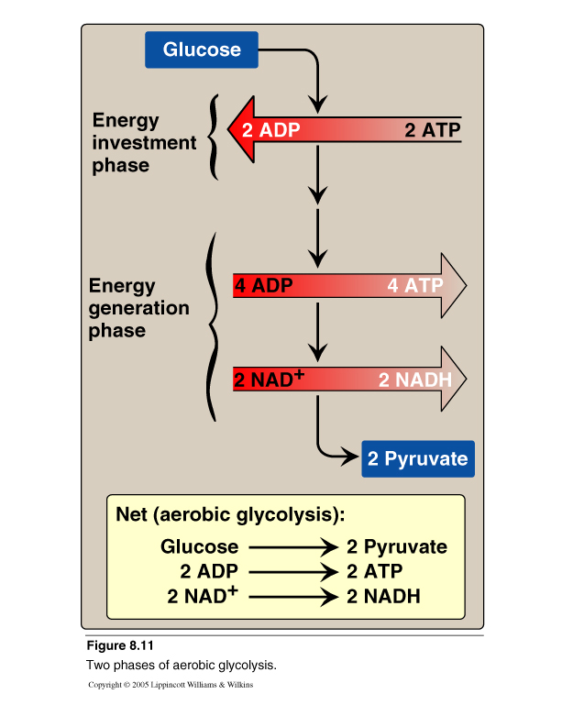
Aerobic Glycolysis: Total Vs Net ATP Production

Slide 9
Aerobic Glycolysis: ATP Production
ATP Consumed:
2 ATP
ATP Produced:
Substrate-level 2 X 2 = 4 ATP
Oxidative-level 2 X 3 = 6 ATP
Total 10 ATP
Net: 10 – 2 = 8 ATP

Slide 10
Aerobic Vs Anaerobic Glycolysis

Slide 11
Anaerobic Glycolysis
NADH produced cannot used by ETC
for ATP production
(No O₂ and/or No mitochondria)
Less ATP production, as compared to aerobic glycolysis
Lactate is an obligatory end product,
Why?

Slide 12
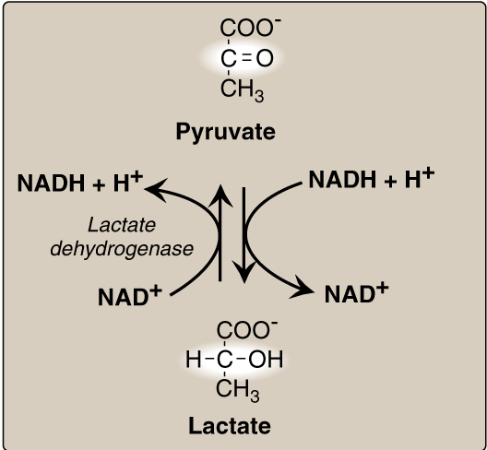
Lactate Dehydrogenase

Slide 13
Anaerobic Glycolysis: ATP Production
ATP Consumed:
2 ATP
ATP Produced:
Substrate-level 2 X 2 = 4 ATP
Oxidative-level 2 X 3 = 6 ATP
Total 4 ATP
Net: 4 – 2 = 2 ATP

Slide 14
Anaerobic Glycolysis in RBCs: 2,3-BPG Shunt
2
2
2
2
2
2

Slide 15
Anaerobic Glycolysis in RBCs: 2,3-BPG Shunt
2
2
2

Slide 16
Glycolysis in RBCs: ATP Production
ATP Consumed:
2 ATP
ATP Produced:
Substrate-level 2 X 2 = 4 ATP
1 X 2 = 2 ATP
Oxidative-level 2 X 3 = 6 ATP
Total 4 OR 2 ATP
Net: 4 – 2 = 2 ATP
2 – 2 = 0 ATP
OR
OR

Slide 17
Glycolysis in RBCs: Summary
End product:
Lactate
No net production or consumption of NADH
Energy yield:
If no 2,3-BPG is formed: 2 ATP
If 2,3-BPG shunt occurs: 0 ATP
PK Deficiency hemolytic anemia depends on:
Degree of PK Deficiency
Compensation by 2,3-BPG

Slide 18
Take Home Message
Glycolysis is the major oxidative pathway for
glucose
Glycolysis is employed by all tissues
Glycolysis is a tightly-regulated pathway
PFK-1 is the rate-limiting regulatory enzyme

Slide 19
Take Home Message
Glycolysis is mainly a catabolic pathwayfor ATP production, But it has some anabolic features (amphibolic)
Pyruvate kinase deficiency in RBCs results in hemolytic anemia

Slide 20
Take Home Message
Net energy produced in:
Aerobic glycolysis: 8 ATP
Anaerobic glycolysis: 2 ATP
Net energy produced in glycolysis in RBCs:
Without 2,3 BPG synthesis: 2 ATP
With 2,3 BPG synthesis: 0 ATP

