Slide 1
بسم الله الرحمن الرحيم

Slide 2
Oxidative Decarboxylation and Krebs Cycle
By
Reem M. Sallam, M.D.; Ph.D.
Clinical Biochemistry Unit, Pathology Dept.
College of Medicine, King Saud University

Slide 3
Fates of Pyruvate
ALT
Alanine
PLP
αKG
Glutamate

Slide 4
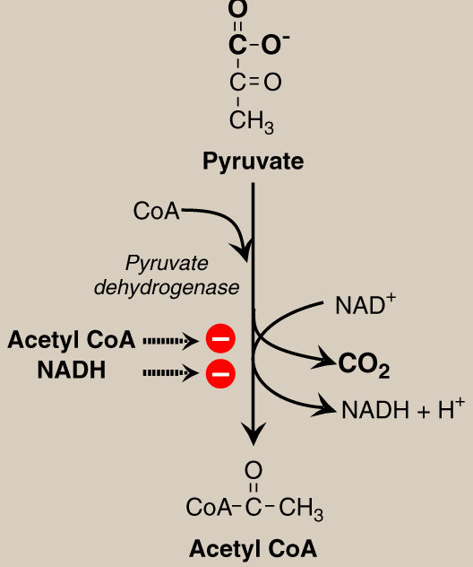
Oxidative Decarboxylation of Pyruvate
Allosteric
Regulation

Slide 5
PDH Complex: Covalent Regulation
Insulin
+
PDH
Insulin
Glucagon
-
PDH
+
P
P_{i}
Pyruvate dehydrogenase
complex (active)
Protein Phosphatase
H₂O
Pyruvate dehydrogenase
complex (inactive)
Protein Kinase
ATP
ADP
+
Glucagon

Slide 6
Tricarboxylic Acid Cycle: Krebs Cycle
Final common pathway for oxidation
Exclusively in mitochondria
Major source for ATP
Mainly catabolic with some anabolic features
Synthetic reactions (anabolic features):
Glucose from amino acids
Nonessential amino acids
Fatty acids
Heme

Slide 7
Krebs Cycle

Slide 8
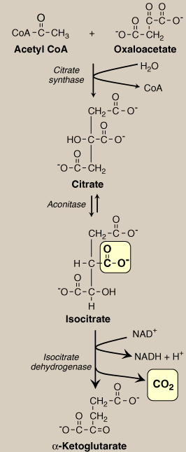
Krebs Cycle Reactions (1)

Slide 9
Krebs Cycle Reactions (2)
Succinate Thiokinase
Substrate-Level
Phosphorylation

Slide 10
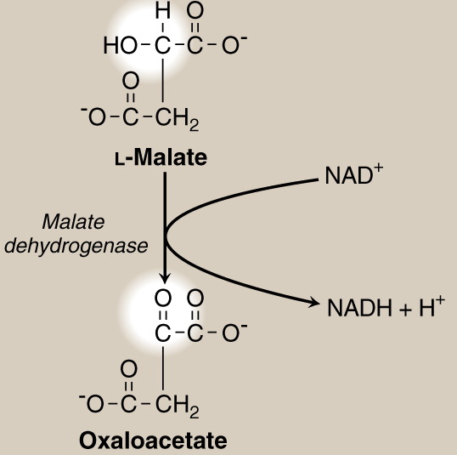
Krebs Cycle Reactions (3)

Slide 11
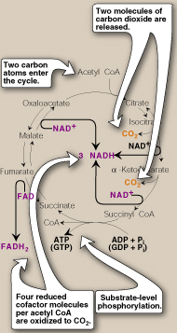
Krebs Cycle: Energy Yield

Slide 12
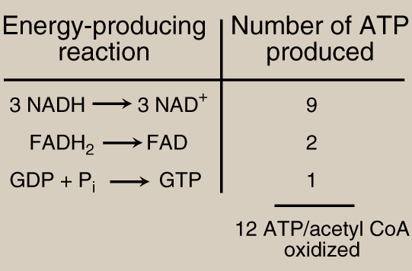
Krebs Cycle: Energy Yield

Slide 13
Net ATP Production by Complete Glucose Oxidation
Aerobic glycolysis: 8 ATP
Oxidative decarboxylation: 2 X 3 = 6 ATP
Krebs cycle: 2 X 12 = 24 ATP
Net: 38 ATP

Slide 14
Take Home Message
Pyruvate is oxidatively decarboxylated by PDH to acetyl CoA inside the mitochondria
Krebs cycle:
Final common pathway for the oxidation of carbohydrates, fatty acids and amino acids
occurs in the mitochondria
Aerobic
Mainly catabolic, with some anabolic reactions
The complete oxidation of one glucose molecule results in a net production of 38 ATP molecules

Slide 15
Thank you

