Slide 1
بسم الله الرحمن الرحيم

Slide 2
Glucose Metabolism: Gluconeogenesis
By
Reem M. Sallam, MD, PhD
Assistant Prof. & Consultant, Medical Biochemistry Unit,
Pathology Dept., College of Medicine, KSU
sallam@ksu.edu.sa

Slide 3
Objectives
The importance of gluconeogenesis as an important pathway for glucose production
The main reactions of gluconeogenesis
The rate-limiting enzymes of gluconeogenesis
Gluconeogensis is an energy-consuming, anabolic pathway

Slide 4
Gluconeogenesis: An Overview
Liver (mainly) and Kidneys
Both mitochondria and Cytosol
Exception: Glycerol, only cytosol
Gluconeogenic substrates:
Glycerol
Lactate and Pyruvate
Glucogenic amino acids

Slide 5
Gluconeogenic Pathway
Dephosphorylation of G-6-P
Dephosphorylation of F 1,6-P
Transport of OAA
& decarboxylation into PEP
Carboxylation of pyruvate

Slide 6
Gluconeogenic Substrates: Glycerol
*GK
Glycerol
Glycerol 3-phosphate
ATP
ADP
NAD+
Glycerol 3-phosphate
dehydrogenase
NADH
Glucose
Dihydroxyacetone phosphate
*GK: Glycerol kinase only in liver & kidneys

Slide 7
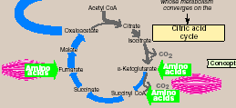
Glucogenic Amino Acids
Asp
Asn
Amino
acids
Glu, Gln
Phe
Tyr
Met
Val

Slide 8
Gluconeogenic Substrates
Lactate
Gly, Ala
Amino
acids
Pyruvate
Asp
Asn
Amino
acids
Glu, Gln
Phe
Tyr
Met
Val

Slide 9
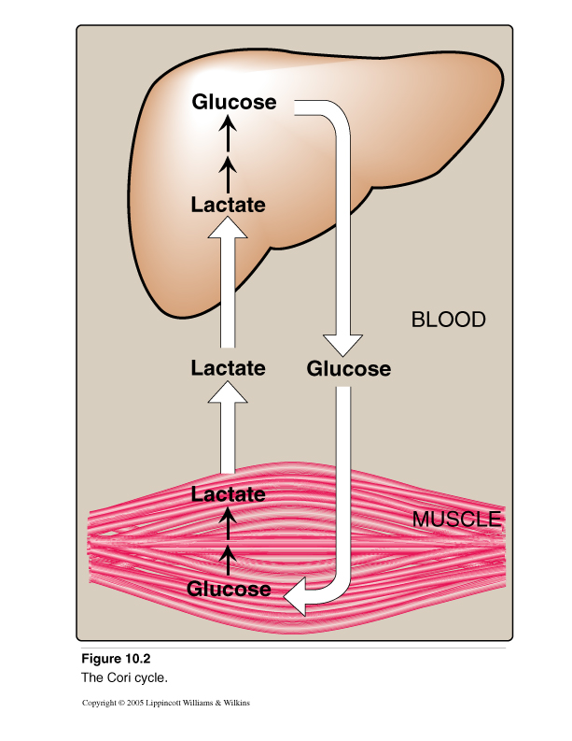
Gluconeogenic Substrates: Lactate (Cori Cycle)

Slide 10
Gluconeogenic Pathway
Dephosphorylation of G-6-P
Dephosphorylation of F 1,6-P
Transport of OAA
& decarboxylation into PEP
Carboxylation of pyruvate

Slide 11
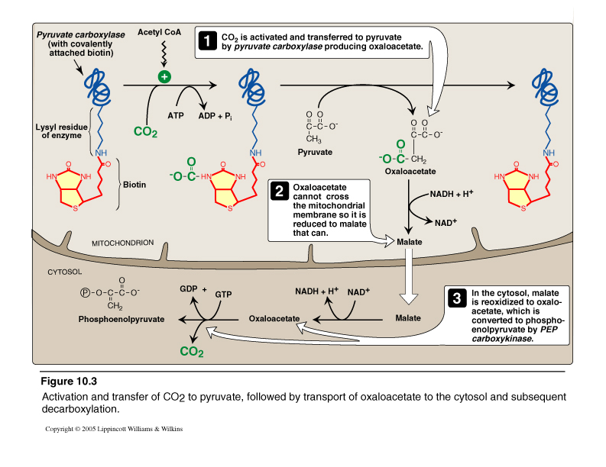
Pruvate Carboxylase and PEP-CK
Pyruvate carboxylase + PEP-CK = Pyruvate kinase

Slide 12
Regulation of Pruvate Carboxylase
Fasting → ↑lipolysis in adipose tissue → ↑ FFA to liver → FA oxidation → ↑Acetyl CoA → allosteric activation of pyruvate carboxylase to increase the Gluconeogensis rate

Slide 13
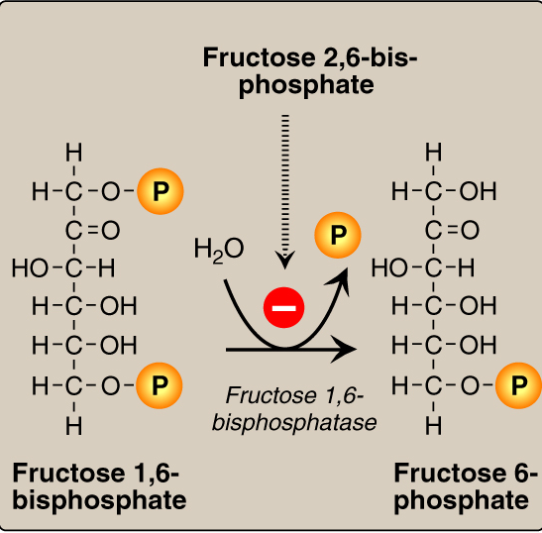
Fructose 1,6-Bisphosphatase
Fructose 1,6-bisphosphatase = PFK-1

Slide 14
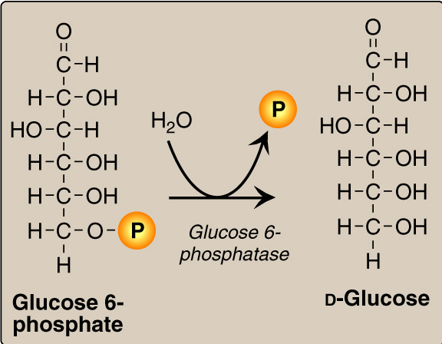
Glucose 6-Phosphatase
Glucose 6-phosphatase = Glucokinase

Slide 15
Gluconeogensis: Energy Consumed
Six High-Energy
Phosphate Bonds
From Pyruvate to
Glucose
2 ADP
2 ATP

Slide 16
Gluconeogenesis: Regulation
Reciprocal control
Gluconeogenesis & Glycolysis
Allosteric:
↑Acetyl CoA → stimulates Pyruvate carboxylase
↓ AMP or ↑ ATP
(i.e. energy-rich state in cells)
↓ F 2,6-Bisphosphate
↑Glucagon (or ↓ I/G ratio): stimulates gluconeogenesis
Allosteric (glucagon → ↓ F 2,6-Bisphosphate)
Induction (glucagon → induction of PEP-CK gene)
→ Stimulate F 1,6-bisphosphatase

Slide 17
Take Home Message
Gluconeogenesis:
Synthesis of glucose from noncarbohydrates
Anabolic
Energy-consuming
4 Unique enzymes are required for
reversal of the 3 irreversible reactions
of glycolysis
Both gluconeogenesis & glycolysis are
reciprocally-regulated

