Slide 1
Molecular Biology - I
Dr. Sumbul Fatma
Clinical Chemistry Unit
Department of Pathology

Slide 2
The Central Dogma of Molecular Biology
Human genome contains about 35,000 genes

Slide 3
Nucleic acids
Required for the storage and expression of genetic information
Two types
DNA (Deoxyribonucleic acid)
RNA (Ribonucleic acid)
Building blocks of nucleic acids are nuclueoside triphosphates (nucleotides)

Slide 4
Nucleotides
Nucleotides are composed of -
nitrogenous base
Purines – Adenine (A) and Guanine (G)
Pyrimidines- Cytosine (C), Thymine (T) and Uracil (U)
Sugar – pentose with 5 carbon ring
Ribose (with –OH at C₂)
Deoxyribose (no –OH at C₂)
phosphate groups

Slide 5
Names and Abbreviations of Nucleic Acid Bases, Nucleosides, and Nucleotides
Page 86

Slide 6
Chemical structures of (a) ribonucleotides and (b) deoxyribonucleotides
Page 81

Slide 7
The sugar carbon numbers are primed (1’ 2’ 3’ etc.)
The nitrogenous base atoms are unprimed
The nitrogenous base is bonded to C₁’ of sugar
The PO₄ group is bonded to C₃’ or C₅’ of sugar

Slide 8
Functions of Nucleotides
Polymers of nucleotides (as DNA or RNA) store and transfer genetic information
Free nucleotides and their derivatives perform various metabolic functions not related to genetic information
Other nucleotides: FAD, NAD, CoA,

Slide 9
DNA and RNA
 | Purine | Pyrimidine | Sugar
DNA | Adenine Guanine | Thymine Cytosine | DeoxyrRibose
RNA | Adenine Guanine | Uracil Cytosine | Ribose

Slide 10
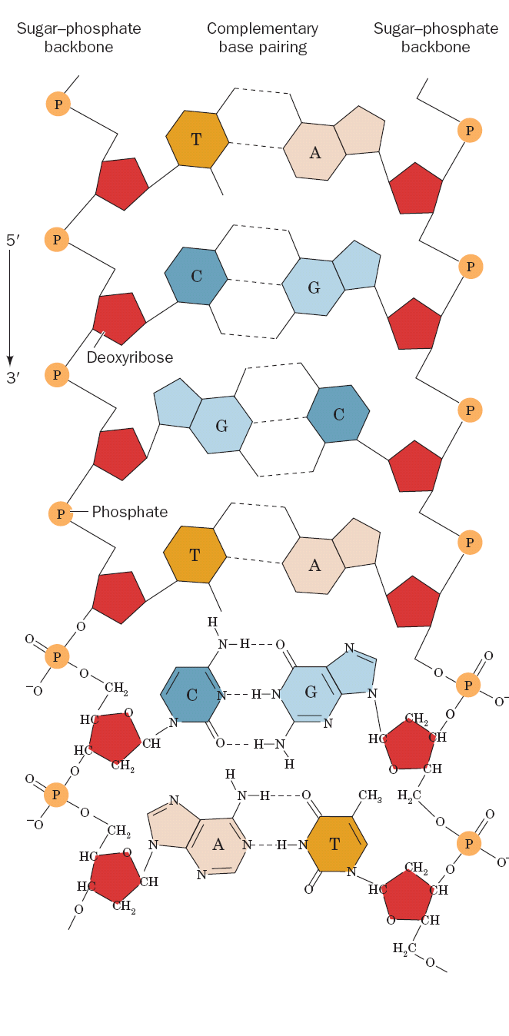
Structure of DNA
DNA is a double-stranded, helical polymer of deoxyribonucleotides

Slide 11
Chemical structure of a nucleic acid
The PO₄ bridges the 3’ and 5’ positions of ribose sugar
The PO₄ and sugar bonding is the backbone of DNA structure
Page 82

Slide 12
Chemical structure of a nucleic acid
The linkage between the nucleotides is called phosphodiester bond
Page 82

Slide 13
Base pairing in DNA
Adenine (A) Thymine (T)
Guanine (G) Cytosine (C)
In RNA there is no Thymine (T)
Adenine (A) Uracil (U)
Guanine (G) Cytosine (C)

Slide 14
Watson-Crick base pairs
Page 88

Slide 15
The double helix DNA
The structure of DNA was first determined by James Watson and Francis Crick in 1953
Commonly known as Watson-Crick structure

Slide 16
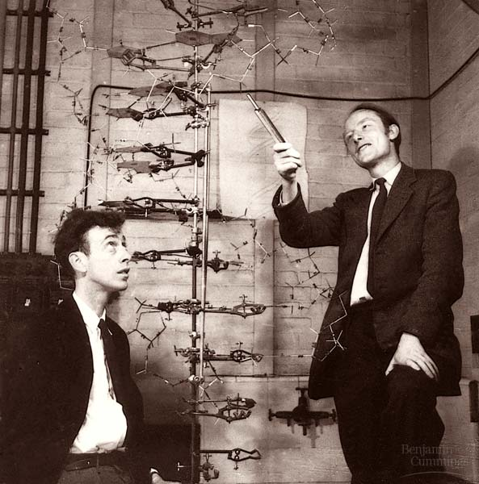
James Watson and Francis Crick

Slide 17
Three-dimensional structure of B-DNA
Page 87

Slide 18
The Features of Watson-Crick DNA structure
Two polynucleotide chains wind around a common axis to form a double helix
The two strands are anti-parallel (run in opposite direction)
Each strand is a right-handed helix
The nitrogenous bases are in the center of the double helix and the sugar-phosphate chains are on the sides

Slide 19
The Features of Watson-Crick DNA structure
The surface of the double helix contains 2 grooves: the major and minor grooves
Each base is hydrogen bonded to a base in the opposite strand to form a base pair (A-T and G-C), known as complementary base pairing
The helix has 10 base pairs (bp) per turn

Slide 20
Types of DNA Structure
A-DNA
B-DNA (Watson-Crick DNA)
Z-DNA

Slide 21
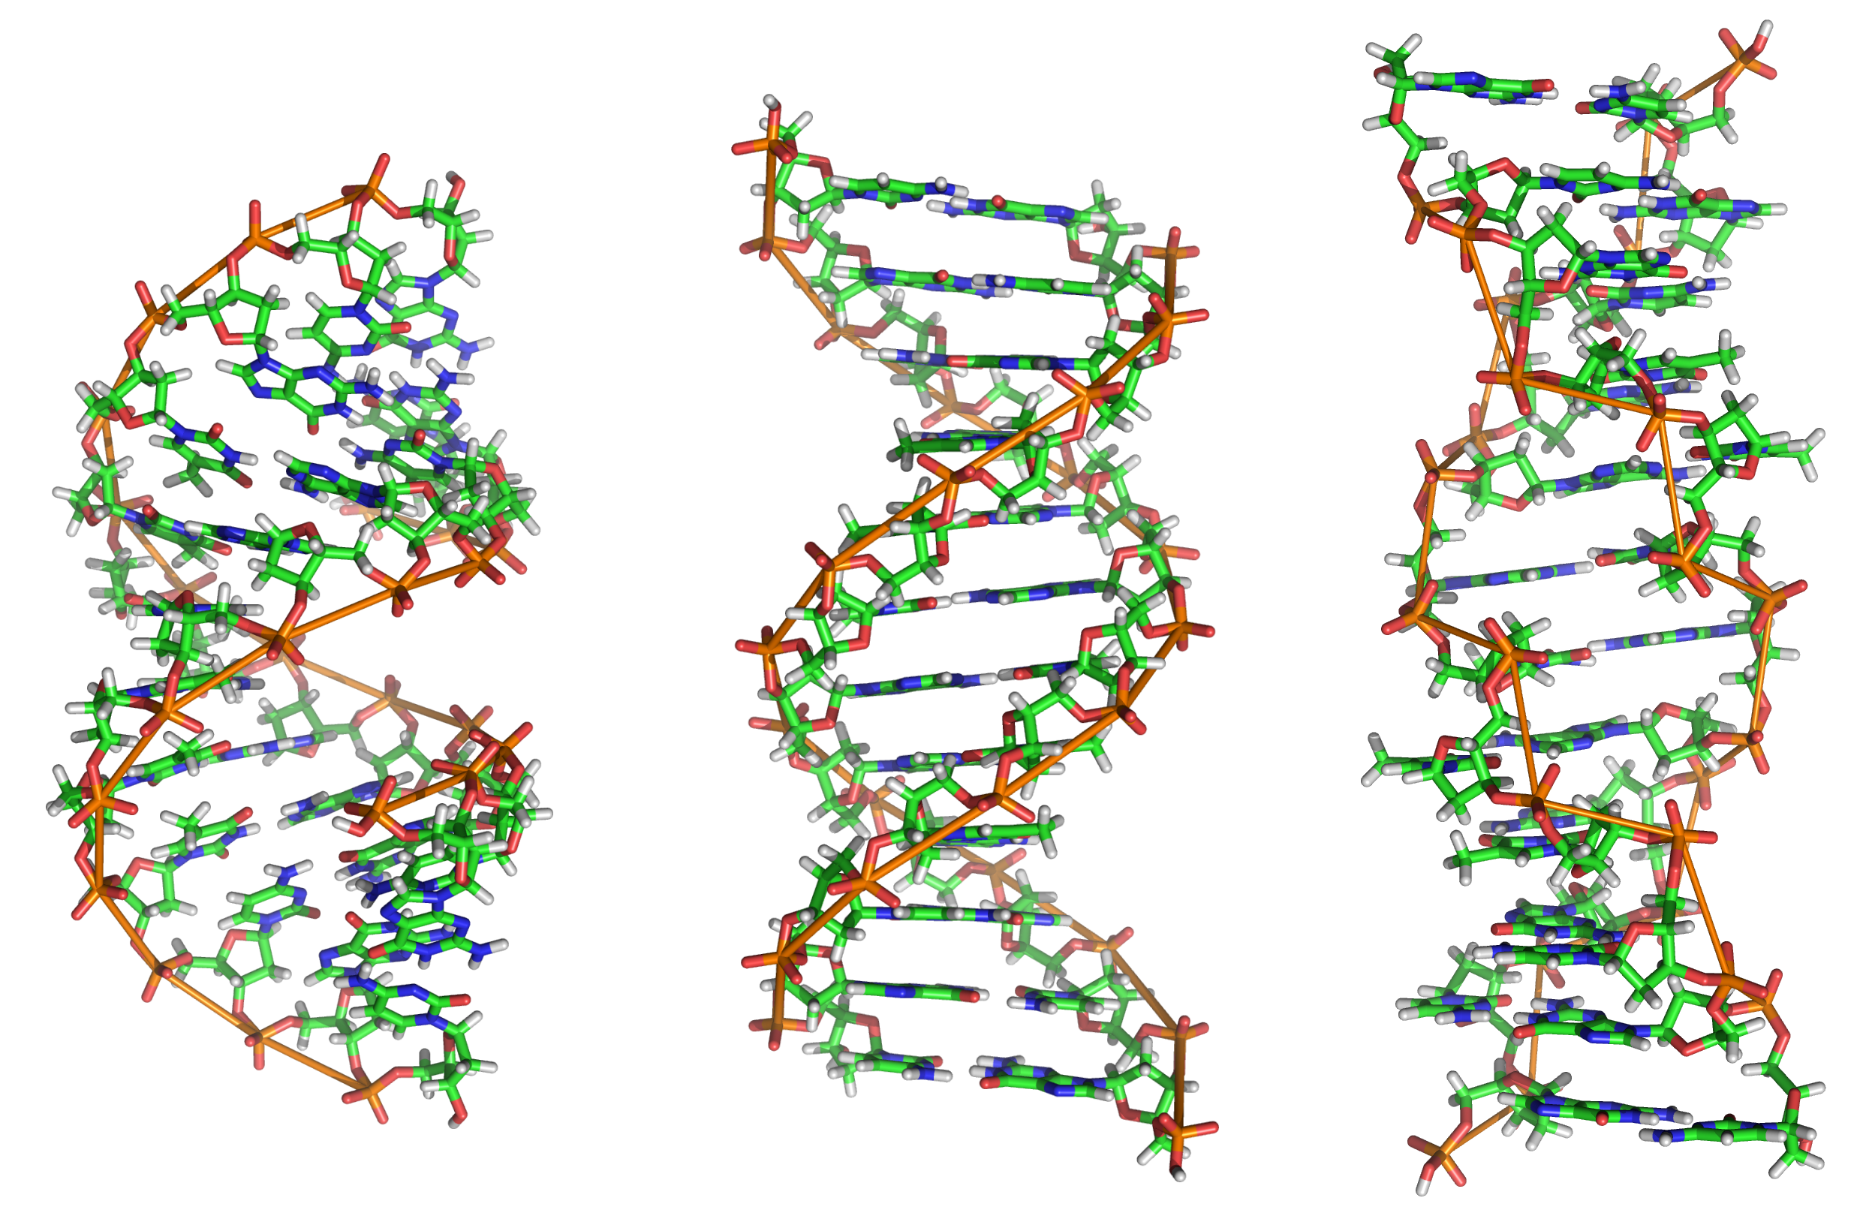
Z-DNA
B-DNA
A-DNA

Slide 22
DNA Supercoiling
The chromosomes of many bacteria and viruses contain circular DNA which is supercoiled

Slide 23
DNA Supercoiling in bacteria and viruses
Page 1122

Slide 24
Melting Temperature (Tm)
The temperature at which the double-stranded DNA is separated into two single strands
Melting temp. of DNA depends on nitrogenous base content (A-T and G-C)
G-C has 3 hydrogen bonds (stronger than A-T)

Slide 25
DNA melting due to heat
Page 90

Slide 26
Structure of RNA
RNA is a single-stranded polymer of ribonucleotides
Types of RNA
mRNA (messenger RNA)
rRNA (ribosomal RNA)
tRNA (transfer RNA)

Slide 27
Types of RNA
mRNA (messenger RNA)
Function: Transcription process (from DNA to mRNA)
tRNA (transfer RNA)
Function: Translation process (from mRNA to protein synthesis); it transfers amino acids to the growing protein chain
rRNA (ribosomal RNA)
Function: Site of protein synthesis (factory)

Slide 28
Structure of a tRNA
Page 1292

Slide 29
Chromosome Structure: How DNA is organized in a chromosome?
The human genome contains 3.5 billion base pairs and more than 95% is non-coding or “junk” DNA
The DNA from single 23 human chromosomes have a length of 1 meter
How such large quantities of DNA are packed into a single cell?

Slide 30
Electron micrograph of a human chromosome
Page 1423

Slide 31
The DNA of a human chromosome
Page 1430

Slide 32
Chromatin: Each chromosome is a complex of a single linear DNA molecule and protein called chromatin
Histones: 50% of chromatin consists of proteins called histones

Slide 33
Electron micrograph of chromatin filaments
Page 1429

Slide 34
Histones
Five major types of histones:
H1 H2A H2B H3 H4
Histones have positively charged amino acids (arginine and lysine)
These proteins bind to negatively charged PO₄ groups of DNA to stabilize the chromatin structure

Slide 35
Nucleosomes
Nucleosomes are particles consisting of DNA and histones connected by thin strands of naked DNA (like beads on a string; Sibhah in Arabic)
Nucleosomes consist of the histone octamer (eight) and DNA
(H2A)₂(H2B)₂(H3)₂(H4)₂
H1 binds to 2 complete helical turns of DNA

Slide 36
Electron micrograph of chromatin showing nucleosomes
Page 1424

Slide 37
A nucleosome showing interaction of histones with the DNA
Page 1427

Slide 38
Chromatin filament with nucleosomes and naked DNA
Page 1430

Slide 39
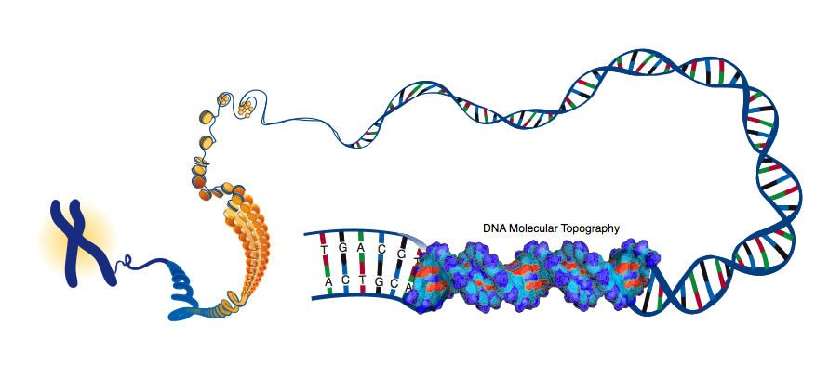

Slide 40
References
Lippincott’s Illustrated Reviews in Biochemistry
Biochemistry by Voet and Voet 3e

