Slide 1
Molecular Biology - II
Dr. Sumbul Fatma

Slide 2
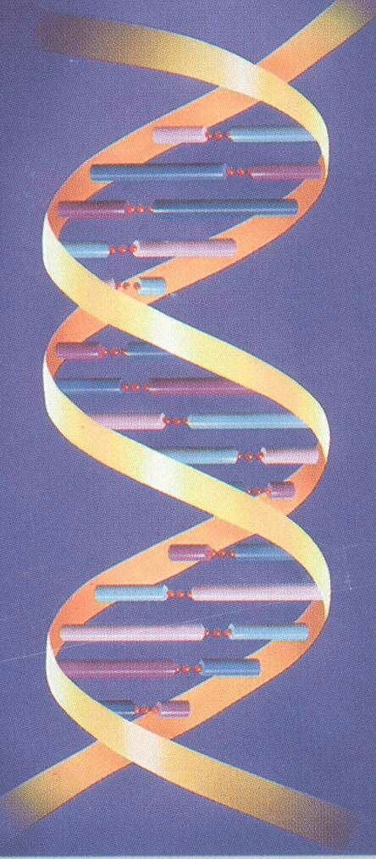
DNA is the Genetic Material
Therefore it must:
Replicate faithfully
Have the coding ability to produce proteins for all cellular functions

Slide 3
Replication of DNA
Page 1137

Slide 4
Features of DNA Replication
Semiconservative
Bidirectional
Semidiscontinuous
Notes:
9

Slide 5
Model for DNA Replication
Semiconservative model:
Daughter DNA molecules contain
one parental strand and
one newly-replicated strand

Slide 6
SEMICONSERVATIVE DNA REPLICATION

Slide 7
Prokaryotic DNA Polymerases
5 types of DNA polymerases are found in E. coli
DNA polymerase I: functions in repair and replication
DNA polymerase II: functions in DNA repair
DNA polymerase III: main DNA replication enzyme
DNA polymerase IV: functions in DNA repair
DNA polymerase V: functions in DNA repair
Notes:
5

Slide 8
Replication can be Uni- or Bidirectional
UNIDIRECTIONAL REPLICATION
Origin
BIDIRECTIONAL REPLICATION
5’
3’
Origin
3’
5’
5’
3’
3’
5’

Slide 9
Semidiscontinuous DNA replication. In DNA replication, both daughter strands (leading strand red, lagging strand blue) are synthesized in their 5′ → 3′ directions
DNA Replication is Semi-Discontinuous
Page 1138

Slide 10
Replication fork
3’
5’
Primer
3’
Continuous replication
5’
Direction of
unwinding
3’
Primer
5’
Discontinuous replication
3’
5’
Primer
3’
5’

Slide 11
Replication
3’
3’
5’
5’
3’
5’
3’
5’
Helicase protein binds to DNA sequences called
origins and unwinds DNA strands
SS binding proteins prevent single strands from rewinding
Primase protein makes a short segment of RNA
primer complementary to the DNA

Slide 12
Replication
Overall direction
of replication
3’
3’
5’
5’
3’
5’
3’
5’
DNA polymerase enzyme adds DNA nucleotides
to the RNA primer

Slide 13
Replication
Overall direction
of replication
3’
3’
5’
5’
3’
5’
3’
5’
DNA polymerase adds DNA nucleotides
to the RNA primer
DNA polymerase proofreads bases added and
replaces incorrect nucleotides

Slide 14
Replication
Overall direction
of replication
3’
3’
5’
5’
3’
5’
3’
5’
Leading strand synthesis continues in a
5’ to 3’ direction

Slide 15
Replication
Overall direction
of replication
3’
3’
5’
5’
Okazaki fragment
3’
5’
3’
5’
3’
5’
Leading strand synthesis continues in a
5’ to 3’ direction
Discontinuous synthesis produces 5’ to 3’ DNA
segments called Okazaki fragments

Slide 16
Replication
Overall direction
of replication
3’
3’
5’
5’
Okazaki fragment
3’
5’
3’
5’
3’
5’
Leading strand synthesis continues in a
5’ to 3’ direction
Discontinuous synthesis produces 5’ to 3’ DNA
segments called Okazaki fragments

Slide 17
Replication
3’
3’
5’
5’
3’
5’
3’
3’
3’
5’
5’
5’
Leading strand synthesis continues in a
5’ to 3’ direction
Discontinuous synthesis produces 5’ to 3’ DNA
segments called Okazaki fragments

Slide 18
Replication
3’
3’
5’
5’
3’
5’
3’
3’
3’
5’
5’
5’
Leading strand synthesis continues in a
5’ to 3’ direction
Discontinuous synthesis produces 5’ to 3’ DNA
segments called Okazaki fragments

Slide 19
Replication
3’
3’
5’
5’
3’
5’
3’
3’
3’
5’
5’
5’
Exonuclease activity of DNA polymerase I removes RNA primers

Slide 20
Replication
3’
3’
5’
3’
5’
3’
3’
5’
5’
Polymerase activity of DNA polymerase I fills the gaps
Ligase forms bonds between sugar-phosphate backbone

Slide 21
Enzymes of DNA replication
Helicase unwinds
parental double helix
Single-strand Binding protein
stabilizes separate
strands
Primase adds a
short primer to template strand
DNA polymerase
forms new strands
DNA polymerase I (exonuclease) removes RNA primer and inserts the correct bases
Ligase joins Okazaki
fragments and seals
gaps in sugar-phosphate backbone

Slide 22
Eukaryotic DNA Replication Enzymes
5 types of DNA polymerases in Eukaryotes
DNA polymerase α
DNA polymerase β
DNA polymerase γ (Mitochondrial DNA replication enzyme)
DNA polymerase δ
DNA polymerase ε
Notes:
5

Slide 23
Transcription
A process of mRNA (messenger RNA) synthesis from DNA (gene)
The enzyme responsible for this process is RNA polymerase
Only one of the DNA strands is transcribed
A complementary strand of messenger RNA (mRNA), is produced from the DNA template
The direction of transcription is 5’ → 3’

Slide 24
DNA makes RNA makes Protein
5’-AATCGCCATACGCACGCA-3’
3’-TTAGCGGTATGCGTGCGT-5’
DNA
Transcription
5’-AAUCGCCAUACGCACGCA-3’
RNA
Translation
N-Asn-Arg-His-Thr-His-Ala-C
PROTEIN

Slide 25
Chain Initiation
RNA polymerase binds to promoter region of DNA to start transcription

Slide 26
Chain Elongation
A portion of DNA template unwinds (opens) at the point of RNA synthesis by DNA gyrase
This forms a short length of RNA-DNA hybrid
The unpaired “bubble” of DNA in the open initiation complex travels along the direction of RNA polymerase

Slide 27
RNA chain elongation by RNA polymerase
Page 1227

Slide 28
Chain Termination
DNA contains specific sites which stop transcription
Transcription is terminated at a sequence of
4-10 AT base pairs

Slide 29
Post-Transcriptional Modifications (RNA Processing)
Capping
Addition of a methylated guanine nucleotide at 5’ end of mRNA
Function: To prevent mRNA degradation by exonuclease enzymes
Polyadenylation
Addition of a poly A tail (poly Adenylate…AAAAAA…) at 3’ end of mRNA
Function:
To protect the mRNA from degradation
For ribosomal RNA recognition

Slide 30
Translation (Protein Synthesis)
A process of protein synthesis from mRNA
mRNA has codes for amino acids present in proteins

Slide 31
Translation (Protein Synthesis)
components of protein synthesis
the genetic code
mRNA
ribosomes
tRNAs
amino acids
enzymes / protein factors
the process
chain initiation
chain elongation
chain termination
post-translational modifications

Slide 32
DNA makes RNA makes Protein
5’-AATCGCCATACGCACGCA-3’
3’-TTAGCGGTATGCGTGCGT-5’
DNA
Transcription
5’-AAUCGCCAUACGCACGCA-3’
RNA
Translation
N-Asn-Arg-His-Thr-His-Ala-C
PROTEIN

Slide 33
The Genetic Code
The genetic code is a dictionary that identifies the correspondence between a sequence of nucleotide bases and a sequence of amino acids
Each individual word in the code is composed of three nucleotide bases. These genetic words are called codons

Slide 34
The Genetic Code
A genetic code contains 3 nucleotides
Genetic code is triplet, non-overlapping, comma-free
64 possible codons
61 codons specify 20 amino acids
1 Start codon (also specifies an aa)
3 stop codons

Slide 35
The “Standard” Genetic Code
Page 1290

Slide 36
The genetic code is degenerate
One amino acid can be coded for by more than one codon
The genetic code is unambiguous
One codon can specify only one amino acid
Mitochondrial DNA has different codons

Slide 37
The “Standard” Genetic Code
Page 1290

Slide 38
The genetic code is read by molecules that recognize a particular codon and carry the corresponding amino acid
Page 1292

Slide 39
Chain Initiation
There are two mechanisms by which the ribosome recognizes the nucleotide sequence that initiates translation:
Shine Dalgarno sequence (prokaryotes)
Eukaryotic initiation factor eIF-4
Translation is initiated by Initiation Factors: IF-1, IF-2, IF-3
They combine ribosome, mRNA and tRNA together
The first tRNA binds to AUG (start codon) of mRNA in the P-site of ribosome

Slide 40
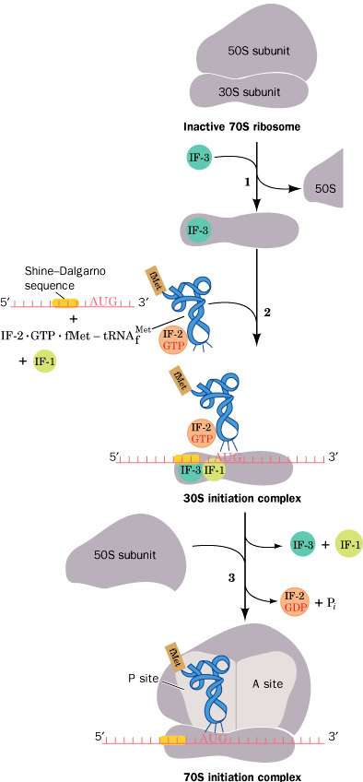
Translational initiation pathway in E. coli

Slide 41
Chain Elongation
The second tRNA bind to A-site of ribosome
Peptide bond formation takes place between two amino acids (transpeptidation)
P-site tRNA is empty and leaves the ribosome
A-site tRNA carries the growing protein chain and moves to P-site (translocation)

Slide 42
Elongation cycle in E. coli ribosomes. The E site, to which discharged tRNAs are transferred before being released into solution, is not shown
Page 1327

Slide 43
Chain Termination
mRNA contains stop codons (UAA, UAG, UGA)
When ribosomes reads any stops codon, translation is terminated
This releases the new protein chain
Post-translational modifications:
The new protein chain is chemically modified
It is also folded to become functional

Slide 44
Termination pathway in E. coli ribosomes. RF-1 recognizes the Stop codons UAA and UAG, whereas RF-2 (not shown) recognizes UAA and UGA

Slide 45
References
Lippincott’s Illustrated Reviews in Biochemistry

Slide 46
http://spine.rutgers.edu/cellbio/assets/flash/bidir.htm

Slide 47
A, P, and E sites on the ribosome
The ribosome has three binding sites for tRNA molecules—the A, P, and E sites
These three sites cover three neighboring codons
A site binds an incoming aminoacyl-tRNA as directed by the codon currently occupying this site.
The P-site codon is occupied by peptidyl-tRNA. This tRNA carries the chain of amino acids that has already been synthesized
The E site is occupied by the empty tRNA as it is about to exit the ribosome

