Slide 1
Natural Defense Mechanisms.
Immunology Unit.
College of Medicine & KKUH.

Slide 2
Objectives
1. First (non-specific immunity) and second (adaptive immunity) lines of defense
2. Complement activation provides protection by killing pathogens
3. Accumulation of inflammatory cells important for clearance of infection
4. Cytokines as mediators regulate inflammation

Slide 3
The main function of the immune system is to protect from infections:
Viruses e.g.
Influenza
Polio
Parasites e.g.
Tapeworms
Malaria
Fungi e.g.
Candida albicans
Bacteria e.g.
Tubercule bacillus
Staphylococci

Slide 4
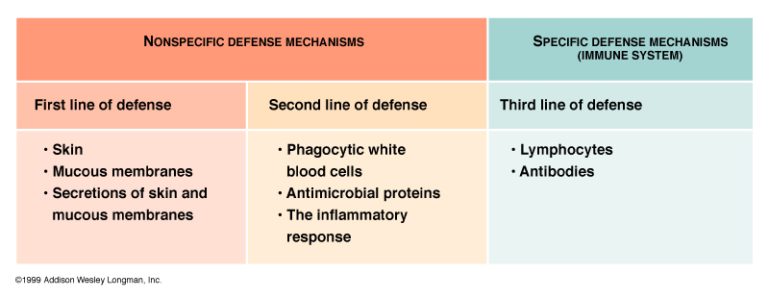
First and the second lines of defense:
First Line of Defense
Second Line of Defense

Slide 5
First line of defense :
Natural (Innate) Immunity
Physical (skin/ mucous membranes ) .
Mechanical (Coughing, sneezing, vomiting, action of cilia in trachea) .
Biochemical barriers (antimicrobial peptides, lung secretions, mucus, saliva, tears)

Slide 6
Physical and mechanical barriers
Skin, impermeable to microbes.
Mucous membranes lining the gastrointestinal, genitourinary and respiratory tracts.
Other protective mechanisms:
Coughing and sneezing.
Flushing of urine.
Vomiting.
Mucus and cilia in respiratory tract.

Slide 7
Biochemical barriers
Body secretions contain toxic substances to pathogens ; e.g. saliva, tears and sweat.
Antimicrobial peptides (e.g., defensins, hepcidins)
Normal bacterial flora.
(Compete with pathogenic bacteria for nutrients)

Slide 8
Inflammation:
Inflammation is the first response of the immune system to infection or irritation.
It consist of a series of vascular & cellular changes that occur in response to various
stimuli
e.g. infections, injury, radiation etc.

Slide 9
Microbial infections initiate inflammation
As bacteria possess an array of pro-inflammatory molecules :
e.g. Lipopolysaccharides (LPS).

Slide 10
Inflammation
Goals
Prevent and limit infection and further damage.
Interact with adaptive immune system.
- For example Monocytes / Macrophages serve as a link between the adaptive and innate immunity by antigen presentation.
Prepare the area of injury for healing.

Slide 11
The Complement system
Consist of a group of serum proteins circulate in inactive form once they become activated they produce important biological effects that initiate inflammation.
This system plays an important role in Innate & Adaptive immunity

Slide 12
The complement system:
3 Pathways of activation :
Classical. (Requires antigen-antibody binding)
(C1,C4,C2,C3,C5,C6,C7,C8,C9)
Lectin. (Activated by mannan binding protien binding manose groups of bacterial carbohydrates)
(-C4,C2,C3,C5,C6,C7,C8,C9)
Alternative.(Activated by bacterial products)
(- C3,C5,C6,C7,C8,C9)

Slide 13
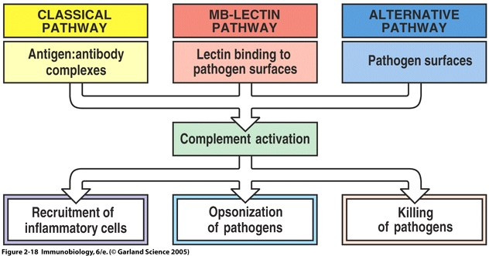

Slide 14
Lytic pathway C5-activation
C5a
C5
C4b
C3b
b
C2
a

Slide 15
Components of the lytic pathway
C7
C6
C5
C8
C
9

Slide 16
Lytic pathway Assembly of the lytic complex
C6
C7
C5
b

Slide 17
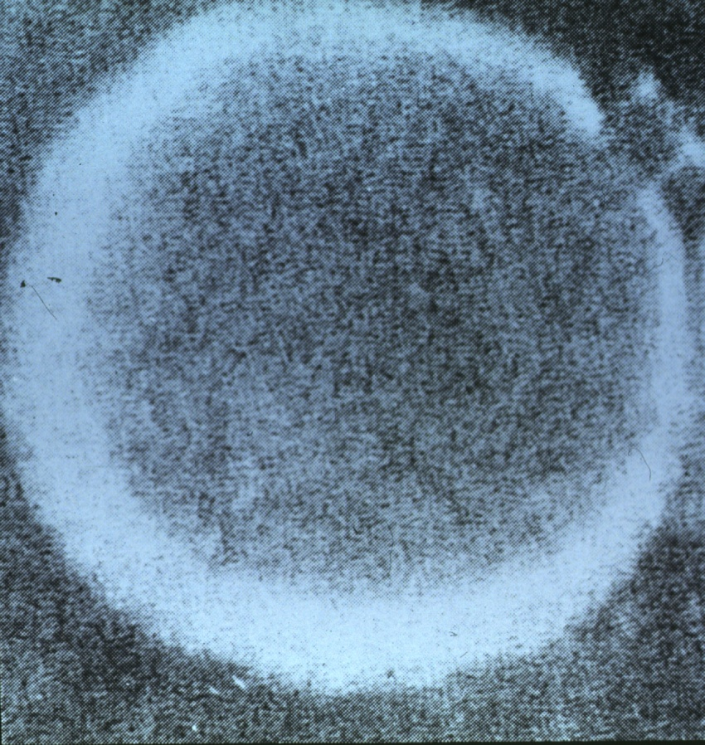
Lytic pathway: insertion of lytic complex into cell membrane
C6
C8
C7
C5
b
C
9
C
9
C
9
C
9
C
9
C
9
C
9
C
9
C
9

Slide 18
Biological effects of complement activation
1. Anaphylatoxin (C3a, C5a)
- Induce histamine release from mast cells.
release chemotactic agents.
2. Opsonization: (opsonin, C3b )
- Coating of bacteria enhances phagocytosis
3. Cause direct cell lysis
- Destruction of bacteria.

Slide 19
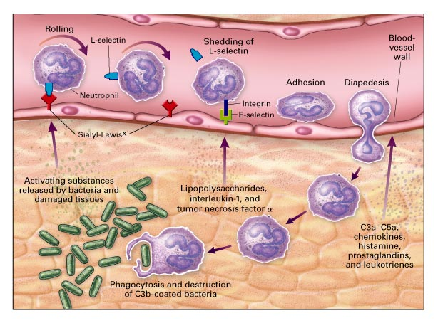
Process of chemotaxis: Rolling on vessel wall. Adhesion (attach) Pass through. :

Slide 20
Types of Cells attracted to site of infection that mediate inflammation :
Monocytes :
Become Macrophages when they leave the blood and enter the tissues.
Neutrophils: (Phagocytic cells)
Eosinophils: (Allergy and Parasitic infections)
Natural Killer (NK) cells: (Kill tumor cells and virus infected cells)

Slide 21
Phagocytic cells (neutrophils & macrophages) at site of infection start the process of phagocytosis. The process by which a cell ingests and destroy foreign material

Slide 22
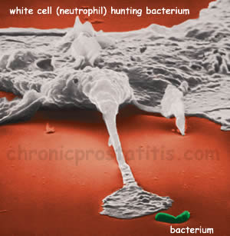
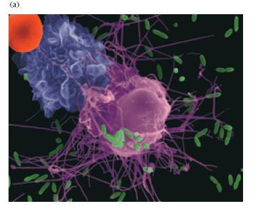
Macrophage attacking
E.coli .

Slide 23
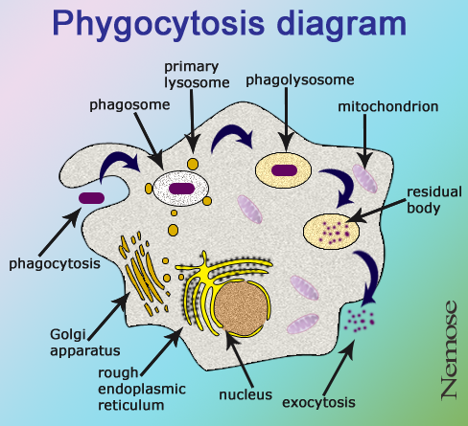

Slide 24
Cytokines Soluble molecules, produced by different cells, that control cell functions e.g. activation or inhibition.
e.g. Interleukins
Produced primarily by macrophages and lymphocytes in response to a pathogen.
Many types
Examples
IL-1, IL-2, IL-3…....

Slide 25
Cytokines
Interferons:
Protects against viral infections
Produced and released by virally infected cells in response to viral infections.

Slide 26
Cytokines
Tumor necrosis factor (TNF)
Secreted by macrophages.
Induces fever by acting as an endogenous pyrogen (a substance released from inside the body that produces fever)
Increases synthesis of inflammatory serum proteins

Slide 27
Take home message
1. Non-specific (innate immunity) acts as a first line of defense against invading pathogens
2. Innate immunity is an important initial step for generation adaptive immune response
3. Inflammation is vital for controlling infection and limiting tissue damage

