Slide 1
Immune deficiency disorders
Immunology Unit.
Department of Pathology.

Slide 2
Lecture Objectives
Identify that Immunodeficiency is due to a defect in the immune function.
Describe the classification of Immunodeficiency.
Explain the presentations of different types of Immuno-deficiencies (e.g. recurrent infections).
Understand the varieties of immune system deficiencies involving defects in :
- T cells, B cells, phagocytes and complement.
Know the laboratory investigations for immunodeficiency disorders

Slide 3
Definition
A state in which the ability of the immune system to fight infectious disease is compromised or entirely absent
A person who has an immunodeficiency is said to be immuno-compromised

Slide 4
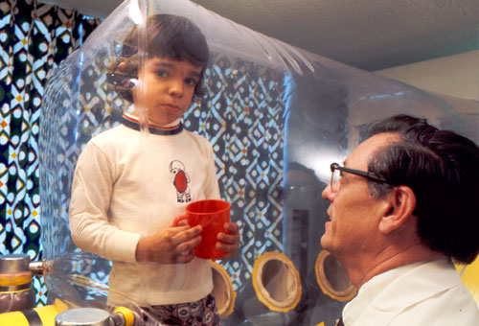
A boy with congenital ID lived in a bubble for 12 years before he died

Slide 5
Immunodeficiency is considered to be present when infections are:
Frequent and severe
Caused by opportunistic microbes
Resistant to antimicrobial therapy

Slide 6
Classification of ID
Primary
(Congenital)
Genetic Mutation
Monogenic (Single gene)
Polygenic (Multiple genes)
Secondary
(Acquired)
Viral and Bacterial Infections
(AIDS)
Immunosuppressive Therapy
(Corticosteroids)
Excessive Proteins Loss
(Burns, nephrotic syndrome)
Malnutrition

Slide 7
Primary or Acquired Can Affect
Natural Immunity
Phagocytic Cells
Complement Proteins
Acquired Immunity
T cells
B cells

Slide 8
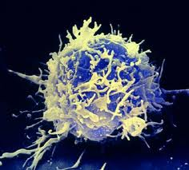
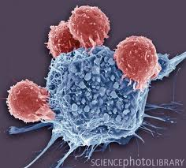
T-cell defects

Slide 9
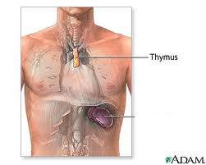
DiGeorge Syndrome (Congenital Thymic Aplasia )
A congenital defect that is marked by:
Absence or underdevelopment of the Thymus gland (hypoplasia)
Hypoparathyroidism
- Cardiovascular abnormalities

Slide 10
Features of DiGeorge syndrome
- Children may present with tetany
- Extreme susceptibility to viral protozoal, and fungal infections
- Profound depression of T-cell numbers
- Absence of T-cell responses

Slide 11
Management of DiGeorge syndrome
Fetal thymus tissue graft
(14 weeks old)

Slide 12
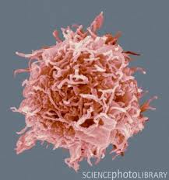
B-cell defects
(Gammaglobulinaemias)

Slide 13
Patients with B-cell defects are subject to:
Recurrent bacterial infections
but
Display normal immunity to most viral fungal infections
because:
T-cells are unaffected

Slide 14
Diverse spectrum ranging from:
- Complete absence of B-cells
- Complete absence of plasma cells
Low or absent immunoglobulins
Selective absence of certain immunoglobulins
-X-linked disease:
Females : carriers (normal)
Males : manifest the disease

Slide 15
X-linked agammaglobulinaemia (XLA) or
Bruton’s hypogammaglobulinaemia
(Congenital disease)
The most common 80 to 90 percent
Defect in Bruton tyrosine kinase (BTK)
The defect involves a block in maturation of pre- B- cells to mature B-cells in bone marrow

Slide 16
Features of XLA
- Reduced B-cell counts to 0.1 percent
(normally 5-15 percent)
- Absence of Immunoglobulins
- Affected children suffer from recurrent pyogenic bacterial infections

Slide 17
Selective immunoglobulin deficiency (Congenital disease)
IgA deficiency (1:700)
Most are asymptomatic: but may have increased incidence of respiratory tract infections (R.T.I)
Some have recurrent R.T.I and gastrointestinal tract symptoms

Slide 18
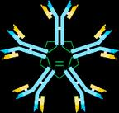
X- linked hyper-IgM Syndrome
(Congenital disease)
Characterized by:
- Markedly elevated IgM
- Low IgG, IgA & IgE

Slide 19
Management of immunoglobulin deficiencies:
*Periodic intravenous immunoglobulin (IVIG) reduces infectious complications

Slide 20
Severe Combine Immunodeficiency (SCID)
(Congenital disease)
Causes of SCID:
Enzyme deficiencies:
1. ADA (adenosine deaminase ) deficiency
2. PNP (purine phosphorylase) deficiency
Toxic metabolites accumulate in T and B cells

Slide 21
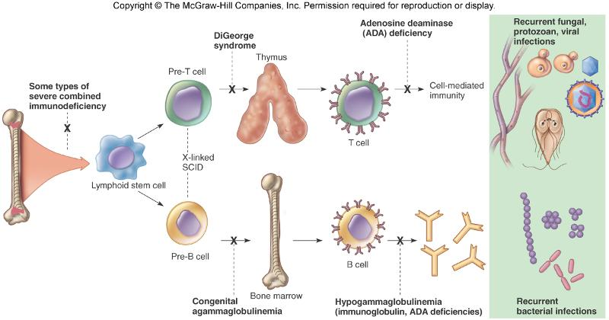
Features of SCID
- Increased susceptibility to :viral, fungal, bacterial protozoal infections (starting at 3 months of age)

Slide 22
Management of SCID
1. Infusion of purified enzymes
2. Gene therapy

Slide 23
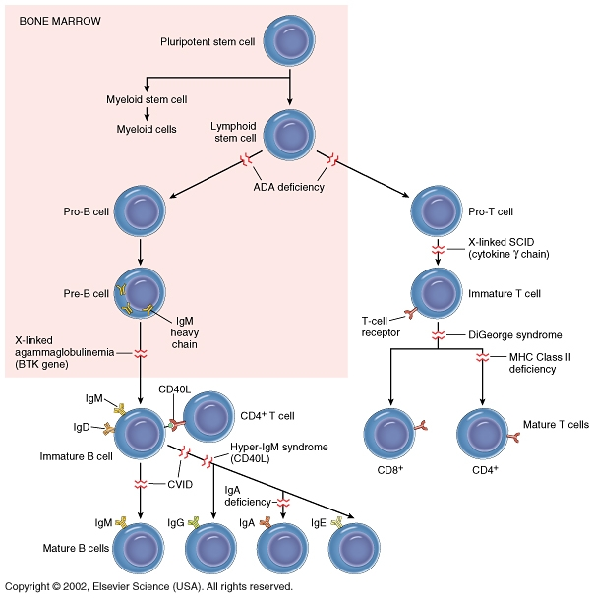

Slide 24
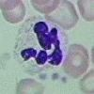
Leukocyte defects
Quantitative
Qualitative

Slide 25
Quantitative Defects
Congenital agranulocytosis:
Defect in the gene inducing G-CSF (granulocyte colony stimulating factor)
Features:
Pneumonia, otitis media, abscesses

Slide 26
Qualitative Defects
(Congenital disease)
A. Defect in chemotaxis
Leukocyte adhesion deficiency (LAD)
B. Defect in intracellular Killing
Chronic granulomatous disease:
Defect: in the oxidative complex responsible for producing superoxide radicals

Slide 27
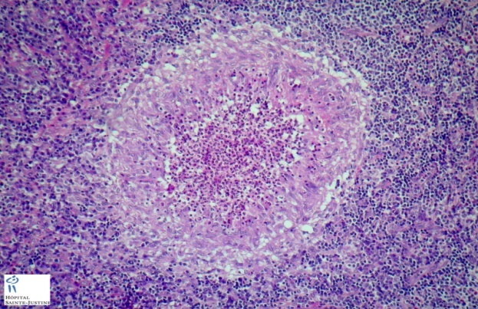
Chronic granulomatous disease (CGD) (Congenital disease)
Neutrophils lack the "respiratory burst" upon phagocytosis
- Characterized by recurrent life- threatening bacterial and fungal infections and granuloma formation

Slide 28
Complement Deficiency

Slide 29
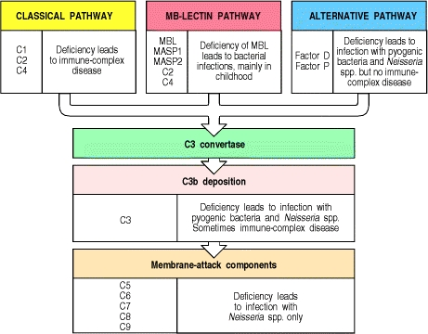
Deficiency of all complement components
have been described C1-C9

Slide 30
Laboratory diagnosis of ID
Complete blood count : total & differential
Evaluation of antibody levels and response to antigens
T and B cells counts (Flowcytometry)
Measurement of complement proteins and function (CH₅₀)
Assessment of phagocytosis and respiratory burst (oxygen radicals)

Slide 31
Take Home Message
Immunodeficiency may be congenital or acquired
It can involve any component of the immune system such as cells, antibodies, complement etc.
Most common presentation of immunodeficiency is recurrent infections that may be fatal due to delay in diagnosis and lack of appropriate theary

Slide 32
Thank you

