Slide 1
Title:
Bacterial Structure & Genetics
(Foundation Block, Microbiology)
Lecturer name: Prof Hanan Habib & Dr. Albdulaziz Al-Khattaf
Department of Pathology, Microbiology Unit, KSU

Slide 2
Lecture Objectives..
By the end of this lecture the student should be able to:
Upon completion of this lecture, students should be able to :
. Define the cellular organization of bacteria and know the differences between Eukaryotes and Prokaryotes.
. Know the structure of bacteria that include:
Shapes and arrangements and select examples.

Slide 3
Lecture Objectives..
Cell wall of bacteria including ; chemical structure , the differences between Gram positive and Gram negative bacteria and understand various functions of the cell wall.
Know short encounter on the bacteria with defective cell wall.
Know the external structures of bacteria with regards to its structure and function ( flagella, pili and capsule ).

Slide 4
Lecture Objectives..
Know the cytosol and internal structures of bacteria including ; cytoplasmic membrane ,nucleoid, ribosomes and cytoplasmic inclusions.
Describe bacterial spores , its chemical structure, function, types and its important application on the practice of medicine.
Know basic information on bacterial genetics and the meaning of the following terminologies:

Slide 5
Lecture Objectives..
-Genotypes, Phenotypes, Wild type, and Mutants.
- Outline the structure and types of bacterial DNA (chromosomal and extrachromosomal DNA).
- Know brief information on replication of bacteria and bacterial cell division.
- Define plasmids, its origin , types and importance
- Recalls genetics variations, including ; mutation and its types , gene transfer by transformation, transduction and conjugation and recognize its

Slide 6
Lecture Objectives..
-Genotypes, Phenotypes, Wild type, and Mutants.
- Outline the structure and types of bacterial DNA (chromosomal and extr-achromosomal DNA).
- Know brief information on replication of bacteria and bacterial cell division.
- Define plasmids, its origin , types and importance
- Recalls genetics variations, including ; mutation and its types , gene transfer by transformation, transduction and conjugation and recognize its

Slide 7
Lecture Objectives..
importance and application on bacterial resistance to antimicrobial agents.
Know brief information of the fate of gene transfer to bacteria.
Define transposon and know its role in the transfer of resistance to antimicrobial agents among bacterial species.

Slide 8
Definition
Bacteria : Is a heterogenous group of uni-cellular organisms about 1-8 μm in diameter
Prokaryotic (has a primative nucleus):
- one chromosome
- no nuclear membrane
- no mitochondria
- no sterols
- Ribosome 70 S
Plasmids: extra piece of DNA.

Slide 9
Structures of bacteria
Shapes : Spherical / Oval…….Cocci
Rods…………… …Bacilli
very short Bacilli…Coccobacilli
Tapered end ………Fusiform
Club-shaped / Curved….Vibrio
Helical / Spiral… ..Spirochaetes

Slide 10
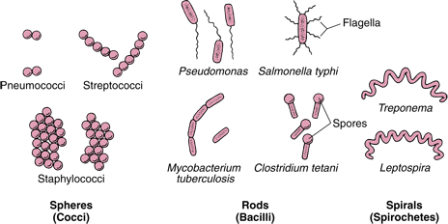
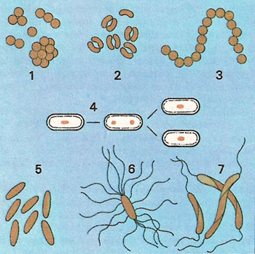
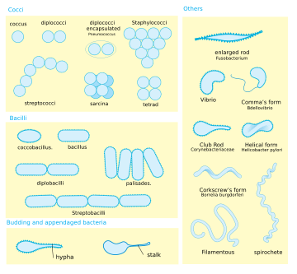

Slide 11
Arrangements
among Cocci :
Pairs………Diplococci
Chains……Streptococci
Clusters…..Staphylococci
In four……Tetrad
Pallisades…..Corynebacterium

Slide 12
Major structures of bacteria cell wall / appendeges & cytosol

Slide 13
Cell wall
Bacteria are cells with rigid cell wall surround cytoplasmic membrane and internal structures.
Functions of cell wall:
- Rigidity
- Shapes bacteria
Protection
-Porous / permeable to LMW molecules
-Cell division
- Antigenic determinants

Slide 14
Structure of cell wall
Two groups of cell wall depending on reaction to GRAM STAIN
GRAM POSITIVE BACTERIA
GRAM NEGATIVE BACTERIA

Slide 15
Chemical Structure of Cell Wall
Peptidoglycan :
rigid part , mucopeptide composed of alternating strands of N- acetyl muramic acid and N- acetyle glucosamine linked with peptide sub units.

Slide 16
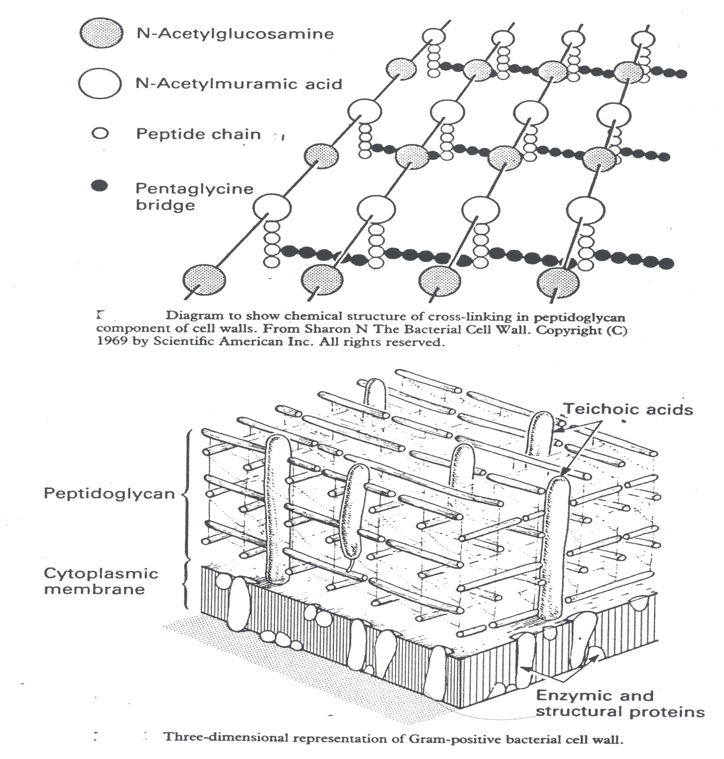

Slide 17
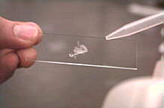
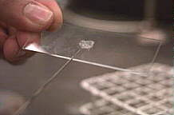
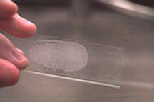
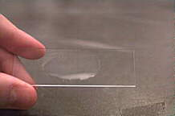

Slide 18
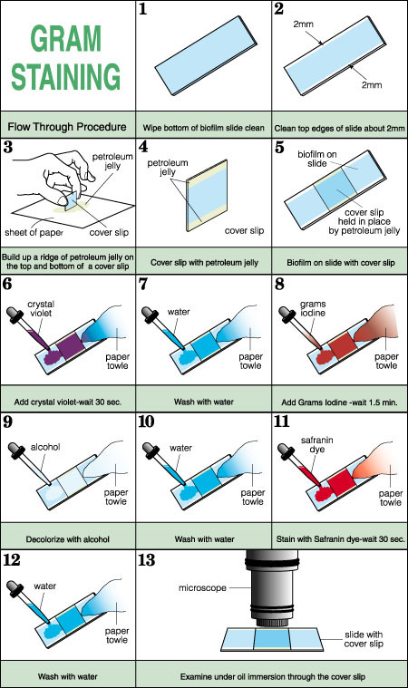
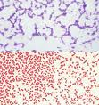

Slide 19
Gram Negative Cell Wall
Thin Peptidoglycan
Outer membrane that contains :
- specific proteins (porins) important in the transport of hydrophilic molecules
- lipopolysaccharide & lipid (ENDOTOXIN)

Slide 20
Gram Positive Cell Wall
Peptidoglycan thicker than Gram negative bacteria.
Closely associated with cytoplasmic membrane.
Techoic acid : anchores cell wall to cell membrane , epithelial cell adhesion.
Antigens : - polysaccharides (Lancefield)
- protein (Griffith)

Slide 21
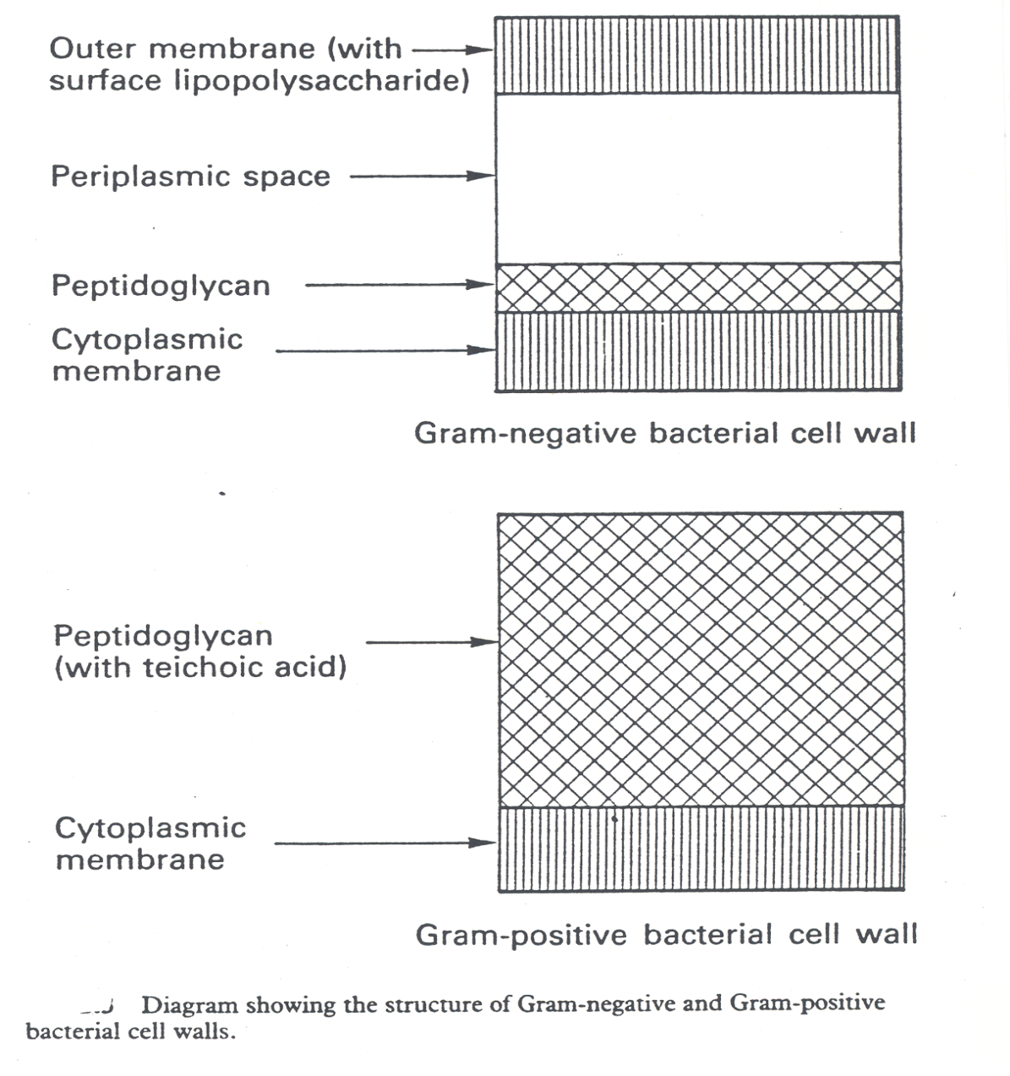

Slide 22
Bacteria with defective cell wall
4 types:
1-Mycoplasma: natural , stable.
2-L- Form : produced in the lab. Or body of patient on penicillin , stable , can replicate.
3- Spheroplasts: from Gram –ve , retain some cell wall , non functional , osmotically fragile, hypertonic media needed.
4- Protoplasts: from Gram +ve , lack cell wall, unstable ,produced by lysozyme /hypertonic media.

Slide 23
External Structures
Protrude from the cell into the environment.:
Flagella
Pili
Capsule

Slide 24
Flagella
Helical filaments
Composed of protein FLAGELLIN.
Found in Gram positive & Gram negative bacteria.
Distribution:
- Peritrichous
- Monotrichous
- Lophotrichous

Slide 25
Monotrichous
Lophotrichous
Peritrichous
Distribution of flagella on bacteria

Slide 26
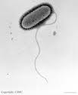
Structure of Flagella
Basal Body : a protein arranged as rings on central rod (4 ring in Gram –ve , 2 ring in Gram +ve).
-outer pair of rings: only in Gram –ve, pushed through outer membrane.
- inner pair of rings : inserted into peptidoglycan & cytoplasmic membrane.
Hook : bent structure -act as joint
Long Filament : Flagellin protein
Function of Flagella:
1- Motility. 2- Chemotaxis

Slide 28
Pilli
Fine short filaments extruding from cytoplasmic membrane.
Found on the surface of many Gram negative & Gram positive bacteria.
Composed of protein Pilin.
Two classes:
1- Common pili (fimbriae): covers the surface— responsible for: adhesion & colonization
2- Sex pili : in some bacteria only, responsible for conjugation.

Slide 29
Capsule
Amorphous material surrounds bacteria.
Usually polysaccharide
Occasionally protein
Function : - Inhibits phagocytosis
- acts as Virulence factor in some bacteria by assessing attachment to the surfaces.

Slide 30
Cytoplasmic membrane (cell membrane)
Double layered structure composed of phospholipid & protein
Act as semi- permeable membrane (passive diffusion)
Site of numerous enzymes involved in active transport of nutrients and various metabolic processes

Slide 31
Internal structures
Mesosomes : convoluted invaginations of cytoplasmic membrane.
Involved in DNA segregation during cell division & respiratory activity
Contain receptors involved in chemotaxis
Permeability barrier (active transport of solutes).

Slide 32
Core
Composed of : Cytoplasmic inclusions
Nucleoid
Ribosome
Cytoplasmic inclusions:
Nutritional storage granules , eg.
- Volutin
- Lipid
- Starch / or Glycogen

Slide 33
Nucleoid (nuclear body)
Circular single stranded chromosome (bacteria genome or DNA)
No nuclear membrane
DNA undergoes semi-conservative replication ,bidirectional from a fixed point

Slide 34
Ribosomes
Distributed throughout the cytoplasm
Site of protein synthesis
Composed of RNA and protein
Organized into 30s and 50s subunits.

Slide 35
Spores
Small ,dense, metabolically inactive , non- reproductive structures produced by Bacillus & Clostridium
Enables the bacteria to survive adverse environmental conditions.
Contain high con. of Calcium dipicolonate
Resistant to heat, dissecation & disinfectants
Often remain associated with the cell wall

Slide 36
continue -spores
Described as :
1- Terminal spores
2- Sub-terminal spores
3- Central spores
Germinate when growth conditions become favorable to produce vegetative cells.
Spore preparations used for checking the efficacy of autocalves, eg B. subtilis, B. sterothermophilus.

Slide 37
Sport
position , size and shape
Gram’s stain
Projecting , spherical and terminal
Non –projecting, ovoid and central
Non –projecting, ovoid and subterminal
Free spores

Slide 38
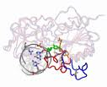
BACTERIAL GENETICS

Slide 39
DEFINITIONS
Genetics is the study of inheritance and variation.
Genetic information encoded in DNA.
Function of genetic material:
1- Replication of the genome
2- Expression of DNA to mRNA then to protein.

Slide 40
Definitions
Genotype: the complete set of genetic determinants of an organism.
Phenotype: expression of specific genetic material under particular set of growth condition.
- Wild type: reference (parent) strain- active.
Mutant: progeny with mutation- inactive.

Slide 41
Bacterial DNA
2 types of DNA:
- Chromosomal
- Extra-chromosomal (plasmid).

Slide 42
Bacterial chromosome
Haploid, circular molecule of ds- DNA attached to cell membrane. No nuclear membrane (prokaryotes).
DNA a double helical structure, genetic code in purine and pyrimidine bases of nucleotides that makes DNA strand.
3 bases comprise one code, each triplet codon codes for one amino acid.
Replication is semi-conservative.

Slide 43
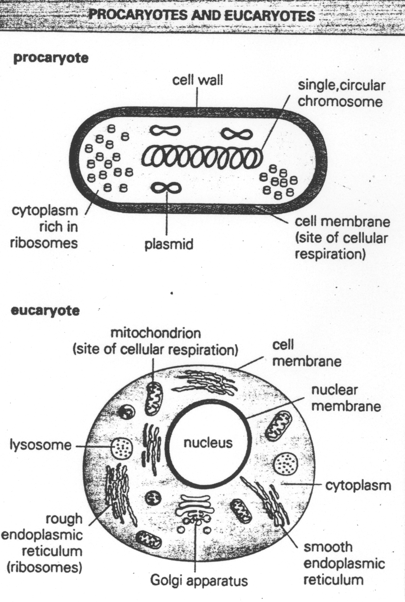

Slide 45
Plasmid
Extrachromosomal DNA composed of ds-DNA.
Found in most species of bacteria.
Origin?
Govern their own replication
Genetic exchange, amplify genes
Transfer by conjugation(conjugative plasmid)
Unrelated plasmids coexist together only

Slide 46
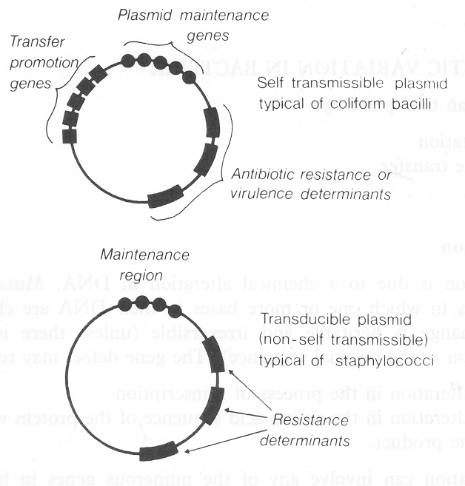

Slide 47
Types of plasmids
1- R-plasmids: genes code for antibiotic resistance paricularly Gram –ve bacteria.
2-Col-plasmids:in enterobacteria, codes for extracellular toxins.
3- F-plasmids: (fertility) factor, transfer of chromosome at HFR into recipient bacteria during mating eg. F⁺------- F⁻.

Slide 48
Genetic variation in bacteria
Takes place by :
1- Mutation
2-Gene transfer.

Slide 49
Mutation
Inheritable changes in the structure of genes (DNA).
Chemical changes in one or more bases of DNA.
Inactive mutated form is a mutant allele versus active wild type allele.

Slide 50
Results of gene defect
Alteration in,
transcription.
Amino acid sequence.
Function eg. Antibiotic resistance.
Lethal : undetected mutation.

Slide 51
Types of mutations
Base substitution (replacement)
Deletion
Insertion
Inversion
Duplication (common).

Slide 52
Classification of mutations
Depending on biological sequencing:
1- Resistance mutation: affect structure of cell protein.
2- Auxotropic mutation: affect biosynthetic enzyme resulting in a nutritional requirement of mutant cell.
3- Lethal mutation.

Slide 53
Gene Exchange
Three types:
1- Transformation
2- Transduction
3- Conjugation.

Slide 54
Transformation
A fragment of exogenous naked bacterial DNA are taken up and absorbed into recipient cells.
Common in Haemophilus influenzae & Streptococcus pneumoniae.

Slide 55
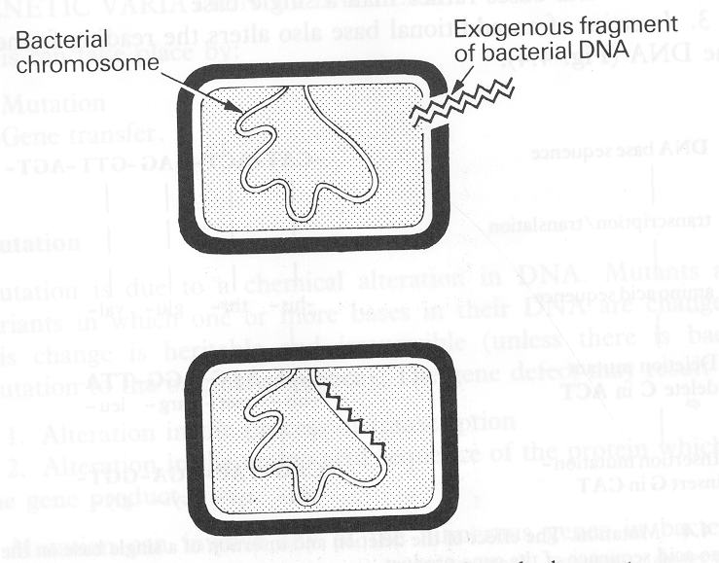

Slide 56
Transduction
Phage mediated transfer of genetic information from donor to recipient cells.
Example:
Beta – lactamase production in S. aureus, and:-
toxin production in Corynebacterium diphtheriae.

Slide 57
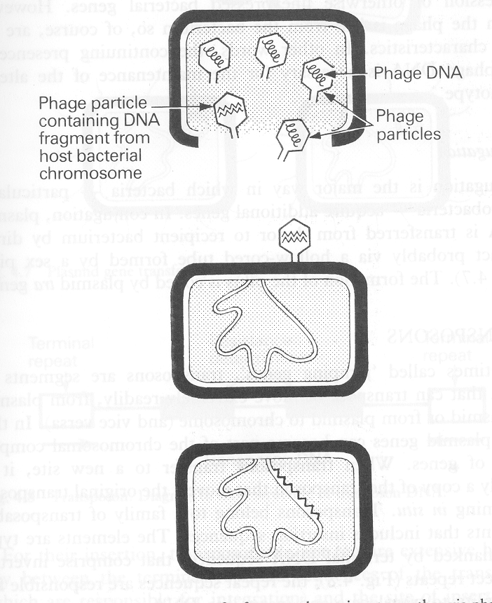

Slide 58
Conjugation
Major way bacteria acquire additional genes.
Plasmid mediated
Cell contact required and genes reside on plasmid resident within donor (male) cells transfer to recipient (female ) cell (mating).
Differs between Gram +ve & Gram –ve bacteria.

Slide 59
Conjugation among Gram -ve
Mediated by plasmid called F factor (fertility).
Gene encode changes in surface by producing a sex pilus .this facilitates capture of F⁻ cells and the formation of a conjugation bridge through which DNA passes from F ⁺ into F⁻cells.

Slide 60
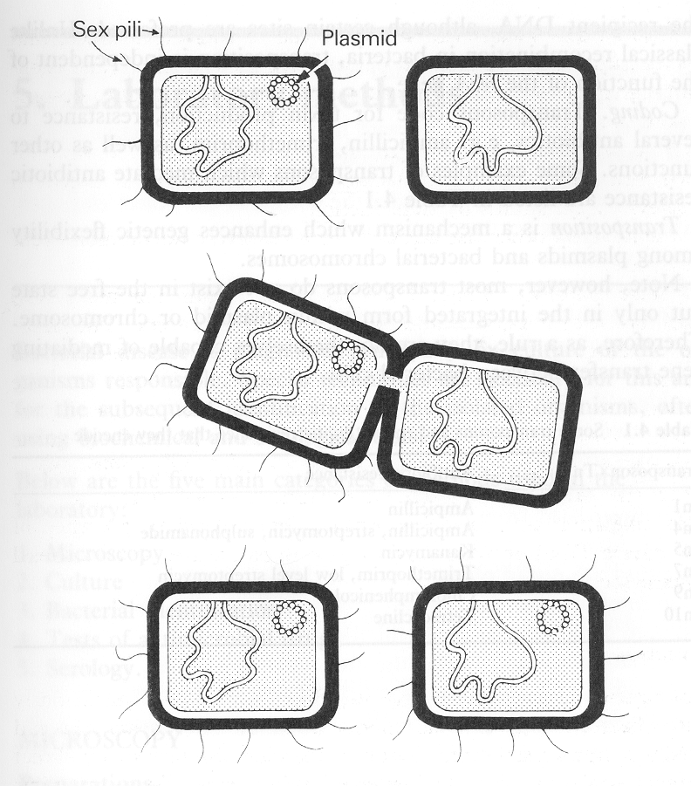

Slide 61
Conjugation among Gram +ve
It involves clumping of cells and secretion of phermones.

Slide 62
Genetic Recombination
After gene transfer, there are 3 possible fates:
1-Exogenous DNA degraded by nuclease.
2-Stabilized by circulization, become plasmid.
3- Form a partially hybrid chromosome with segment derived from each source.

Slide 63
Transposable Elements
Genetic units capable of mediating own transfer from chromosome to another, from location to other on same chromosome or between plasmid and chromosome or phage DNA.
Types: 1- Transposons .
2- Insertion sequence.

Slide 64
Reference book and the relevant page numbers..
Sherries Medical Microbiology, an Introduction to Infectious Diseases. Latest edition, Kenneth Ryan and George Ray. Publisher : McGraw Hill .
Chapter 2 : page 11-25, Chapter 4: page 53-75

Slide 65
Thank You ☺
(Foundation Block, Microbiology)
Prof Hanan Habib &
Dr. Albdulaziz Al-Khattaf

