Slide 1
Lecture Title:
NORMAL FLORA
(Foundation Block, microbiology)
Lecturer name: Prof Hanan Habib & Prof. A.M. Kambal
Department of Pathology, Microbiology Unit,KSU

Slide 2
Lecture Objectives
By the end of this lecture the student is expected to be able to:
Define the terms: Normal Flora, Resident flora, Transient flora and carrier state
Know the origin of normal flora.
Know the importance of normal flora with examples, including importance as:
Source of opportunistic infection.
Immunostimulation.
Nutrition: Vitamins production.
Production of Carcinogens.
Protection against external invaders.
Know areas of the body with normal flora (GIT, Urogenital tract, and skin) and most common types of organism in these areas and relation to pathogenicity of these organism.
Know sites of the body with no normal flora e.g. sterile body sites and the importance of this fact in relation to interpretation of culture results.

Slide 3
Definition
Normal flora are microorganisms that are frequently found in a particular site in normal healthy individual.
Some are found in association with humans / animals only. The Majority are bacteria.
Symbolic relationship with the host.
Subject to constant changes.
Altered by antimicrobial agents.

Slide 4
Types of Normal Flora
Commensals: natural relationship with host.
Residents : present for invariable period .
Transients : establish itself briefly , excluded by host defence or competition from residents.
Carrier state : potentially pathogenic , eg. S.pneumoniae, N. meningetidis in throat of healthy individual.

Slide 5
Origin of Normal Flora
Newborn sterile in utero.
After birth ,exposed to flora of mother’s genital tract, skin, respiratory tract flora of those handling him ,and organisms in the environment.

Slide 6
Beneficial effects of normal flora
1- Immunostimulation (antibody development)
2- Exclusionary effect (vacuum effect ) and protection from external invaders.
3-Production of essential nutrients (vit. K & B by some normal intestinal flora eg. E.coli.

Slide 7
Other facts regarding normal flora
May be a source of opportunistic infections. eg . In patients with impaired defense mechanisms. eg S.epidermidis, E.coli.
Some may cross react with normal tissue components ,eg, antibodies to various ABO group arise because of cross reaction between intestinal flora and the antigens of A &B blood substances.

Slide 8
Continue
Production of carcinogens:
Some normal flora may modify through their enzymes chemicals in our diets into carcinogens. eg. artificial sweeteners may be enzymatically modified into bladder carcinogens.

Slide 9
Distribution of normal flora
Internal organs (except alimentary tract) are sterile at health.
Sterility maintained by :
- local defence mechanisms
- chemical substances in serum & tissues eg. Complement , antibodies.
-phagocytic activity of PMN

Slide 10
Areas of the body with normal flora
GIT: mouth & large colon
Urogenital tract : vagina & distal 1/3 of the urethra
Skin

Slide 11
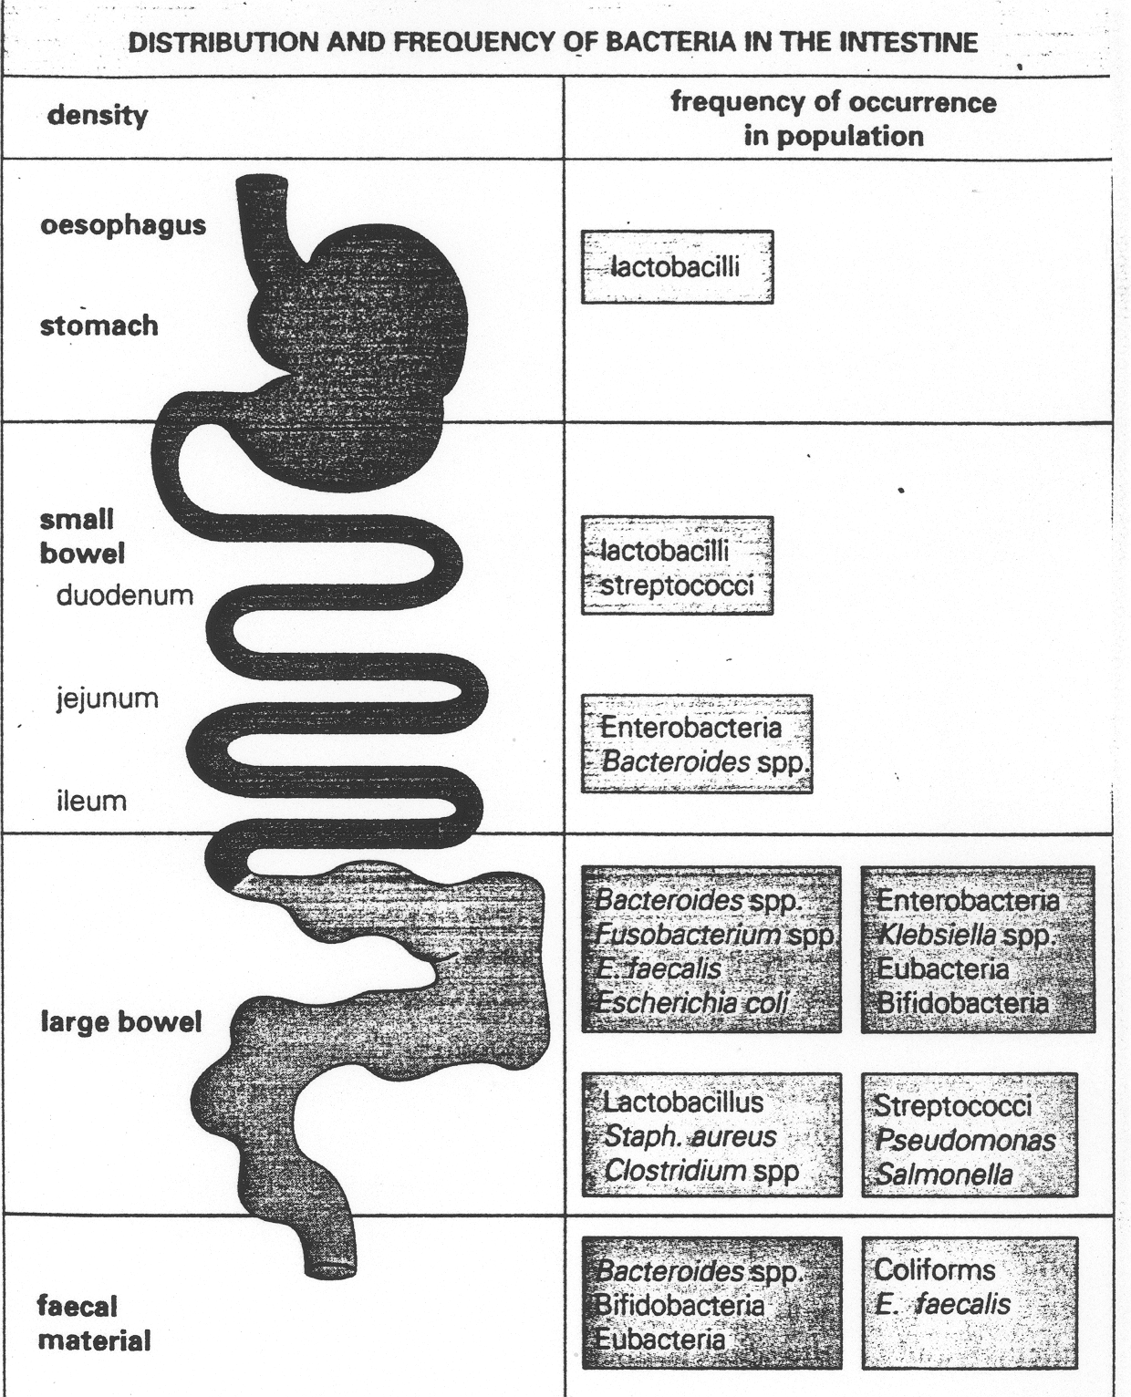

Slide 12
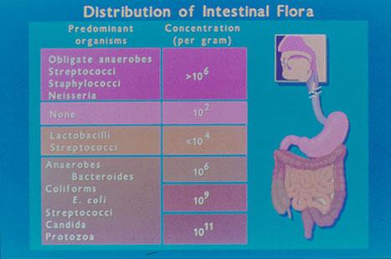

Slide 13
Normal flora of the respiratory tract
Upper resp. tract colonizes by flora as in mouth & nasopharynx
Lower respiratory tract is sterile
Nose: - Staph. epidermidis
- Staph. aureus
-Corynebacteria

Slide 14
Oropharynx flora
Viridance streptococci
Commensal neisseriae
Corynebacteria
Bacteroides
Fusobacteria , Veillonella, actinomyces, spirochaetes.
Heamophilus inflenzea & Pneumcoccus are potential pathogens.
Less common: S.pyogenes , N.meningitidis

Slide 15
Gastrointestinal tract flora
Saliva contains 10⁸ bact/ml
Gingival margin debris &dent. Plaque continually colonized by bacteria.
Oesophyagus flora as pharyngeal flora.
Empty stomach sterile due to gastric acid.
Duodenum, jejunum & upper ileum have scanty flora
Large intestine heavily colonized by bacteria.

Slide 16
Faeces
1/3 of faeces wt. is bacteria , mainly dead,
Living bacteria ~ 10¹⁰/gm
99% anaerobes
Anaerobic environment maintained by aerobic bacteria utilizing free O2.
Bacteroides fragilis group the dominant anaerobes, Bifidobact. Lactobacilli…etc.
Less common: E.coli ,Proteus,….etc.

Slide 17
Genital tract flora
Female genital tract heavily colonized , why ?
10⁸/ml in normal vaginal secretion.
In both sexes Mycobacterium Smegmatis (AFB) ( acid fast bacilli) in secretions which contaminate urine-leads to confusion /misdiagnosis.
M & F distal urethra: - S.epidermidis
- Corynebacteria
-Mycoplasma.

Slide 18
Female Vulva
S. epidermidis , corynebacteria, E.coli and othe coliforms & Enterococcus faecalis.
Vagina :
-Lactobacilli (Doderlein’s bacilli)
- Bacteroides melaninogenicus
-Enterococcus faecalis
- Corynebacteria
-Mycoplasma
- Yeasts.

Slide 19
Normal Skin Flora
Skin has rich resident bacterial flora(10⁴/cm²).
Exist as microcolonies.
Anaerobic organisms predominate in aereas with sebaceous glands.
Moist skin ,often colonized by coliforms.

Slide 20
Main Skin Flora
Propionibacterium acnes
Anaerobic cocci
S. epidermidis
Corynebacteria
S. aureus (less common, potential pathogen)
Coliforms

Slide 21
External auditory meatus
S. epidermidis
Corynebacteria
AFB ( Acid Fast Bacilli)occasionally in wax.
CONJUNCTIVAL SAC FLORA
-Corynebacterium xerosis
- S.epidermidis

Slide 22
Reference book and the relevant page numbers.
SHERRIS MEDICAL MICROBIOLOGY, AN INTRODUCTION TO INFECTIOUS DISEASES. KENNETH RYAN /GEORGE RAY. LATEST EDITION. PUBLISHER MC GRW HILL.
CHAPTER 9, PAGE 141-148

Slide 23
Thank You ☺
(Foundation Block, Microbiology)
Prof Hanan Habib &
Prof. A.M. Kambal

