Slide 1
Lecture Title:
Sterilization & Disinfection
(Foundation Block, microbiology)
Lecturer name: Prof Hanan Habib & Dr. AlKhattaf
Department of Pathology, Microbiology Unit,ksu

Slide 2
Lecture Objectives
1- Define the terms sterilization, disinfectant and antisepsis.
2- Classify the different methods of sterilization in physical and chemical method.
3- To recall the different physical methods of sterilization.
4- Know and realizes heat is the most important method of sterilization and that it should be used where ever that is possible.

Slide 3
Lecture Objectives
5- Know the different types of heat sterilization methods.
6- Know dry heat as applied in hot air oven and moist heat as applied in autoclaves.
7- Know the principles of autoclave function and control method of sterilization process.
8- Know the importance of non heat sterilization methods and their use for sterilization of heat sensitive objects.

Slide 4
Lecture Objectives
9-Know the difference between antiseptics and disinfectants.
10- Classify the disinfectants and antiseptics and know factors affecting their functions.
11- Know different applications for different disinfections and antiseptics.

Slide 5
Definitions
Sterilization: complete killing of all forms of microorganisms, including bacterial spores
Disinfection: killing or removing of harmful vegetative microorganisms.
Disinfectant: chemical substance used to achieve disinfection.
Antiseptic: disinfectant that can be safely used on living tissues.

Slide 6
Methods of sterilization
Physical methods
Chemical Methods

Slide 7
PHYSICAL METHODS
HEAT : Most important should be used when ever possible could be ;
A-dry heat at temperature of 160˚C for one hour
B- Moist heat eg .use of the Autoclave
at121 or 134 C for 15 minute

Slide 8
Radiation
U.V. light
Has limited sterilizing power because of poor penetration into most materials. Generally used in irritation of air in certain areas eg. Operating rooms and T.B. labs.
Ionizing radiation-
e.g. Gamma radiation: Source Cobalt60 has greater energy than U.V. light, therefore more effective. Used mainly in industrial facilities e.g. sterilization of disposable plastic syringes, gloves, specimens containers and Petri dishes.

Slide 9
Filtration
May be done under either negative or positive pressure. Best known example is the membrane filter made from cellulose acetate. Generally removes most bacteria but viruses and some small bacteria e.g. Chlamydias & Mycoplasmas may pass through. Thus filtration does not technically sterilize items but it adequate for circumstances under which is used.
Main use: for heat labile substances e.g. sera, antibiotics.

Slide 10
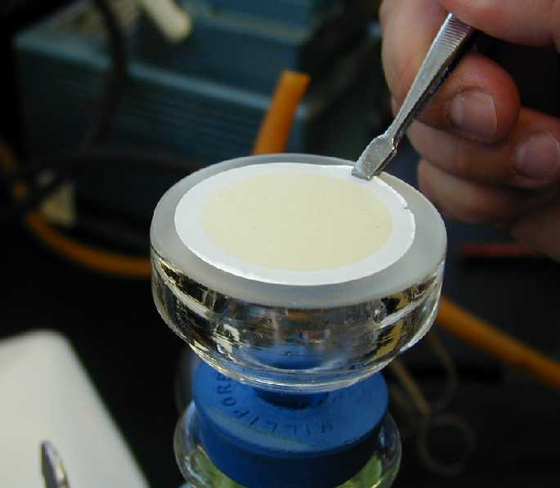
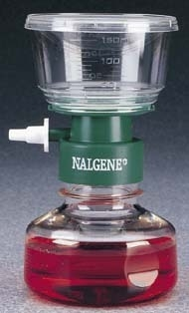
Membrane filter

Slide 11
Chemical Methods
Some chemical substances may be used to achieve sterilization e.g. Gluteraldehyde and Ethylene oxide.

Slide 12
Sterilization by Heat Most common method Dry Heat
Dry Heat- kills microorganisms by destroying their oxidative processes.
Simplest method is exposing item to be sterilized to the naked flame e.g. Bunsen burner- for sterilizing bacteriological loops, knives, blades.
Hot air oven expose items to 160 °C for 1 hour.
Has electric element in chamber as source of heat plus a fan to circulate air for even distribution of heat in chamber. Oven without fan is dangerous.
Used for: metals ,Glassware, ointment/ oils/ waxes/powder ,i.e. items that are lacking water

Slide 13
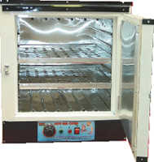
Hot air oven

Slide 14
Moist Heat
Uses hot water. Moist heat kills microorganisms by denaturating proteins.
Autoclaving – standard sterilization method in hospitals.
The equipment is called Autoclave and it works under the same principle as the pressure cooker where water boils at increased atmosphere pressure i.e. because of increase pressure the boiling point of water is >100 °C.
The autoclave is a tough double walled chamber in which air is replaced by pure saturated steam under pressure.

Slide 15
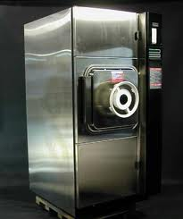
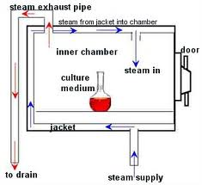
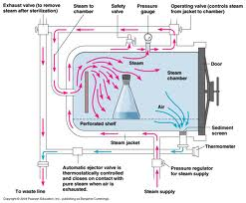
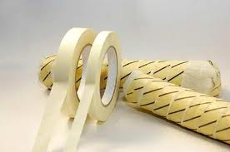
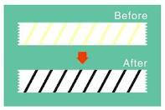
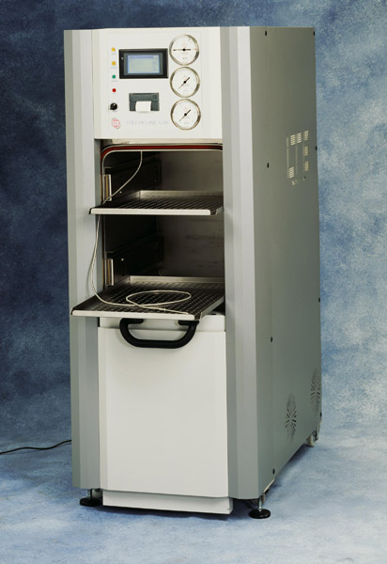
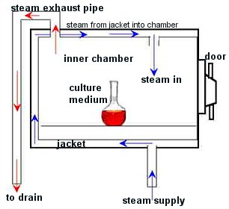
The Autoclave

Slide 16
Advantages of Autoclave
1. Temp. > 100 C therefore spores killed.
2. Condensation of steam generates extra heat.
3. The condensation also allows the steam to penetrate rapidly into porous materials.
Note: that autoclavable items must be steam permeable. Can not be used for items that are lacking water.

Slide 17
The air in the chamber is evacuated and filled with saturated steam. The chamber is closed tightly the steam keeps on filling into it and the pressure gradually increases. The items to be sterilized get completely surrounded by saturated steam (moist heat) which on contact with the surface of material to be sterilized condenses to release its latent heat of condensation which adds to already raised temperature of steam so that eventually all the microorganisms in what ever form –are killed.
The usual temperature achieved is 121 °C at a pressure of 15 pps.i. at exposure time of only 15 mins

Slide 18
Monitoring of autoclaves
1. Physical- use of thermocouple to measure accurately the temperature.
2. Chemical- it consists of heat sensitive chemical that changes color at the right temperature and exposure time.
e.g. a)- Autoclave tape
b)- Browne’s tube.
3. Biological – where a spore-bearing organism is added during the sterilization process and then cultured later to ensure that it has been killed.

Slide 19
Moist heat: Other Applications
Pasteurization
Used heat at temperatures sufficient to inactivate harmful organism in milk. The temperatures sterilization a not achieved .
Temperature may be 74°C, for 3-5 secs ( Flash method )or 62°C for 30 mins. (Conventional method ).
b)- Boiling – quite common especially in domestic circumstances.

Slide 20
Pasteurization of milk
To prevent diseases like :
Typhoid fever
Brucellosis
Tuberculosis
Q fever

Slide 21
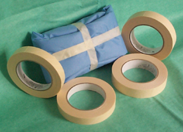
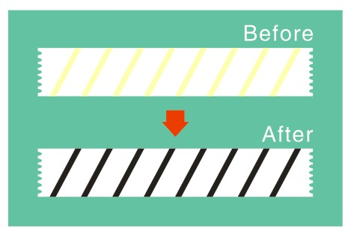
Autoclave tape

Slide 22
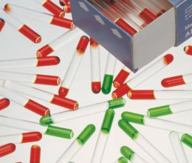
Browne’s tube

Slide 23
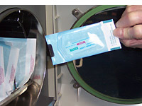
Spore test

Slide 24
II Sterilization by Chemical Methods
Useful for heat sensitive materials e.g. plastics and lensed instruments endoscopes).
1. Ethylene Oxide Chamber
Ethylene oxide alkylates DNA molescules and thereby
inactivates microorganisms.
Etylenes oxide may cause explosion if used pure so it is
mixed with an inert gas e.g Neon, Feron at a ratio of 10:90
Requires high humidity and used at relative humidity
50-60% Temperature : 55-60°C and exposure period 4-6 hours.
2. Activated alkaline Gluteraldehyde 2%
Immerse item in solution for about 20 mins. If organism is tuberculosis . But if spores then immersion period 2-3 hours.

Slide 25
Factors influencing activity of disinfectants
1. Activity directly proportional to temperature.
2. Directly proportional to concentration up to a point – optimum concentration. After this level no advantage in further increases in concentration.

Slide 26
Factors influencing activity of disinfectants (cont.)
3. May be inactivated by
Dirt
Organic matter : Proteins, Pus, Blood, Mucus and Faeces.
Non organic: Cork,, Hard water and Some plastics.
4. Time : Disinfectants need time to work.
5. Range of Action : Disinfectants not equally effective against the whole spectrum of microbes. E.g. Chlorhexidine less active against GNB than Gram Positive cocci.
Hypochlorites and Gluteraldehyde are more active against hepatitis viruses than most other disinfectants.

Slide 27
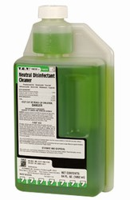
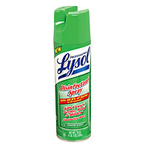
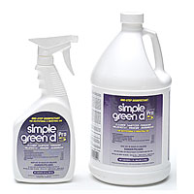
Chemical disinfectants

Slide 28
Corrosive Action | Inactivated by |  | TB | Activity against |  | GPC | Disinfectant
 | Soap | Protein |  | Spores | GNB
+ | _ | + | + | _ | ++ | ++ | Phenolics Sudol
_ | _ | + | _ | _ | ++ | ++ | Izal
+ to + | _ | + | + | _ | ++ | ++ | Soluble Phenolic* e.g. clearsol
++ or +Φ (buffered Solution) | _ | ++ | + | ++ | ++ | ++ | Chlorine compound
_ | _ | + | + | + (Slow) | ++ | ++ | Lodophor
_ | _ | _ | _ | _ | + | ++ | Chorhexidine (Hibitane)
_ | _ | ++ | + | _ | ++ | ++ | 70° alcohol
++ | _ | + | ++ | ++ (slow) | ++ | ++ | Formaldehyde
+ | _ | + | ++ | ++ | ++ | ++ | Glutaraldehyde (Cidex)

Slide 29
Hospital disinfection methods
Article Disinfectant
Floors,walls phenolics fluids 1-2%
Surfaces tables hypochloride,alcohol
skin:
Surgeons’hands chlorhexidine, iodine
alcohol
Patient skin 70%alcohol,iodine
Endoscopes gluteraldehyde2%
(cidex),sub-atmospheric
steam
Thermometers 70% Alcohol

Slide 30
Reference book and the relevant page numbers..
Sherris 175-185

