Slide 1
GRAM POSITIVE & GRAM NEGATIVE BACTERIA
Dr . Fawzia Al-O tabi

Slide 2
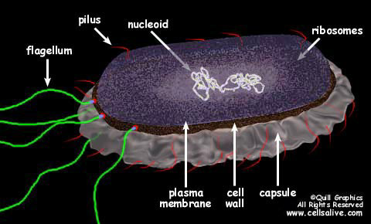
Bacterial cells

Slide 3
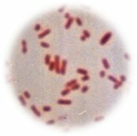
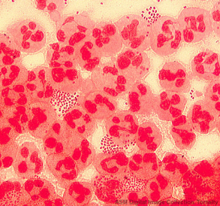
GRAM STAIN
Developed in 1884 by the Danish physician Hans Christian Gram
An important tool in bacterial taxonomy, distinguishing so-called Gram-positive bacteria, which remain coloured after the staining procedure, from Gram-negative bacteria, which do not retain dye and need to be counter-stained.
Can be applied to pure cultures of bacteria or to clinical specimens
Top: Pure culture of E. coli
(Gram-negative rods)
Bottom: Neisseria gonorrhoeae in a smear of urethral pus
(Gram-negative cocci, with pus cells)

Slide 4
CELL WALL
Gram positive cell wall
Gram negative cell wall
Consists of
a thick, homogenous sheath of peptidoglycan 20-80 nm thick
tightly bound acidic polysaccharides, including teichoic acid and lipoteichoic acid
cell membrane
Retain crystal violet and stain purple
Consists of
an outer membrane containing lipopolysaccharide (LPS)
thin shell of peptidoglycan
periplasmic space
inner membrane
Lose crystal violet and stain pink from safranin counterstain

Slide 5
Characteristic Gram positive Gram-negative
Gram reaction Retain crystal violet dye and stain dark violet or purple can be decolorized to accept
Peptidoglycan layer Thick (multilayered) Thin (single-layered)
Teichoic acids Present in many Absent
Periplasmic space Absent Present
Outer membrane Absent Present
Lipopolysaccharide (LPS) content Virtually non High
Lipid and lipoprotein content Low High
Toxins produced Primarily exotoxins Primarily endotoxins

Slide 6
Gram Positive
Gram Negative

Slide 7
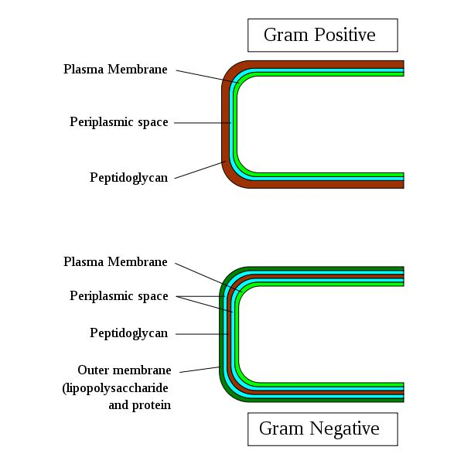

Slide 8
The Gram Stain
Gram's
Crystal
iodine
violet
Decolorise with
acetone
Gram-positives
appear purple
Counterstain with
e.g. methyl red
Gram-negatives
appear pink

Slide 10
Gram-positive cocci
Gram-positive rods
Gram-negative cocci
Gram-negative rods

Slide 11
Gram positive bacteria
Cocci Bacilli
Aerobic /facltative Anaerobe
Anaerobe Peptostreptococci
Staphylococci
Streptococci
Enterococcci
Aerobic/facultative anaerobe Anaerobic
Cornybacterium
Listeria Clostridium
Nocardia
Latobacillus ,Bacillus

Slide 12
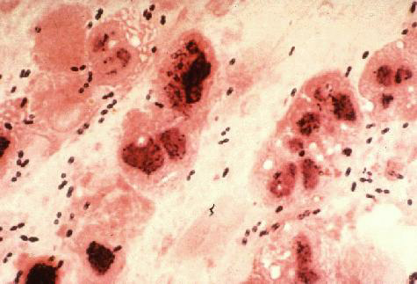
Gram-positive Cocci
Staphylococci
Catalase-positive
Gram-positive cocci in clusters
Staphylococcus aureus
coagulase-positive most important
pathogen
Staph. epidermidis
and other coagulase negative staphylococci egS saprophiticus
Streptococci
Catalase-negative
Gram-positive cocci in chains or pairs
Strep. pyogenes
Strep. pneumoniae
Viridans-type streps
Enterococcus faecalis

Slide 13
Streptococcus divided by type of haemolysis
S. viridans-oral flora -infective endocarditis
S. pyogenes
Group A, beta hemolytic strep
pharyngitis, cellulitis
rheumatic fever
fever
migrating polyarthritis
carditis
immunologic cross reactivity
acute glomerulonephritis
edema, hypertension, hematuria
antigen-antibody complex deposition

Slide 14
S. pneumoniae

Slide 15
GRAM POSITIVE BACILLI
A-Spore forming
B-Non spore forming
Spore forming are divided into:-
Aerobic spore forming most important is Bacillus anthracis,that causes anthracis

Slide 16
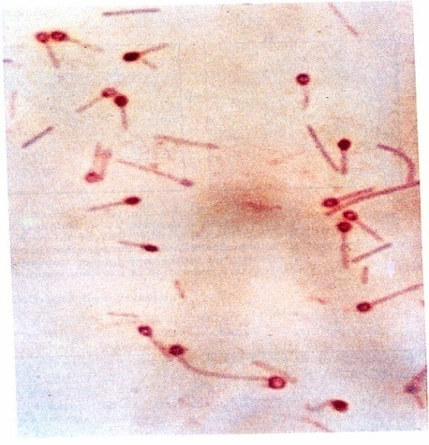
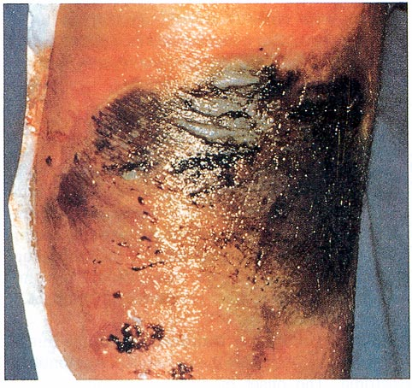
Anerobic Gram Positive Bacilli
C. tetani - Tetanus C. perfringens
Gas gangarene
C. botulinum - botulism
Descending weakness-->paralysis
diplopia, dysphagia-->respiratory failure
C. diphtheriae - Fever, pharyngitis, cervical LAD
thick, gray, adherent membrane
sequelae-->airway obstruction, myocarditis

Slide 17
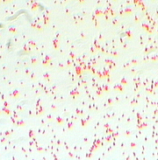
Gram-Negative Cocci
Neisseria gonorrhoeae
The Gonococcus
Neisseria meningitidis
The Meningococcus
Both Gram-negative intracellular diplococci
Moraxella catarrhalis

Slide 18
Gram-Negative Rods
Enteric Bacteria they ferment sugars most important are;
E. coli
Salmonella
Shigella
Yersinia and Klebsiella pneumoniae
Proteus

Slide 19
Gram-Negative Rods
Fastidious GNRs
Bordetella pertussis
Haemophilus influenzae
Campylobacter jejuni
Helicobacter pylori
Legionella pneumophila
Anaerobic GNRs
Bacteroides fragilis
Fusobacterium

Slide 20
Oxidise positive non fermentative i.e. they do not ferment sugars e.g.
Pseudomonas that causes infection in
Immunocompromised patients
Oxidise negative non fermentative e.g.
Acinobacter species

Slide 21
Oxidise positive comma shaped and also fermentative most important is Vibrio cholerae that causes cholera which is a disease characterized by severe diarrhea and dehydration

Slide 22
Non-Gram-stainable bacteria
Unusual gram-positives
Spirochaetes
Obligate intra-cellular bacteria

Slide 23
Unusual Gram-positives
Mycoplasmas
Smallest free-living organisms
No cell wall
M. pneumonia, M. genitalium

