Slide 1
ANAEROBIC BACTERIA
Dr- Fawzia Al-otaibi
Notes:
DR FAWZIA AL OTAIBI

Slide 2
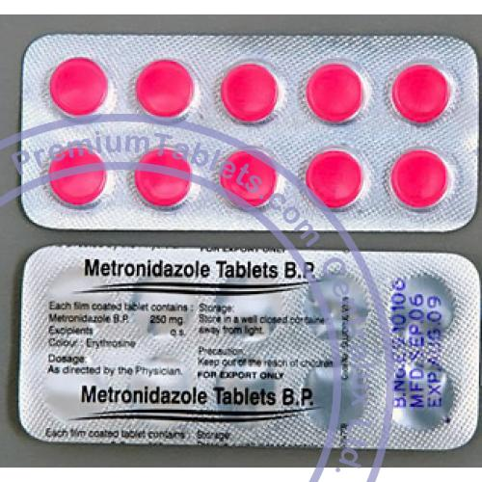
DEFENITION
A MICRBE THAT CAN ONLY GROW UNDER ANAROBIC CONDITION
SENSETIVE TO MTZ
FAIL TO GROW IN AIR 10 % O₂

Slide 3
Why can’t anaerobic bacteria survive in oxygen?
The presence of oxygen leads to the production in cells of the superoxide radical (a negatively charged O2 molecule). Normally, the superoxide anion is lethal enough to kill almost any organism. Aerobic organisms and facultative anaerobes have the enzymes superoxide dismutase and catalase. These enzymes work together to convert superoxide to oxygen and hydrogen peroxide

Slide 4
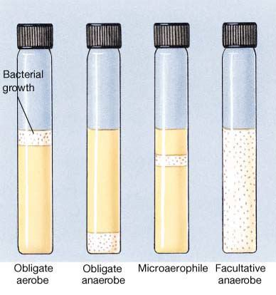

Slide 5
CLASSIFICATION
A -NON SPORE FORMINGN {MOR COMMN}
B - SPORE FORMING

Slide 6
A - NON SPORING
A –GRAM NEGATIVE BACILLI
bacteroides fragilis
Prevotella spp
Leptotricha buccalis
fusobacterium spp f.nucleatum
Viellonella sp.

Slide 7
B –GRAME POSITIVE COCCI
Peptococci
Peptostreptococci
C –GRAME POSITIVE BACILLI
Propionobacterium propionicum ,p.acne
Bifidobacterium
Euobacterium
LACTOBACILLUS
Actinomyces israelii
D-MICROAEROPHILIC STREPT.

Slide 8
SPORE FORMING
GRAME POSITIVE BACILLI
CL .perfringens
CL .Septicum
CL .novyi
CL .Histolyticum
CL .Difficile
CL .Tetani
CL .Botulinum

Slide 9
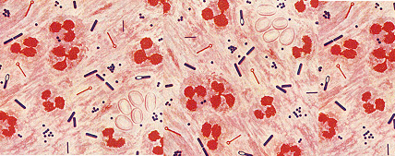
IMPORTANCE
Dominate the indigenous flora (colonization resistance)
Commonly found in infection
Easy to overlook
special precautions
Slow growth
Mixed infection
Difficult treatment

Slide 10
PRESENCE AS NORMAL FLORA
Skin
Nose
Mouth, throat
Stomach
Large intestine >10¹¹ / gram colonic contents
Vagina
Endocervix
Urethra

Slide 11
MODEFIED BY
Pathophysiologic states
Antimicrobial agents ,H-Blockers ,antacids
Hormonal changes
Age

Slide 12
EPIDEMIOLOGY
Almost all infections are indigenous except
Tetanus
Infant ,wound botulism
Gas gangrene { some cases }
Bites
C .difficile {nosocomial }

Slide 13
CHARACTER OF ANAEROBIC INFECTION
Suppuration
Abscess formation
Tissue destruction{gangrene}
Septic thrombophlebitis
Some have unique pathology
Actinomycosis
Psedomembranous colitis
Gas gangrene

Slide 14
PREDISPOSING FACTORS
Low O tension {Eh}
Trauma, dead tissue , deep wound
Impaired blood supply
Presence of other organisms
Foreign bodies

Slide 15
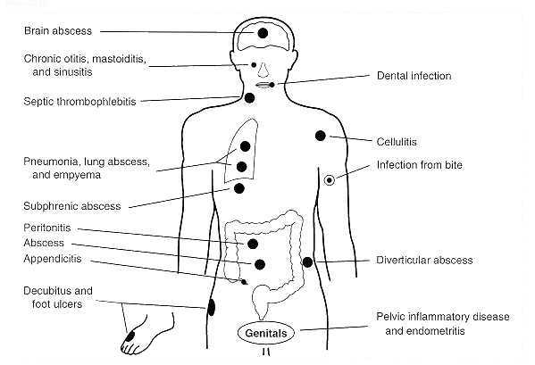

Slide 17
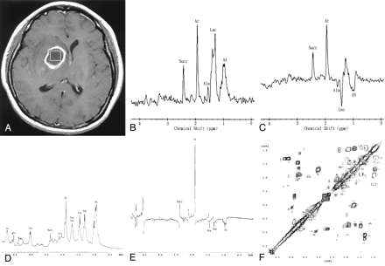
A 43-year-old man with surgically proved pyogenic brain abscess in the right basal ganglion secondary to Eubacterium lentum (obligate anaerobe) infection.
Axial contrast-enhanced T1-weighted MR image shows a ring-shaped cystic lesion and surrounding edema.

Slide 18
Predisposing factors
Antibiotic therapy
Neoplasm
Trauma
Cholecystitis
Obstruction
Ulceration
Diabetes mellitus
Pylephlebitis
Diverticula formation

Slide 19
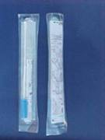

Slide 20
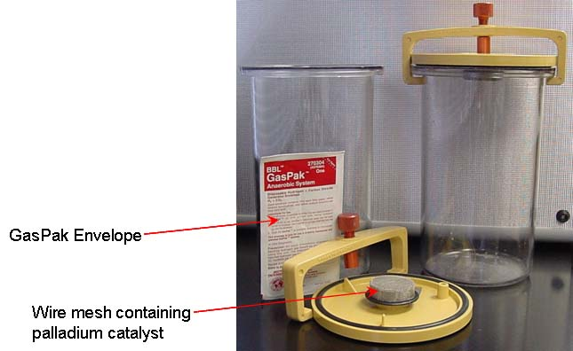

Slide 21
TETANUS
TRIMUS
LOCKJAW 1884
Strict toxigenic disease

Slide 22
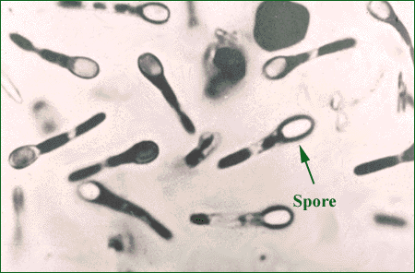

Slide 23
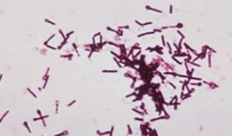

Slide 24
EPIDEMIOLOGY
1 Million/year > 60 yr .injection of drugs {young}
½ due to neonatal tetanus
Cryptogenic t. {23%}
Disease of non-immunized animals and humans {toxoid}

Slide 25
SOURCE
Animals feaces {horses} ,soil
Contaminated wound {minor}
Compound fracture
Narcotic addicts
Unsterile injections
Burns , bites ,avulsions
Umbilical stump
Face , neck , upper extremities wounds are more dangerous

Slide 26
TETANUS
PATHOGENESIS
EXTOXIN {TETANOSPASMIN}
Presynaptic terminals of LMN Inhibitory impulses to MNs
Persistent tonic spasm
Clinical picture
Generalized
Localized
Cephalic
Neonatal{ >90%}mortality
IP 3-21 days

Slide 27
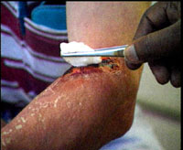

Slide 28
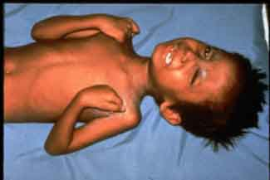

Slide 29
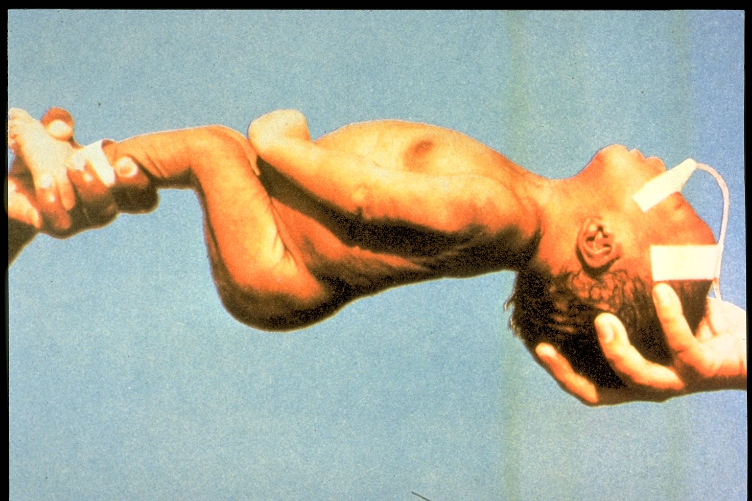

Slide 30
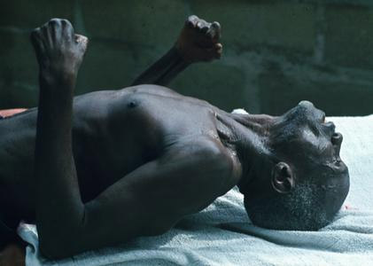

Slide 31
TRATMENT
Supportive
Airway
Muscle relaxant
Wound care
Antitoxin
Antibiotics :MTZ , PG
TIG {500 UNITS}
DIAGNOSIS
Clinical
Laboratory
{minor role}
PREVENTION
Complete active childhood immunization
Appropriate wound management
Type of wound
Immunization history

Slide 32
C. Perfringens {C.Welchii}
Histotoxic clostridia
Gas gangrene
Food Poisoning

Slide 33
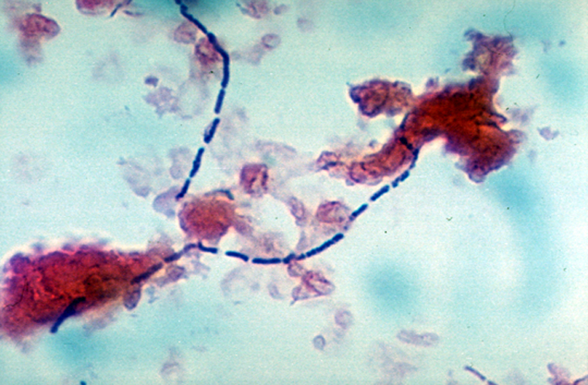
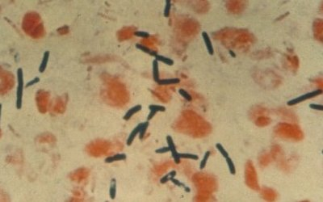

Slide 34
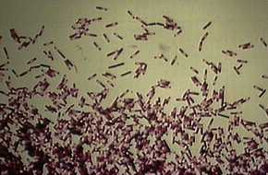

Slide 35
NATURAL HABITATS
Soil and intestinal tracts of animals and humans { 10³ 10⁸ }
Widespread occurrence
Vagina of 1-9 % healthy women

Slide 36
CLINICAL SIGNIFICANCE
Species most commonly isolated from clinical specimens
Many clinical settings ranging from :-
Simple contamination of wounds – traumatic or non traumatic myonecrosis
C. Cellulitis
Intra-abdominal sepsis
Gangrenous cholecystitis
Post-abortion infections – septicemia
Bacteremia
Brain abscess

Slide 37
Gas gangrene
Toxin mediated breakdown of muscle tissue
Rapid progression { Uterus }
Liquefactive necrosis of muscle , gas formation , toxemia
Fulminant septicemia
Intravascular hemolysis
Hemoglobinuria
Blood cultures positive in 15 % of patients

Slide 39
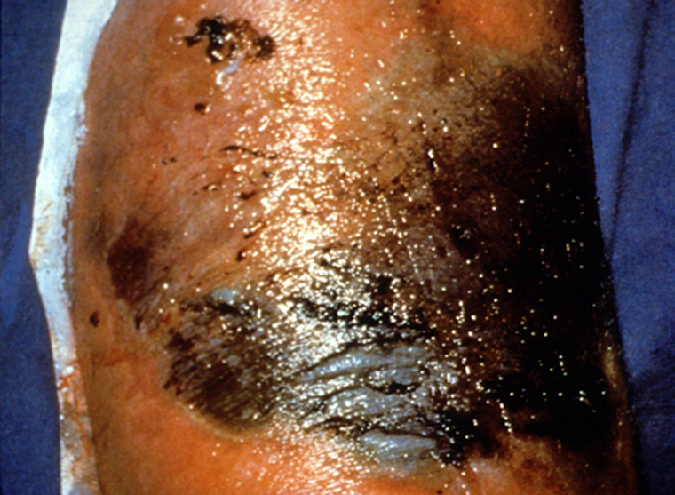

Slide 40
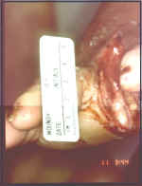
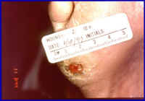

Slide 41
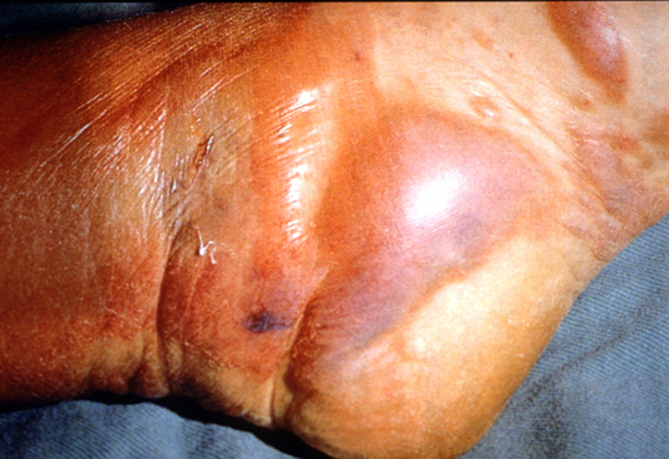

Slide 42
PATHOGENESIS
5 – Toxins [ A – E ]
Phospholipase C { alpha toxin }
Acts on membranes of muscle cells , leukocytes and platelets .
Play major role in the pathogenesis of C. myonecrosis
Has necrotizing activity
Other toxins :- collagenase , proteinase , DNAs

Slide 43
Clinical picture
Acute progressive pain , edema , skin discoloration
Systemic – fever , tachycardia , hypotension , renal failure , crepitus , pulmonary edema , death

Slide 44
ETIOLOGY
C.perfringens { 80% }
C.Novyi
C.Septicum
C.Histolyticum

Slide 45
Control Measures
Proper hand washing {contact precautions}
Limiting use of antimicrobial agents
Isolation of patients with diarrhea
Disinfection of pt. rooms

Slide 46
DIAGNOSIS
CLINICAL
SURGICAL
MICRO.
Gram stain :- G PB , absent leukocytes
Culture { aerobic and anaerobic }
Exudate , aspirates
Tissue
Blood
Nagler reaction

Slide 47
FOOD POISONING
One of most common bacterial causes of food –borne illness
Sporadic cases and outbreaks
Almost all due to type A
Improperly cooked meat or meat product
Ingestion of vegetative cells [ 10^{8 ]}
Afebrile Crampy abdominal pain - diarrhea within 7-15 h
Enterotoxin [ SPORULATION ]
Mild illness , recovery after 2-3 days

Slide 48
TRATMENT
Early and complete surgical excision of necrotic infected tissue { most important }
High dose of :-
Penicillin G IV
Metronidazole
Clindamycin
Management of shock , hemolysis , anemia

Slide 49
C . Difficile
Pseudomembranous colitis
Antimicrobial associated diarrhea
Hospital acquired diarrhea

Slide 50
Epidemiology
Clostridium difficile causes antibiotic associated diarrhea (AD) and more serious intestinal conditions such as colitis and pseudo membranous colitis .
Overgrowth of Clostridium difficile in the colon, usually after the normal flora has been disturbed by anti microbial chemotherapy

Slide 51
EPIDEMIOLOGY
Soil
Human and animal feces
Hospital environment {Reservoirs}
Spores acquired –
Environment
Fecal – oral { colonized persons }
Intestinal colonization rate
Healthy neonates , young infant [ 50 %]
Children > 2yrs , adults {3 % }

Slide 52
CLINICAL PICTURE
Mild diarrhea , asymptomatic carriage – Toxic megacolon ,bowel perforation and death
Pseudomembranous colitis
Bloody diarrhea , abdominal cramps,
Fever , systemic toxicity
Colonic mucosa – yellowish plaques
Sever disease – neutropenic , inflammatory bowel disease .

Slide 53
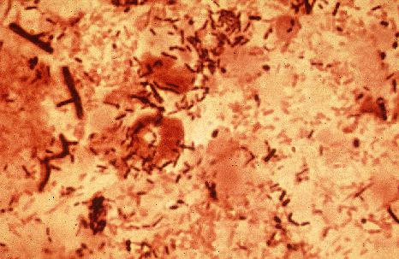

Slide 54
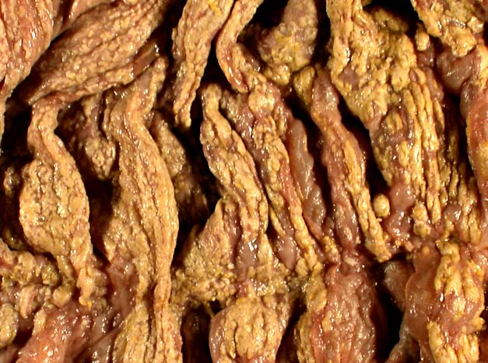

Slide 55
TREATMENT
Discontinue antimicrobial therapy { clinical significant diarrhea or colitis
Antimicrobial therapy : severe toxicity , persistent diarrhea
Metronidazole for 7-10 days , oral , IV
Oral vancomycin : {emergence of VRE }
10-20 % relapse rate
Antimotility drugs : contraindicated

Slide 56
Risk Factors
Exposure to organisms
Disturbed normal gut flora {proliferate – toxin}
Repeated enema
Prolonged NG tube
GI surgery
Bowel stasis
Antimicrobials : penicillins , clindamycin , Cephalosporins

Slide 57
PATHOGENESIS
TOXINS
TOXIN A [ Enterotoxin ]
TOXIN B [ Cytotoxin ] , more potent
Most strains produce both or no toxins

Slide 58
DIAGNOSIS
Endoscopy : pseudomembranes and Hyperemic rectal mucosa
Stool : toxins { EIA } , Cell culture Confirm toxigenic strains
Isolation of C. Difficile { not diagnostic }
PCR

Slide 59
C.BOTULINUM
BOTULISM

Slide 60
TRANSMISSION
SPORES
VEGETABLES , MEATS ,FISH
CANNED FOOD
PREFORMED TOXIN

Slide 61
PATHOGENESIS TOXIN (PHAGE) MOST TOXIC SUBSTANCE
GUT BLOOD PERIPHERAL NERVE SYNAPSES
BLOKS RELEASE OF ACETYLCHLINE
FLACCID PARALYSIS

Slide 62
CLINICAL
DESCENDING PARALYSIS
DIPLOPIA
DYSPHAGIA
RESPIRATORY MUSCLE FAILURE
NO FEVER
WOUND , INFANT BOTULISM ( honey )

Slide 64
Diagnosis : clinical (TOXIN ,FOOD SERUM )
TREATMENT
ANTITOXIN
A , B ,E
RESPIRATORY SUPPORT
PREVENTION
STERILIZATION OF CANNED FOOD
Notes:
DR : FAWZIA

