Slide 1
Lecture Title:
Diversity of Fungi and Fungal Infections
(Foundation Block, Microbiology)
Lecturer name:
Dr. Ahmed M. Albarrag
Lecture Date: Oct-2011

Slide 2
Lecture Objectives..
To provide students with an overview of the common medically important yeasts and mold fungi.
2. To provide students with an overview of the major fungal diseases that threatens human health.

Slide 3
Mycotic Diseases
Hypersensitivity (Allergy)
Mycotoxicoses
Infections
Notes:
3

Slide 4
Types of fungal infections ( Mycoses)
Superficial mycoses
Cutaneous mycosis
Subcutaneous mycoses
Systemic mycoses
Opportunistic mycoses
Notes:
4
4

Slide 5
Types of fungal infections - Mycoses
Superficial Mycoses
Affect the outer layer of the skin or hair shaft
No immune response
Examples
Tinea versicolor
Tinea nigra
Black Piadra
White piedra
Etiology
Malassezia furfur
Exophiala spp
Piedraia hortae
Trichosporon beigelii
Notes:
5
5

Slide 6
Types of fungal infections - Mycoses
Cutaneous Mycoses
Dermatophytosis
Infection of the skin, hair or nails caused by a group of keratinophilic fungi, called dermatophytes
Primary pathogens
Contagious
Tinea or Ringworm
Examples
Tinea capitis Scalp
Tinea pedis Foot (Athlete's foot)
Tinea manuum Hand
Notes:
6
6

Slide 7
Types of fungal infections - Mycoses
Subcutaneous Mycoses
Fungal infections involving the dermis, subcutaneous
tissues, muscle and may extend to bone.
Usually they are initiated by trauma to the skin.
Are difficult to treat and surgical intervention (excision or amputation) is frequently required.
Disease in healthy host, more severe in immunocompromised host.
Notes:
7
7

Slide 8
Types of fungal infections - Mycoses
Primary Systemic Mycoses
Caused by primary pathogens
Contracted by inhalation, Start as respiratory disease
Geographically restricted (endemic), north and south America
8
Notes:
8

Slide 9
Types of fungal infections - Mycoses
Opportunistic fungal infections
Diseases in immunocompromised host
Risk factors
HIV/AIDS
Hematopoietic stem cell transplant (HSCT)
Solid organs transplantation
Malignancies
Neutropenia
Notes:
9
9

Slide 10
The Fungi
Opportunistic Fungi
Normal flora
Candida spp.
Other yeast
Ubiquitous in our environment
Aspergillus spp.
Cryptococcus spp.
Zygomycetes spp.
Other fungi
Fusarium spp.
Scedosporium spp.
Exophiala
Bipolaris
and many others
Primary Pathogens
Dermatophytes
Microsporum
Tricophyton
Epidermophyton
Endemic, geographically restricted
- Histoplasma spp.
- Blastomyces spp.
Coccidioides spp.
Paracoccidioides spp
Notes:
10
10

Slide 11
Diagnosis of fungal infection
Clinical features (history, risk factors, etc)
Imaging
Good value in diagnosis and therapy monitoring
Lab Investigations
Histopathology
Microbiology
Notes:
11

Slide 12
Lab Diagnosis
Direct Microscopy
1. Potassium Hydroxide (10-20% KOH)
2. Fungal stains:
Giemsa Stain
Grocott’s Methenamine Silver stain (GMS)
India ink (for Capsulated yeast, Cryptococcus neoformans)
Culture
Fungal media: SDA, BHI, other media if needed.
Serology
Candida
Aspergillus
Cryptococcus
PCR
Histoplasma
Blastomyces
Coccidioides
Paracoccidioides
Notes:
12

Slide 13
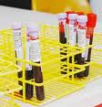
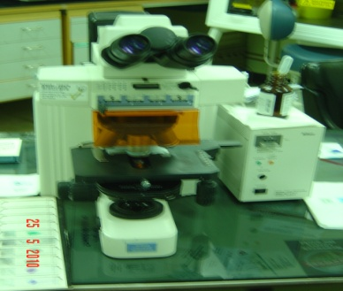
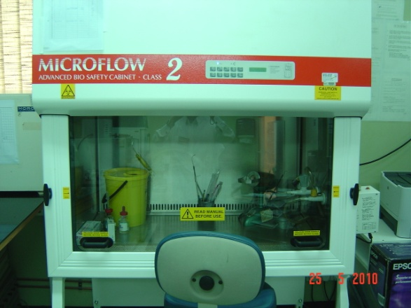
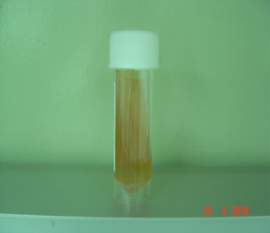
Microscopy
Clinical samples
Culture
Yeast
+/-
pseudohyphae
Fungal hyphae or other fungal element
Yeast
Mold
No growth
Negative
Notes:
13

Slide 14
Antifungal agents
Notes:
14
14

Slide 15
Targets for antifungal agents
Cell membrane
• Polyene
- Amphotericin B, lipid formulations
- Nystatin
• Azole
- Ketoconazole
- Itraconazole
- Fluconazole
- Voriconazole
- Posaconazole
- Miconazole, clotrimazole
Notes:
15
15

Slide 16
Targets for antifungal agents
Cell wall
• Echinocandins
Caspofungin
Micafungin
Anidulafungin
DNA/RNA synthesis
Pyrimidine analogues
- Flucytosine
Notes:
16
16

Slide 17
Polyenes—Amphotericin B
Mechanism of Action (MOA):
Binds to ergosterol within the fungal cell membrane resulting in formation of pores which permit leakage of intracellular contents, and lead to death .
Formulations
Classic amphotericin B deoxycholate (Fungizone™) formulation: serious toxic side effects.
Less toxic preparations:
Liposomal amphotericin B (Ambisome ® L-AMB)
Amphotericin B lipid complex (Abelcet ® ABLC)
Notes:
17
17

Slide 18
Amphotericin B - Clinical Uses
Amphotericin B has an broad antifungal spectrum which includes most fungi that cause human disease
Exceptions:
Aspergillus terreus, Scedosporium spp., some isolates of Candida lusitaniae, and few others.
The drug of choice for:
Cryptococcal meningitis
Mucormycosis (zygomycosis)
Invasive fungal infection, not responding to other therapy
Notes:
18
18

Slide 19
Flucytosine
MOA
Fungal RNA miscoding
Interfering with DNA synthesis
Spectrum of Activity (Restricted spectrum of activity)
Active against
Candida species
Cryptococcus neoformans
use as combination therapy for Cryptococcal meningitis (Synergy with amphotericin B )
Monotherapy : now limited (Resistance)
Notes:
19
19

Slide 20
The Fungal Cell Wall
mannoproteins
β1,3
β1,6
glucans
Cell membrane
b1,3 glucan
synthase
chitin
ergosterol
Introduction to Medical Mycology. Merck and Co. 2001
Notes:
20
20

Slide 21
Echinocandins
MOA
Inhibits B-1,3 –D glucan synthase, the enzyme complex that forms glucan polymers in the fungal cell wall.
Glucan polymers are responsible for providing rigidity to the cell wall.
Good activity against
Candida spp
Aspergillus spp
Not active against
Cryptococcus Zygomycetes
Fusarium Scedosporidium
Notes:
21
21

Slide 22
AZOLES
MOA
Inhibits 14-α-sterol demethylase, which is a microsomal CYP450 enzyme.
This enzyme is responsible for conversion of lanosterol to ergosterol, the major sterol of most fungal cell membranes.
Notes:
22
22

Slide 23
Azoles—Spectrum of Activity
 | Fluconazole | Itraconazole | Voriconazole | Posaconazole
C. albicans | +++ | ++ | +++ | +++
C. glabrata | + | + | ++ | ++
C. krusei | -- | + | +++ | ++
C. tropicalis | +++ | ++ | +++ | +++
C. parapsilosis | +++ | ++ | +++ | +++
Cryptococcus | +++ | +++ | +++ | +++
Aspergillus | -- | ++ | +++ | +++
Coccidioides | +++ | +++ | +++ | +++
Blastomyces | ++ | +++ | ++ | +++
Histoplasma | + | +++ | ++ | +++
Fusarium | -- | -- | ++ | ++
Scedosporium | -- | +/- | + | +/-
Zygomycetes | - | - | - | ++
Notes:
23

Slide 24
Azoles
Common Adverse Effects
Examples: Rash, Hepatotoxicity, Visual disturbance, Fever
Serious Adverse Events
Drug Interactions
Notes:
24
24

Slide 25
Thank You ☺
(Foundation Block, Microbiology)
Dr. Ahmed M. Albarrag
Oct-2011

