Slide 1
Hemodynamic disorders practical session

Slide 2
Thrombosis
The formation of a blood clot (thrombus) within the non-interrupted vascular system
due to inappropriate activation of normal hemostatic processes

Slide 3
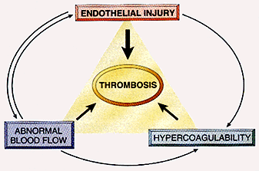
Thrombosis Pathogenesis:
Predisposing Factors:
Virchow’s Triad:
endothelial injury
stasis or turbulence of blood flow
blood hypercoagulability

Slide 4
Fate of Thrombosis
Propagation and obstruction
Embolization
Dissolution “nothing left”
Organization and recanalization

Slide 6
1- Organizing thrombus

Slide 7
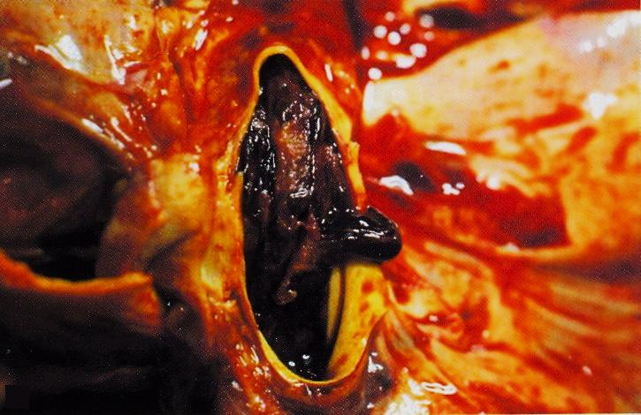
Organizing thrombus in a case of pulmonary embolism

Slide 8
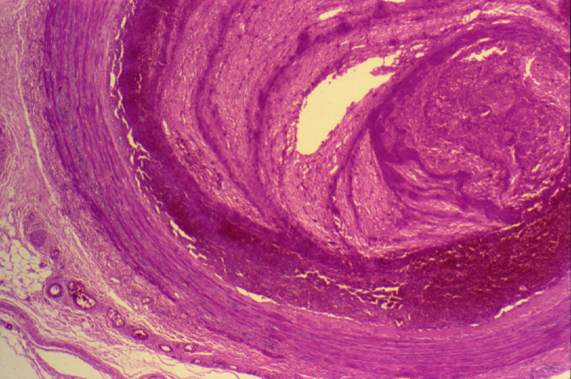
ORGANIZING THROMBUS

Slide 9
Organizing thrombus: Cross section of blood vessel shows:
The lumen is occluded by thrombus which consists of alternate layers of platelets with fibrin thread and clotted blood (line of Zahn).
Organization is seen at the periphery of thrombus which also shows formation of small capillaries & fibroblasts with chronic inflammatory cells.
Recanalization is seen at one side.

Slide 10
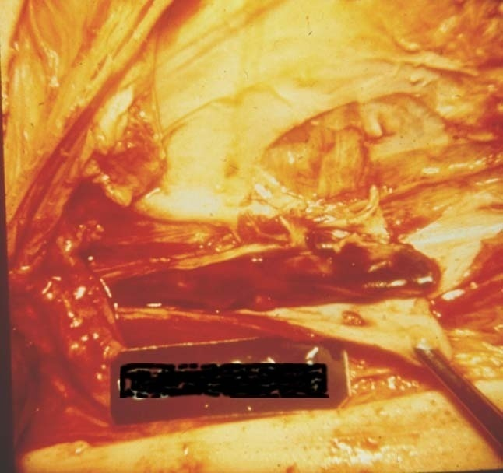
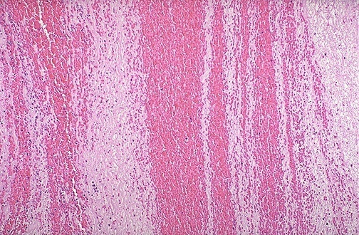
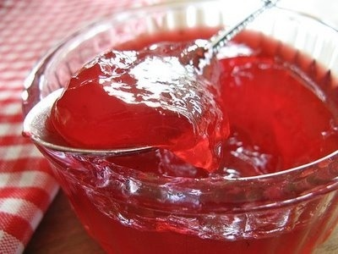
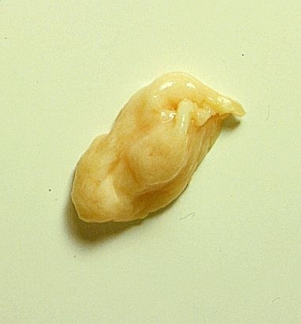
Lines of Zahn, gross and microscopic, top, is evidence to prove a clot is PRE-mortem.
Clots appearing like current jelly or chicken fat are said to be POST-mortem.
Notes:
Lines of Zahn, gross and microscopic, top, is evidence to prove a clot is PRE-mortem.
Clots appearing like current jelly or chicken fat are said to be POST-mortem.
In general, post mortem clots are rather AMORPHOUS and have no binding texture when you squeeze them

Slide 11
Embolism
An embolus is:
a detached intravascular solid, liquid or gaseous mass that is carried by the blood to a site distant from its point of origin

Slide 12
Embolism
Source:
99% are dislodged thrombus:
thromboembolism
Rarely:
fat, air, atherosclerotic debris, tumor fragments, bone marrow, foreign bodies (bullets)

Slide 13
2- Pulmonary embolus with infarction

Slide 14
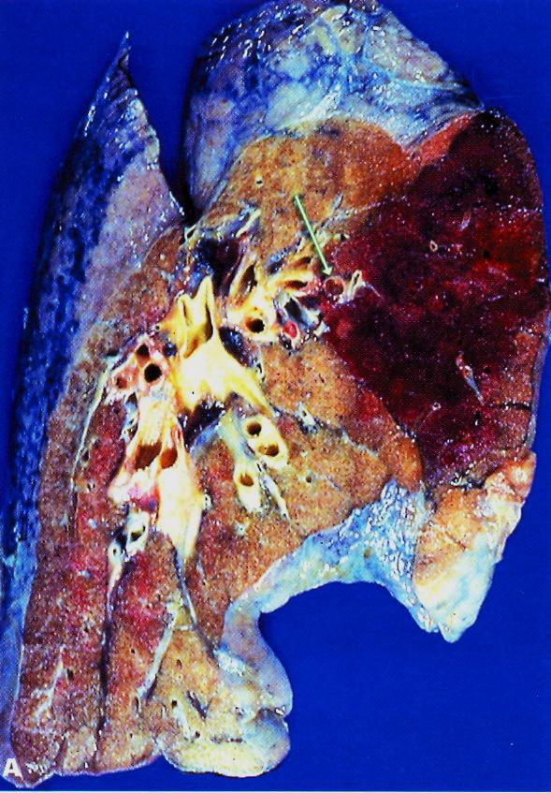

Slide 15
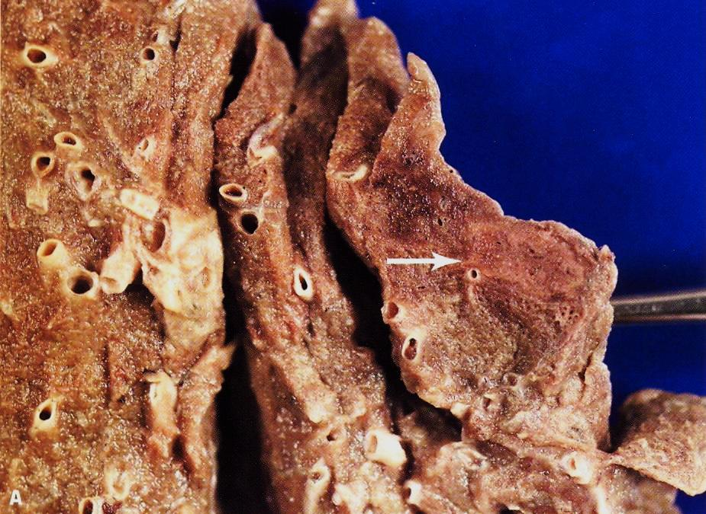

Slide 16
Infarction
An area of ischemic necrosis caused by occlusion of either the arterial supply or the venous drainage in a particular tissue

Slide 17
Infarction
Causes:
Arterial occlusion due to thrombotic or embolic events (99%)
Other arterial causes:
Vasospasm
Swelling of atheroma
Extrinsic compression on vessel (by tumor …)
Twisting of vessels
Traumatic rupture
Venous thrombosis:
in organs with single venous outflow e.g. testis, ovary

Slide 18
3- Myocardial infarction

Slide 19
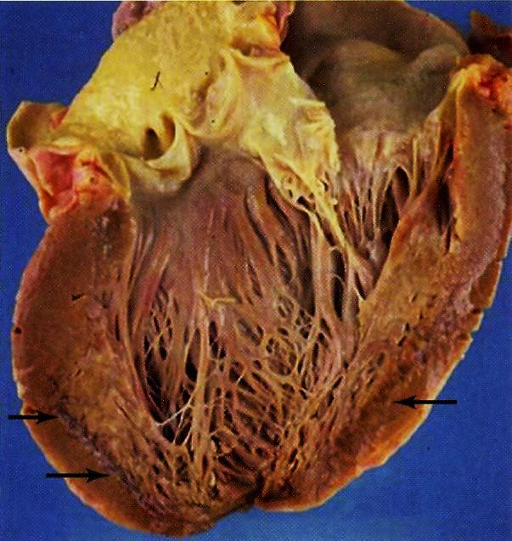

Slide 20
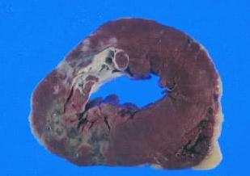
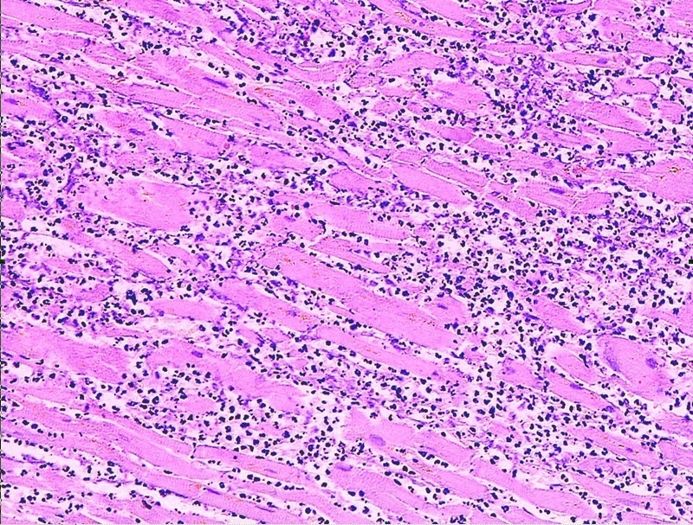
Myocardial infarction (recent stage)

Slide 21
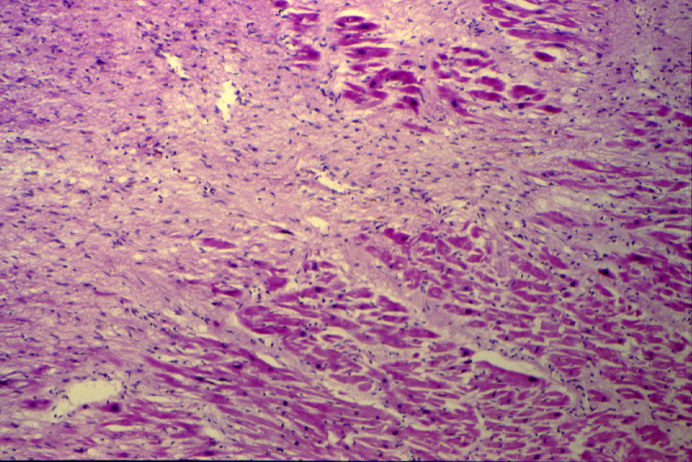
MYOCARDIAL INFARCTION (LATE STAGE)

Slide 22
Myocardial infarction: Section of myocardial shows:
Patchy coagulative necrosis of myocardial fibres. The dead muscle fibres are structureless and hyaline.
The necrotic muscle fibres are pale with loss of nuclei and striations. Infiltration of neutrophils in recent stage is seen .
Later granulation tissue formation and fibrosis.

Slide 23
4- Infarcted kidney

Slide 24
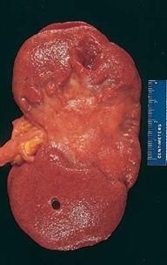
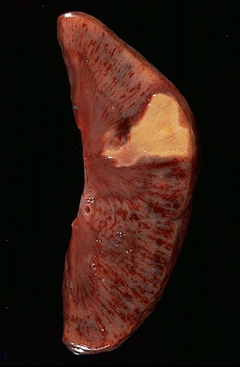
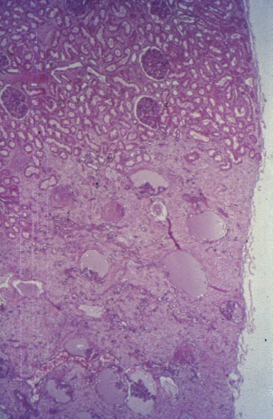
Notes:
WEDGE SHAPED SCARRED INFARCT following the distribution of a end artery branch of the renal artery. FIBROSIS implies that it is old (months to years)

Slide 25
Organ: Kidney Dx:Coagulative necrosis

Slide 26
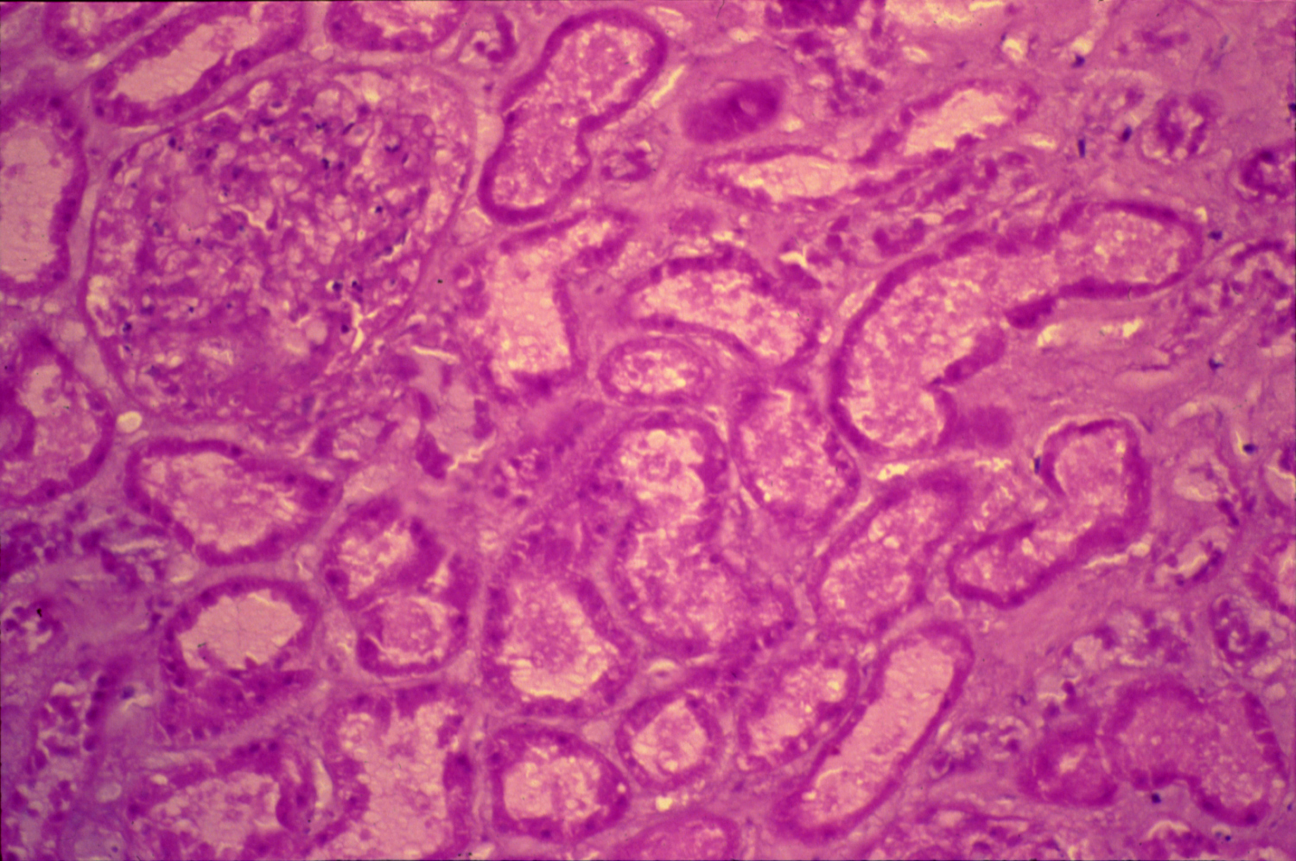
INFARCTED KIDNEY

Slide 27
Infarcted kidney: Section of kidney shows:
A cortical infarct showing coagulative necrosis of glomeruli, tubules and interstitial tissue with loss of cell nuclei.
The haemorrhagic zone at the periphery of the infarct shows dilated and congested blood vessels and cellular infiltrate by neutrophils, red blood cells and lymphocytes.

Slide 28
5- Infarction of the small intestine

Slide 29
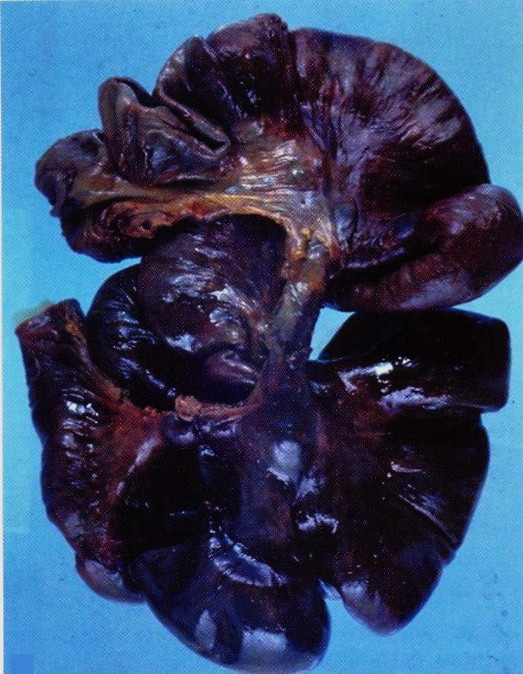

Slide 30
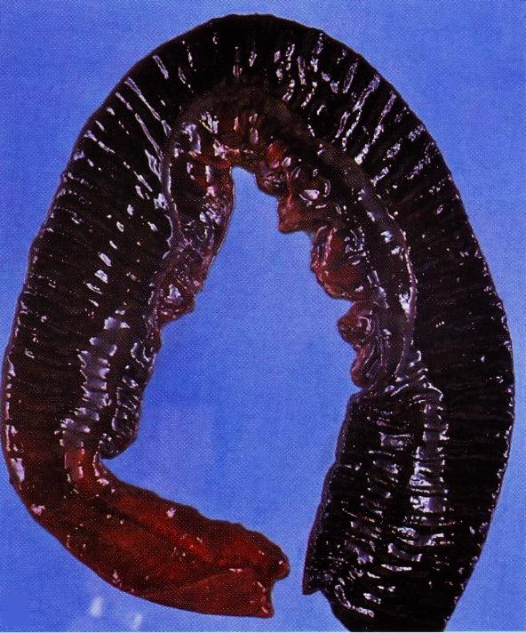

Slide 31
Hyperemia & Congestion
Increased blood in an area
(inside blood vessels)
compared to normal

Slide 32
Compare between: “Hyperemia & Congestion”
Hyperemia:
is an “active process”
resulting from augmented tissue inflow
due to arteriolar dilation
(e.g. acute inflammation)
Congestion
is a “passive process”
resulting from impaired outflows from a tissue
Impaired venous return
(e.g. cardiac failure or venous obstruction)

Slide 33
6- Chronic venous congestion of the liver

Slide 34
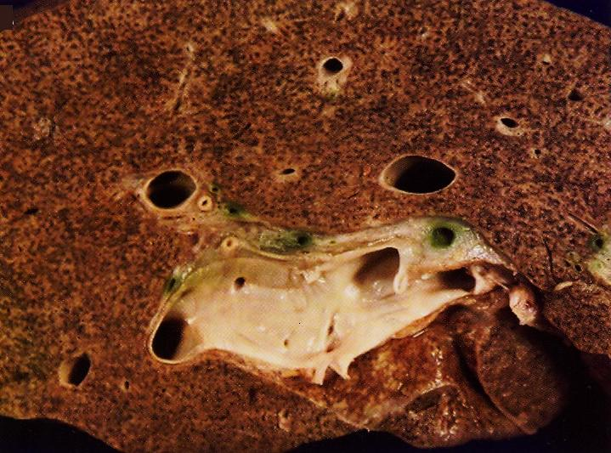

Slide 35
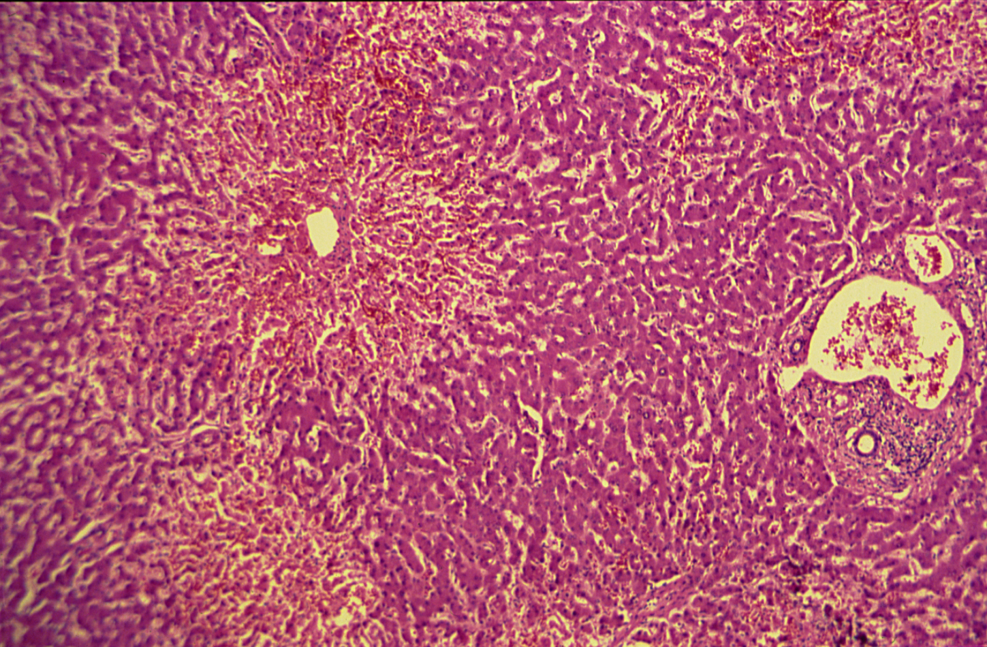
CHRONIC VENOUS CONGESTION

Slide 36
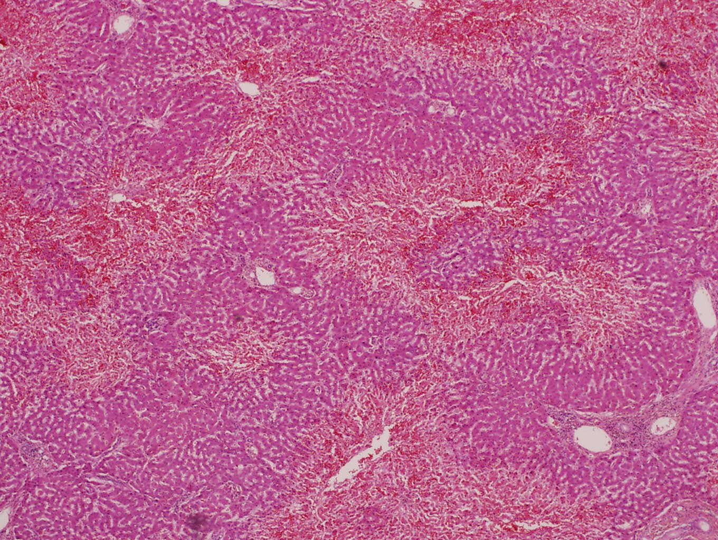
PASSIVE CONGESTION OF THE LIVER (NUTMEG LIVER)

Slide 37
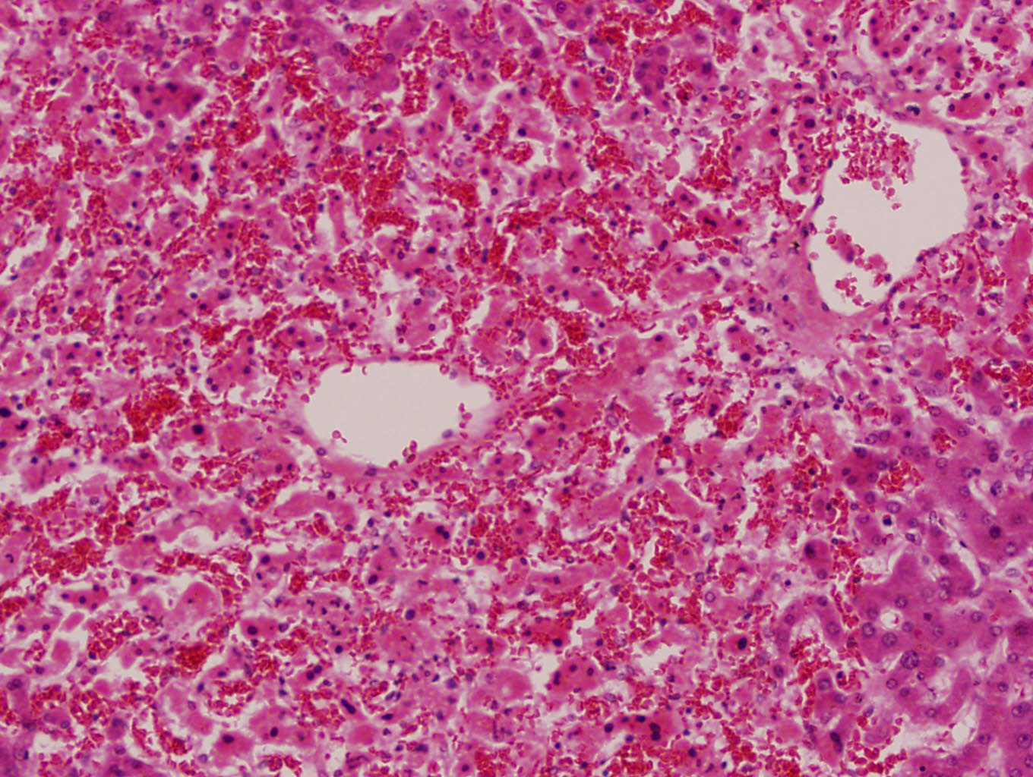
PASSIVE CONGESTION OF THE LIVER (NUTMEG LIVER)

Slide 38
Chronic venous congestion of the liver: Section of liver shows:
The central portion of liver lobules shows congestion and dilatation of central veins and blood sinusoids, with atrophy and necrosis of liver cells.
Kupffer cells contain few brown haemosiderin pigment granules.

Slide 39
7- Chronic venous congestion of the lung

Slide 40
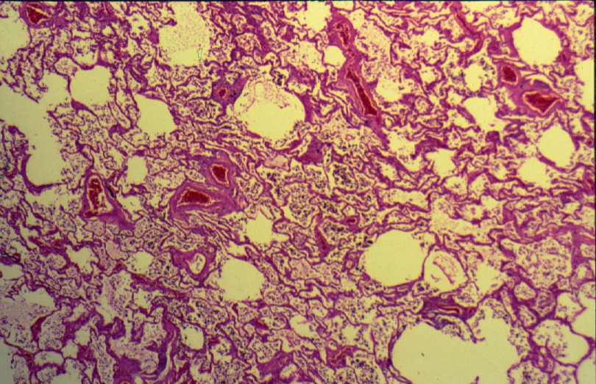
CHRONIC VENOUS CONGESTION (LUNG)

Slide 41
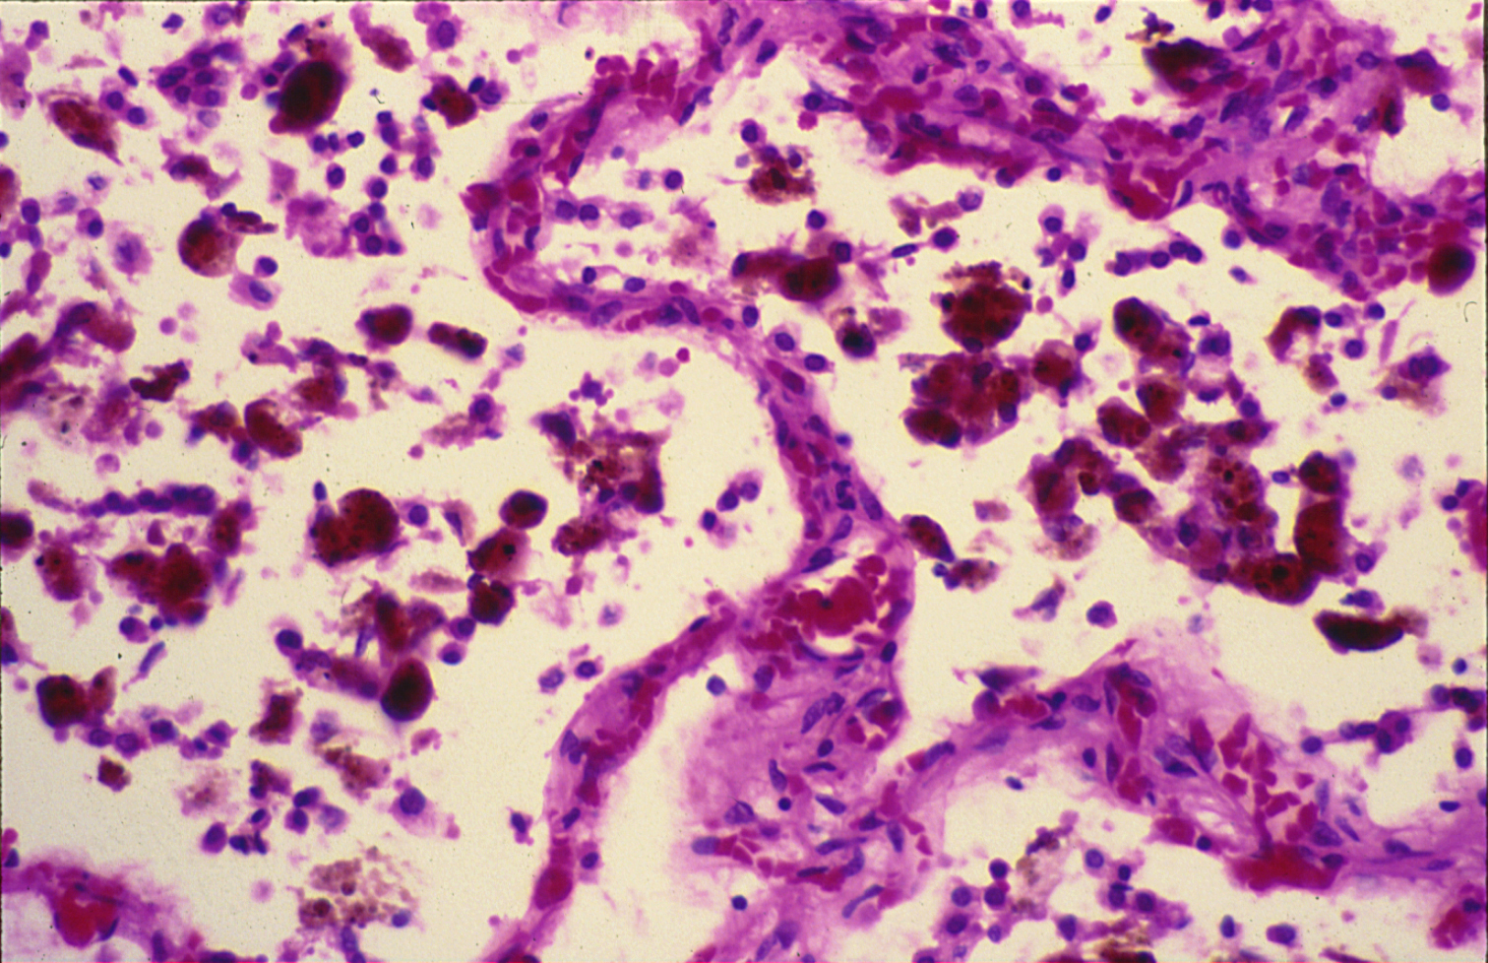
CHRONIC VENOUS CONGESTION (LUNG)

Slide 42
Chronic venous congestion of the lung: Section of lung shows:
The alveolar walls are thickened by dilated and engorged capillaries.
The alveoli contain edema fluid, red blood cells and large alveolar macrophages (heart failure cells), which are filled with haemosiderin pigment derived from red cells breakdown.
In the late stage some fibrous tissue may also be seen.

