Slide 1
Lecture Title: Cell injury
(Foundation Block, pathology)
Lecturer name: Dr. Maha Arafah
Lecture Date: 21-9-2011

Slide 2
CONCEPT OF INJURY AND CELLULAR RESPONSE TO INJURY
L1:
Overview of Cell Injury, adaptation to environmental stress and Cell Death
L2:
Necrosis and Apoptosis
L3:
Cellular accumulation and Calcification

Slide 3
Overview of Cell Injury and ADAPTATION
Upon completion of this lecture, the student should know:
Causes of cell injury
Adaptation to stress
Mechanisms of Cell Injury:
Hypoxic cell injury and its causes
Free radical injury
Reversible cell injury ( nonlethal hit)
Irreversible injury and cell death ( lethal hit)
Morphology of cell injury

Slide 4
Reference book and the relevant page numbers..
Robbins Basic Pathology 8th edition, pages 1-8.

Slide 5
ALL CELLS

Slide 6
ALL ORGANISMS

Slide 7
All medical student

Slide 8
Living in the World

Slide 9
Must cope with…

Slide 10
Stress!!!

Slide 11
CONCEPT OF INJURY AND
CELLULAR RESPONSE TO INJURY
Cells are constantly exposed to a variety of stresses.
When too severe, INJURY results.
Injury alters the preceding normal steady state of the cell.

Slide 13
Cellular Responses to Injury
Nature and Severity of Injurious Stimulus | Cellular Response
Altered physiologic stimuli: | Cellular adaptations:
Increased demand, increased trophic stimulation (e.g. growth factors, hormones) | Hyperplasia, hypertrophy
Decreased nutrients, stimulation | Atrophy
Chronic irritation (chemical or physical) | Metaplasia

Slide 14
The Four Main Types of Cell Adaptations
Atrophy: shrinkage of an organ as a result of decreased cell size (and cell number).
Hypertrophy: enlargement of an organ as a result of increased cell size.
Hyperplasia: enlargement of an organ through an increase in cell number.
Metaplasia: the replacement of one differentiated cell type by another in a tissue or organ.

Slide 15
Atrophy
Hypoplasia & Aplasia
Developmental failure
Atrophy of organ
Failure in morphogenesis
Signals/injury
Atrophy
Autophagy
Less organells
Reduced metabolic rate
Lipofuscin granules
Reversible
Decrease in size of cell (-s) previously of normal size
Physiologic
shrinkage of testes and ovaries with age
Pathologic
Decreased function
Loss of innervation
Pressure (“bed soars”)
Malnutrition/cahexia
Loss of endocrine stimulation
Aging
Net results: tissue /organ smaller than normal

Slide 16
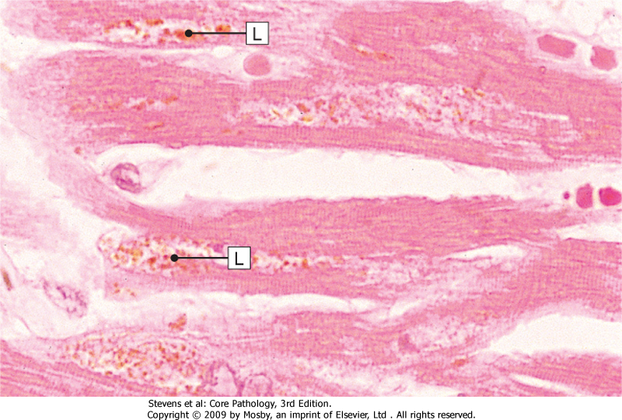
Lipofuscin granules are yellow/brown in color and represent non-digestible fragments of lipids and phospholipids combined with protein within autophagic vacuoles.
They are commonly seen in ageing liver and myocardial cells.
LIPOFUSCIN: wear and tear pigment

Slide 17
Hypertrophy – cell or organ
Signals/injury
Increased:
membrane synthesis.
amounts of ATP.
enzyme activity.
myofilaments
Endoplasmic reticulum
Occur in cells which cannot divid
Reversible
Increase in size of cell in response to increased functional demand and/or in response to Hormone/growth factors stimulation
Physiologic
Athletes muscle
Pregnant uterus
Prostatic tissue (elderly)
Pathologic
Cardiac muscle
bladder smooth muscle hypertrophy in outflow obstruction
Net effect: increase in size/volume/weight of tissue / organ

Slide 18
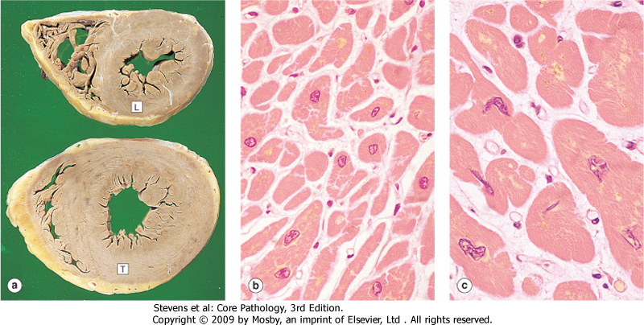
Morphology of hypertrophy
Hypertrophic muscle cells show:
Increased membrane synthesis.
Increased amounts of ATP.
Increased enzyme activity.
Increased myofilaments.
Hypertrophy of smooth endoplasmic reticulum

Slide 19
Hyperplasia – cell or organ
Signals/injury
Reversible
Increase in number of cells in response to increased functional demand and/or in response to Hormone/Growth Factor stimulation
Physiologic
Uterine muscle
Lactating breast
Pathologic
Thyroid
Focal nodular hyperplasia (liver)
Adenomatous hyperplasia of endometrium
Net effect :increase in size/volume/weight of tissue / organ

Slide 20
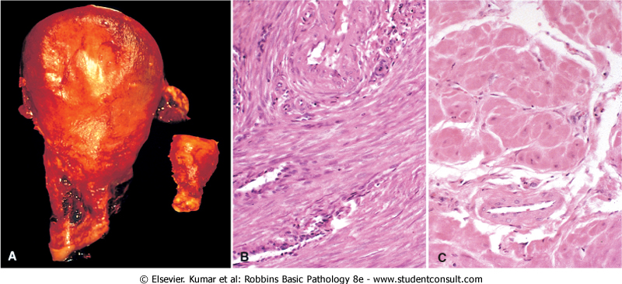

Slide 21
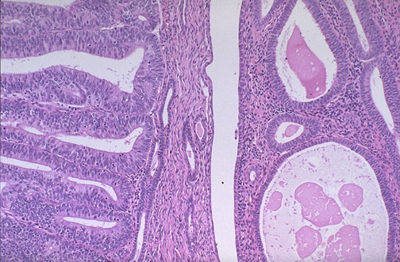
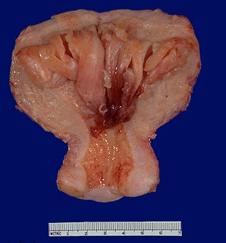
Endometrial carcinoma and endometrial hyperplasia
Endometrial carcinoma
endometrial hyperplasia

Slide 22
Signals/injury
Metaplasia
Reversible
But not always
genetic "reprogramming" of stem cells
Substitution of mature (differentiated) cell for another mature cell
Physiologic
(metaplastic tissue/organs)
cervical canal
Pathologic
(metaplastic tissue/organs)
Gastric/duodenal metaplasia
Squamous metaplasia-cervix
Ciliated to squamous
Osseous
Barret’s oesophagus
Net effect: another cell/tissue - protective – changes in function

Slide 23
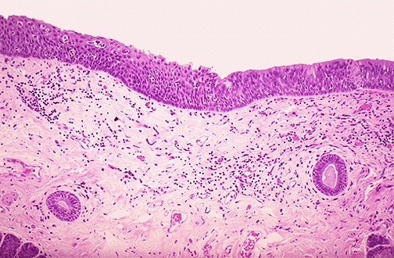
Metaplasia
Ciliated
Squamous

Slide 24
Metaplasia is often seen next to neoplastic epithelium, indicating that although this adaptive response is potentially reversible, continued insult to the cells may cause uncontrolled growth and the development of cancer.

Slide 26
Etiologic agents

Slide 27
Causes of cell injury
EXCESS or DEFICIENCY OF OXYGEN
PHYSICAL AGENTS
CHEMICAL AGENTS
INFECTION
IMUNOLOGICAL REACTIONS
GENETIC DERANGEMENTS
NUTRITIONAL IMBALANCE
AGING

Slide 28
MECHANISMS OF CELL INJURY
General principles:
The cellular response to injurious stimuli depends on
1. type of injury
2. Its duration
3. Severity
The consequences depend on
the type, status, adaptability, and genetic makeup of the injured cell.
The structural and biochemical components of a cell are so integrally connected that multiple secondary effects rapidly occur
Cellular function is lost far before cell death occurs

Slide 29
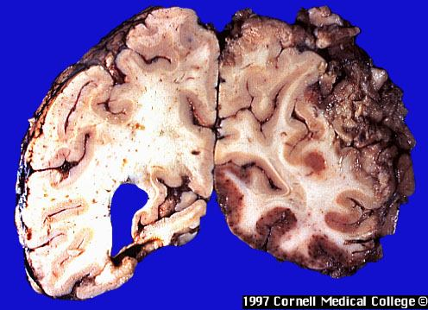
Brain – massive haemorrhagic focus (ischemia) in the cortex
This is a lesion
caused by
DEFICIENCY OF OXYGEN

Slide 30
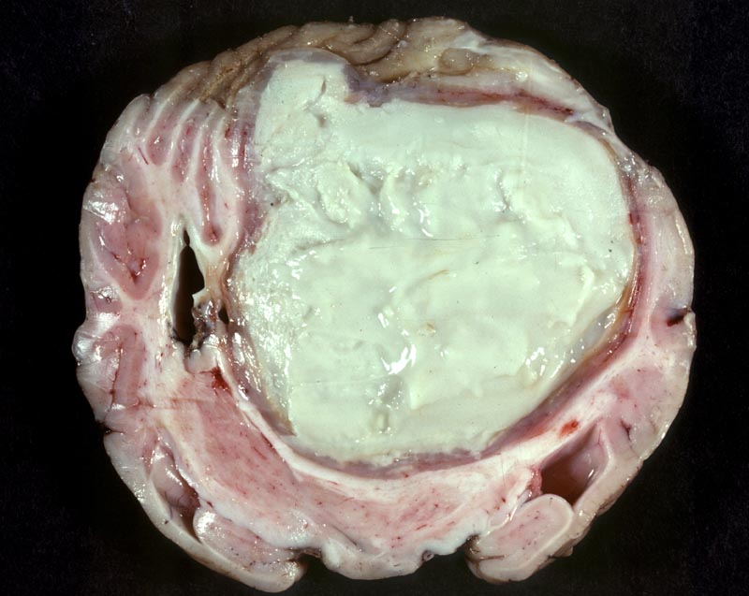
Abscess of the brain (bacterial)
This is a lesion
caused by
infectious agent

Slide 31
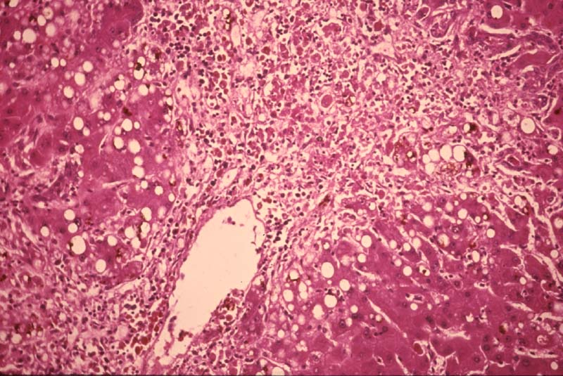
Hepatic necrosis (patient poisoned by carbon tetrachloride)
This is a lesion
caused by
chemical agent

Slide 32
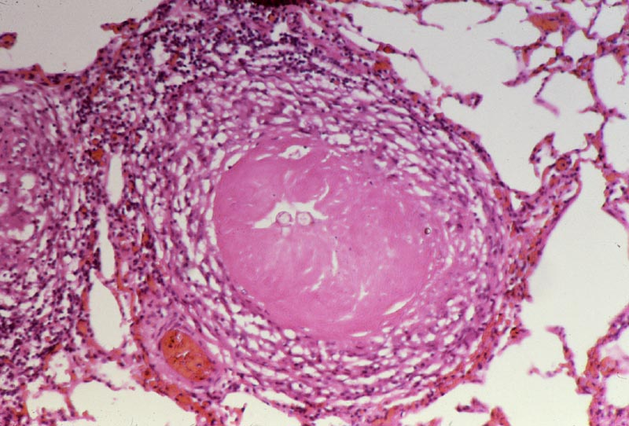
Pulmonary caseous necrosis (coccidioidomycosis)
This is a lesion
caused by
infectious agent

Slide 33
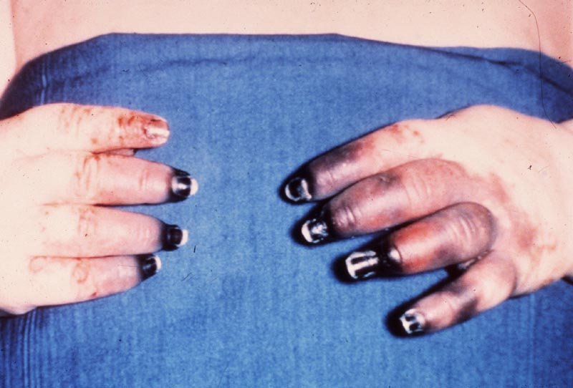
Gangrenous necrosis of fingers secondary to freezing
This is a lesion
caused by
physical agent

Slide 34
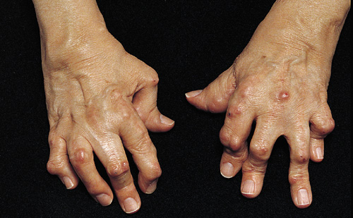
The “boutonnière” (buttonhole) deformity
This is a lesion
caused by
intrinsic factors
(autoimmune disease)

Slide 35
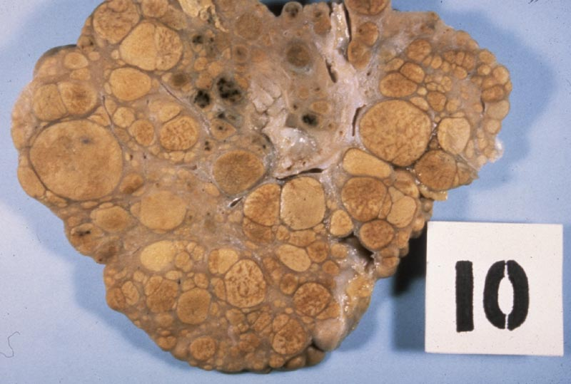
Liver: macronudular cirrhosis (HBV)
This is a lesion
caused by
infectious agent:
Viral hepatitis
(chemical:alcohol, genetic:α1-AT deficiency)

Slide 36
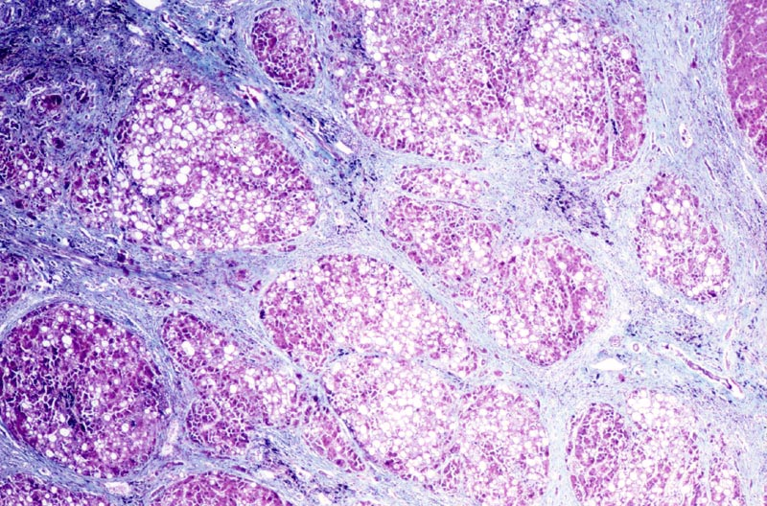
Liver: cirrhosis
This is a lesion
caused by HBV
infectious agent
(chemical:alcohol, genetic:a1AT deficiency)

Slide 37
Mechanisms of cell injury
Cell membrane damage
Complement-mediated cell membrane lysis via the membrane attack complex (MAC)
Bacterial toxins
Free radicals
Mitochondrial damage leading to inadequate aerobic respiration
Hypoxia (lack of oxygen)
Cyanide poisoning
Ribosomal damage leading to altered protein synthesis
Alcohol in liver cells
Antibiotics in bacteria
Nuclear change
Viruses
Radiation
Free radicals

Slide 38
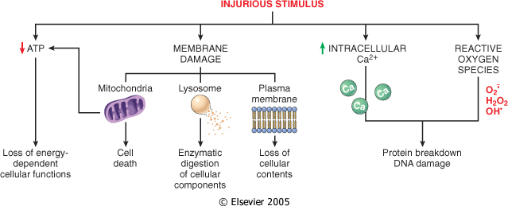
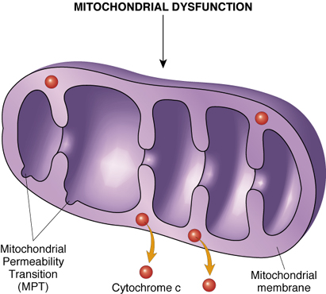
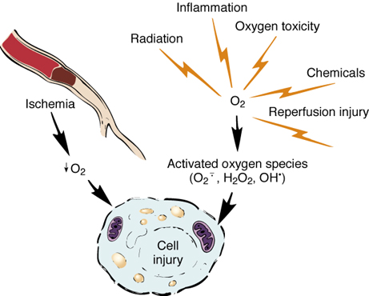
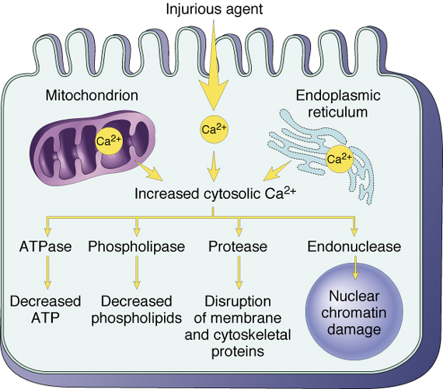

Slide 39
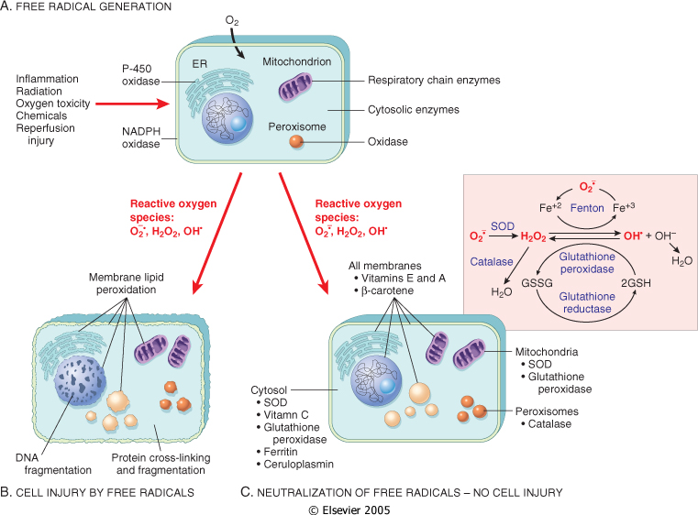

Slide 40
ISCHEMIC AND HYPOXIC INJURY
Oxygen is required for oxidative phosphorylation.
Hypoxia and ischemia occur in:
a] Hypoglycaemia.
b] Hypoxia due to :
1. Respiratory obstruction or lung disease.
2. Ischemia.
3. Anaemia.
4. Alteration of hemoglobin.
c] Enzyme inhibition by cyanide.
d] Uncoupling of oxidative phosphorylation.

Slide 41
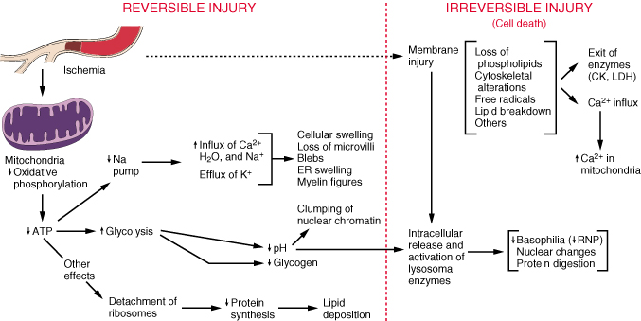
MECHANISMS OF INJURY: Ischemia
The result is defective ATP production
First cells affected are those with highest demand of oxygen.

Slide 42
ISCHEMIC AND HYPOXIC INJURY
Specialization.
Cells that are enzyme rich, nucleated or have specialized organelles within the cytoplasm may be more vulnerable.
Cell state.
Cells that have an inadequate supply of oxygen, hormones or growth factors or lack essential nutrients may be more prone to injury.
Regenerative ability.
Damaged areas in tissues made up of cells which can divid will quickly be restored to normal, while populations of permanent cells will be incapable of regeneration.

Slide 43
Injury features
In addition, the character of the injury will also affect the severity of the damage.
Type of injury.
Exposure time.
Severity.

Slide 44
morphology of cells in reversible and irreversible injury

Slide 45
Morphologic changes in Reversible Injury
Early changes:
(1) Cloudy swelling or hydropic changes: Cytoplasmic swelling and vacuolation due to intracellular accumulation of water and electrolytes secodary to failure of energy-dependent sodium pump.
(2) Mitochondrial and endoplasmic reticulum swelling due to
loss of osmotic regulation.
(3) Clumping of nuclear chromatin.

Slide 46
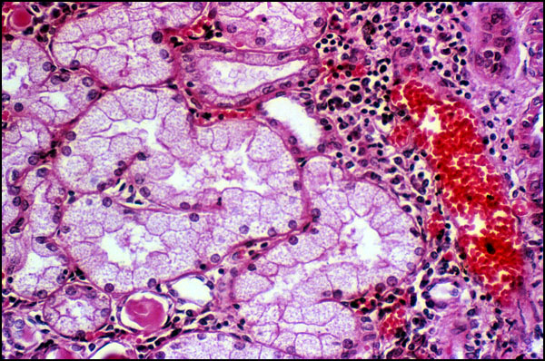
Vacuolar (hydropic) change in cells lining the proximal tubules of the kidney
Reversible
changes

Slide 47
Morphologic changes in irreversible injury:
1. Severe vacuolization of the mitochondria, with
accumulation of calcium-rich densities.
2. Extensive damage to plasma membranes.
3. Massive calcium influx activate phospholipase, proteases, ATPase and endonucleases with break down of cell component.
4. Leak of proteins, ribonucleic acid and metabolite.
5. Breakdown of lysosomes with autolysis.
6. Nuclear changes: Pyknosis, karyolysis, karyorrhexis.

Slide 48
IRREVERSIBLE CELL INJURY- NECROSIS

Slide 49
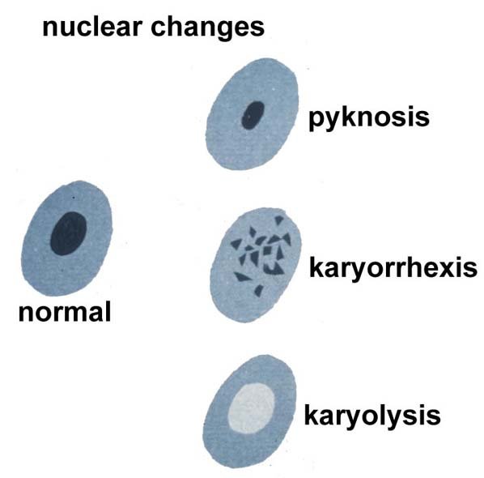

Slide 51
Morphologic changes in irreversible injury
- Dead cell are either collapsed and form a
whorled phospholipid masses or degraded
into fatty acid with calcification.
- Cellular enzymes are released into circula-
tion. This provides important clinical
parameter of cell death
e.g. increased level of creatinin kinase in blood after myocardial infarction

Slide 52
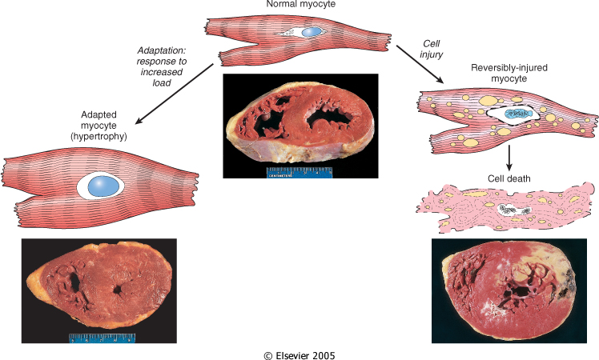

Slide 53
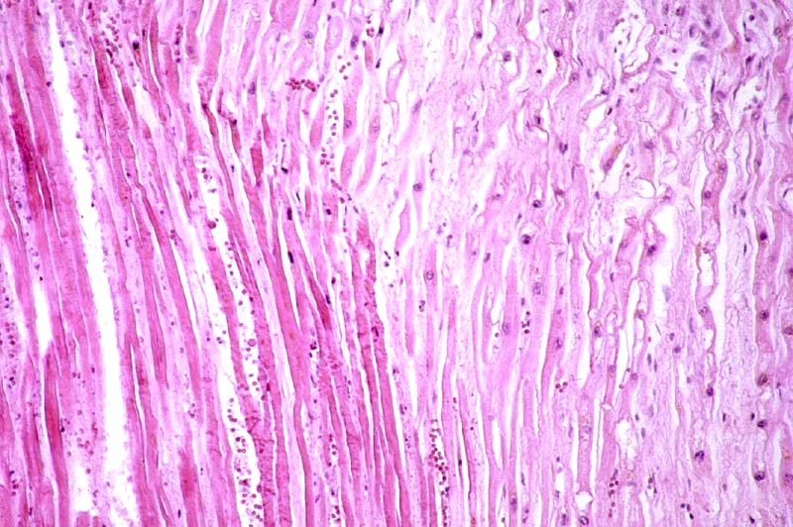
Myocardial infarct
Cell Pathology
This is a lesion
caused by
oxygen
deprivation

Slide 54
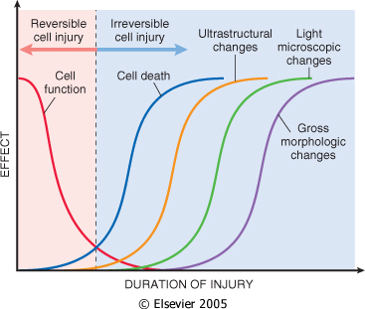

Slide 55
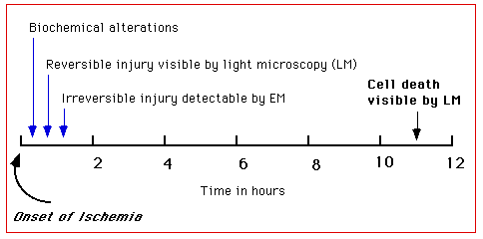
Following ischemic heart injury, the following sequence is observed:
rapid biochemical and ultrastructural responses
light microscopic evidence of reversible injury after several minutes
ultrastructural evidence of irreversible injury in 20-60 minutes
unequivocal light microscopic evidence of cell death after 11-12 hours

Slide 56
TAKE HOME MESSAGES:
Cell injury is common event and the body respond by adaptation to a certain limit.
Adaptation include atrophy, hypertrophy, hyperplasia and metaplasia.
Cellular injury is caused by various elements include bacterial toxins, hypoxia, alcohol, viruses and radiation.
Depletion of ATP, free radicals production, disruption of cell membrane and chromatin are important mechanism in cell injury
Cellular injury could be reversible (sublethal) or irreversible (lethal).

Slide 57
Thank You ☺
(Foundation Block, pathology)
Dr. Maha Arafah
21-9-2011

