Slide 1
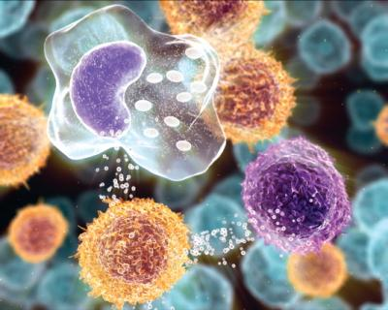
Inflammation and Repair
INFLAMMATION AND REPAIR
Lecture 3
Foundation block: pathology
Dr. Maha Arafah
Dr. Maha Arafah
Monday, October 10, 2011
11:00-12:00 am

Slide 2
Chemical mediators outcome of acute inflammation

Slide 3
Objectives
Upon completion of this lecture, the student should:
Define the chemical mediators of inflammation.
Know the general principles for chemical mediators.
Know the cellular sources and major effects of the mediators.
List the most likely mediators of each of the steps of inflammation.
List and describe the outcome of acute inflammation.

Slide 4
What are mediators?
Chemical mediators of inflammation are substances produced during inflammation inducing a specific events in acute inflammation.

Slide 5
General principles for chemical mediators
The production of active mediators is triggered by:
microbial products
host proteins, such as the proteins of the complement, kinin and coagulation systems
( these are themselves activated by microbes and damaged tissues)
-

Slide 6
General principles for chemical mediators
Most mediators have the potential to cause harmful effects.
Therefore, there should be a mechanism to checks and balances their action.
Mediator function is tightly regulated by:
decay (e.g. AA metabolites)
inactivated by enzymes (kininase inactivates bradykinin)
eliminated ( antioxidants scavenge toxic oxygen metabolites)

Slide 7
Source of Chemical mediators
Plasma-derived:
Complement
kinins
coagulation factors
Many in “pro-form” requiring activation (enzymatic cleavage)
Cell-derived:
Synthesized as needed (prostaglandin)
Preformed, sequestered and released (mast cell histamine)

Slide 8
Notes:
.

Slide 10
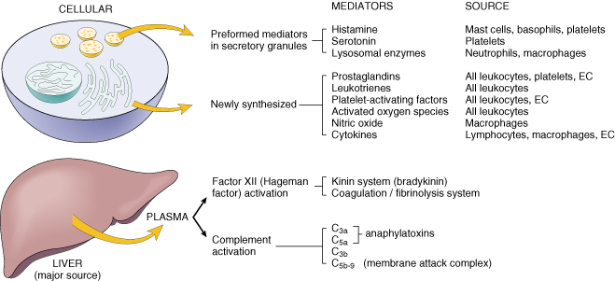
Cell-Derived Mediators
Producing cells:
Tissue macrophages
Mast cells
Endothelial cells
Leukocytes
Notes:
Endothelial cells at the site of inflammation
Leukocytes recruited to the site form the blood

Slide 11
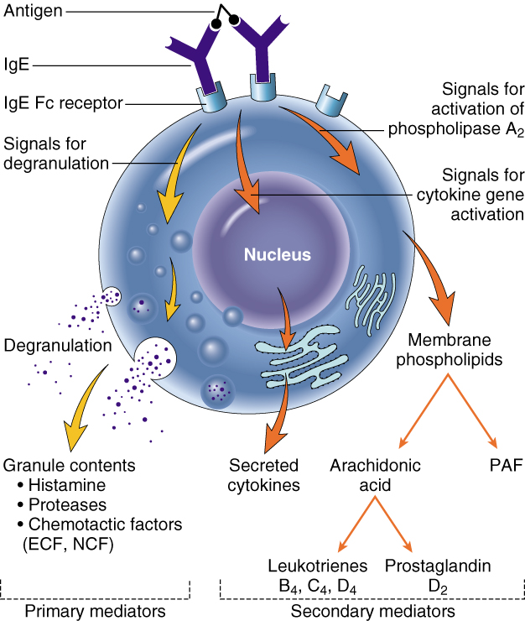
Vasoactive Amines Histamine & Serotonin
Among first mediators in acute inflammatory reactions
Preformed mediators in secretory granules

Slide 12
Histamine
Source:
many cell types, esp. mast cells, circulating basophils, and platelets
Stimuli of Release:
Physical injury
Immune reactions
C3a and C5a fragments
Leukocyte-derived histamine-
releasing proteins
Neuropeptides
Cytokines (e.g. IL-1 and IL-8)
Actions:
ARTERIOLAR DILATION
INCREASED VASCULAR PERMEABILITY (venular gaps)
ENDOTHELIAL ACTIVATION
Inactivated by:
Histaminase
Notes:
Histamine is the principal mediator of the immediate phase of increased vascular permeability, inducing venular endothelial contraction and interendothelial gaps.

Slide 13
Serotonin (5-HT)
Source:
Platelets
Action:
Similar to histamine
Stimulus:
Platelet aggregation

Slide 14
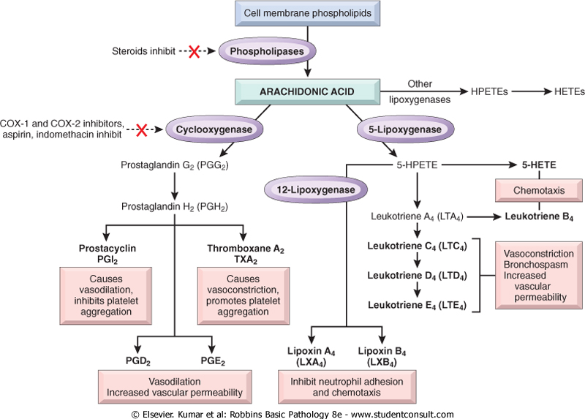
Source:
Leukocytes
Mast cells
Endothelial cells
Platelets
Notes:
.

Slide 15
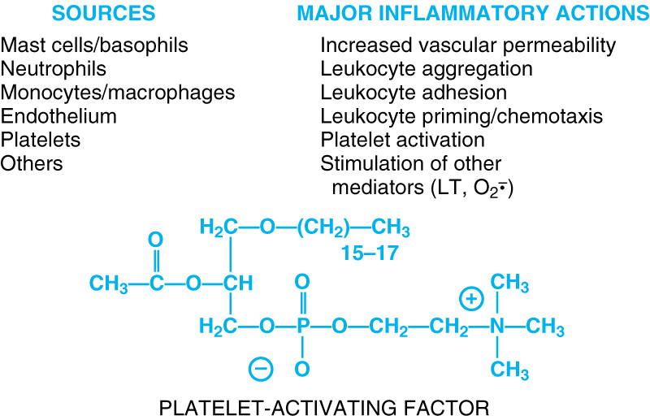
Notes:
.

Slide 16
Cytokines
Polypeptides
Actions:
Involved in early immune and inflammatory reactions
Some stimulate bone marrow precursors to produce more leukocytes
Notes:
.

Slide 17
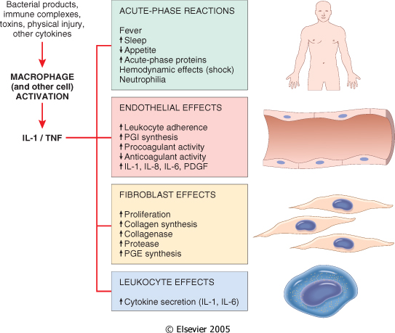
Cytokine of
Acute inflammation:
Interleukin (IL-1) & TNF

Slide 18
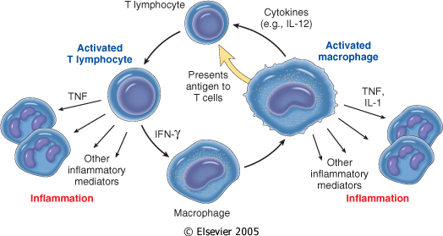
Chronic Inflammation:
Interferon-γ INF- γ & Interleukin ( IL-12)
Activated lymphocytes and macrophages influence each other and also release inflammatory mediators that affect other cells.

Slide 19
Chemokines
Small proteins
They are chemoattractants for leukocytes
Main functions:
Leukocyte recruitment & activation in inflammation
Normal anatomic organization of cells in lymphoid and other tissues
Notes:
.

Slide 20
Reactive Oxygen Species
Synthesized via
NADPH oxidase pathway
Source:
Neutrophils and Macrophages
Stimuli of release:
Microbes
Immune complexes
Cytokines
Action:
Microbicidial (cytotoxic) agent
Notes:
.

Slide 21
Nitric Oxide ( NO)
Short-lived
Soluble free-radical gas
Functions:
Vasodilation
Antagonism of platelet activation (adhesion, aggregation, & degranulation)
Reduction of leukocyte recruitment
Microbicidial (cytotoxic) agent (with or without ROS) in activated macrophages
Notes:
.

Slide 22
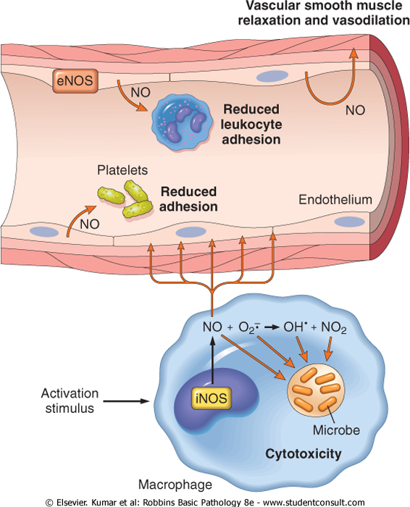

Slide 23
Lysosomal Enzymes of Leukocytes
Neutrophils & Monocytes
Enzymes:
Acid proteases
Neutral proteases (e.g. elastase, collagenase, & cathepsin)
Their action is checked by:
Serum antiproteases (e.g. α1-antitrypsin)
Notes:
.

Slide 24
Neuropeptides
Small proteins
Secreted by nerve fibers mainly in lung & GIT
Initiate inflammatory response
e.g. Substance P :
Transmits pain signals
Regulates vessel tone
Modulates vascular permeability
Notes:
.

Slide 26
PLASMA PROTEASES
A variety of phenomena in the inflammatory response are mediated by plasma proteins that belong to three interrelated systems
1. Kinin
2. the complement
3. clotting systems

Slide 27
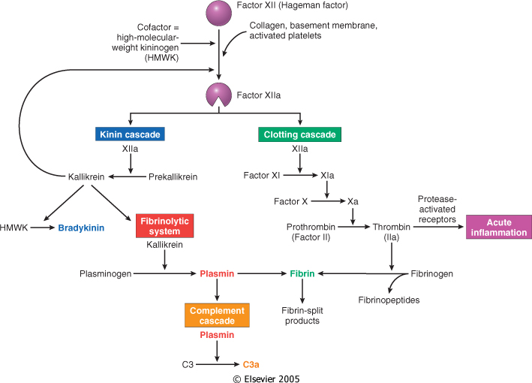
Kinin & clotting systems
enhanced leukocyte adhesion & activation
increases vascular permeability, pain
increases vascular permeability, Chemotaxis

Slide 28
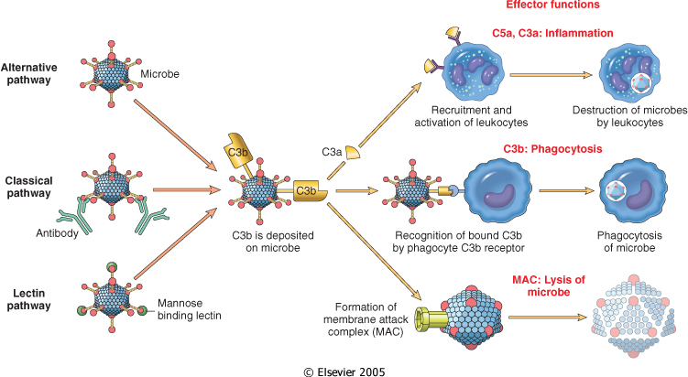
Complement System

Slide 29
Complement protein
C3a & C5a ➔ Increase vascular permeability (^ histamine)
anaphylatoxins
C5a ➔ Chemotaxis
C3b ➔ Opsonization
C5-9 ➔ membrane attack complex

Slide 30
Vasodilation | Prostaglandins Histamine Nitric oxide
Increased vascular permeability | Vasoactive amines Bradykinin Leukotrienes C4, D4, E4 PAF Substance P
Chemotaxis, leukocyte recruitment and activation | C5a Leukotriene B4 Chemokines IL-1, TNF Bacterial products
Fever | IL-1, TNF Prostaglandins
Pain | Prostaglandins Bradykinin
Tissue damage | Neutrophil and macrophage lysosomal enzymes Oxygen metabolites Nitric oxide
Role of Mediators in Different Reactions of Inflammation

Slide 31
Outcomes of Acute Inflammation
Acute inflammation may have one of the four outcomes:
Complete resolution
Healing by connective tissue replacement (fibrosis)
Progression of the tissue response to chronic inflammation
Abcess formation

Slide 32
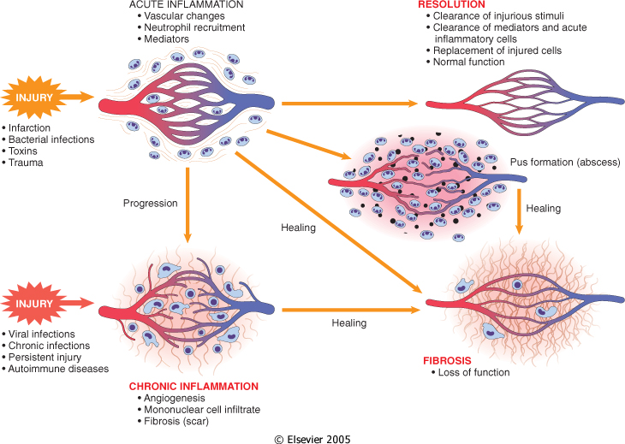

Slide 33
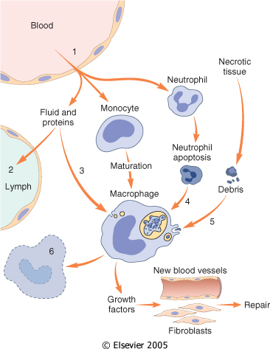
Events in the resolution of inflammation

