Slide 1
GRANULOMATOUS INFLAMMATION
Foundation Block, Pathology
Dr. Maha Arafah
Saturday
Oct 22, 2011 8:00-9:00 am

Slide 2
OBJECTIVES AND KEY PRINCIPLES TO BE TAUGHT:
Upon completion of this lecture, the student should:
Define Granulomatous inflammation.
Recognize the morphology of granulomas (tubercles) and list the cells found in granuloma along with their appearance.
Understands the pathogenesis of granuloma formation.
Identify the two types of granulomas, which differ in their pathogenesis.
Foreign body granulomas
Immune granulomas
List the common causes of Granulomatous Inflammation.

Slide 3
Granulomatous inflammation
A form of proliferative inflammation characterized by the formation of granulomas.

Slide 4
Pathogenesis of granuloma
A granuloma is a cellular attempt to contain an offending agent that is difficult to eradicate.

Slide 5
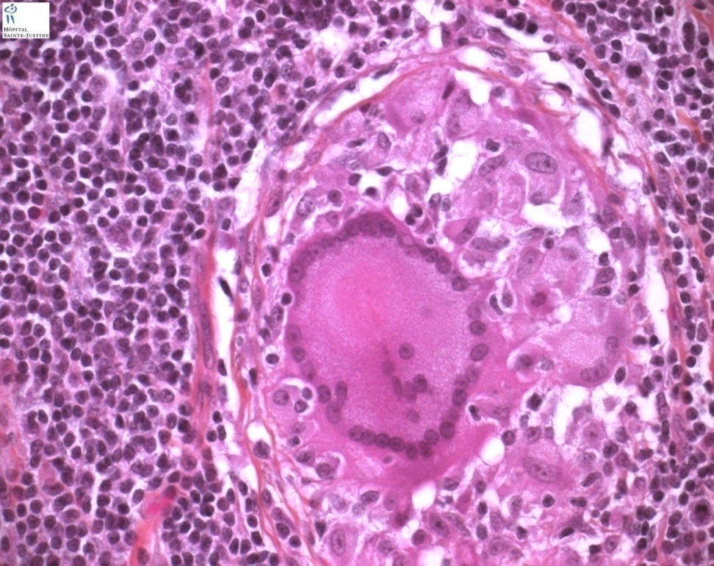
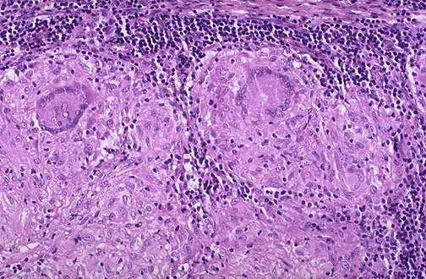
Granuloma = Nodular collection of epithelioid macrophages surrounded by a rim of lymphocytes
Epitheloid macrophages: squamous cell-like appearance

Slide 7
Why is it important to recognize granuloma?
Granulomas are encountered in certain specific pathologic states.
Recognition of the granulomatous pattern is important because of the limited number of conditions (some life-threatening) that cause it

Slide 8
Pathogenesis There are two types of granulomas
Foreign body granuloma
Immune granuloma
are incited by relatively inert foreign bodies. Typically, foreign body granulomas form when material such suture are large enough to preclude phagocytosis by a single macrophage
These material do not incite any specific inflammatory immune response.
The foreign material can usually be identified in the center of the granuloma, by polarized light (appears refractile).
are caused typically by microbes, that are capable of inducing a cell-mediated immune response.

Slide 9
Granulomatous Inflammation Causes
Non-immune granuloma
Immune granuloma:
Foreign body
Suture
Graft material
talc (associated with intravenous drug abuse)
Bacteria
Tuberculosis
Leprosy
Actinomycosis
Cat-scratch disease
Parasites
Schistosomiasis
Leishmaniasis
Fungi
Histoplasmosis
Blastomycosis
Metal/Dust
Berylliosis
unknown
Sarcoidosis
Crohn’s disease

Slide 10
Pathogenesis

Slide 11
IL-2, and IFN-γ,

Slide 12
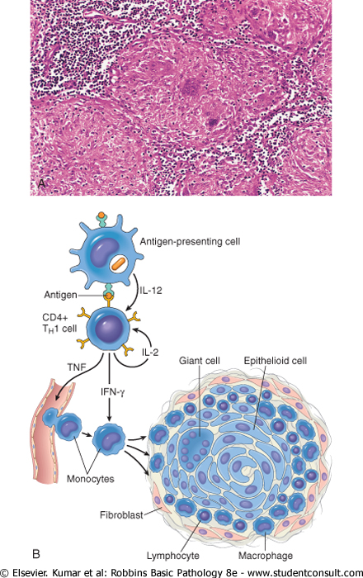
Immune granuloma mechanism
What is the initiating event in granuloma formation?
indigestible antigenic material in macrophages
Antigen presentation on cell membrane
to appropriate CD+T lymphocytes, causing them to become activated. The responding T cells produce cytokines, such as IL-2, and IFN-γ,
IFN-γ is important in activating macrophages and transforming them into epithelioid cells and multinucleate giant cells

Slide 13
Morphology of Granulomatous Inflammation

Slide 14
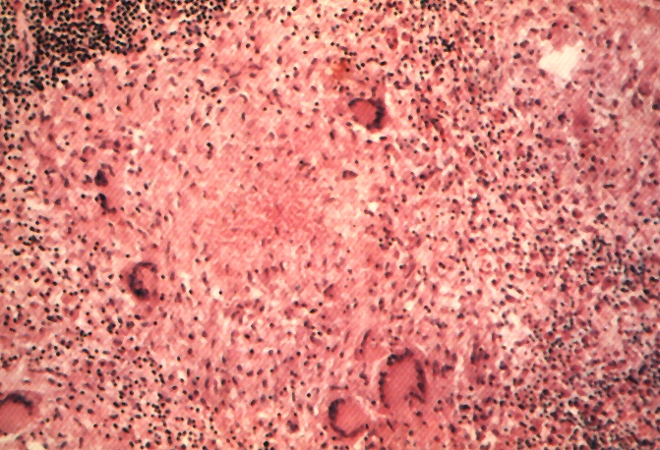
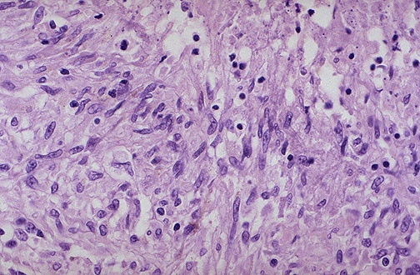
Granuloma
Langhans Giant Cell
Lymphocytic Rim
Caseous Necrosis
Epithelioid Macrophage

Slide 15
Common Examples

Slide 16
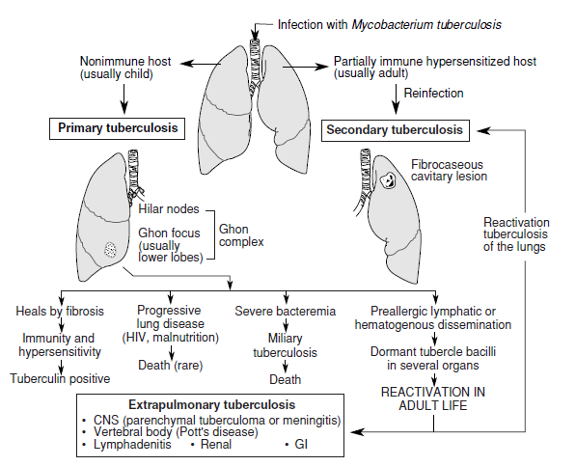

Slide 18
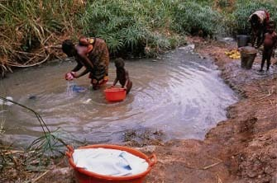
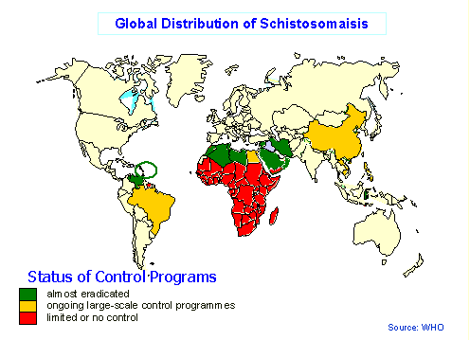
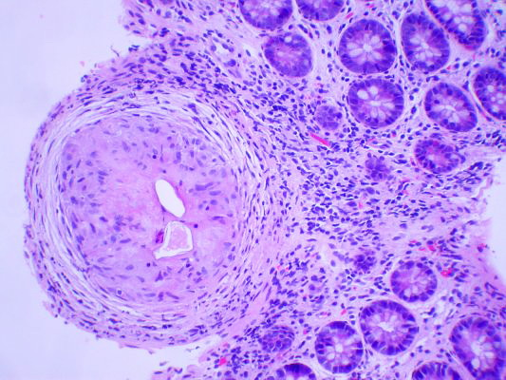
Schistosomiasis

Slide 19
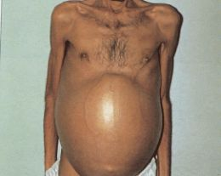
Schistosomiasis

Slide 20
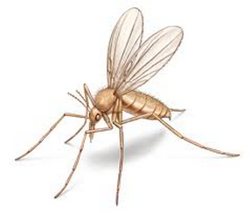
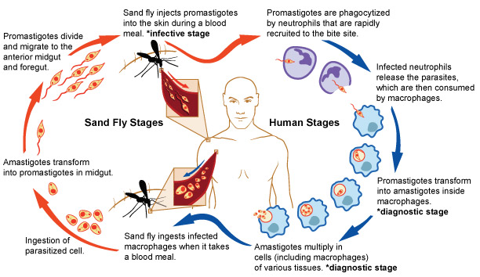
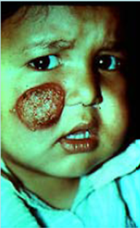
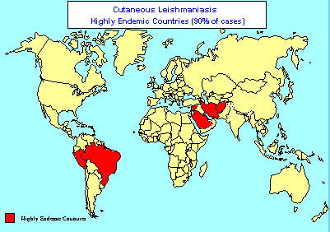
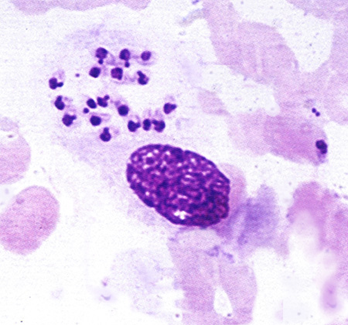
Leishmaniasis
Sand fly

Slide 21
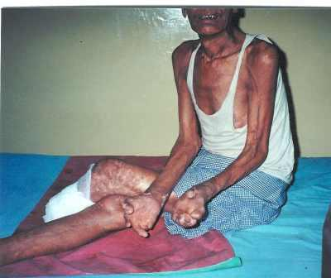
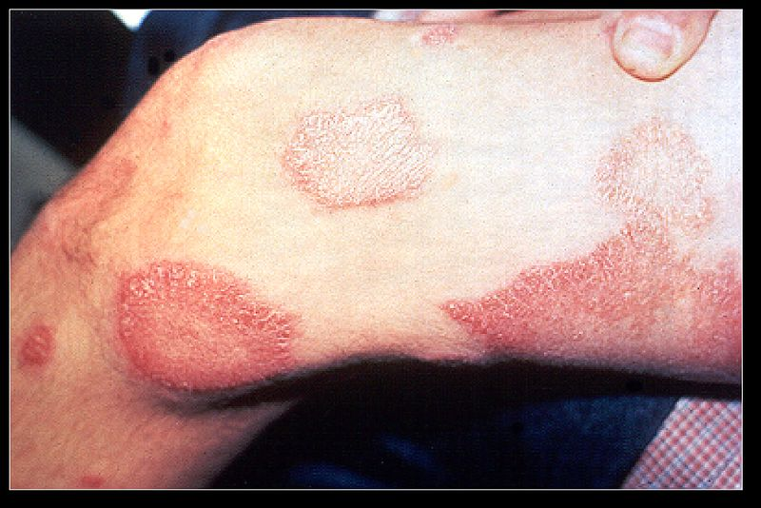
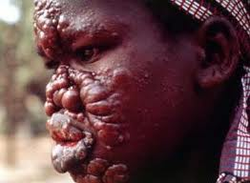
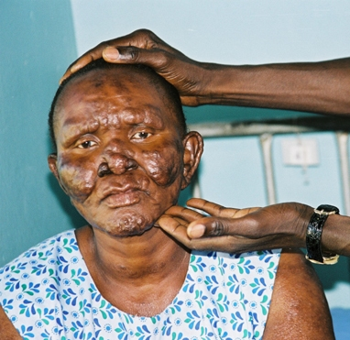
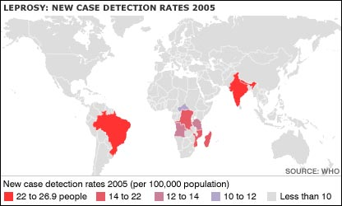
Leprosy

Slide 22
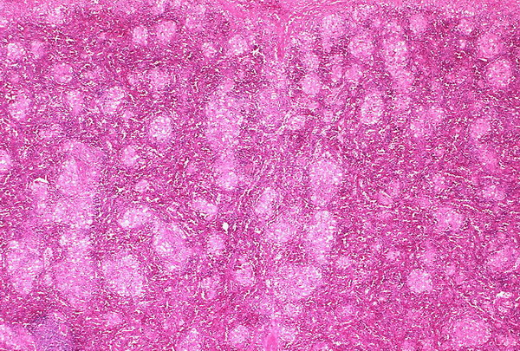
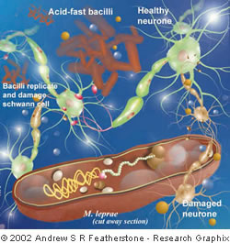
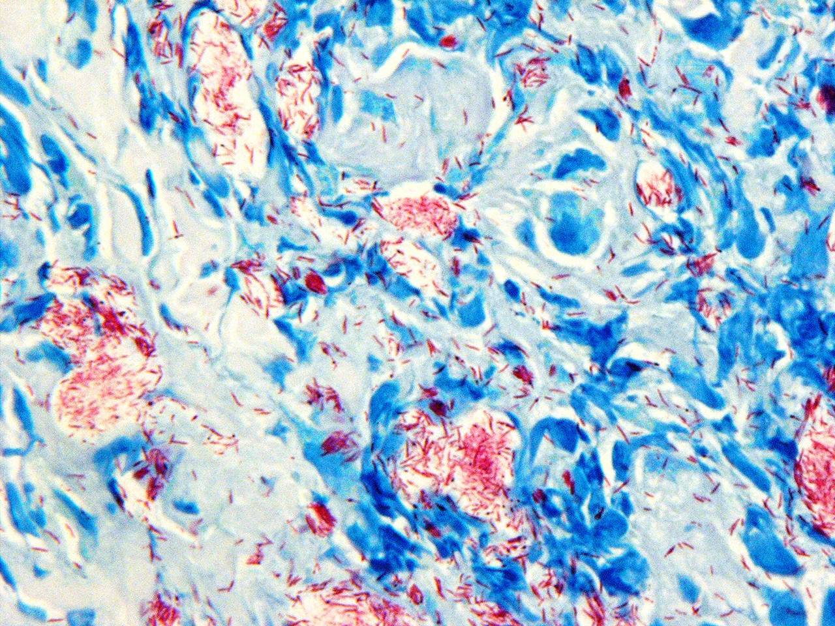
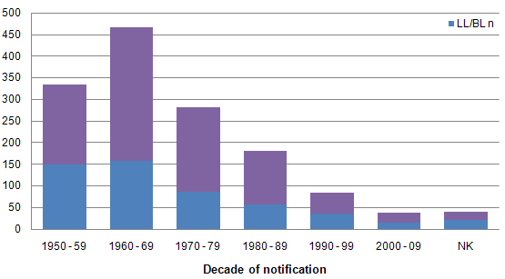
Leprosy

Slide 23
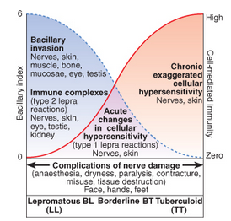
Leprosy

Slide 24
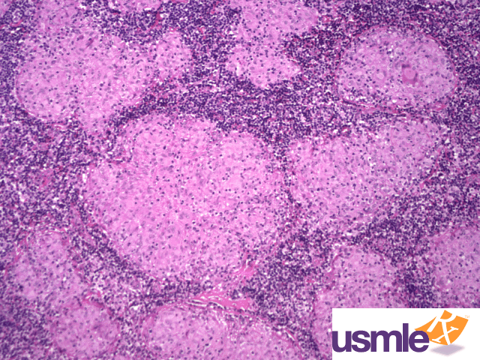
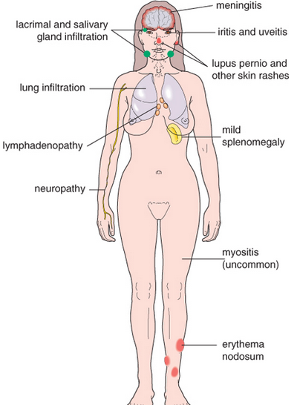
Sarcoidosis
Cause: Unknown

Slide 25
Important Disease

Slide 26
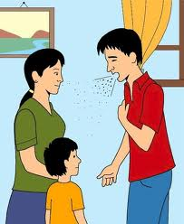
A Disease
Easily transmitted

Slide 27
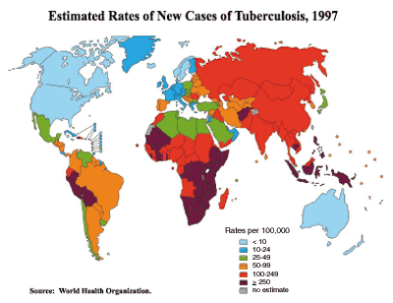
A Disease
Common World Wide

Slide 28
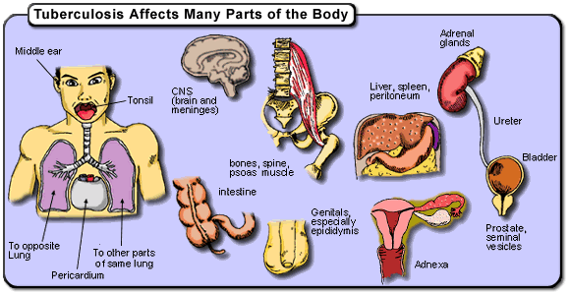
A Disease
Could Affect Any Organ

Slide 29
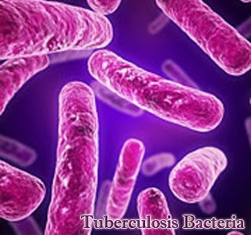
الدرن TB

Slide 30
TAKE HOME MESSAGES:
Granulomatous inflammation is a distinctive pattern of chronic inflammation characterized by aggregates of activated macrophages that assume an epithelioid appearance.
Damaging stimuli which provoke a granulomatous inflammatory response include:
Microorganisms which are of low inherent pathogenicity but which excite an immune response.
Granulomata are produced in response to:
Bacterial infection
parasitic infection: e.g. Schistosoma infection
Certain fungi cannot be dealt with adequately by neutrophils, and thus excite granulomatous reactions.
Non-living foreign material deposited in tissues, e.g. keratin from ruptured epidermal cyst.
Unknown factors, e.g. in the disease 'sarcoidosis' and Crohn's diseas

