Slide 1
Neoplasia
Lecture 1
Maha Arafa,MD,KSFP
Abdulmalik Alsheikh, MD, FRCPC

Slide 2
Neoplasia
Upon completion of these lectures, the student should:
Define a neoplasm. Contrast neoplastic growth with hyperplasia, metaplasia, and dysplasia.
Know the basic principles of the nomenclature of benign and malignant processes.
Define and use in the proper context:
  Adenoma.
  Papilloma.
  Polyp.
  Cystadenoma.
  Carcinoma.
  Adenocarcinoma.
  Sarcoma.
  Teratoma.
  Blastoma.
  Hamartoma.

Slide 3
Neoplasia
Cancer is one of the leading causes of death worldwide.
Emotional and physical suffering by the patient.
Different mortality rate …..
  Some are curable
  Others are fatal

Slide 4
Neoplasia
Neoplasia = new growth
Neoplasm = tumor
Tumor = swelling
The study of tumors = Oncology
  Oncos = tumor + ology = study of

Slide 5
Neoplasia
Definition:
  is an abnormal mass of tissue,
  the growth of which is uncoordinated with that of normal tissues,
  and that persists in the same excessive manner after the cessation of the stimulus which evoked the change“
  With the loss of responsiveness to normal growth controls
  Different from hyperplasia, metaplasia and dysplasia.

Slide 6
Neoplasia
Classification
  Benign
  malignant

Slide 7
Neoplasia
Benign tumors :
  Will remain localized
  Cannot spread to distant sites
  Generally can be locally excised
  Patient generally survives

Slide 8
Neoplasia
Malignant neoplasms:
  Can invade and destroy adjacent structure
  Can spread to distant sites
  Cause death (if not treated )

Slide 9
Neoplasia
All tumors have two basic components:
  Parechyma: made up of neoplastic cells
  Stroma: made up of non-neoplastic, host-derived connective tissue and blood vessels
The parenchyma:
  Determines the biological behavior of the tumor
  From which the tumor derives its name
The stroma:
  Carries the blood supply
  Provides support for the growth of the parenchyma

Slide 10
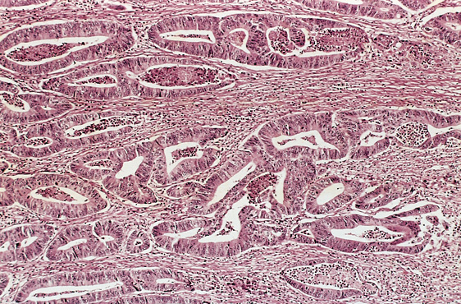

Slide 11
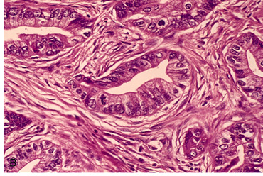

Slide 12
Neoplasia
Nomenclature
  Benign tumors:
    prefix + suffix
    Type of cell + (-oma)

Slide 13
Neoplasia
Examples:
  Benign tumor arising in fibrous tissue:
  Fibro + oma = Fibroma
  Benign tumor arising in fatty tissue:
  Lipo + oma = lipoma

Slide 14
Neoplasia
Benign tumor arising in cartilage
chondro + oma = chondroma
Benign tumor arising in smooth muscle
Leiomyo + oma = leiomyoma
Benign tumor arising in skeletal muscle
Rhabdomyo + oma = rhabdomyoma

Slide 15
Neoplasia
epithelial benign tumors are classified on the basis of :
  The cell of origin
  Microscopic pattern
  Macroscopic pattern

Slide 16
Neoplasia
  Adenoma : benign epithelial neoplasms producing gland pattern….OR … derived from glands but not necessarily exhibiting gland pattern
  Papilloma : benign epithelial neoplasms growing on any surface that produce microscopic or macroscopic finger-like pattern

Slide 17
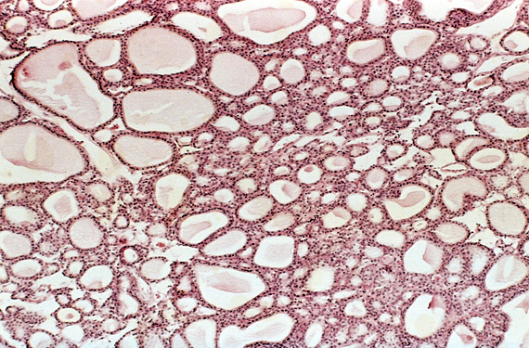
Adenoma

Slide 18
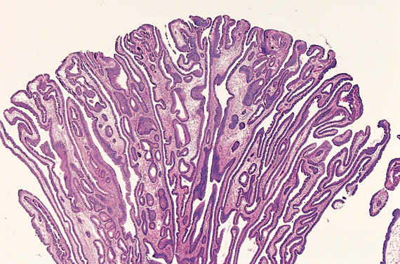
Papilloma

Slide 19
Neoplasia
Polyp : a mass that projects above a mucosal surface to form a macroscopically visible structure.
e.g. - colonic polyp
- nasal polyp

Slide 20
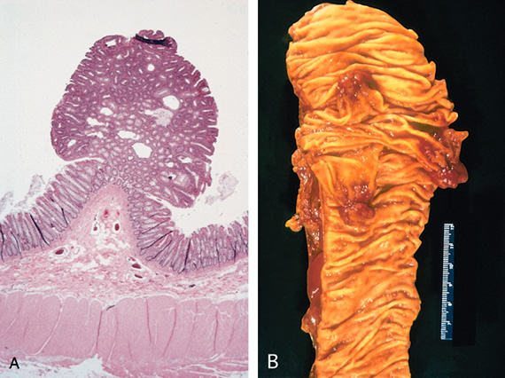
Polyp

Slide 21
Neoplasia
Examples :
  Respiratory airways: Bronchial adenoma
  Renal epithelium: Renal tubular adenoma
  Liver cell : Liver cell adenoma
  Squamous epithelium: squamous papilloma

Slide 22
Neoplasia
Malignant tumors:
  Malignant tumor arising in mesenchymal tissue : SARCOMA
    From fibrous tissue: Fibrosarcoma
    From bone : Osteosarcoma
    From cartilage : chondrosarcoma

Slide 23
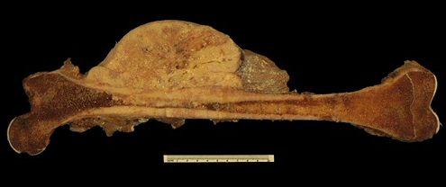
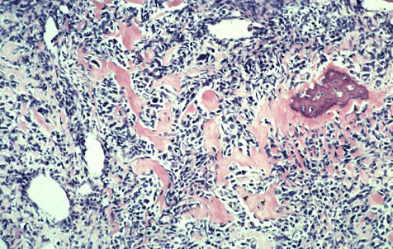
Osteosarcoma

Slide 24
Neoplasia
Malignant tumors arising from epithelial origin : CARCINOMA
  Squamous cell carcinoma
  Renal cell adenocarcinoma
  cholangiocarcinoma

Slide 25
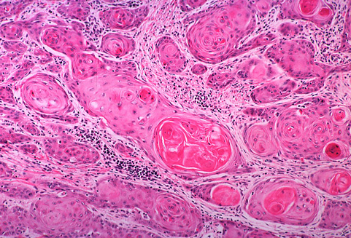
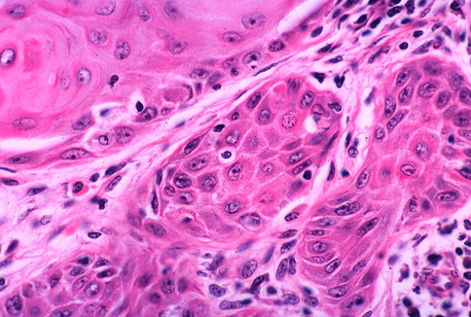
Carcinomas arising from any epithelium of the body that exhibit squamous differentiation are termed squamous cell carcinoma.

Slide 26
Nomenclature
other descriptive terms may be added such as:
Papillary Cystadenocarcinoma of the Ovary

Slide 27
Neoplasia
Exceptions
Melanoma ( skin )
Mesothelioma (mesothelium )
Seminoma ( testis )
Lymphoma ( lymphoid tissue )
See table 6 – 1 page 168 ( Robbin’s )

Slide 28
Neoplasia
Based on the biological behavior :
  Benign and malignant
Based on the cell of origin :
  One neoplastic cell type : lipoma, adenocarcinoma
  More than one neoplastic cell type : fibroadenoma
  More than one neoplastic cell type derived from more than one germ-cell layer: teratoma
  Derived from embryonic tissue: blastoma (could be benign e.g. osteoblastoma, or malignant e.g. neuroblastoma)

Slide 29
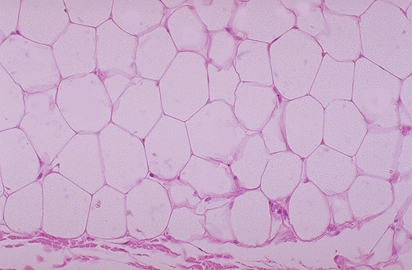
Lipoma

Slide 30
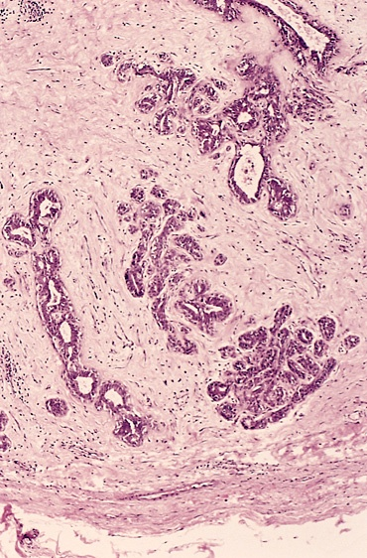
Fibroadenoma

Slide 31
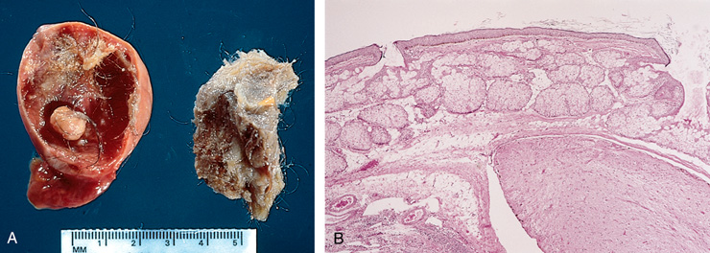
Teratoma

Slide 32
Neoplasia
Teratoma:
  Teratoma contains recognizable mature or immature cells or tissues representative of more than one germ-cell layer and some times all three.
  Teratomas originate from totipotential cells such as those normally present in the ovary and testis.

Slide 33
Neoplasia
Such cells have the capacity to differentiate into any of the cell types found in the adult body. So they may give rise to neoplasms that mimic bone, epithelium, muscle, fat, nerve and other tissues.
Most common sites are: ovary & testis

Slide 34
Neoplasia
If all the components parts are well differentiated, it is a benign (mature) teratoma.
If less well differentiated, it is an immature (malignant) teratoma.

Slide 35
Neoplasia nomenclature
- historic eponyms – “first described by…”
Malignant lymphoma (HL) of B Ly cell origin | Hodgkin’s disease
NHL – B Ly cell in children (jaw and GIT) | Burkitt tumor
Bone tumor (PNET) | Ewing tumor
Kidney tumor - clear cell adenocarcinoma | Grawitz tumor
Malignant tumor derived from vascular epithelium (AIDS) | Kaposi sarcoma
Ovarian tumor derived from Brenner cells | Brenner tumor
Malignant chest wall tumor of PNET | Askin tumor
Skin tumor derived from Merkel cell | Merkel tumor

Slide 36
WHAT ARE HAMARTOMAS AND CHORISTOMA?
Hamartoma: a mass composed of cells native to the organ
e.g. pulmonary hamartoma.
Choristoma: a mass composed of normal cells in a wrong location
e.g. pancreatic choristoma in liver or stomach.
Malformation and not neoplasm.

Slide 37
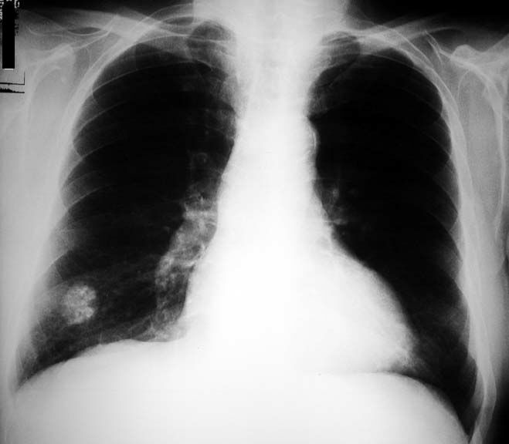
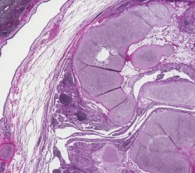
Pulmonary Hamartoma

Slide 38
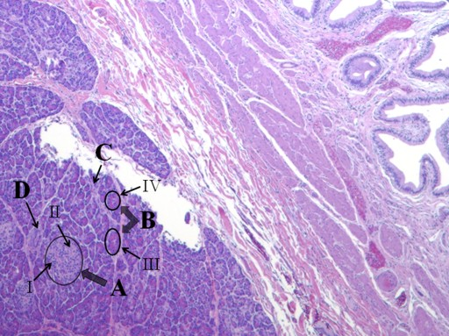
Pancreatic choristoma in gall bladder

Slide 39
Neplasia
Hamartoma and Choristoma
They are distinguished from neoplasms by the fact that they do not exhibit continued growth. they are group of tumor-like tissue masses which may be confused with neoplasms

