Slide 1
NEOPLASIA Lecture 4
Maha Arafa,MD,KSFP
Abdulmalik Alsheikh, M.D, FRCPC

Slide 2
Objectives
List the various causes of neoplasms

Slide 3
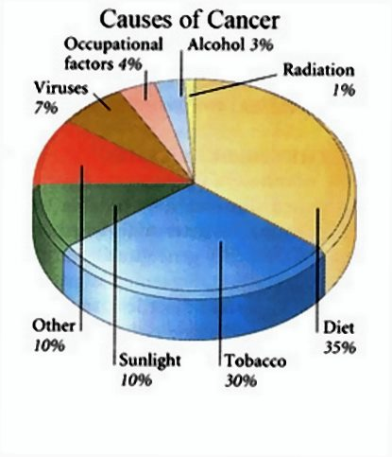
Carcinogenic Agents
Chemicals
Radiation
Microbial agents

Slide 4
Carcinogenic Agents
Chemicals:
Natural or synthetic
Direct reacting or indirect
Indirect → need metabolic conversion to be active and carcinogenic
Indirect chemicals are called “ procarcinogens “ and their active end products are called “ ultimate carcinogens”

Slide 5
Carcinogenic Agents
All direct reacting and ultimate chemical carcinogens are highly reactive as they have electron-deficient atoms
They react with the electron rich atoms in RNA,DNA and other cellular proteins

Slide 6
Carcinogenic Agents
Examples:
Alkylating agents
Polycyclic hydrocarbons:
Cigarette smoking
Animal fats during broiling meats
Smoked meats and fish

Slide 7
Carcinogenic Agents
Aromatic amines and azo dyes:
Β-naphthylamine cause bladder cancer in rubber industries and aniline dye
Some azo dyes are used to color food
Nitrosamines and nitrosamides are used as preservatives. They cause gastric cancer.
Aflatoxin B: produced by aspirigillus growing on improperly stored grains. It cause hepatocellular carcinoma

Slide 8
Carcinogenic Agents
Mechanism of action of chemical carcinogens:
Most of them are mutagenic. i.e. cause mutations
RAS and P53 are common targets

Slide 9
Carcinogenic Agents
Radiation carcinogenesis
UV rays of sunlight
X-rays
Nuclear radiation
Therapeutic irradiations
Radiation has mutagenic effects: chromosomes breakage, translocations, and point mutations

Slide 10
Carcinogenic Agents
UV rays of sunlight :
Can cause skin cancers: melanoma, squamous cell carcinoma, and basal cell carcinoma
It is capable to damage DNA
With extensive exposure to sunlight, the repair system is overwhelmed→ skin cancer
They cause mutations in P53 gene

Slide 11
Carcinogenic Agents
Viral and Microbial oncogenesis
DNA viruses
RNA viruses
other organisms

Slide 12
Carcinogenic Agents
Viral oncogenes:
carry genes that induce cell replication as part of the viral life cycle
host cell has endogenous genes that maintain the normal cell-cycle
Viral infection mimics or blocks these normal cellular signals necessary for growth regulation

Slide 13
Carcinogenic Agents
RNA Oncogenic viruses
Human T-Cell Leukemia Virus type 1 (HTLV-1)
RNA retrovirus targets / transforms T-cells
causes T-Cell leukemia/Lymphoma
Endemic in Japan and Caribbean
Transmitted like HIV but only 1% of infected develop T-Cell leukemia/Lymphoma
20-30 year latent period

Slide 14
Carcinogenic Agents
No cure or vaccine
Treatment : chemotherapy with common relapse

Slide 15
Carcinogenic Agents
DNA Oncogenic Viruses
virus DNA forms stable association with host’s DNA
transcribed viral DNA transforms host cell
Examples: papilloma viruses
Epstein-Barr (EBV)
Hepatitis B (HBV)
Kaposi sarcoma herpes virus

Slide 16
Carcinogenic Agents
Human Papillomavirus (HPV)
70 types
squamous cell carcinoma of
cervix
anogenital region
mouth
larynx

Slide 17
Carcinogenic Agents
sexually transmitted
Cervical cancer
85% have types 16 and 18
Genital warts
types 6 and 11

Slide 18
Carcinogenic Agents
HPV causing benign tumors:
types 6, 11
HPV causing malignant tumors :
types 16, 18, 31
vDNA integrates w/ host

Slide 19
Carcinogenic Agents
HPV (types 16 and 18)
over-expression of Exon 6 and 7
E6 protein binds to Rb tumor suppressor
replaces normal transcription factors
decreases Rb synthesis
E7 protein binds to P53
facilitates degradation of P53

Slide 20
Carcinogenic Agents
HPV infection alone is not sufficient -
other risk factors:
cigarette smoking
coexisting infections
hormonal changes

Slide 21
Carcinogenic Agents
Epstein-Barr Virus
common virus worldwide
Infects B lymphocytes and epithelial cells of oropharynx
causes infectious mononucleosis
EBV infection may cause malignancy
Burkitt’s Lymphoma
B cell lymphoma in immunosuppressed
Nasopharyngeal carcinoma

Slide 22
Carcinogenic Agents Epstein-Barr Virus related
Nasopharyngeal carcinoma
Cancer of nasopharygeal epithelium
Endemic in South China, parts of Africa
100% of tumors contain EBV genome in endemic areas

Slide 23
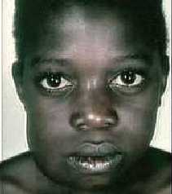
Carcinogenic Agents Epstein-Barr Virus related
Burkitt Lymphoma
highly malignant B cell tumor
sporadic rare occurrence worldwide
most common childhood tumor in Africa
all cases have t(8:14)

Slide 24
Carcinogenic Agents Epstein-Barr Virus related
causes B lymphocyte cell proliferation
loss of growth regulation
predisposes to mutation, esp. t(8:14)

Slide 25
Carcinogenic Agents
Hepatitis B virus (HBV)
Strong association with Liver Cancer
world-wide, but HBV infection is most common in Far East and Africa
HBV infection incurs up to 200-fold risk

Slide 26
Carcinogenic Agents
Helicobacter Pylori
bacteria infecting stomach
implicated in:
peptic ulcers
gastric lymphoma
Mucosal Associated Lymphoid Tumor (MALT)
gastric carcinoma

