Slide 1
Neoplasia Lecture 2
Maha Arafa,MD,KSFP
Abdulmalik Alsheikh, MD, FRCPC

Slide 2
Objectives
Compare and contrast benign and malignant tumors with respect to:
demarcation from surrounding tissue (capsule, local invasiveness.
rate of growth
degree of differentiation (Explain the meaning of differentiation).
distant spread (metastases).
Describe the morphologic changes associated with poorly differentiated tumors; define and understand the usage of the terms anaplasia, pleomorphism, nuclear atypia, abnormal mitoses and tumor giant cells.
Understand the clinical significance of invasiveness and metastasis.
Describe the anatomic pathways utilized by tumors in metastatic spread. Know which pathways are commonly used by carcinomas versus sarcomas.
List some common sites of distant metastases.
Recognize the epidemiologic data of cancer distribution in regard to age, race, geographic factors, and genetic backgrounds.
List some inherited syndromes with a genetic predisposition to cancer.

Slide 3
Neoplasia
Characteristics of benign and malignant neoplasms
Differentiation and anaplasia
Rate of growth
Local invasion
metastasis

Slide 4
Neoplasia
Differentiation and anaplasia:
Differentiation means : the extent to which the parenchymal cells of the tumor resemble their normal counterparts morphologically and functionally

Slide 5
Neoplasia
well differentiated = closely resemble their normal counterparts
Moderately differentiated
Poorly differentiated
Undifferentiated ( Anaplasia )

Slide 6
Neoplasia
Benign tumors = well differentiated
Malignant tumors =
well differentiated -----> anaplastic

Slide 7
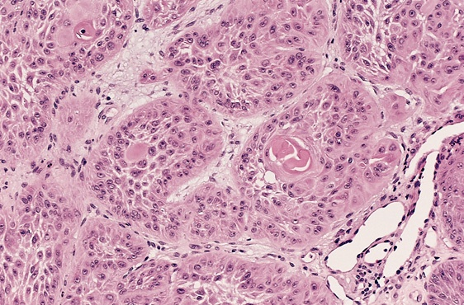

Slide 8
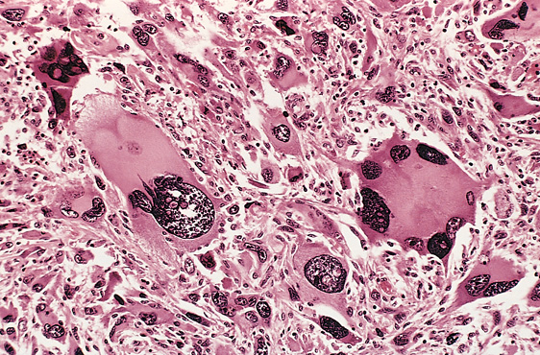

Slide 9
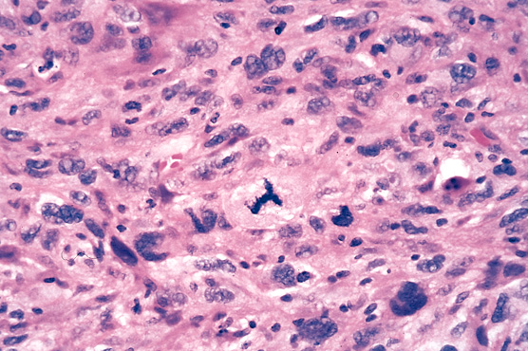

Slide 10
Neoplasia
In the histological examination of a tumor you should look for :
Pleomorphism : variation in size
High nuclear/ cytoplasm ratio ( N/C ratio)
Hyperchrmasia ( dark cell )
Mitosis ….?abnormal one

Slide 11
Neoplasia
Characteristics of benign and malignant neoplasms
Differentiation and anaplasia
Rate of growth
Local invasion
metastasis

Slide 12
Neoplasia
Rate of growth:
Benign tumors:
grows slowly
are affected by blood supply, hormonal effects , location
Malignant tumors :
grows faster
Correlate with the level of differentiation

Slide 13
Neoplasia
Characteristics of benign and malignant neoplasms
Differentiation and anaplasia
Rate of growth
Local invasion
metastasis

Slide 14
Neoplasia
Local invasion :
Benign tumors :
Remain localized
Cannot invade
Usually capsulated
Malignant tumors :
Progressive invasion
Destruction
Usually not capsulated

Slide 15
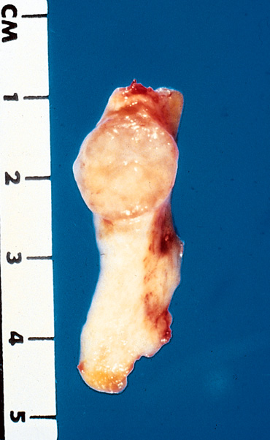
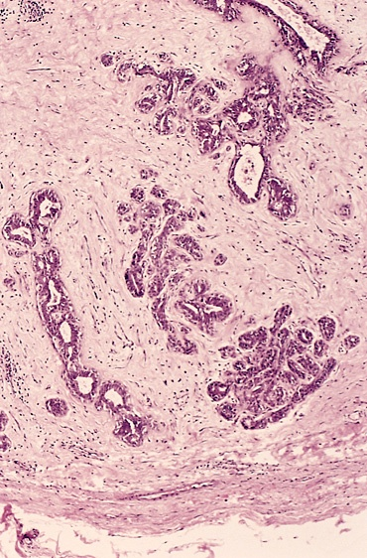

Slide 16
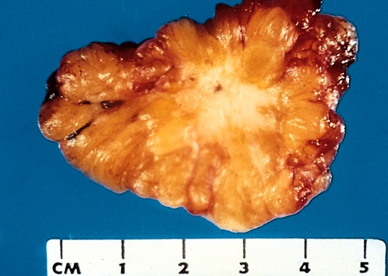
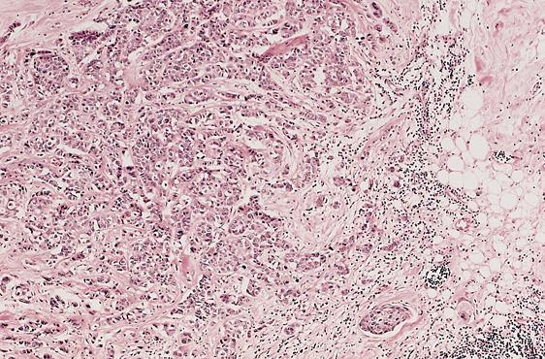

Slide 17
Neoplasia
Characteristics of benign and malignant neoplasms
Differentiation and anaplasia
Rate of growth
Local invasion
metastasis

Slide 18
Neoplasia
Metastasis :
Definition : the development of secondary implants discontinuous with the primary tumor, possibly in remote tissues

Slide 19
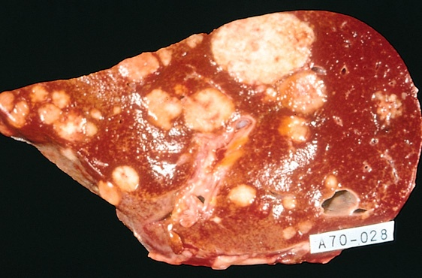

Slide 20
Neoplasia
Metastasis :
Cancers have different ability to metastasize
Approximately 30% patients present with clinically evident metastases.
Generally, the more anaplastic and the larger the primary tumor, the more likely is metastasis

Slide 21
Neoplasia
Metastasis : three pathways
Lymphatic spread :
Hematogenous spread :
Seeding of the body cavities: pleural, peritoneal cavities and cerebral ventricles

Slide 22
Neoplasia
Lymphatic spread :
favored by carcinomas
Breast carcinoma → axillary lymph nodes
Lung carcinomas → bronchial lymph nodes

Slide 23
Neoplasia
Hematogenous spread :
favored by sarcomas
Also used by carcinomas
Veins are more commonly invaded
The liver and lungs are the most frequently involved secondary sites

Slide 24
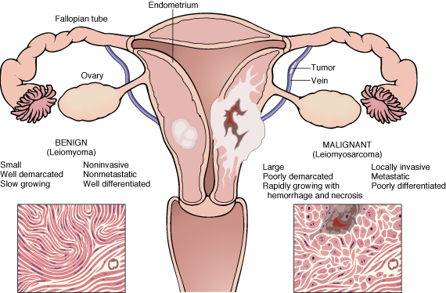

Slide 25
Neoplasia
In the histological examination of a tumor you should look for :
Pleomorphism : variation in size
High nuclear/ cytoplasm ratio ( N/C ratio)
Hyperchrmasia ( dark cell )
Mitosis ….?abnormal one

Slide 26
Neoplasia
Dysplasia :
Definiton: a loss in the uniformity of the individual cells and a loss in their architectural orientation.
Non-neoplastic
Occurs mainly in the epithelia
Dysplastic cells shows a degree of : pleomorphism, hyperchrmasia,increased mitosis and loss of polarity.

Slide 27
Neoplasia
Dysplasia does not mean cancer
Dyplasia does not necessarily progress to cancer
Dysplasia may be reversible
If dysplastic changes involve the entire thickness of the epithelium it is called :
CARCINOMA IN-SITU

Slide 28
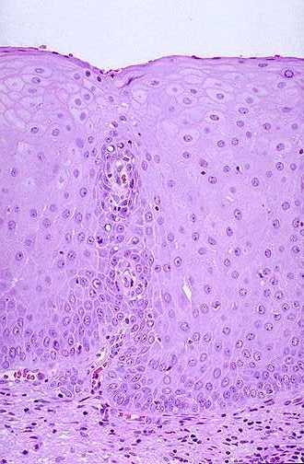
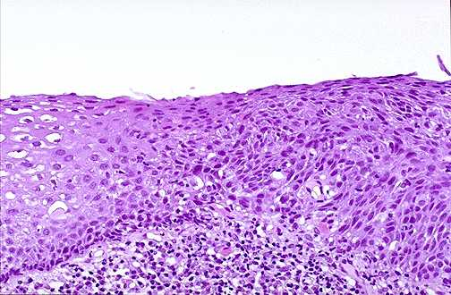

Slide 29
Neoplasia
Carcinoma in-situ
Definition: an intraepithelial malignancy in which malignant cells involve the entire thickness of the epithelium without penetration of the basement membrane.
Applicable only to epithelial neoplasms.

Slide 32
Dysplasia Features:
Nuclear abnormality
Increased N/C ratio
Irregular nuclear membrane
Increased chromatin content
Cytoplasmic abnormalities due to failure of normal maturation
Increased rate of multiplication.
Disordered maturation.

Slide 33
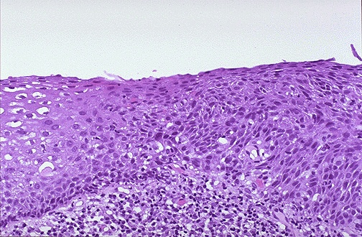
Dysplasia Uterine cervix
Sever Dysplasia
Mild Dysplasia

Slide 34
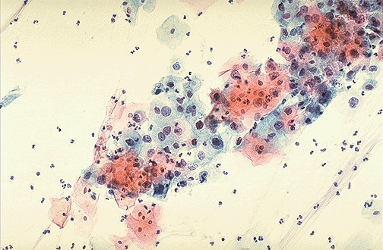
Dysplasia (cervical pap smear)

Slide 35
Dysplasia
Clinical significance:
It is a premalignant condition.
The risk of invasive cancer varies with:
grade of dysplasia (mild, moderate, sever)
duration of dysplasia
site of dysplasia

Slide 36
Dysplasia
Differences between dysplasia and cancer.
∗lack of invasiveness.
∗Reversibility

Slide 37
Carcinoma in situ
A true neoplasm with all of the features of malignant neoplasm except invasiveness
Displays the cytological features of malignancy without invasion of the basement membrane.

Slide 38
CHANGES IN UTERINE CERVIX

Slide 39
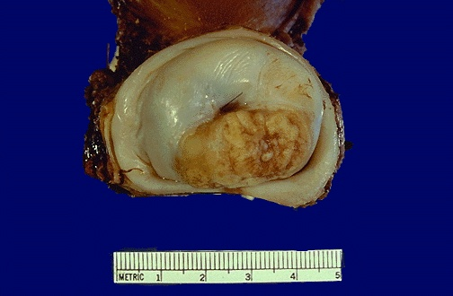
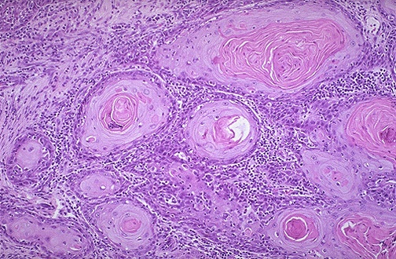
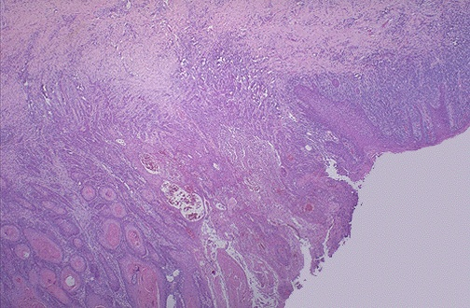
Squamous cell Carcinoma Uterine Cervix
Dysplasia
Notes:
Cervical SC carcinoma - infiltrating

Slide 40
Neoplasia
Epidemiology
Will help to discover aetiology
Planning of preventive measures
To know what is common and what is rare.
Development of screening methods for early diagnosis

Slide 41
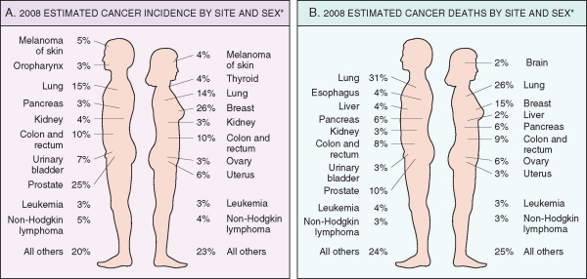

Slide 42
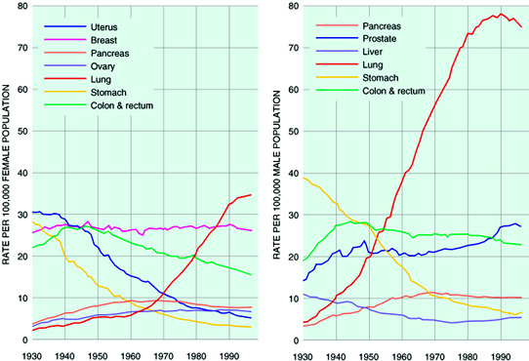

Slide 44
Neoplasia
Factors affecting incidence of cancer
Geographic and Environmental
Age
Heredity
Aquired preneoplastic disorders

Slide 45
Neoplasia
Geographic and Environmental factors:
Rate of stomach carcinoma in Japan is seven times the rate in North America and Europe.
Breast carcinoma is five times higher in North America comparing to Japan
Liver cell carcinoma is more common in African populations

Slide 46
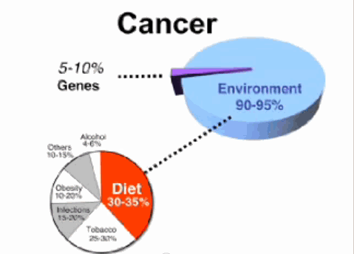

Slide 47
Neoplasia
Geographic and Environmental factors:
Asbestos : mesothelioma
Smoking : lung cancer
Multiple sexual partners: cervical cancer
Fatty diets : colonic cancer
Please see table 6-3 for occupational cancers

Slide 48
Neoplasia
Factors affecting incidence of cancer
Geographic and Environmental
Age
Heredity
Aquired preneoplastic disorders

Slide 49
Neoplasia
Age:
Generally, the frequency of cancer increases with age.
Most cancer mortality occurs between 55 and 75.
Cancer mortality is also increased during childhood
Most common tumors of children: Leukemia, tumors of CNS, Lymphomas, soft tissue and bone sarcomas.

Slide 50
Neoplasia
Factors affecting incidence of cancer
Geographic and Environmental
Age
Heredity
Aquired preneoplastic disorders

Slide 51
Neoplasia
Heredity
Inherited Cancer Syndromes
Familial Cancers
Autosomal Recessive Syndromes of Defective DNA repair

Slide 52
Heredity
Inherited Cancer Syndromes:
Inheritance of a single mutant gene greatly increases the risk of developing neoplasm
E.g. Retinoblastoma in children :
40% of Retinoblastomas are familial
carriers of the gene have 10000 fold increase in the risk of developing Retinoblastoma
E.g. multiple endocrine neoplasia

Slide 53
Heredity
Familial Cancers:
All common types of cancers occur in familial form
E.g. breast, colon, ovary,brain
Familial cancers usually have unique features:
Start at early age
Multiple or bilateral
Two or more relatives

Slide 54
Heredity
Autosomal Recessive Syndromes of Defective DNA repair :
Small group of autosomal recessive disorders
Characterized by DNA instability
Please see table 6-4 for more examples

Slide 55
Neoplasia
Factors affecting incidence of cancer
Geographic and Environmental
Age
Heredity
Aquired preneoplastic disorders

Slide 56
Neoplasia
Aquired preneoplastic disorders: Some Clinical conditions that predispose to cancer
Dysplastic bronchial mucosa in smokers→ lung carcinoma
Liver cirrhosis → liver cell carcinoma
Margins of chronic skin fistula → squamous cell carcinoma

