Slide 1
Granulomatous diseases

Slide 2
Gross and histopathology

Slide 3
1- Tuberculosis of the lung

Slide 4
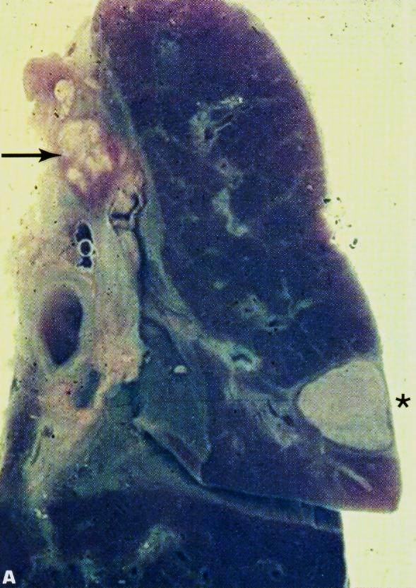

Slide 5
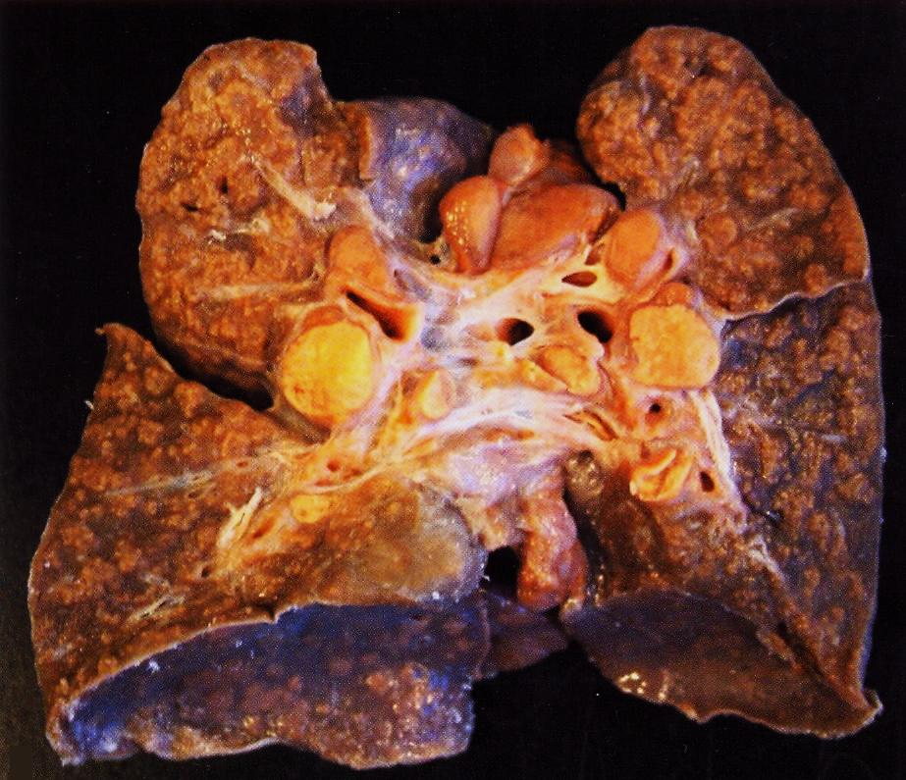

Slide 6
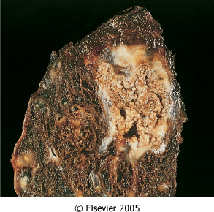
Organ: lung Dx : Caseous necrosis (tuberculosis)

Slide 7
Tuberculous Granulomas

Slide 8
Caseation Necrosis

Slide 9
Epitheloid cells in Granuloma

Slide 10
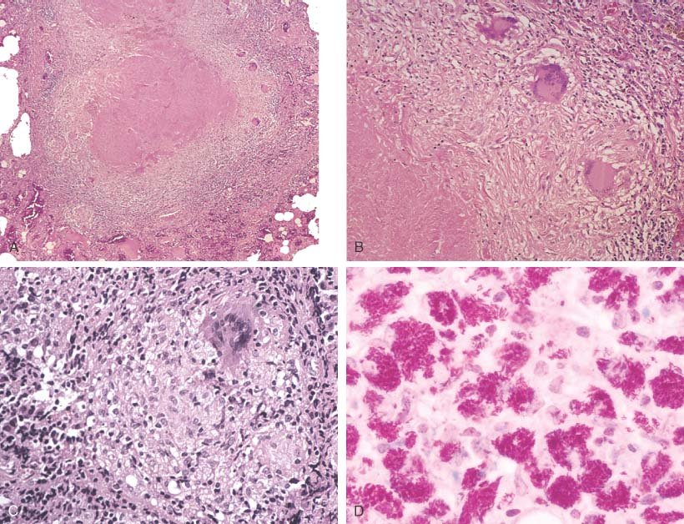
Notes:
Necrotizing (i.e., caseating) granulomas filled with acid fast bacilli. This is CLASSIC for TB.

Slide 11
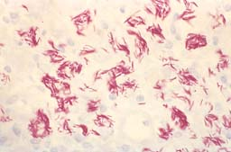
MORE ACID-FAST BACILLI, AFB
Notes:
The acid fast stain for acid fast bacteria is also called the Ziel-Neilseon stain, or simply AFB stain

Slide 12
Miliary tuberculosis of the lung :
Section of the lung shows : The alveolar septae contain many tubercles which consist of epithelioid cells , few langhan’s giant cells and peripheral rim of lymphocytes with or without caseation

Slide 13
2- Tuberculous lymphadenitis

Slide 14
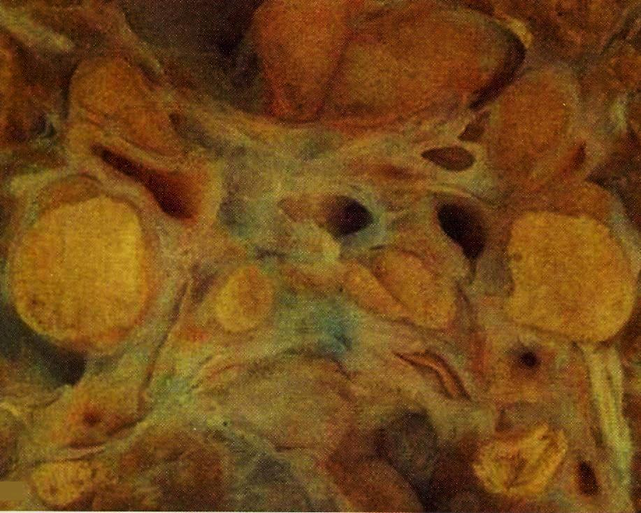

Slide 16
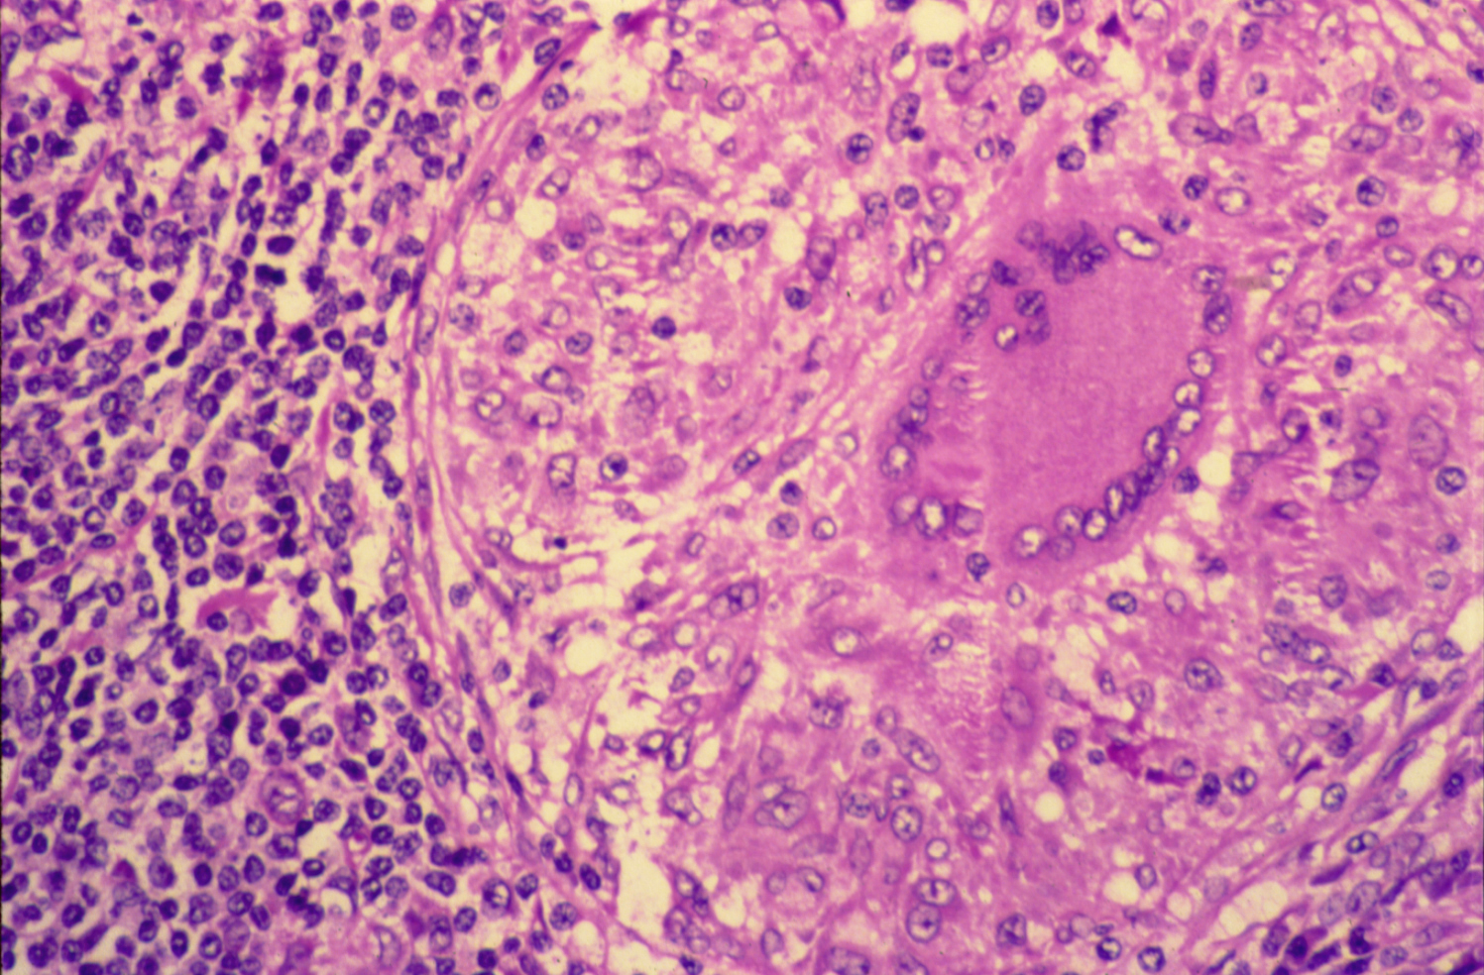
TUBERCULOUS LYMPHADENITIS

Slide 17
Tuberculous lymphadenitis : Section of a lymph node with connective tissue capsule and lymphoid tissue shows:
Many round and oval tubercles/ granulomas with or without central caseation that appears structureless, homogenous and pink in colour.
The granulomas consists of epithelioid cells, few langhan’s giant cells (large cell with multiple peripheral nuclei) and peripheral rim of lymphocytes.

Slide 18
3- Tuberculosis of the kidney

Slide 19
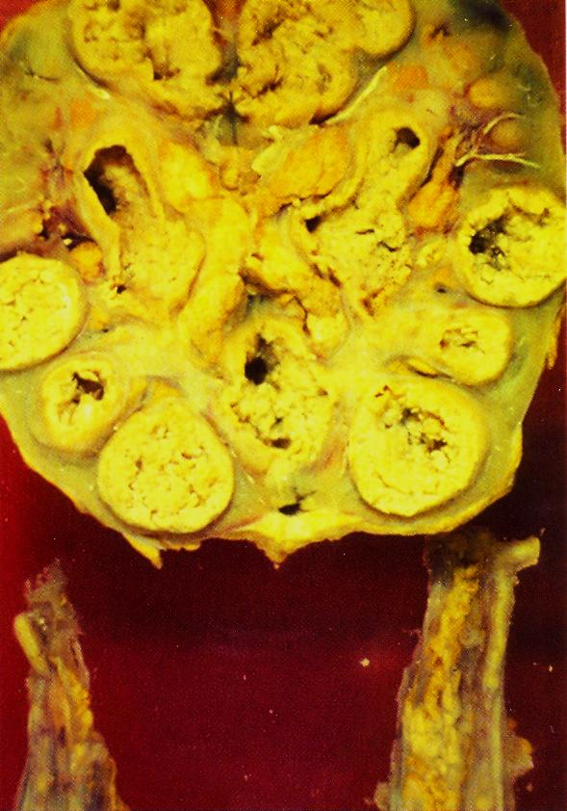

Slide 20
4- Bilharziasis of the colon

Slide 21
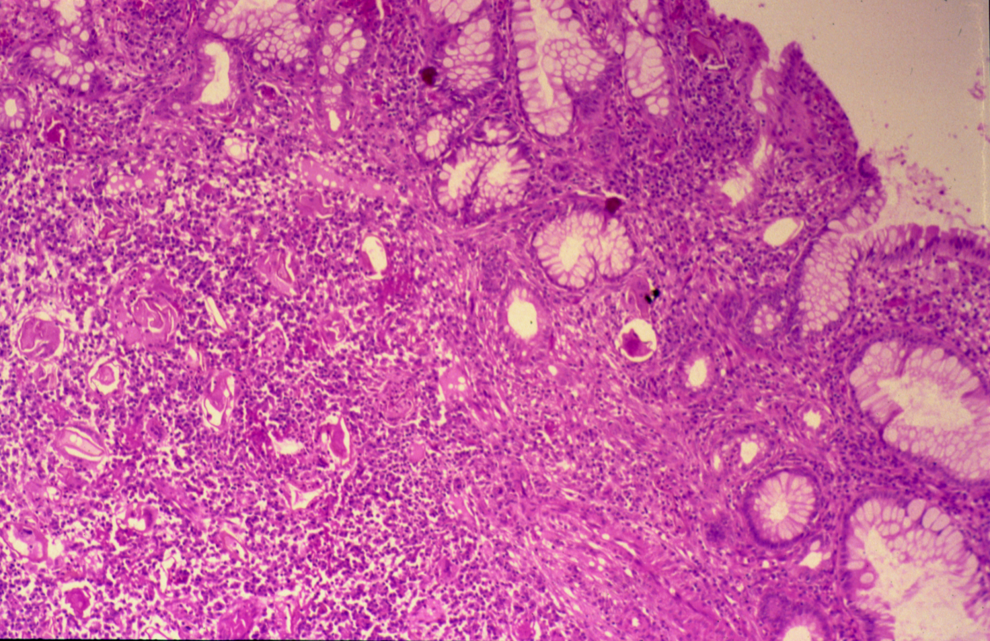
COLONIC BILHARZIASIS

Slide 22
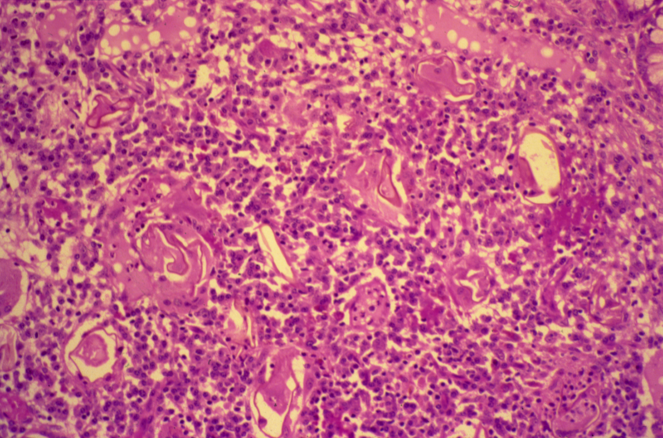
BILHARZIASIS (COLON)

Slide 23
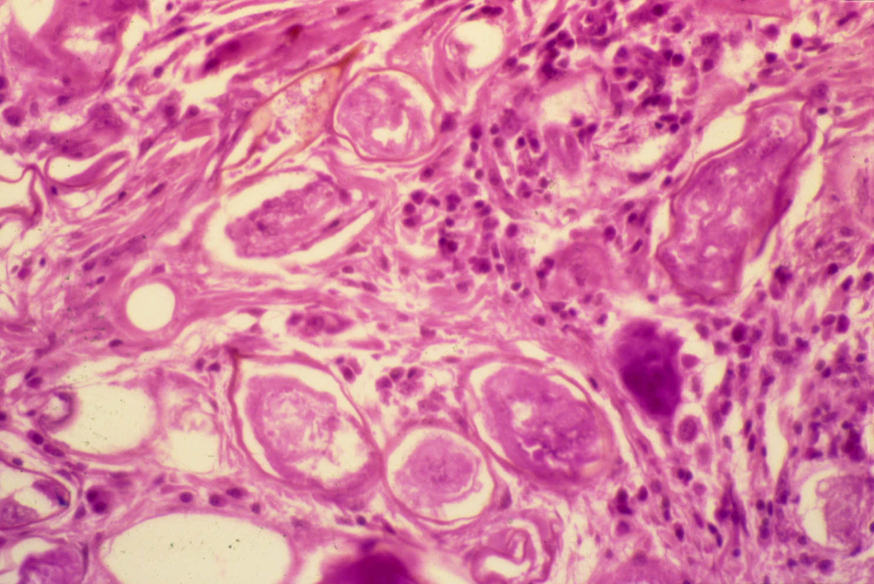
SCHISTOSOMIASIS OF THE URINARY BLADDER

Slide 24
Bilharziasis of the rectum\urinary bladder: Section of fragments of rectal\urinary bladder mucosa shows:
Many Bilharzial ova with yellow brown shells in mucosa and submucosa surrounded by fibrosis and chronic inflammatory cells consisting of lymphocytes, plasma cells and many eosinophils.
Few granulomas are seen around the ova.

Slide 25
5- Cutaneous leishmaniasis

Slide 26
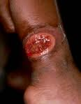

Slide 27
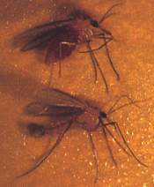
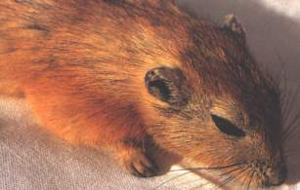
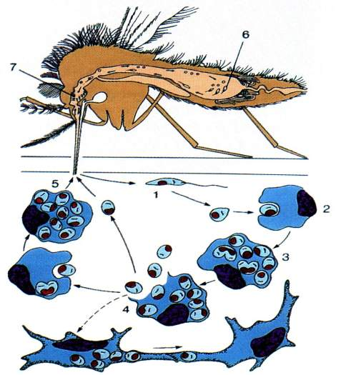
Life Cycle
Reservoir
Vector
Pathology: Parasites in macrophages; Infiltration to skin/RE cells

Slide 28
