Slide 1
Hemodynamic disorders Pathology practical
Dr Shaesta Naseem
17-10-11

Slide 2
Hemostasis &Thrombosis
Normal hemostasis maintain blood in fluid, clot free state in normal vessel and induce localized hemostatic plug at site of vascular injury.
Thrombosis is inappropriate activation of normal hemostatic process (eg formation of thrombus/blood clot) in un-injured vasculature or thrombotic occlusion of vessel after minor injury.

Slide 3
Normal fluid homeostasis means maintaining blood as a liquid until such time as injury necessitates clot formation.
Clotting at inappropriate sites (thrombosis) or migration of clots (embolism) obstructs blood flow to tissues & leads to cell death (infarction).

Slide 4
Thrombosis
Pathogenesis (Causes= Predisposing Factors)
Three primary influences predispose to thrombus formation called Virchow’s triad
Myocardial infarction or valvulitis (cardiac chambers), atherosclerosis, vasculitis, hypertension, smoking, radiation, chemical irritation (arteries), prolonged recumbency & inflammation (veins)
Endothelial Injury
Thrombosis
Abnormal Blood Flow
Hypercoagulability
Turbulence (arteries) &(cardiac chambers)
Stasis (veins)
Primary causes (Genetic) Secondary Causes (Acquired): High Risk Causes & Low Risk Causes
Atherosclerosis, aneurysm, dilated atria, atrial fibrillation, venous stasis, varicose veins

Slide 5
Fate of the Thrombus
If the patient survives the immediate effects of a thrombotic vascular obstruction, thrombi undergo some combination of the following four events
1.Propagation: the thrombus may accumulate more platelets and fibrin eventually obstructing other critical vessel.
2.Dissolution: Thrombi may be removed by the fibrinolytic activity.
3.Embolization: Thrombi may dislodge as thrombotic emboli.
4.Organization and Recanalization: Thrombi may induce inflammation and fibrosis (organization) and may eventually recanalize

Slide 7
1- Organizing thrombus

Slide 8
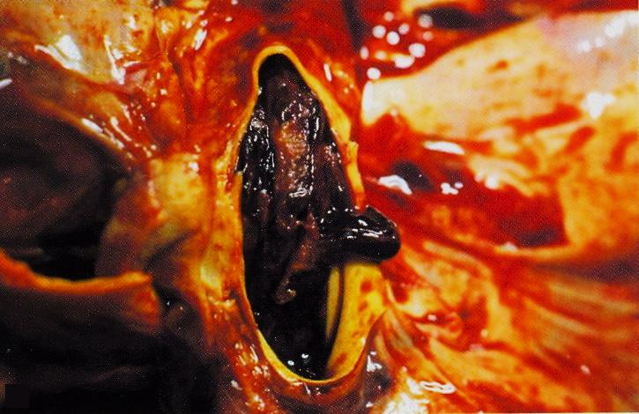
Organizing thrombus in a case of pulmonary embolism
Notes:
Persons who are immobilized for weeks are at greatest risk. Can also be seen in hypercoagulability syndrome and multiple bone fractures. The patient can experience sudden onset of shortness of breath. Death may occur within minutes

Slide 9
Organising thrombus:
reparative process
ingrowth of fibroblasts and capillaries (similar to granulation tissue)
lumen remains obstructed may eventually recanalize
Organization &Recanalization (multiple capillary channels)

Slide 10
Organizing thrombus: Cross section of blood vessel shows:
The lumen is occluded by thrombus which consists of alternate layers of platelets with fibrin thread and clotted blood (line of Zahn).
Organization can be seen at the periphery of thrombus which includes formation of small capillaries & fibroblasts with chronic inflammatory cells.
Recanalization is seen at one side.

Slide 11
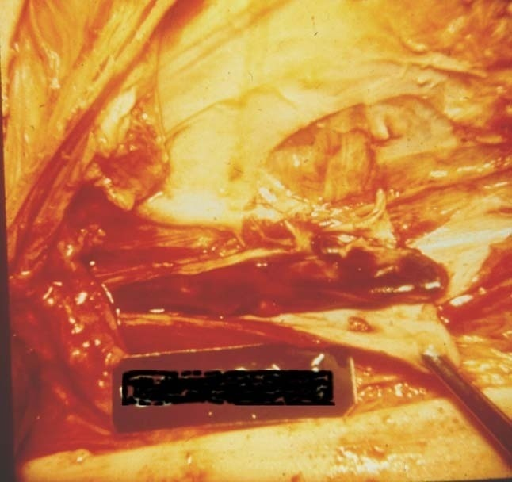
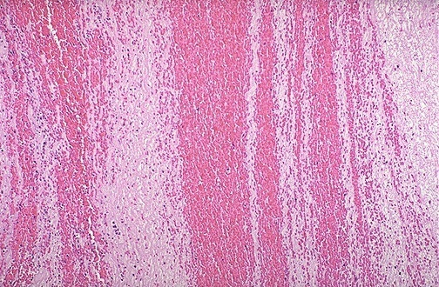
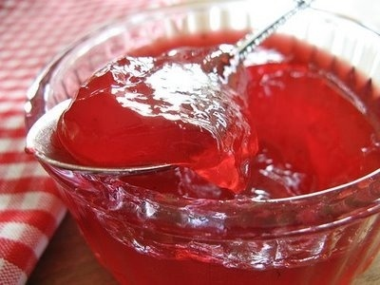
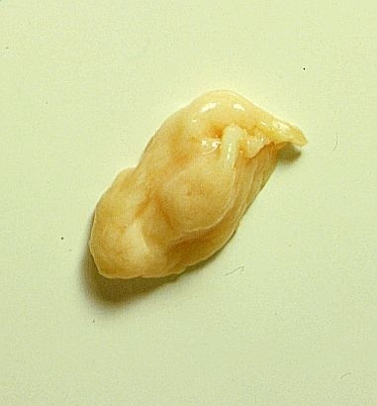
Lines of Zahn, gross and microscopic, top, is evidence to prove a clot is PRE-mortem.
Clots appearing like current jelly or chicken fat are said to be POST-mortem.
Notes:
Lines of Zahn, gross and microscopic, top, is evidence to prove a clot is PRE-mortem.
Clots appearing like current jelly or chicken fat are said to be POST-mortem.
In general, post mortem clots are rather AMORPHOUS and have no binding texture when you squeeze them

Slide 12
Embolism
Definition:
Embolism is the blockage of a blood vessel by solid, liquid or gas at a site distant from its origin.
>90% of emboli are thrombo-emboli

Slide 13
Embolism
Other types
air
amniotic fluid
nitrogen
medical equipment
tumour cells

Slide 14
2- Pulmonary embolus with infarction

Slide 15
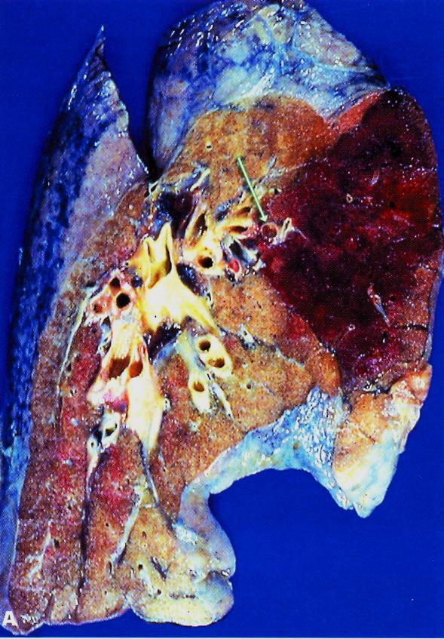

Slide 16
Infarction
It is an area of ischemic necrosis caused by occlusion of either the arterial supply or the venous drainage in a particular tissue.

Slide 17
Infarction
Causes:
Arterial occlusion due to thrombotic or embolic events (99%)
Other arterial causes:
Vasospasm
Swelling of atheroma
Extrinsic compression on vessel (by tumor …)
Twisting of vessels
Traumatic rupture
Venous thrombosis:
in organs with single venous outflow e.g. testis, ovary

Slide 18
3- Myocardial infarction

Slide 19
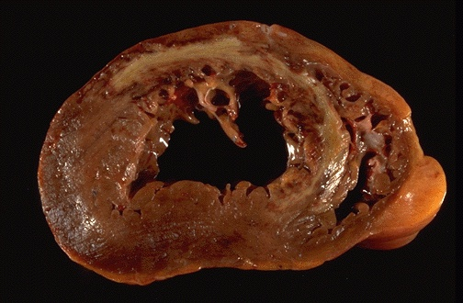
Notes:
Infarction of many internal organs leads to a "pale" infarct from loss of hte blood supply, resulting in coagulative necrosis. Shown here is a myocardial infarction from occlusion of a major coronary artery, here the left anterior descending artery

Slide 20
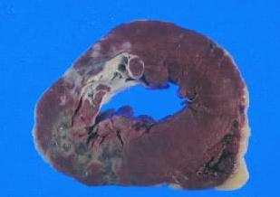
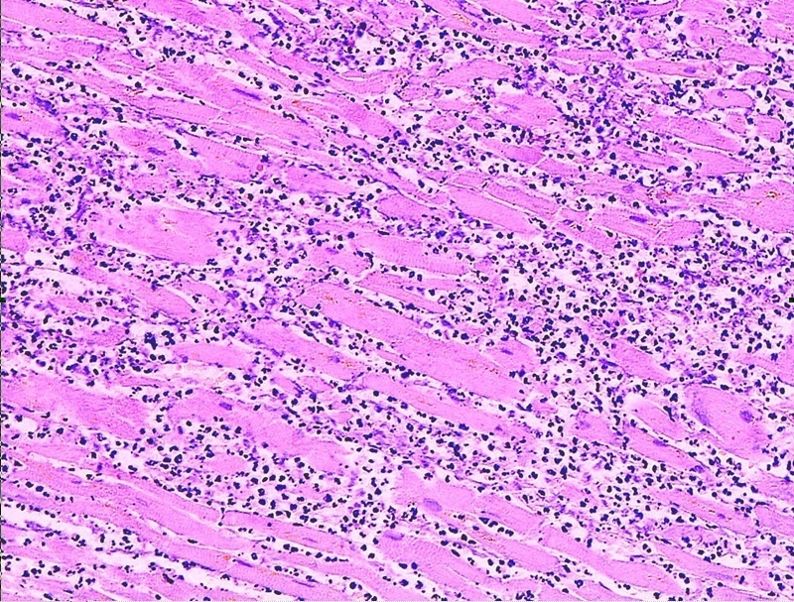
Myocardial infarction (recent stage)

Slide 21
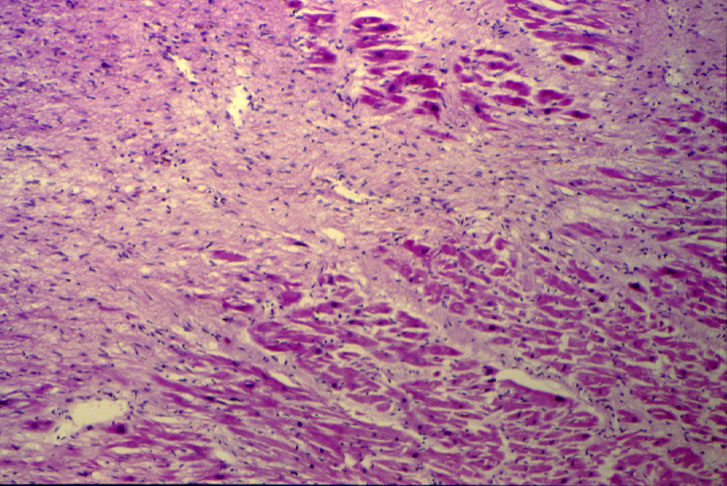
MYOCARDIAL INFARCTION (LATE STAGE)

Slide 22
Myocardial infarction: Section of myocardial shows:
Patchy coagulative necrosis of myocardial fibres. The dead muscle fibres are structure less and hyaline.
The necrotic muscle fibres are pale with loss of nuclei and striations. Infiltration of neutrophils in recent stage is seen .
Later granulation tissue formation and fibrosis.

Slide 23
4- Infarcted kidney

Slide 24
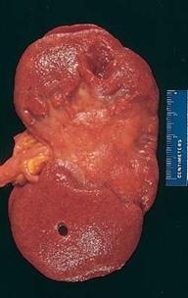
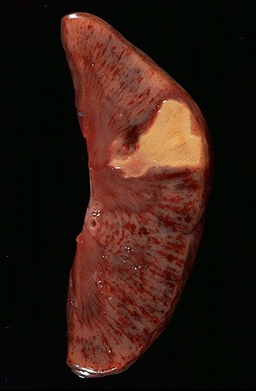
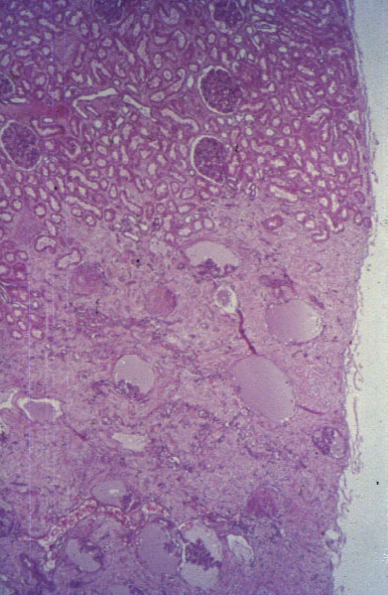
Notes:
WEDGE SHAPED SCARRED INFARCT following the distribution of a end artery branch of the renal artery. FIBROSIS implies that it is old (months to years)

Slide 25
Organ: Kidney Dx:Coagulative necrosis

Slide 26
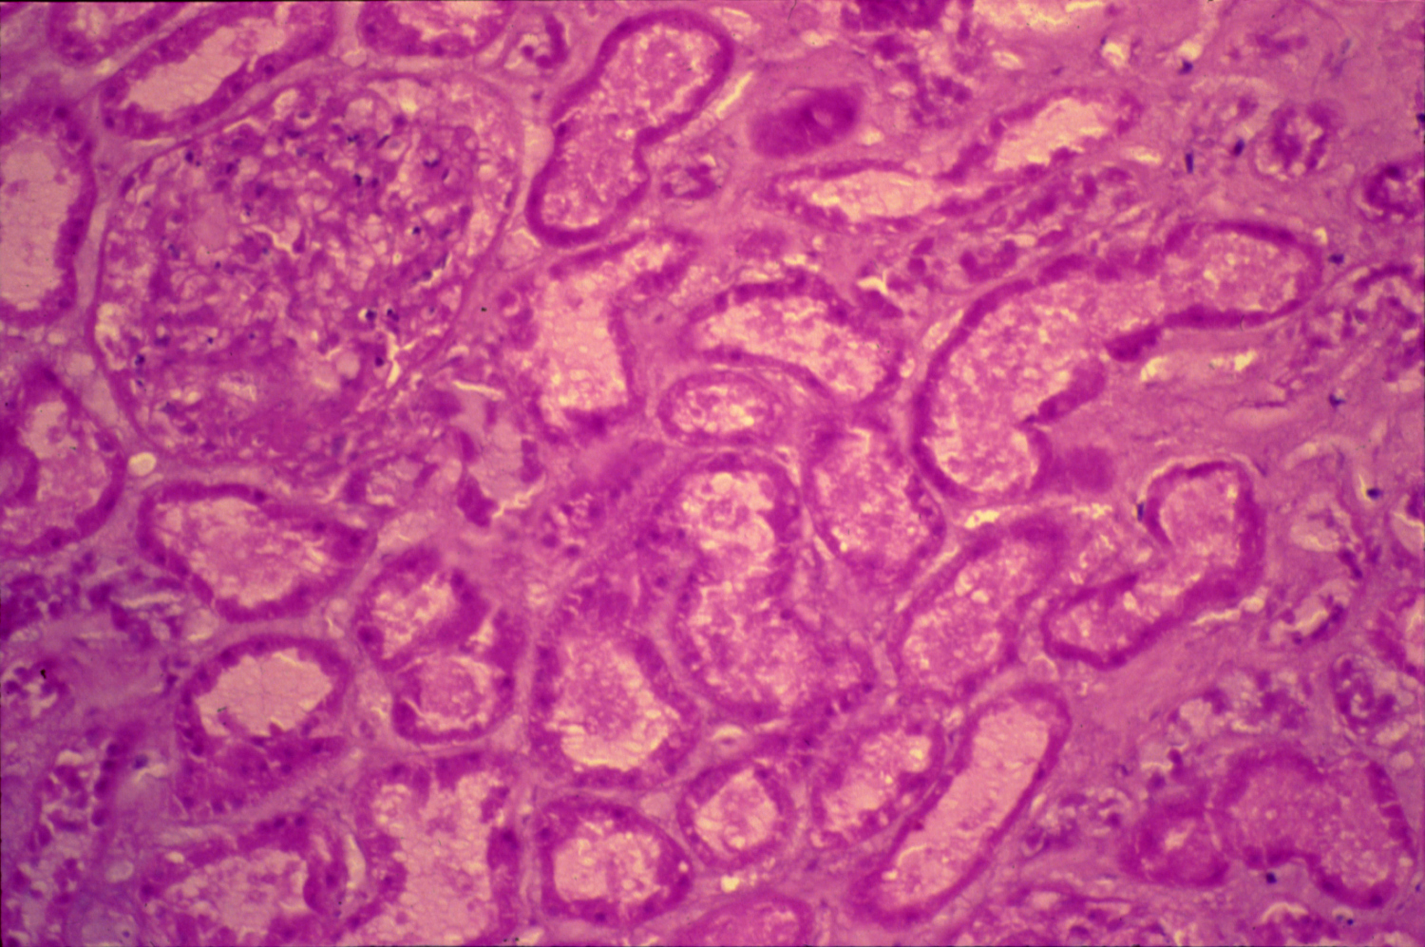
INFARCTED KIDNEY

Slide 27
Infarcted kidney: Section of kidney shows:
A cortical infarct showing coagulative necrosis of glomeruli, tubules and interstitial tissue with loss of cell nuclei.
The haemorrhagic zone at the periphery of the infarct shows dilated and congested blood vessels and cellular infiltrate by neutrophils, red blood cells and lymphocytes.

Slide 28
5- Infarction of the small intestine

Slide 29
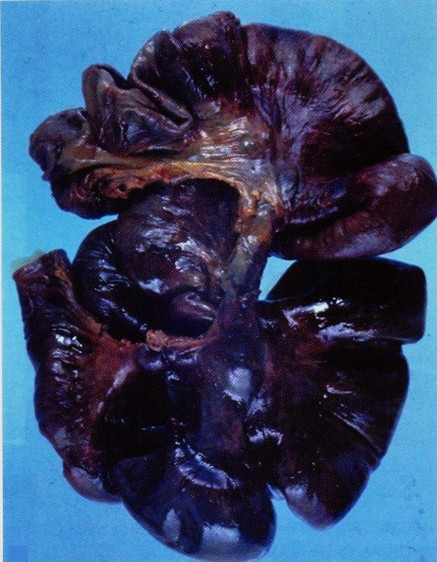

Slide 30
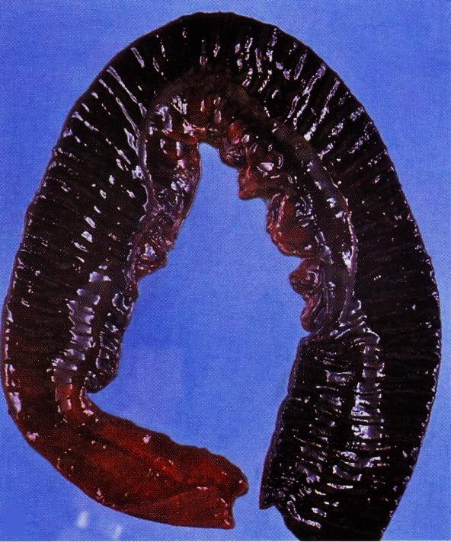

Slide 31
Hyperemia & Congestion
Increased blood in an area (inside blood vessels) compared to normal.

Slide 32
Compare between: “Hyperemia & Congestion”
Hyperemia:
is an “active process”
resulting from augmented tissue inflow
due to arteriolar dilation
(e.g. acute inflammation)
Congestion
is a “passive process”
resulting from impaired outflows from a tissue
Impaired venous return
(e.g. cardiac failure or venous obstruction)

Slide 33
6- Chronic venous congestion of the liver

Slide 34
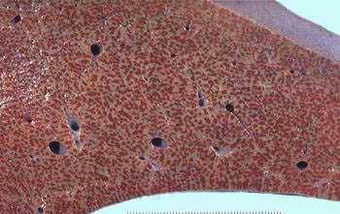
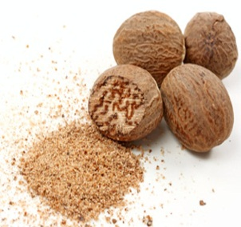
Pathological Features of Chronic Venous Congestion in Liver
1.Liver: It is mainly due to right sided heart failure.
Gross Picture: The liver is enlarged , firm and the cut surface shows alternating dark areas of congestion with pale areas of fatty change, giving the liver the nutmeg appearance.
nutmeg
Nutmeg cut surface of the liver (dark areas of congestion alternating with pale areas of fatty change)

Slide 35
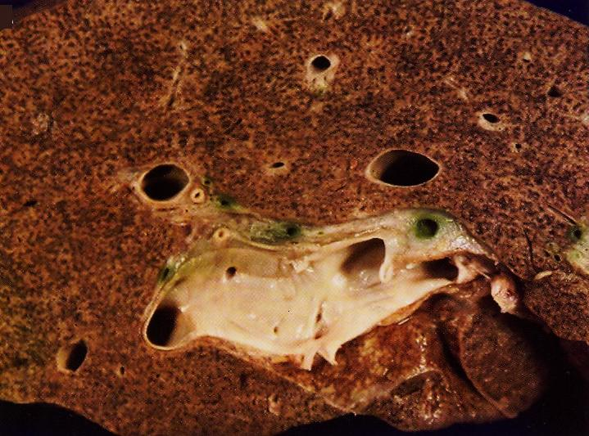

Slide 36
Pathological Features of Chronic Venous Congestion in Liver
Hepatic Lobule
Congested central vein & hepatic sinusoids
Fatty change in midzonal hepatocytes (due to relative hypoxia)
Atrophied central hepatocytes (due to pressure necrosis, hypoxia & anoxia)
Normal peripheral hepatocytes (better nourished as they are near the portal v &hepatic a)

Slide 37
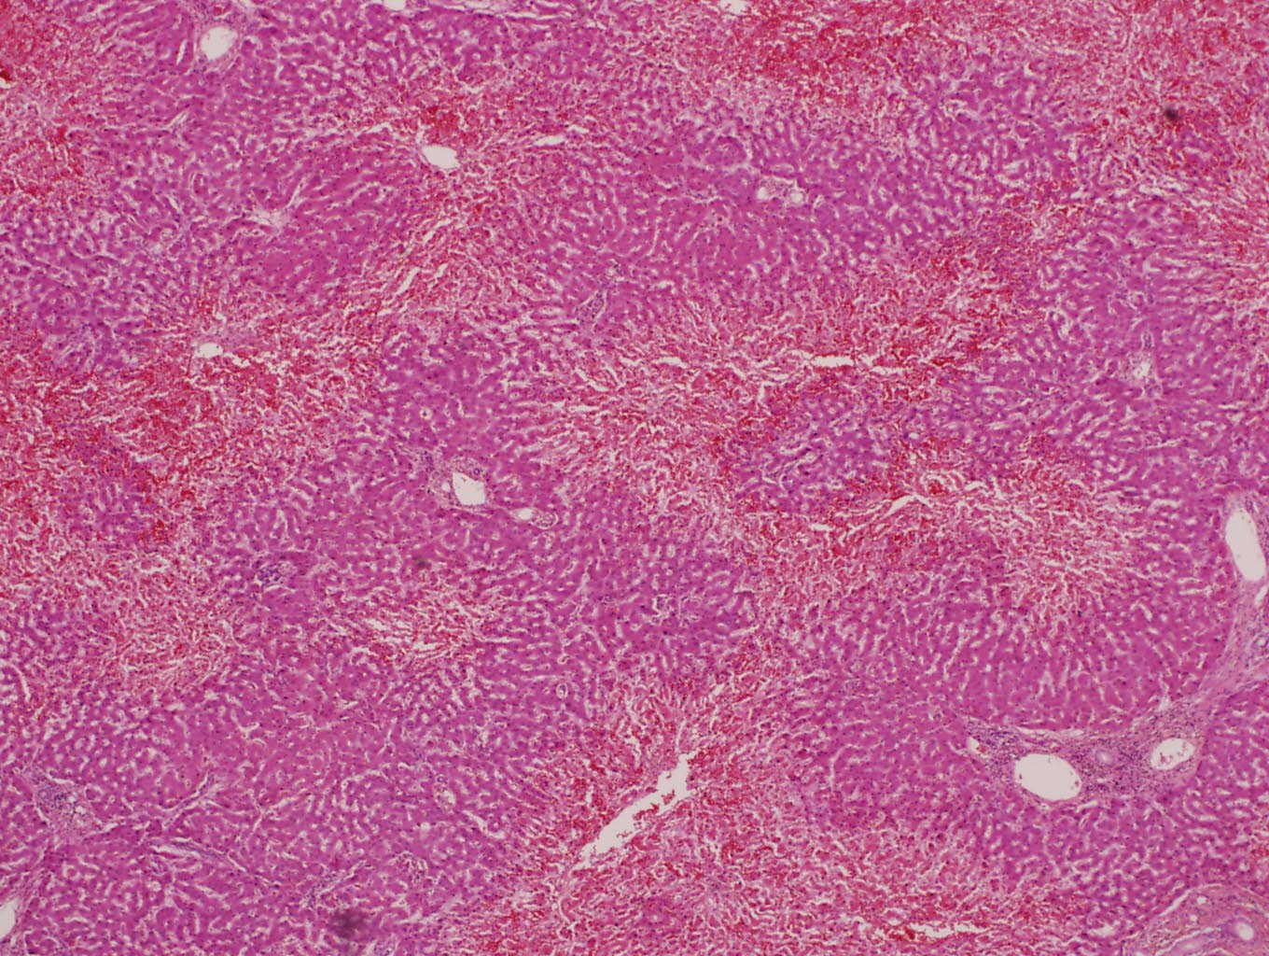
PASSIVE CONGESTION OF THE LIVER (NUTMEG LIVER)

Slide 38
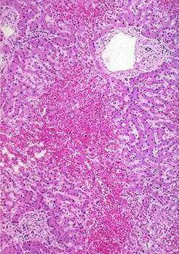
Pathological Features of Chronic Venous Congestion in Various Organs (Liver)
Microscopic Picture of Liver in Chronic Venous Congestion
1.The central vein in hepatic lobule is congested as well as the hepatic sinusoids in the central area. 2.The central hepatocytes will show atrophy and necrosis. 3.The mid zonal hepatocytes may show fatty change due to relative hypoxia. 4.The peripheral hepatocytes are normal.
Early CVC of liver (congestion of central vein &central hepatic sinusoids)

Slide 39
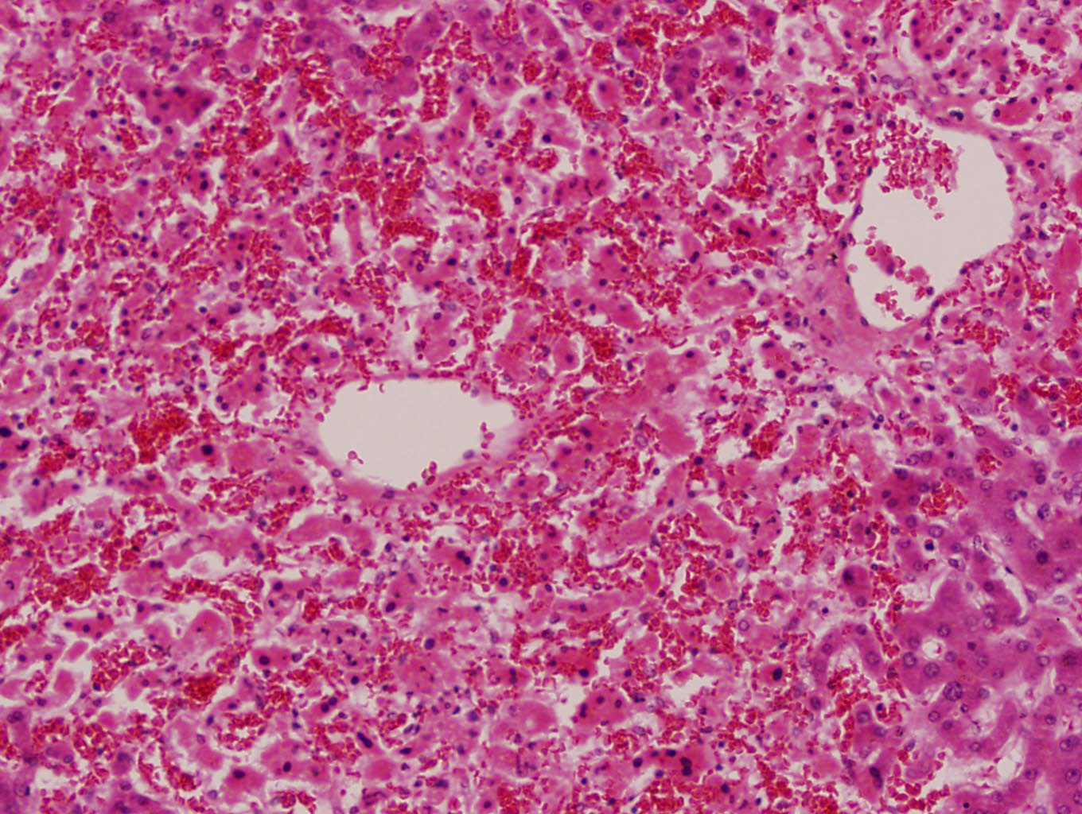
PASSIVE CONGESTION OF THE LIVER (NUTMEG LIVER)

Slide 40
Chronic venous congestion of the liver: Section of liver shows:
The central portion of liver lobules shows congestion and dilatation of central veins and blood sinusoids, with atrophy and necrosis of liver cells.
Kupffer cells contain few brown haemosiderin pigment granules.

Slide 41
7- Chronic venous congestion of the lung

Slide 42
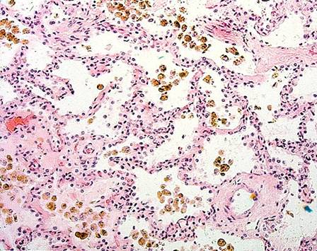
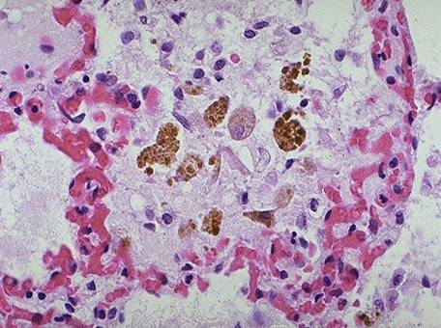
Pathological Features of Chronic Venous Congestion in Various Organs (Lung)
Gross Picture: The lungs are enlarged, heavy, firm and deep red in colour (brown induration). Frothy blood oozes from the cut surface on squeezing.
Microscopic Exam.: The alveolar septa are thickened by congested dilated capillaries and oedema fluid followed later by fibrosis. As a result of microhaemorrhages, the alveoli contain oedema fluid, RBCs either intact or haemolysed and haemosiderin laden macrophage (heart failure cells).
Congested alveolar wall
Thickened alveolar septa (fibrosis)
heart failure cells

Slide 43
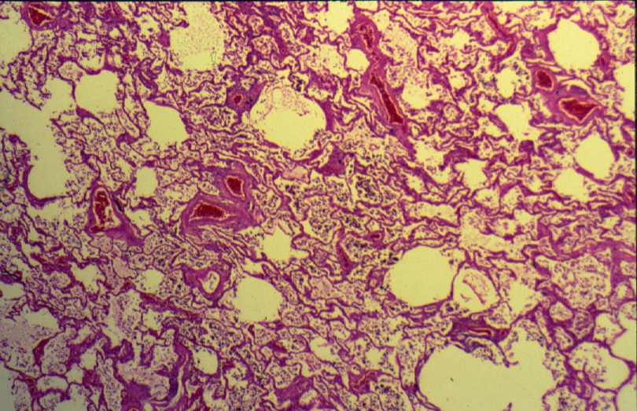
CHRONIC VENOUS CONGESTION (LUNG)

Slide 44
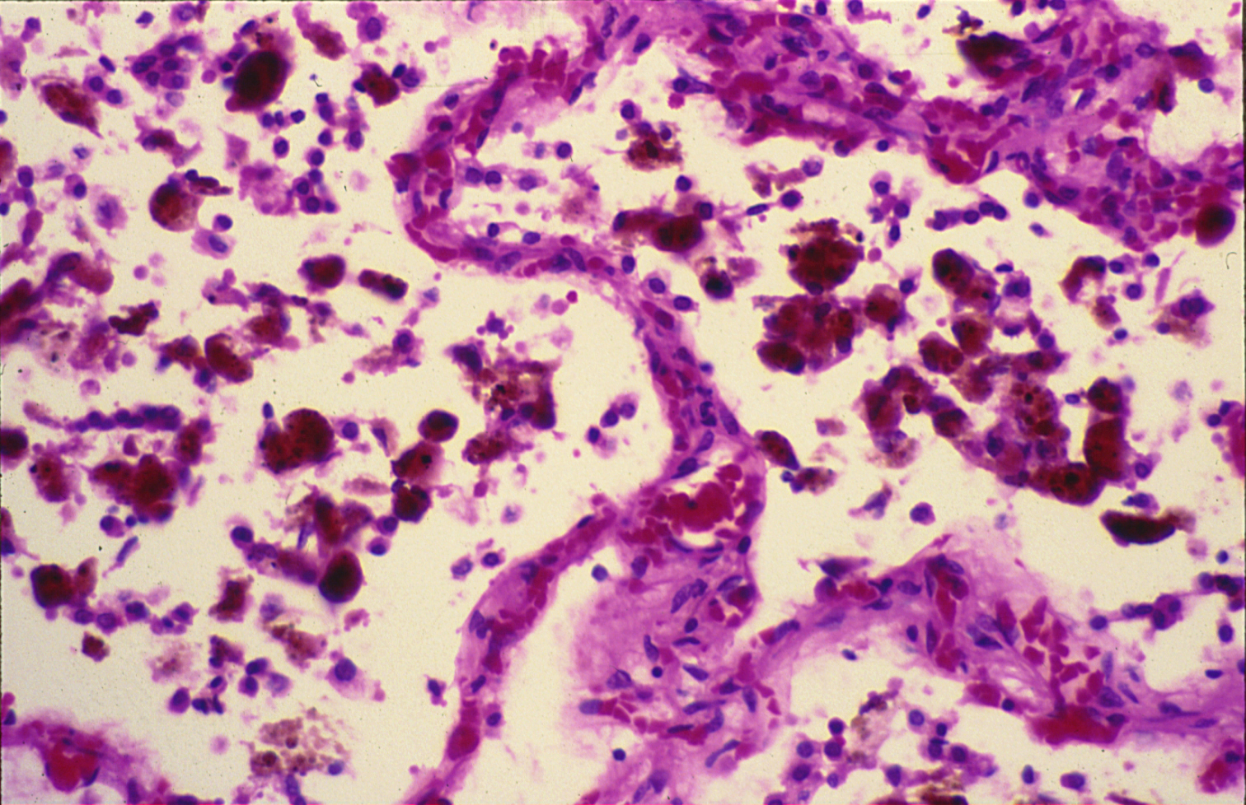
CHRONIC VENOUS CONGESTION (LUNG)

Slide 45
Chronic venous congestion of the lung: Section of lung shows:
The alveolar walls are thickened by dilated and engorged capillaries.
The alveoli contain edema fluid, red blood cells and large alveolar macrophages (heart failure cells), which are filled with haemosiderin pigment derived from red cells breakdown.
In the late stage some fibrous tissue may also be seen.

